Slide 1
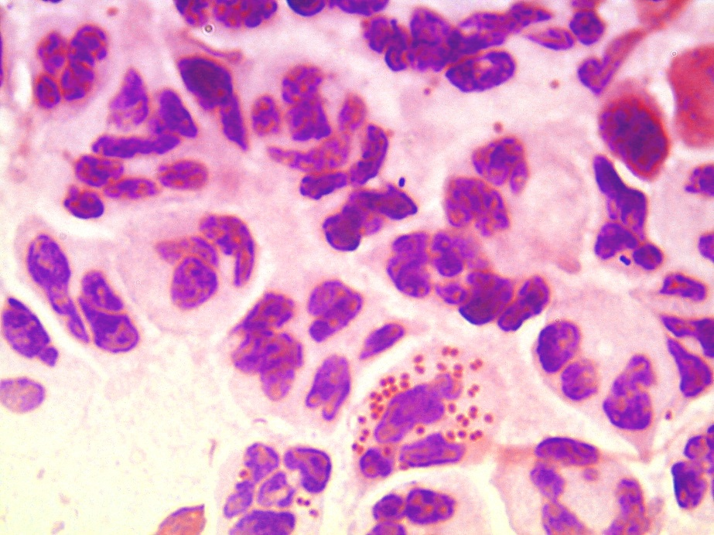
Urethral swab
Gram-negative diplococci (Neisseria gonorrhoae)

