Slide 1
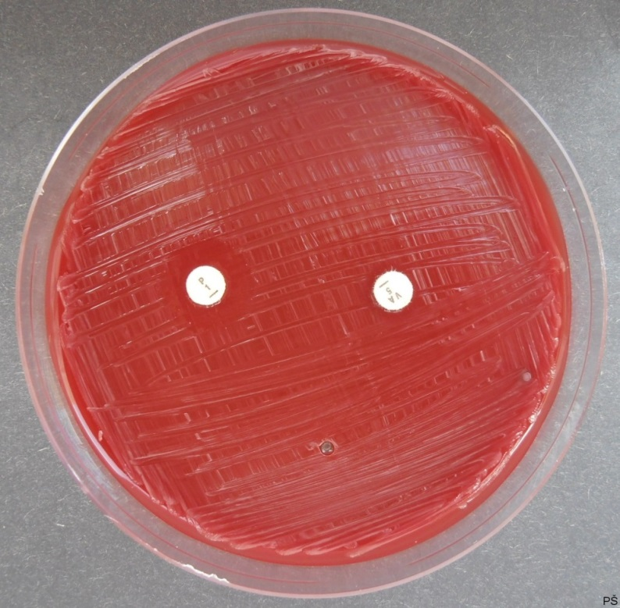
Antibiogram of Pasteurella multocida
Penicillin susceptibility and vancomycin resistance

