Slide 1
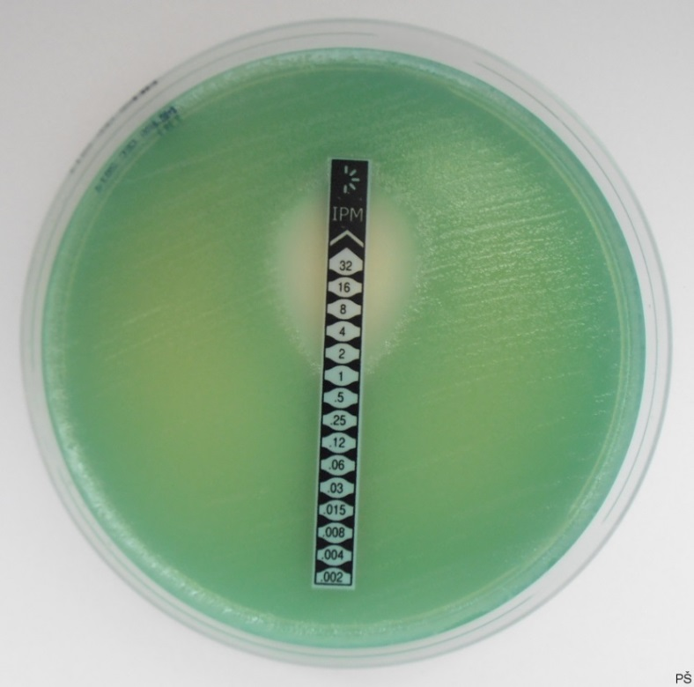
Susceptibility to antibiotics
E-test

