Slide 1
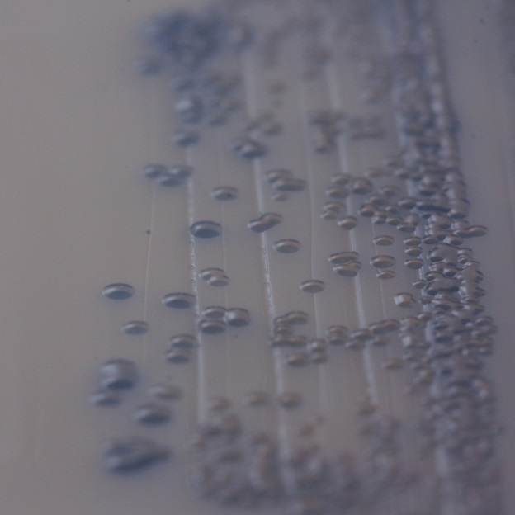
Methicillin-resistant Staphylococcus aureus (MRSA)
Detail of MRSA colonies on chromogenic MRSA agar

