Slide 1
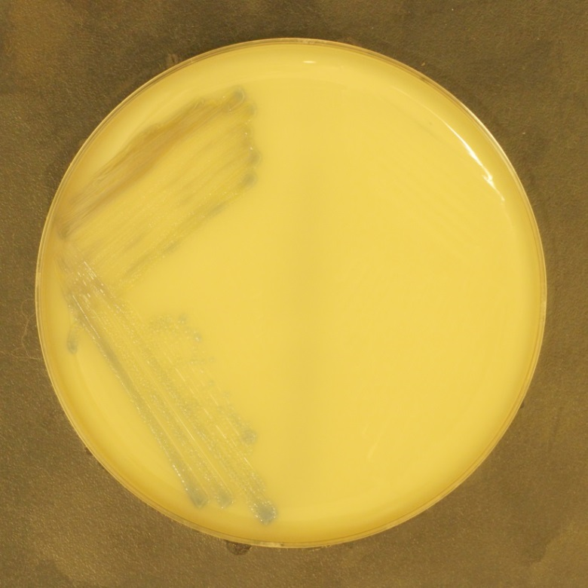
Methicillin-resistant Staphylococcus aureus (MRSA)
Chromogenic Agar, where MRSA growths as blue colonies

