Slide 1
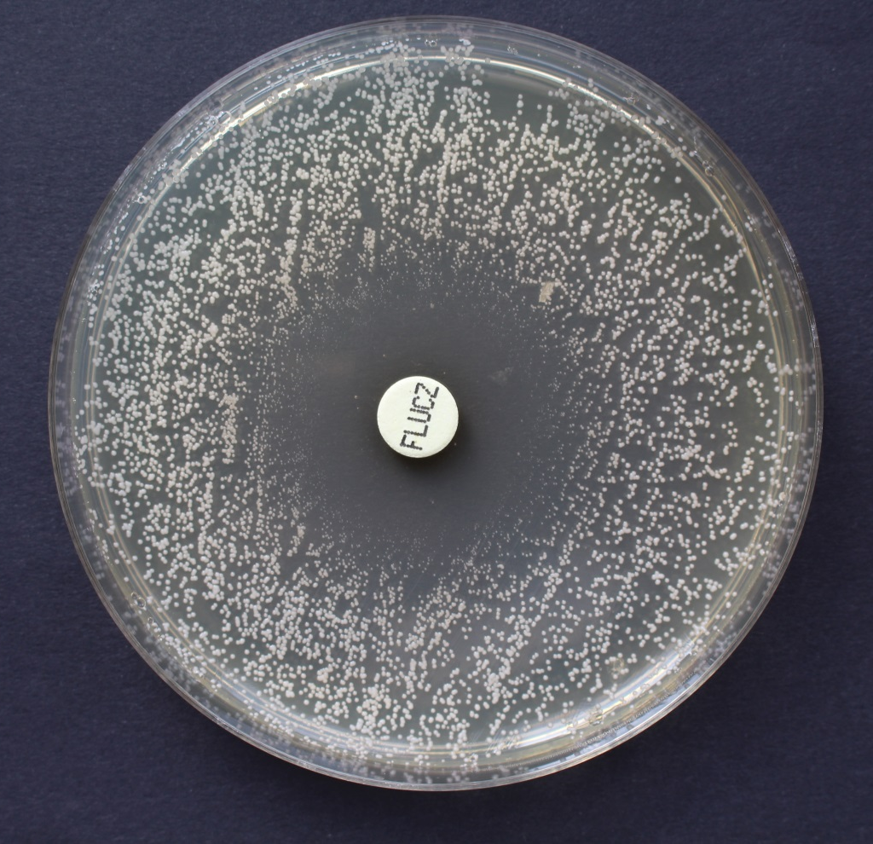
Susceptibility to yeast
Antifungal agent - fluconazole

