Slide 1
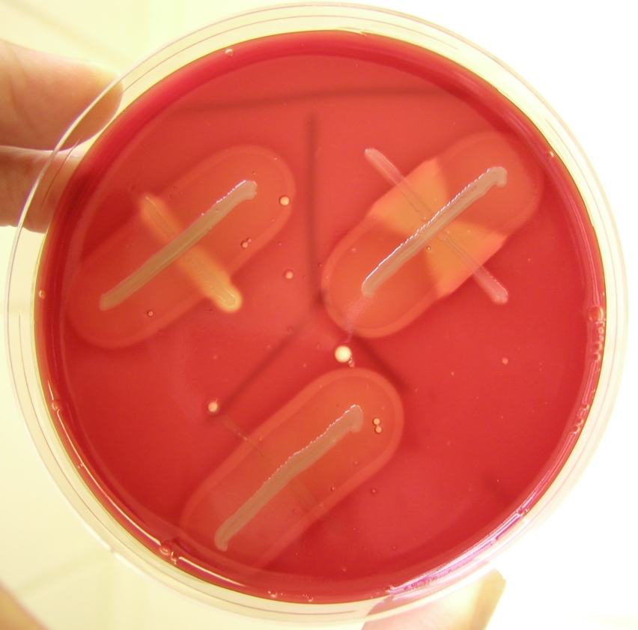
CAMP test
S. agalactiae (circle) is CAMP-positive
Other haemolytic streptococci are CAMP-negative

