Slide 1
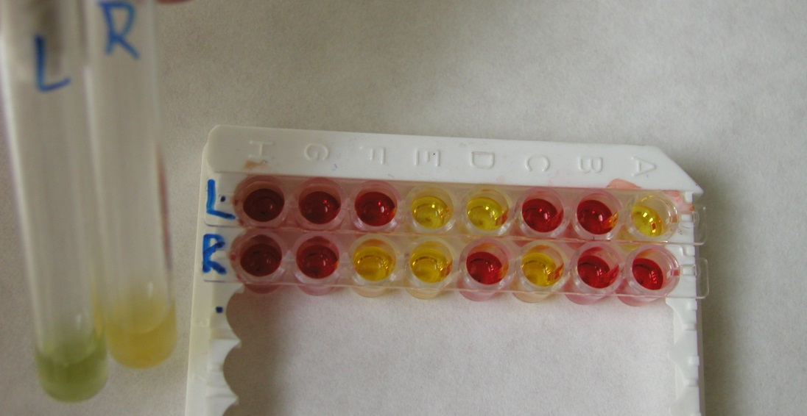
Encoccus test
Biochemical test used for enterococci identification

