Slide 1
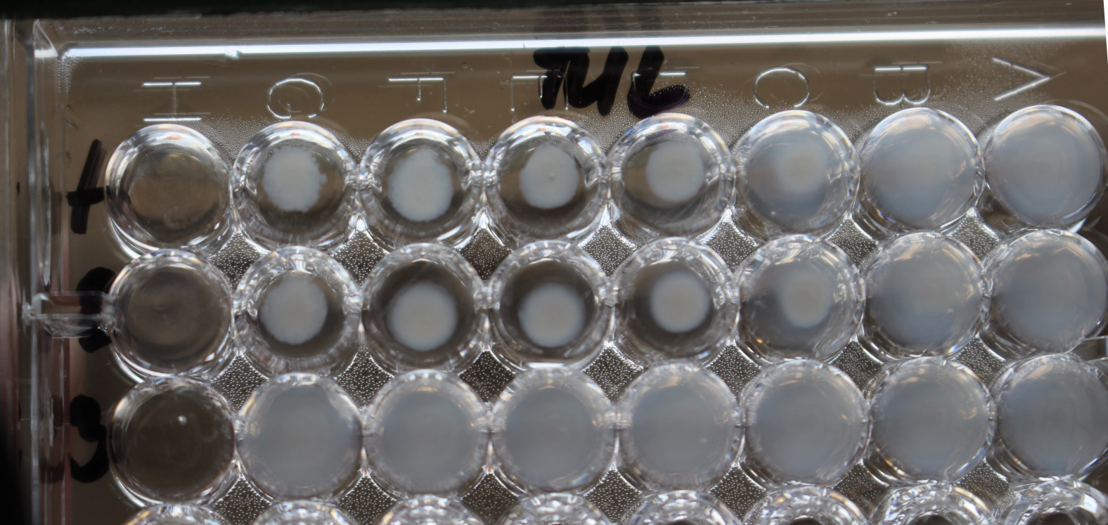
Fracisella tularensis antibody detection
Agglutination

