Slide 1
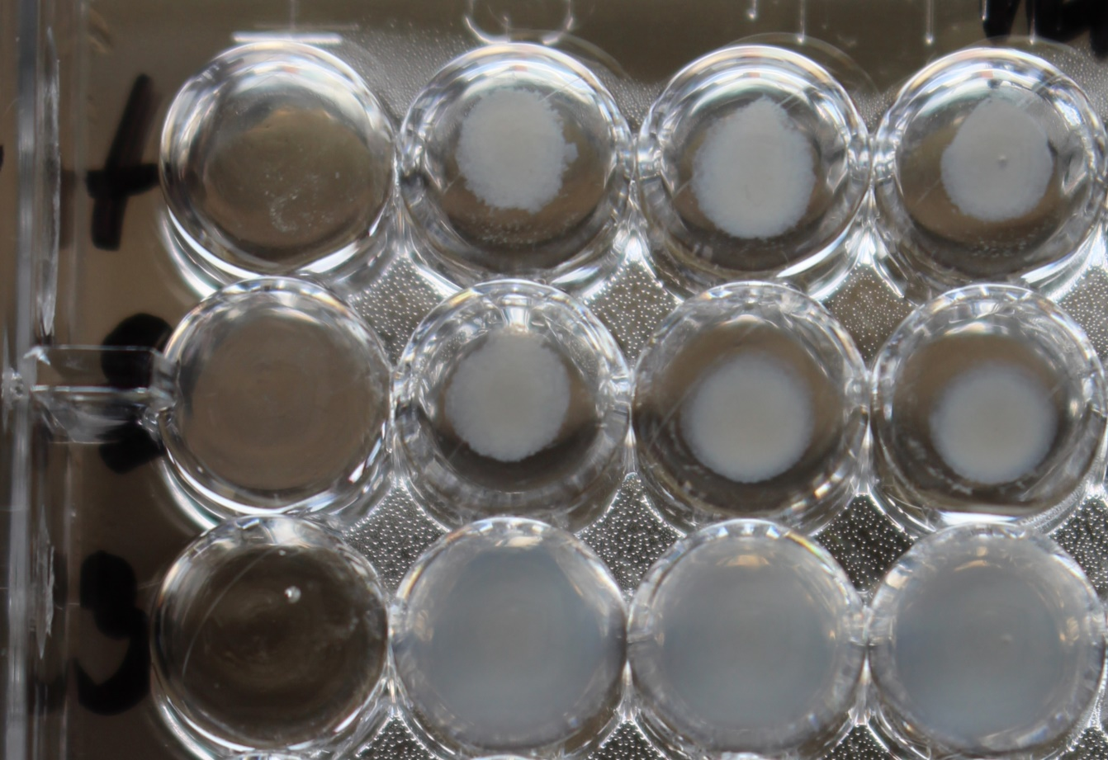
Fracisella tularensis antibody detection
Agglutination – detail

