Slide 1
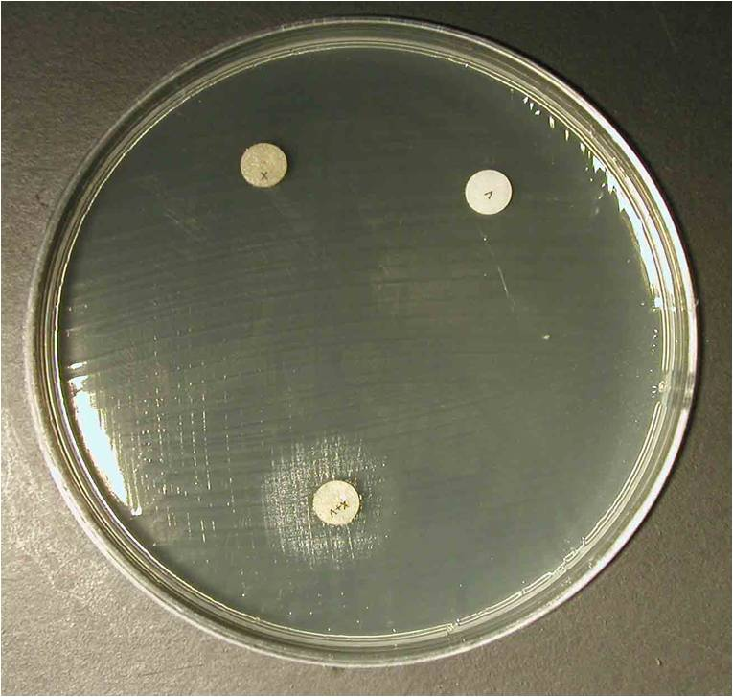
Growth factor – Haemophilus influenzae
Haemophilus influenzae requires both X (hemin) and V (NAD) factors

