Slide 1
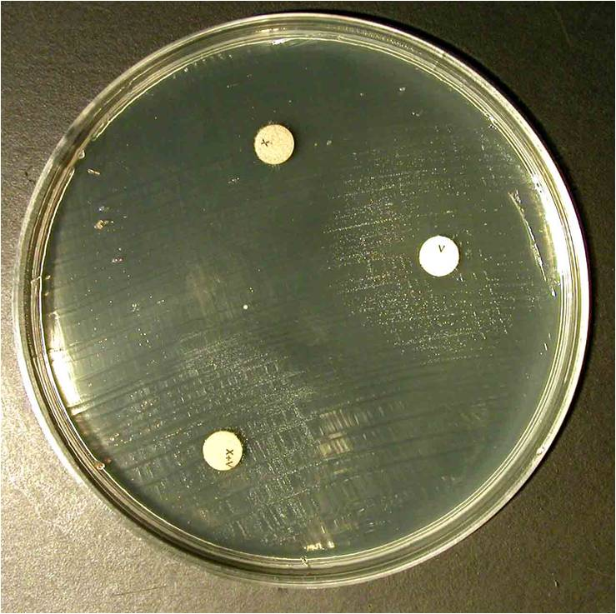
Growth factor– Haemophilus parainfluenzae
Haemophilus parainfluenzae requires V factor (NAD)

