Slide 1
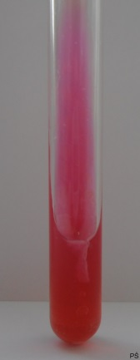
Hajna agar – Non-Fermenting bacteria
Negative reaction (gramnegative non-fermenting bacteria)

