Slide 1
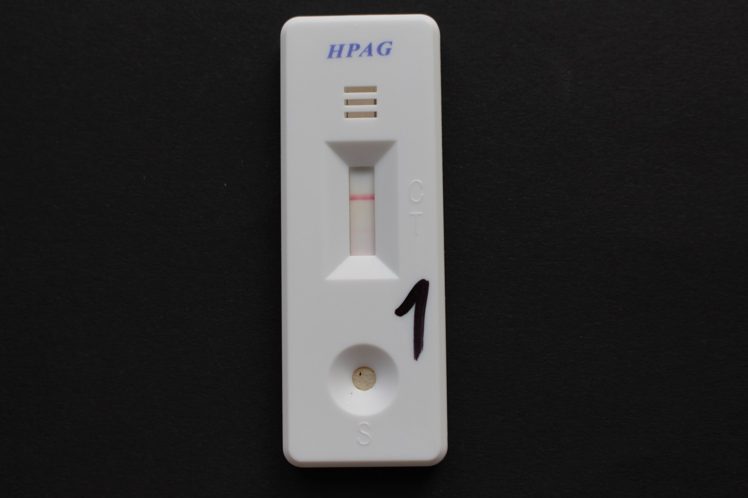
Helicobacter pylori
Antigen detection

