Slide 1
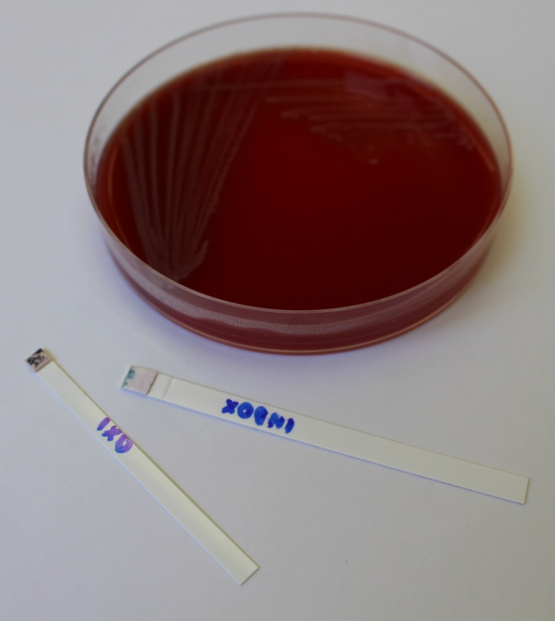
INAC test
Positive indoxyl test (circle) is typical for M. catarrhalis

