Slide 1
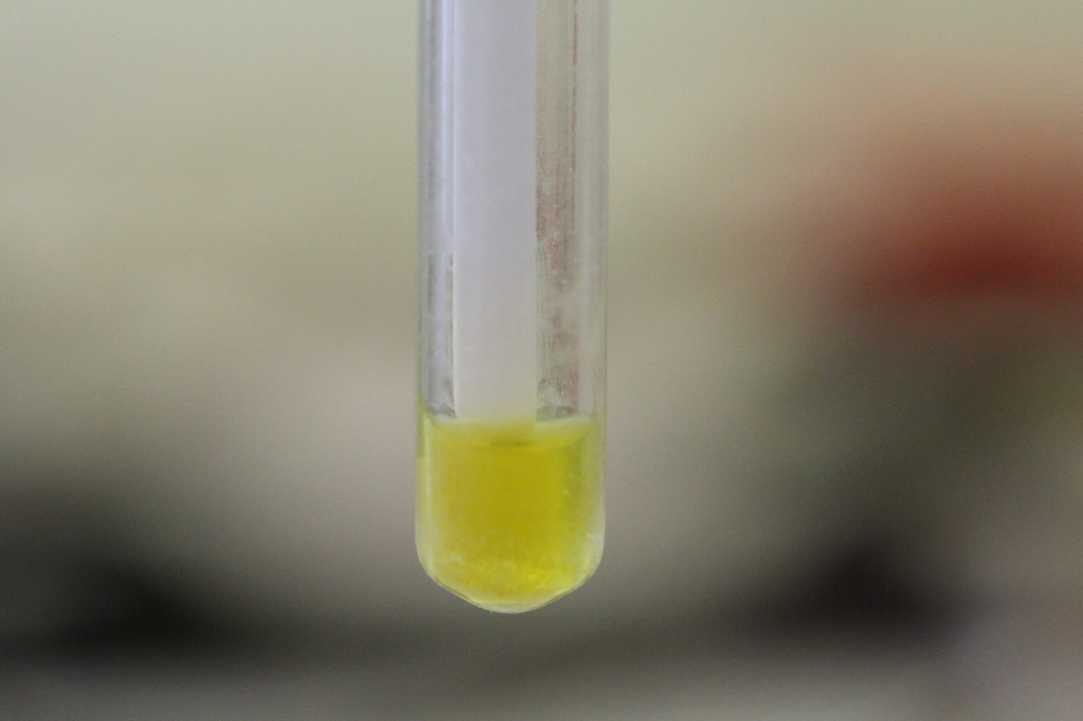
ONP test
Simple biochemical test – yellow colour is positive

