Slide 1
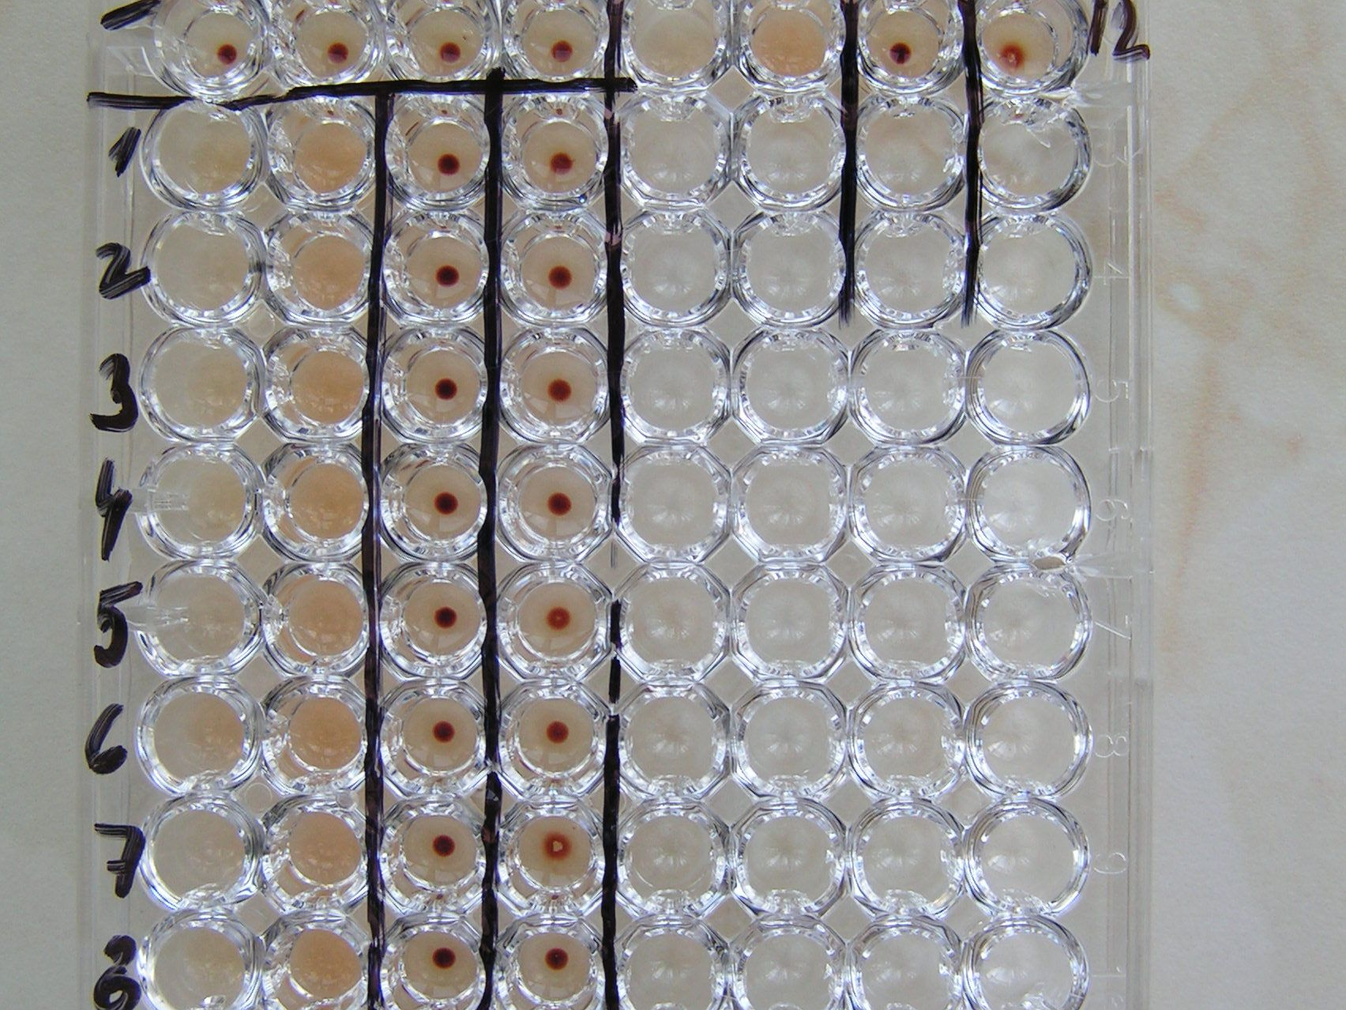
Syfilis - TPHA test
Treponema pallidum hemagglutination – detail

