Slide 1
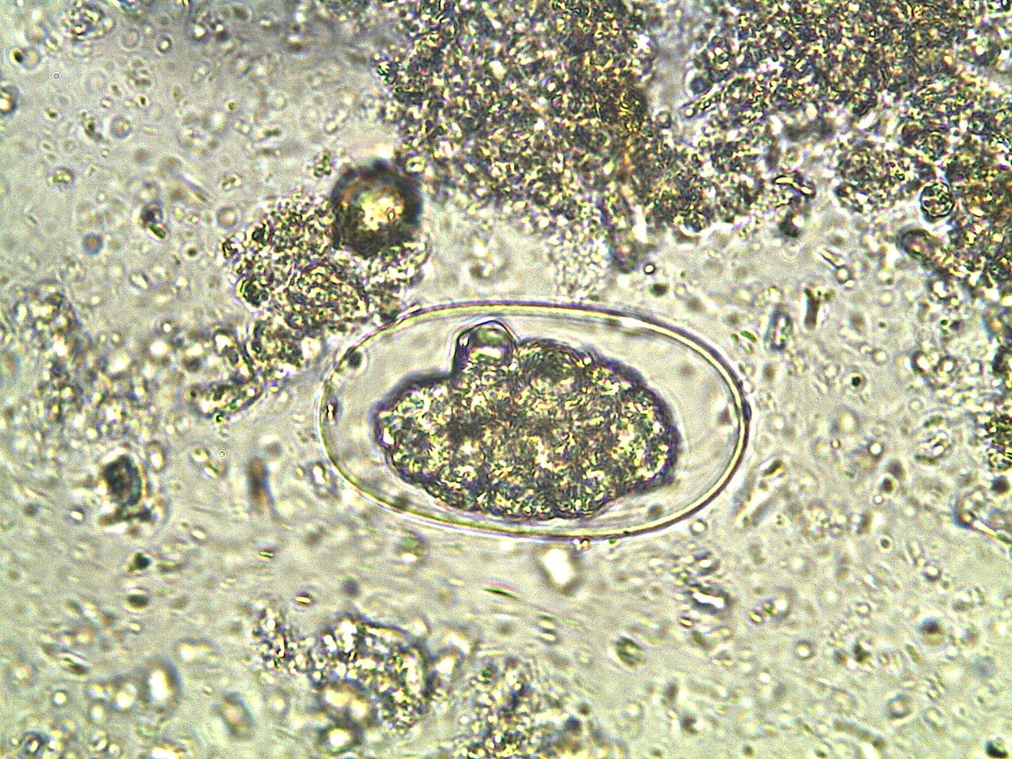
Ancylostoma-Necator - egg

