Slide 1
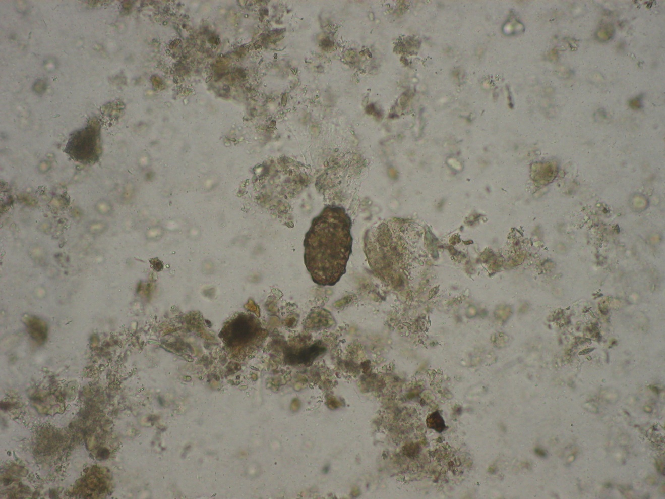
Ascaris lumbricoides - egg
Faust method

