Slide 1
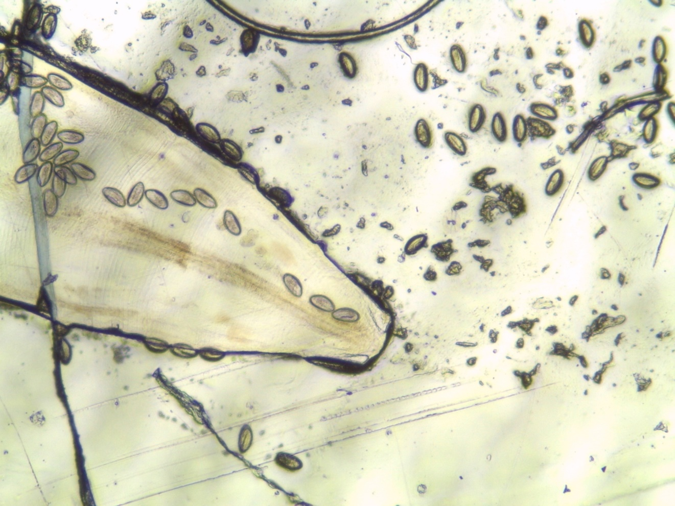
Enterobius vermicularis - detail
Graham method

