Slide 1
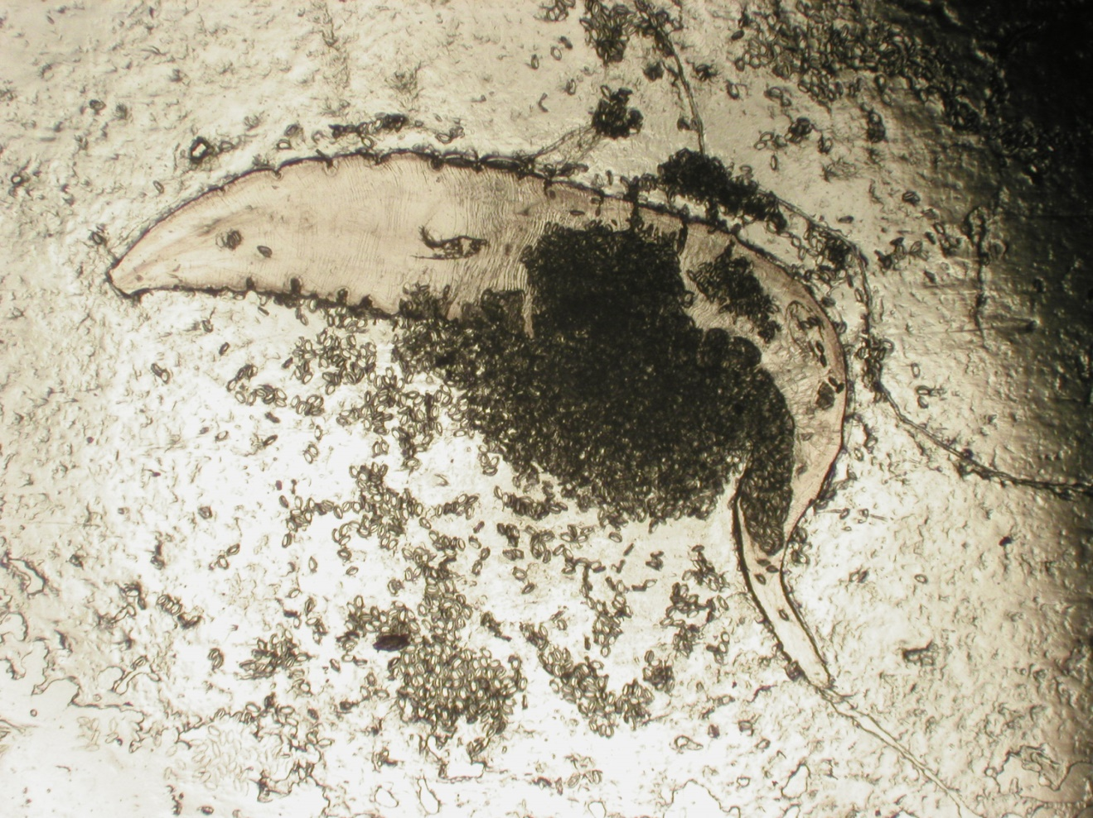
Enterobius vermicularis
Graham method

