Slide 1
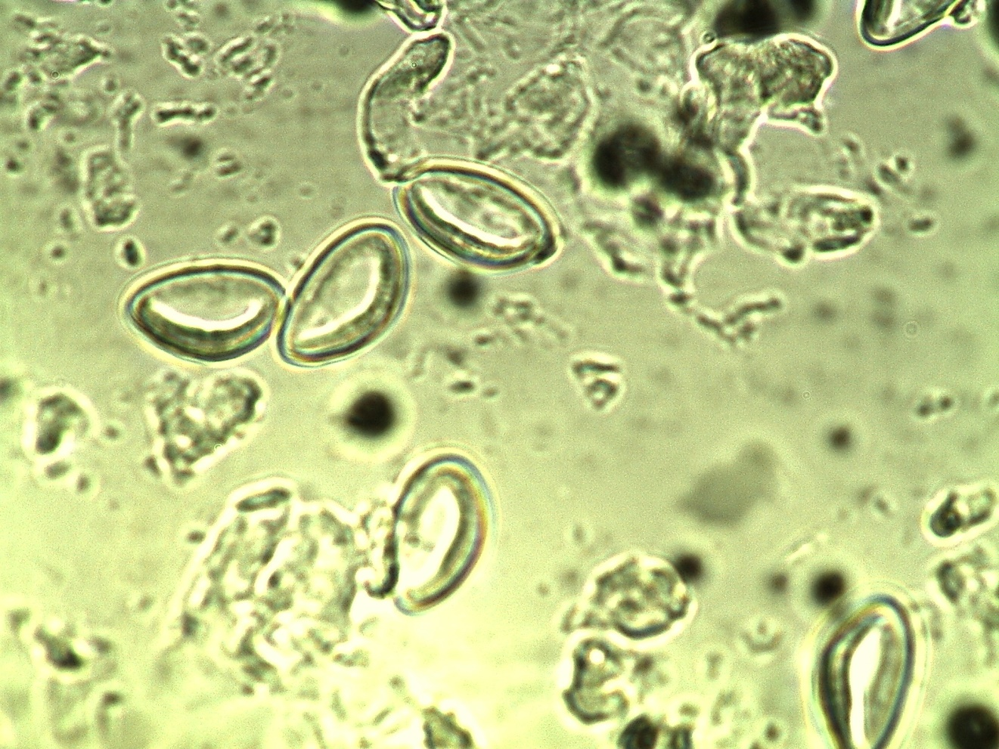
Enterobius vermicularis eggs
Graham method

