Slide 1
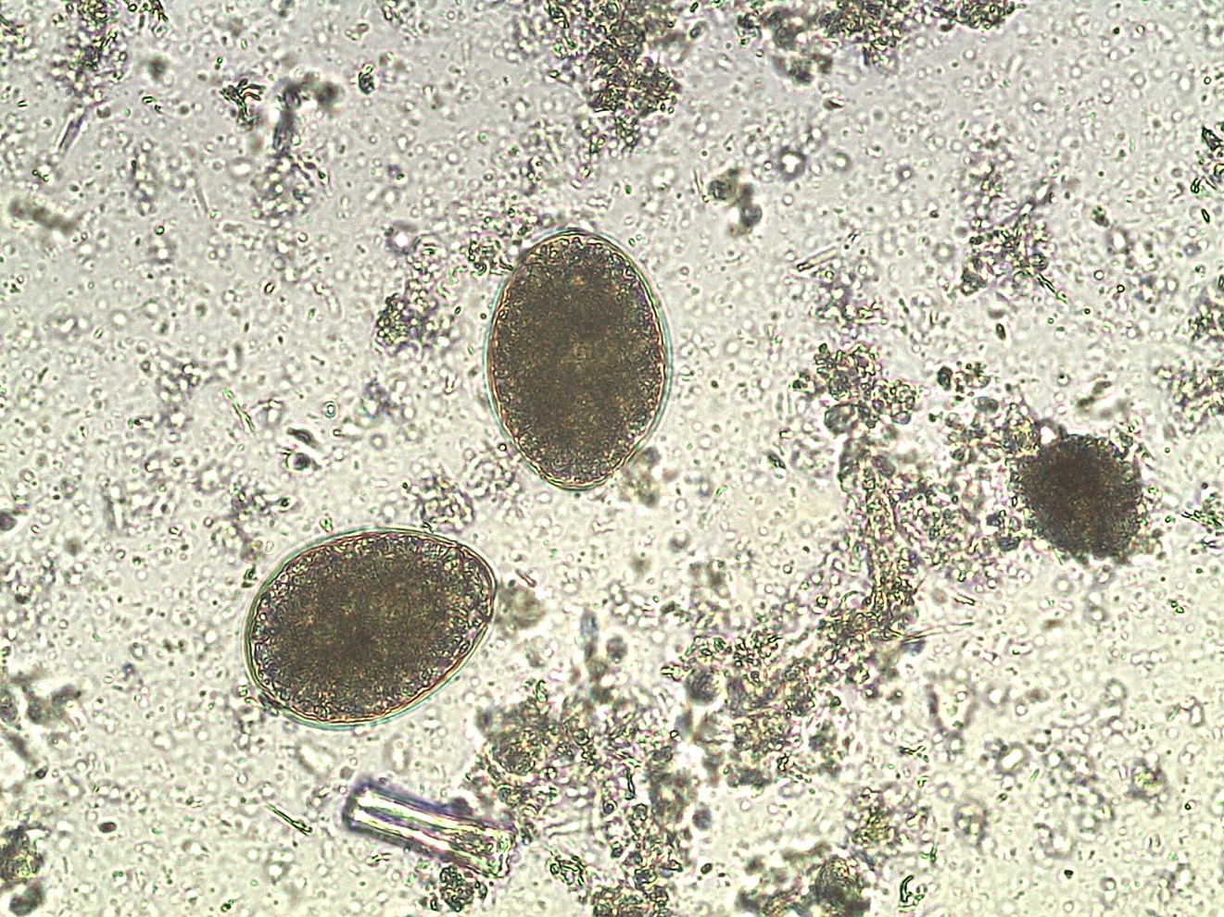
Fasciola hepatica

