Slide 1
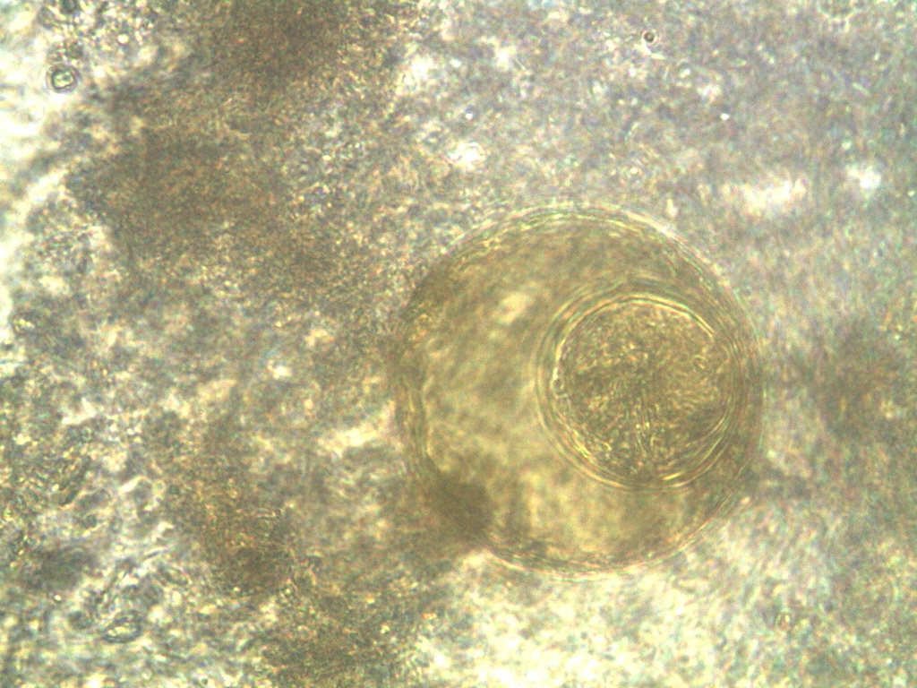
Hymenolepis diminuta - egg

