Slide 1
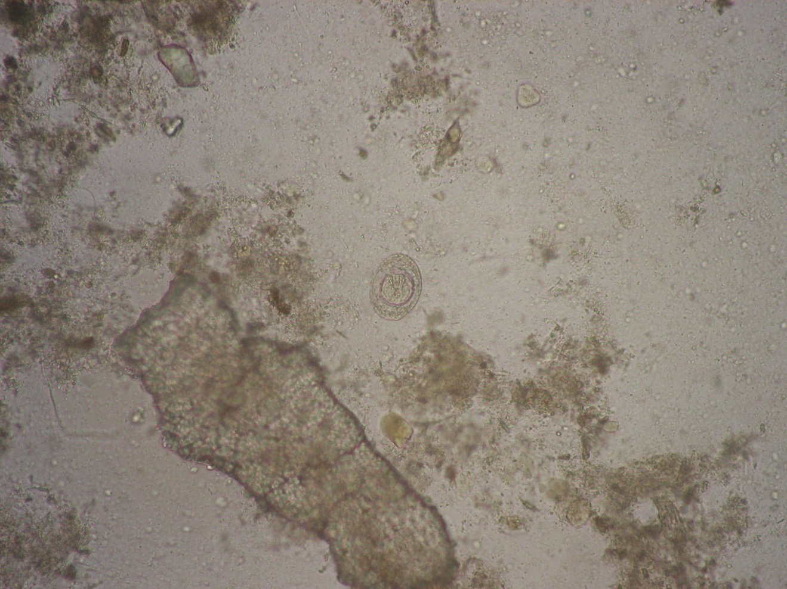
Hymenolepis nana
Kato method

