Slide 1
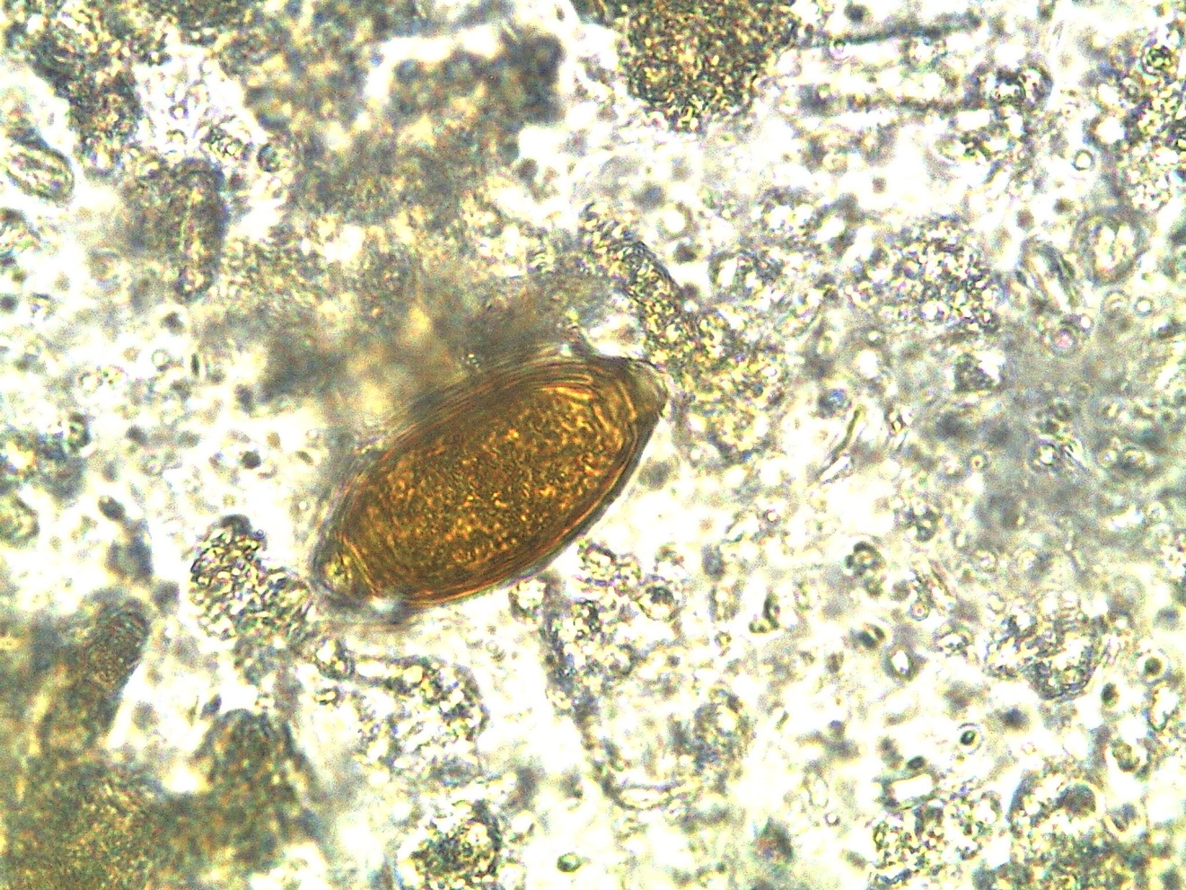
Trichuris trichiura - egg
Faust method

