Slide 1
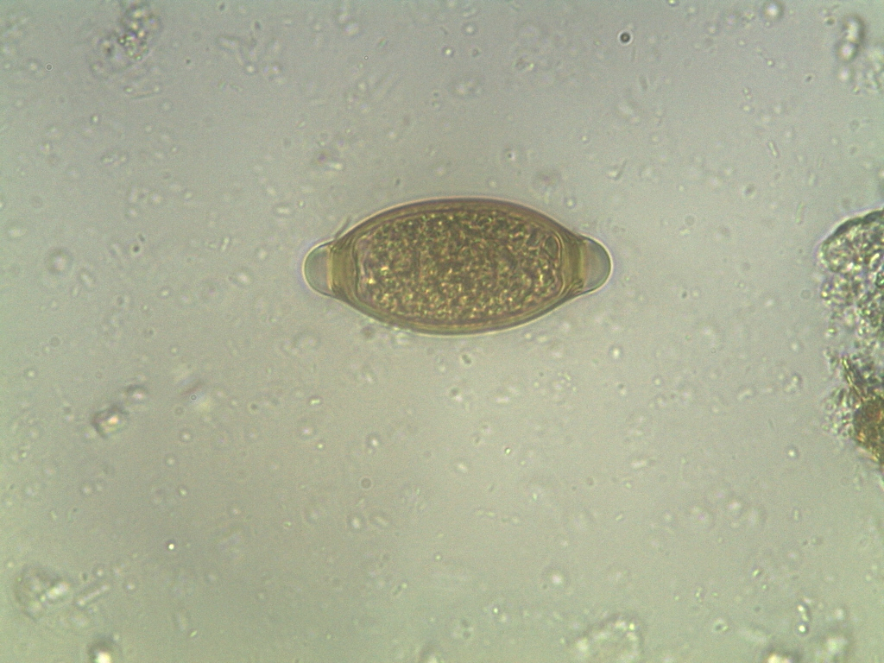
Trichuris trichiura - egg

