Slide 1
INJURIES
IN CLINICAL PRACTICE

Slide 2
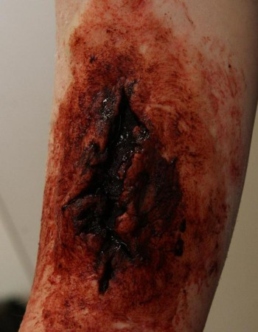
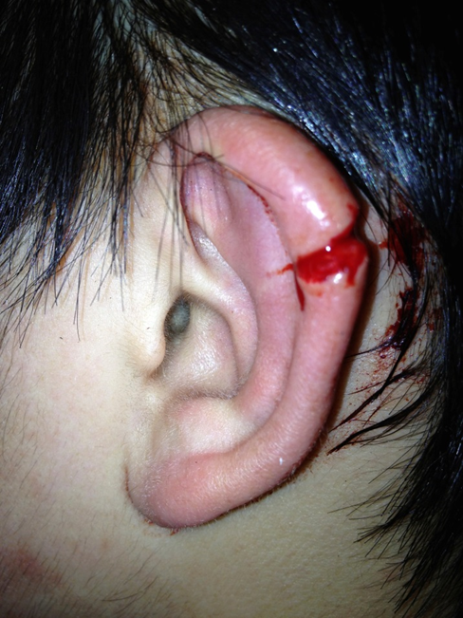
Vulnus lacerum
A torn ragged wound. A wound produced by the tearing of body tissue.
External lacerations may be small or large and may be caused in many ways, such as a blow from a blunt instrument, a fall against a rough surface, or an accident with machinery.
Lacerations within the body occur when an organ is compressed or moved out of place by an external or internal force.

Slide 3
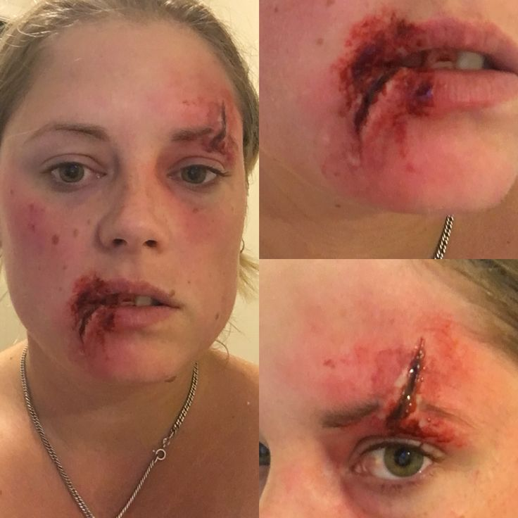
Put the words in correct order
supercilii - oris - l. - vulnus - sin.- labii - et- lacerum - inferioris
vulnus lacerum labii inferioris oris et supercilii l. sin.

Slide 4
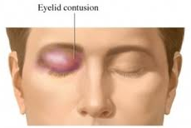
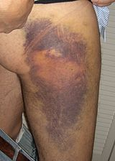
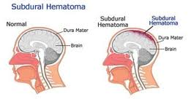
Bruise wound, an injury to tissues with skin discoloration and without breakage of skin. Blood from the broken vessels accumulates in surrounding tissues, producing pain, swelling, and tenderness, and the discoloration is the result of blood seepage just under the skin.
Haematoma
=Localized swelling filled with blood
Vulnus contusum = contusio

Slide 5
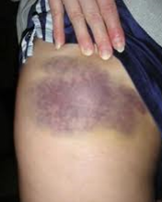
Fill in missing endings
is
Contusio femor__ later__ dextr__ cum haematomat__ muscul__ quadricipit__ femor__ later__ sinistr__
is
i
e
i
is
is
is
i

Slide 6
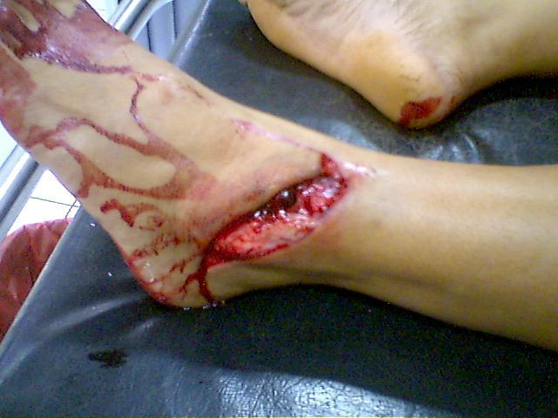
Vulnus contusolacerum
= lacerocontusum

Slide 7
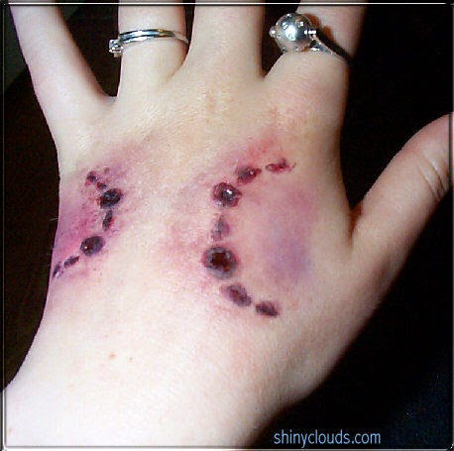
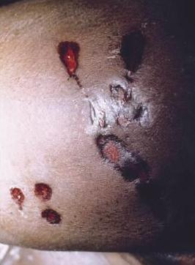
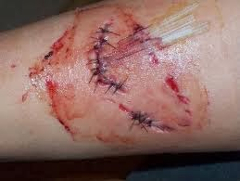
Vulnus morsum
Bite wound
– usually a puncture
or laceration, caused by the teeth. An animal bite usually results in
a break in the skin but also includes contusions from the excessive pressure on body tissue from the bite. The contusions can occur without a break in the skin.
Animal bites often result in serious infections and mortality.

Slide 8
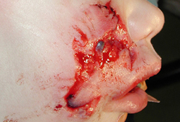
Translate the diagnose
Bite wounds of right face after an animal bite
Vulnera morsa faciei lateris dextri post morsum animalis

Slide 9
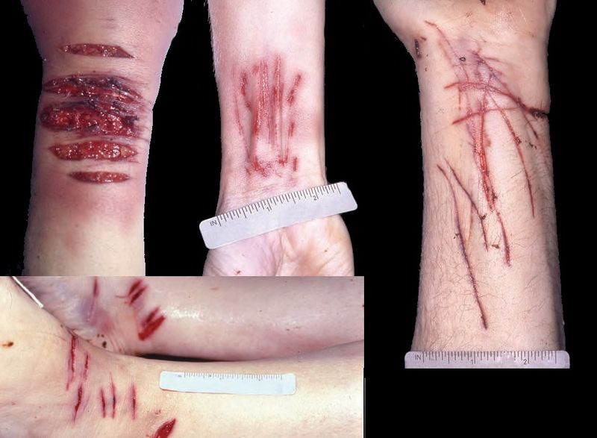
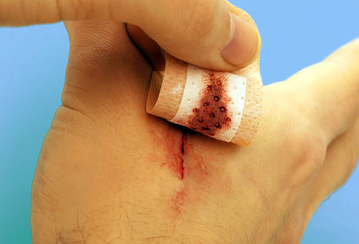
Vulnus scissum / incisum
cut wound = incision
slicing wounds made with a sharp instrument, leaving even edges. They may be as minimal as a paper cut or as significant as a surgical incision. or a wound made by a sharp instrument.

Slide 10
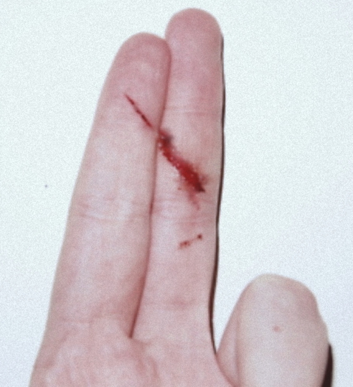
Give full forms of the abbreviations and numbers
vv. scissa dig. II-III manus l. sin.
vulnera scissa digiti secundi et tertii manus lateris sinistri

Slide 11
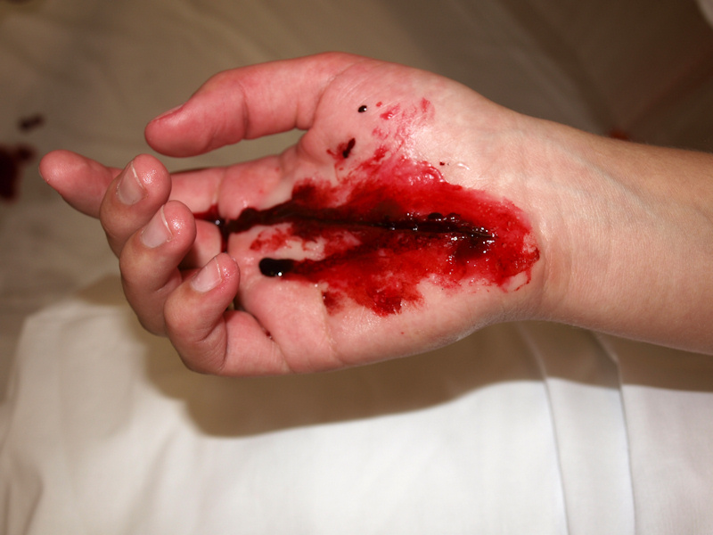
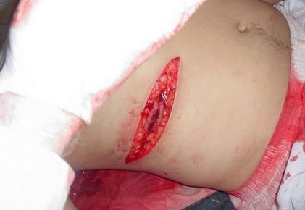
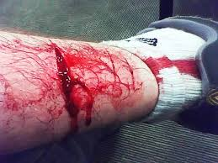
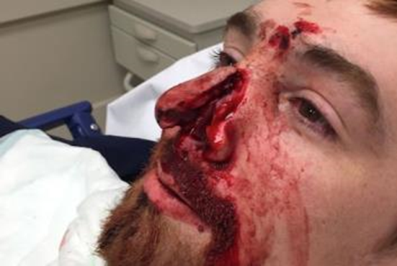
Vulnus sectum
A cut wound – wound caused by falling of a sharp object, typically an axe or a knife...

Slide 12
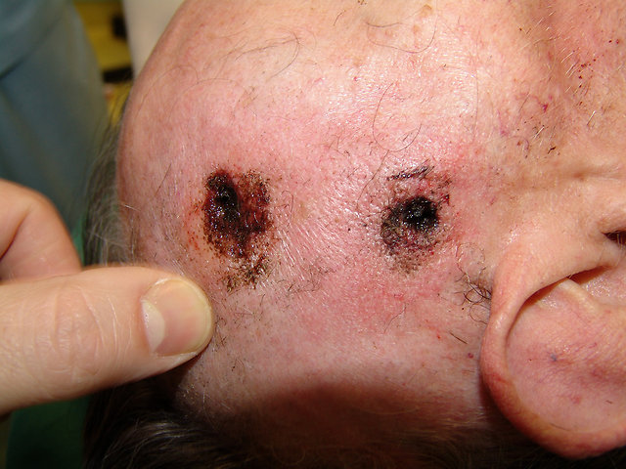
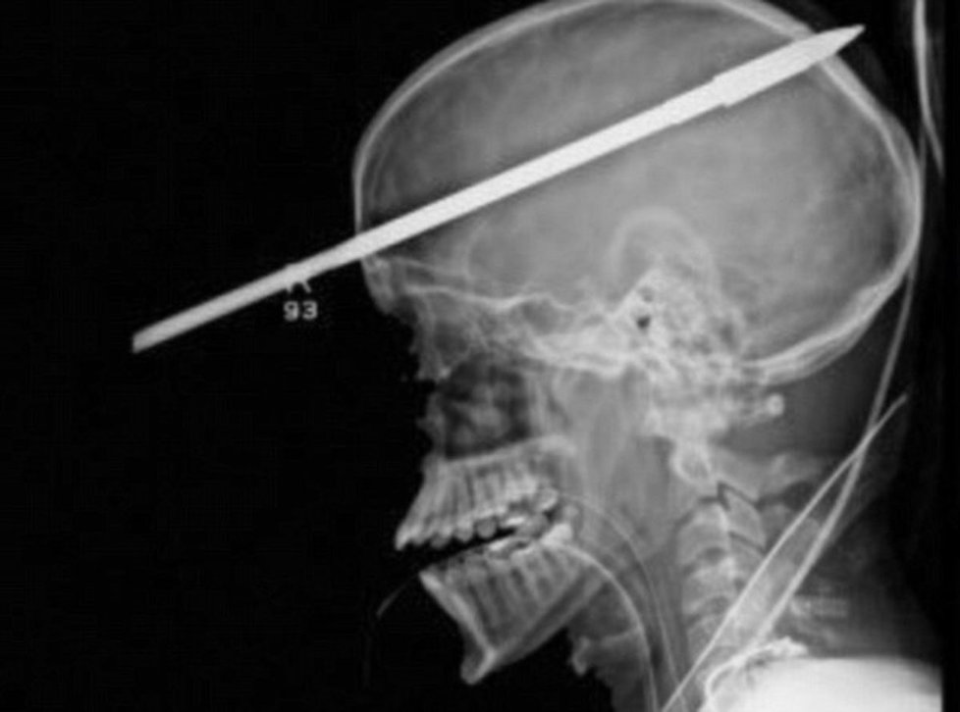
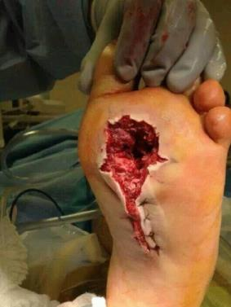
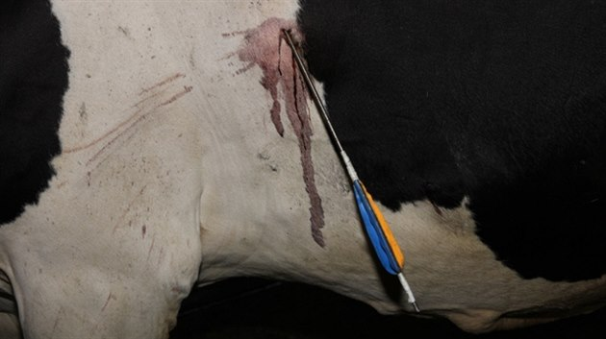
Vulnus sclopetarium
A gunshot wound (GSW) (ballistic trauma or bullet wound)
- form of physical trauma sustained from the discharge of arms or munitions.
Ballistic trauma can be fatal or cause long-term consequences.

Slide 13
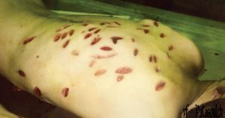
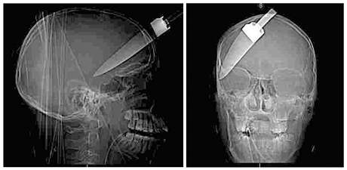
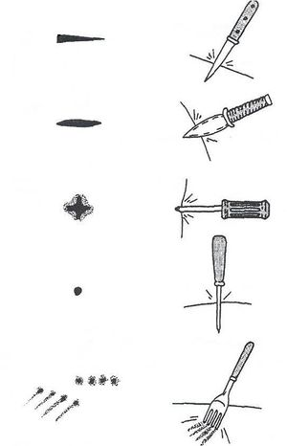
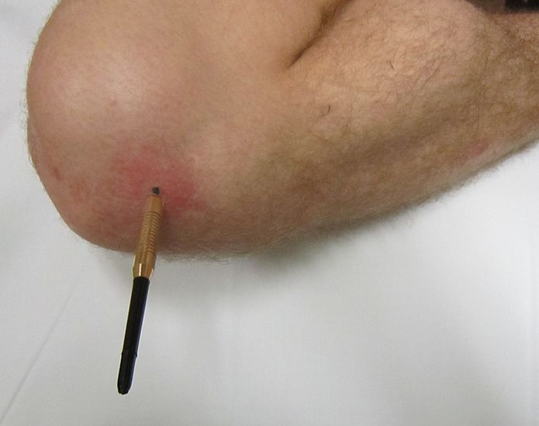
Vulnus punctum
stab wound
- a specific form of penetrating trauma to the skin that results from a knife or a similar pointed object that is "deeper than it is wide".
Stab wounds can occure not only from knives, but also from ice picks, pens, broken bottles, and even coat hangers.
Even though stab wounds are inflicted at a much greater rate than gun shot wounds, they account for less than 10% of all penetrating trauma deaths.

Slide 14
Translate the diagnose
foreign objects in multiple stab wounds of the back
corpora aliena in vulneribus punctis multiplicibus dorsi

Slide 15
Combustio, onis, f.
burn

Slide 16
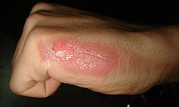
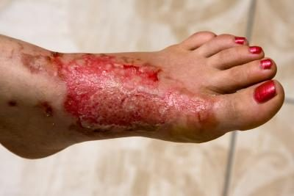
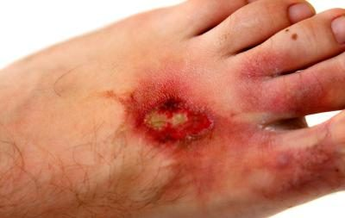
Combustio, onis, f.
2nd degree/grade burn
3rd degree/grade burn
infected burns
-change in the color of the skin around the burn, swelling, strange odor, the wound sinks deeper into the skin and gets larger, green or yellow pus develops, a fever

Slide 17
Write a diagnose of this second degree burn
Combustio brachii et antebrachii l. sin. gr II

Slide 18
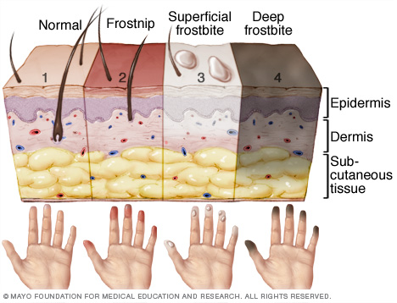
Congelatio, onis, f.
frostbite

Slide 19
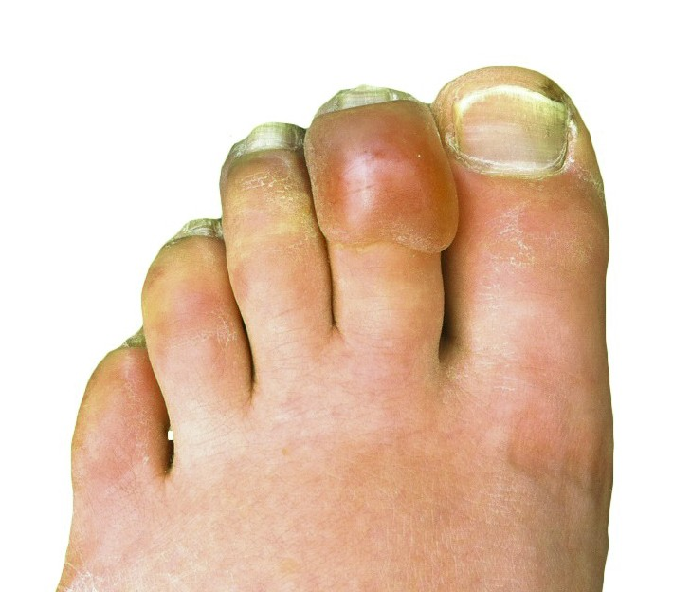
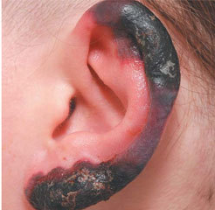
Congelatio, onis, f.

Slide 20
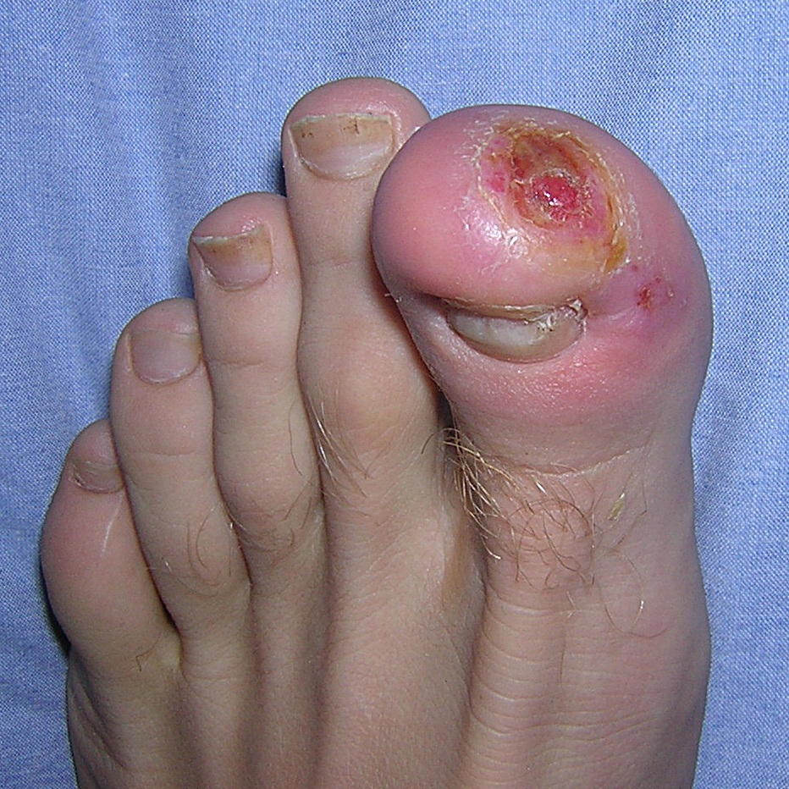
Give full forms of abbreviations and interpret the diagnoses
defectus cutis cum osteomyel. phal. dist. hall. l. dx.
stp. congelationem
defectus cutis cum osteomyelitide phalangis distalis hallucis lateris dextri
Status post congelationem

Slide 21
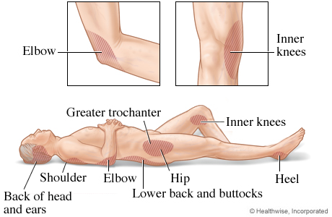
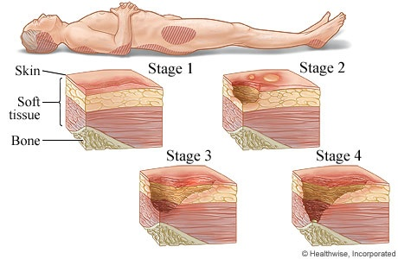
Decubitus, us, m.
bedsore – pressure ulcer due to local interference with circulation; persons most at risk are those who are emaciated (nutritionally deficient in protein), obese, immobilized by traction
or anything else, diabetic,
or suffering from a circulatory
disorder.

Slide 22
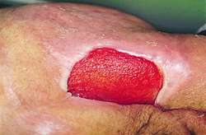
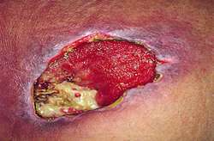
Decubitus, us, m.
stage 1 pressure ulcer
stage 2 pressure ulcer
stage 3 pressure ulcer

Slide 23
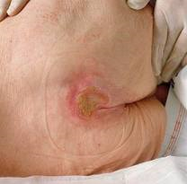
Fill in missing terms
Decubitus regionis _____________ (heel bone) et ______________ (sacral bone) gr. II.
calcanei
ossis sacri

Slide 24
Internal injuries
fractura – luxatio – distorsio
contusio
commotio
perforatio
laceratio
haematoma
abruptio
laesio

Slide 25
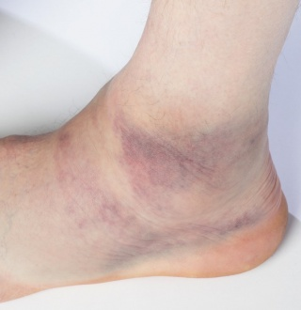
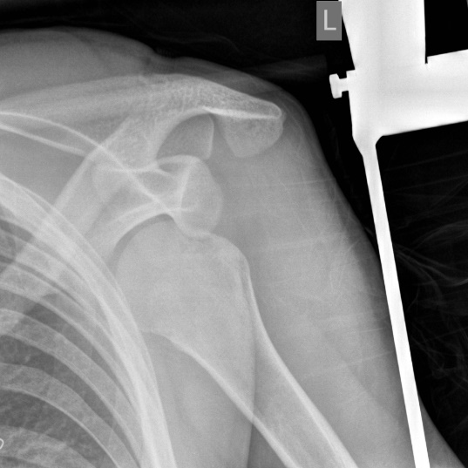
Bones, ligaments, soft tissues
OS = ostesynthesis; FE = ferrum (iron)
articulationis sacroiliacae
repositionem
= severe damage of soft tissues
???
???
Notes:
Decollément = severe damage of soft tissues – undeclined, French origin; distorsio malleoli l. sin.; luxatio humeri l. sin.

Slide 26
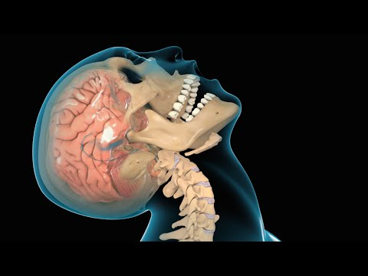
Organs
epidural haematoma in the left parietal region
haematoma epidurale reg. parietalis l.sin.
traumatic brain injury (TBI) ?
commotio cerebri

Slide 27
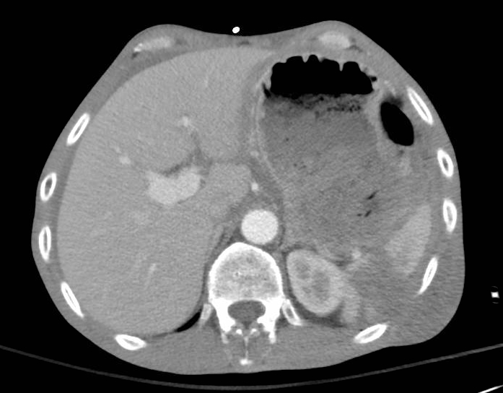
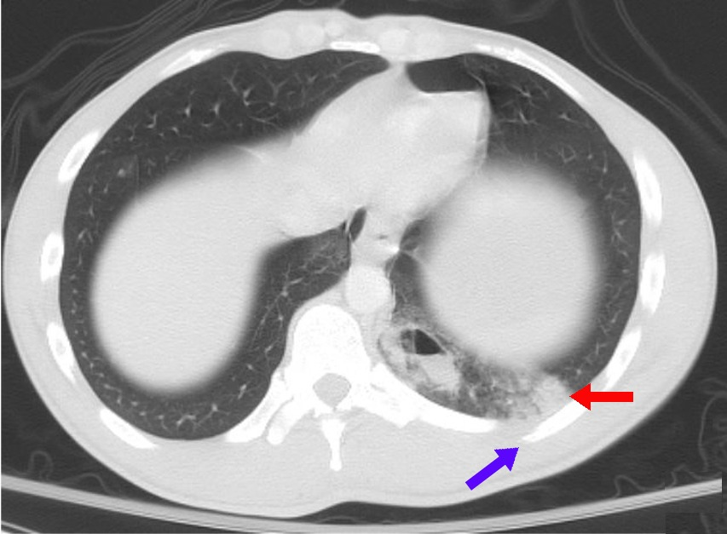
Organs
grade IV splenic laceration ?
laceratio lienis gradus quarti
contusion of the right lung ?
contusio pulmonis l. dx.
Notes:
Contusio = injury made with a blunt instrument, in which the subsurface tissue is injured but the skin is not broken

Slide 28
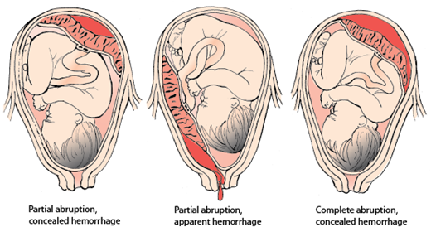
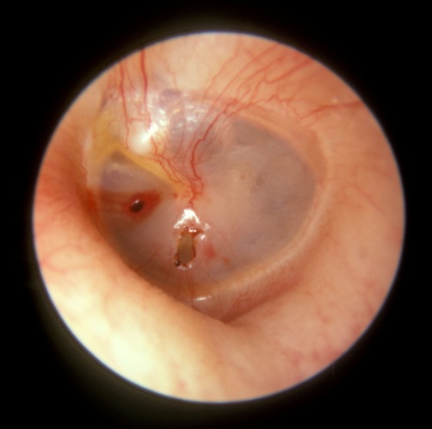
Organs, soft tissues
partial abruption of placenta in the 36th week (+ 4 days) of pregnancy?
abruptio placentae partialis in grav. hebd. 36+4
in graviditatis hebdomade
traumatic perforation of the tympanic membrane in the right ear ?
perforatio tympani l. dx. traumatica
Notes:
Perf abr laes

Slide 30
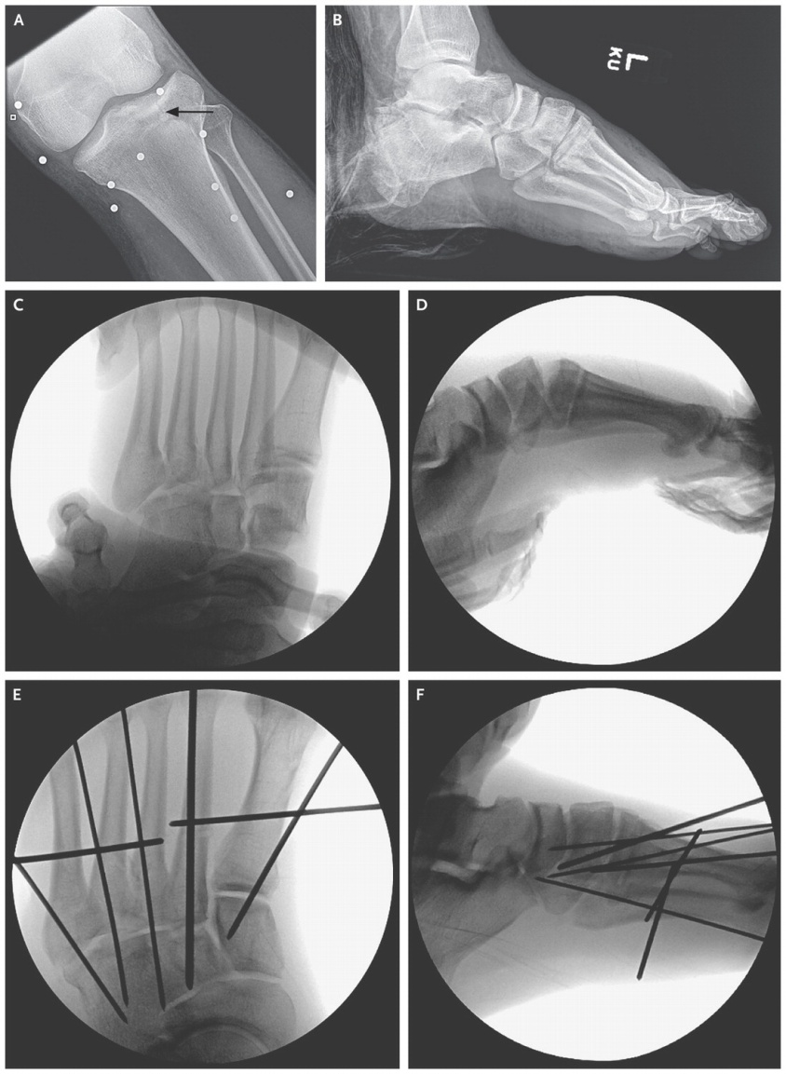
Case study
A 34-year-old man was brought to the emergency department at the hospital because of multiple traumatic injuries that he sustained when a bomb exploded while he was watching the 2013 Boston Marathon. At the scene, the patient reportedly lost consciousness, had a complete amputation of his right leg directly below the knee, and had copious blood loss. A plain radiograph of the left tibia and fibula (Figure 3A Radiographs of the Injuries of the Left Leg) revealed multiple metallic foreign bodies around the knee and a nondisplaced fracture of the lateral tibial plateau. Plain radiographs of the left foot and ankle revealed a comminuted fracture of the calcaneus (Figure 3B), minimally displaced cuboid and cuneiform fractures, and subluxation of multiple tarsometatarsal joints, evidence of a ligamentous Lisfranc injury (dislocation of the tarsometatarsal joints due to midfoot trauma; named after the military surgeon in Napoleon's army) (Figure 3C).
Notes:
Amputatio cruris l.dx. traumatica; Corpora aliena metallica multiplicia circum genu l.sin.; Fractura plato tibiae lateralis l.sin. non dislocata; fractura calcanei l.sin. Comminutiva; subluxatio articulationum tarsometatarsalium = fractura Lisfranc

Slide 31
Check the basic structure of your diagnose !
1) problem: Nominative
fractura; corpora aliena; subluxatio
2) localization: Genitive (rarely preposition)
cruris l.dx.; calcanei; circum genu
3) further specification of the problem:
traumatica; non dislocata; comminutiva
Notes:
Chvilku makají, pak skontrolovat jestli mají dobrou structure

Slide 32
Case study
A 34-year-old man was brought to the emergency department at the hospital because of multiple traumatic injuries that he sustained when a bomb exploded while he was watching the 2013 Boston Marathon. At the scene, the patient reportedly lost consciousness, had a complete amputation of his right leg directly below the knee, and had copious blood loss. A plain radiograph of the left tibia and fibula (Figure 3A Radiographs of the Injuries of the Left Leg) revealed multiple metallic foreign bodies around the knee and a nondisplaced fracture of the lateral tibial plateau. Plain radiographs of the left foot and ankle revealed a comminuted fracture of the calcaneus (Figure 3B), minimally displaced cuboid and cuneiform fractures, and subluxation of multiple tarsometatarsal joints, evidence of a ligamentous Lisfranc injury (dislocation of the tarsometatarsal joints due to midfoot trauma; named after the military surgeon in Napoleon's army) (Figure 3C).
Notes:
Amputatio cruris l.dx. traumatica; Corpora aliena metallica multiplicia circum genu l.sin.; Fractura plato tibiae lateralis l.sin. non dislocata; fractura calcanei l.sin. Comminutiva; subluxatio articulationum tarsometatarsalium = fractura Lisfranc

Slide 33
Specifics of clinical Latin
Eponyms – Lisfranc
Side expressed by l.sin./l.dx.
The specifying adjective usually stands in the end:
Fractura plato tibiae lateralis l.sin. non dislocata
Latinized undeclined terms – plato tibiae
Abbreviations - disloc., comm., mult.

