Slide 1
Prevalence obezity, její příčiny v Brně a možnosti léčby
Robert Prosecký

Slide 2
Etiologie a patogeneze
Hlavní příčinou vzniku obezity je pozitivní energetická bilance (nepoměr mezi energetickým příjmem a výdejem)
Dědičné faktory
Endokrinopatie (Cushingův sy, hypothyreóza, hypopitutarismus,..)
Psychosociální faktory
Léky (PAD, insulin, thyreostatika, glukokortikoidy, estrogeny, antidepresiva, ..)

Slide 3

Porucha výživy ze zvýšeného příjmu potravy v důsledku nevhodných návyků při jídle
Jednorázová konzumace větších kvant potravy
Vynechávání snídaně
Nibbling („uždibování“ nevědomá konzumace např. při sledování TV)
Příjem potravy při stressu (na uklidnění)
Syndrom nočního přejídání
Zvýšená rychlost konzumace potravy

Slide 4
Klinický obraz a diagnostika
Vyjádření stupně nadváhy pomocí indexu tělesné hmotnosti BMI – Body Mass Index
→ váha (kg) ÷ výška² (m) = BMI
- dle BMI můžeme určit zdravotní rizika spojená s obezitou:
BMI | Kategorie dle WHO | Zdravotní rizika
18,5 – 24,9 | normální | minimální
25,0 – 29,9 < 26,9 > 27 | nadváha | nízká lehce zvýšená
30,0 – 34,9 | obezita I. stupně | vysoká
35,0 – 39,9 | obezita II. stupně | vysoká
> 40 | obezita III. stupně | velmi vysoká

Slide 5
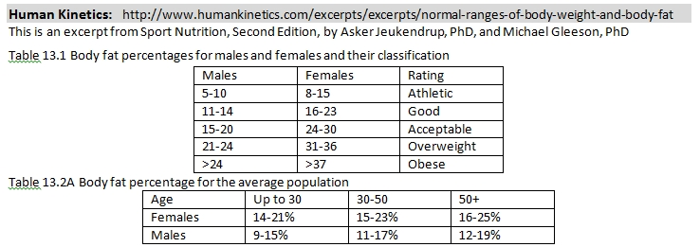
Diagnostická kritéria - % tuku
 | Men | Women
Normal | < 20 | < 30
Overweight | 20 - 25 | 30 - 35
Obesity | > 25 | > 35
Oliveros E, Somers V, Sochor O, Goel K, Lopez-Jimenez F: The concept of normal weight obesity. Progress in cardiovascular diseases, 2014, 56, 426-433
Biospace: Standard body fat percent is 15 % (range 10 - 20) for men and 23 % (range 18 - 28) for women
5
Notes:
5

Slide 6
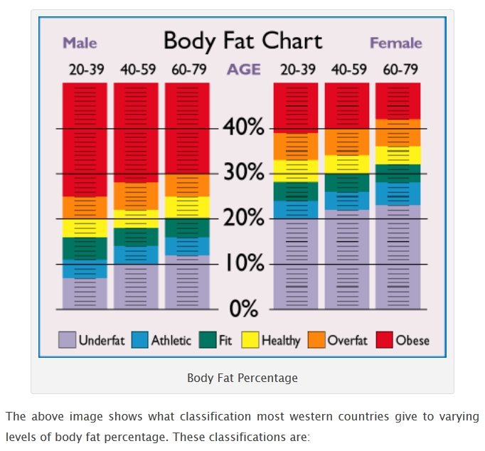
6
Notes:
6

Slide 7
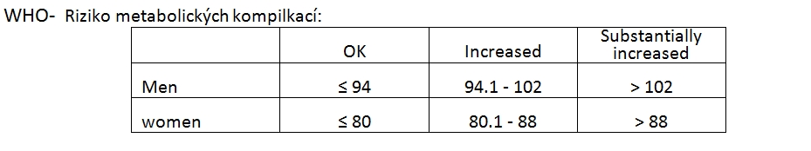
Diagnostická kritéria – obvod břicha
 | Normální | Nadváha | Obezita
Muži | < 94 | 94 - 102 | > 102
Ženy | < 80 | 80 - 88 | > 88
7
Notes:
7

Slide 8
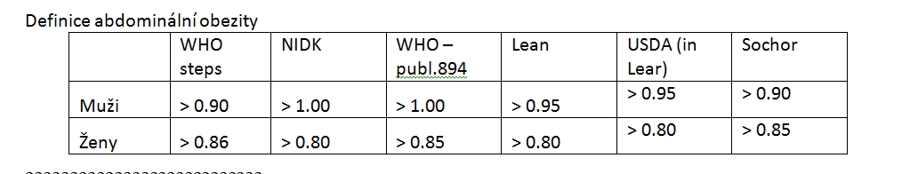
Diagnostická kritéria – WHR
 | Low risk | Moderate risk | High risk
Men | < 0.95 | 0.95 - 1.00 | > 1.00
Women | < 0.80 | 0.81 - 0.85 | > 0.85
Ideál (zdraví a plodnost): Muži 0.9, Ženy 0.7
8
Notes:
8

Slide 9
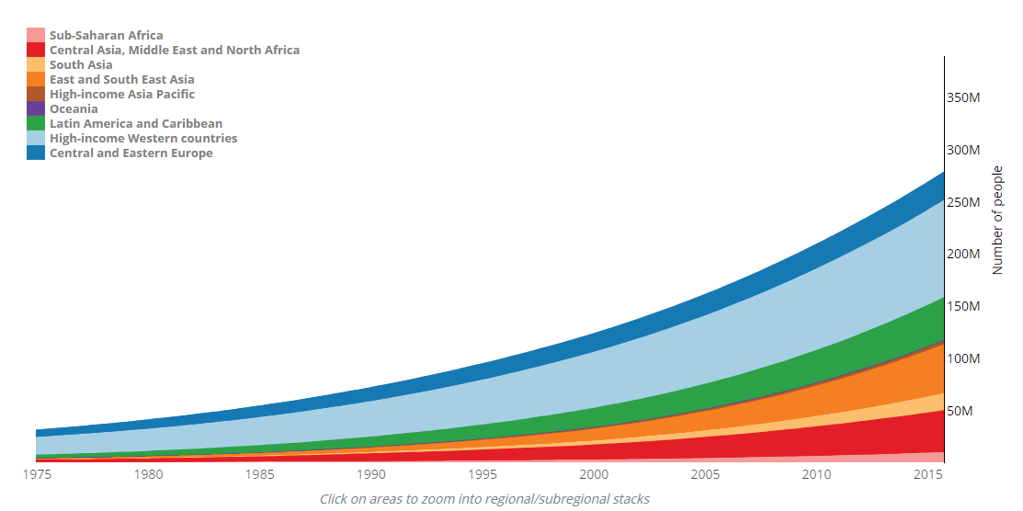
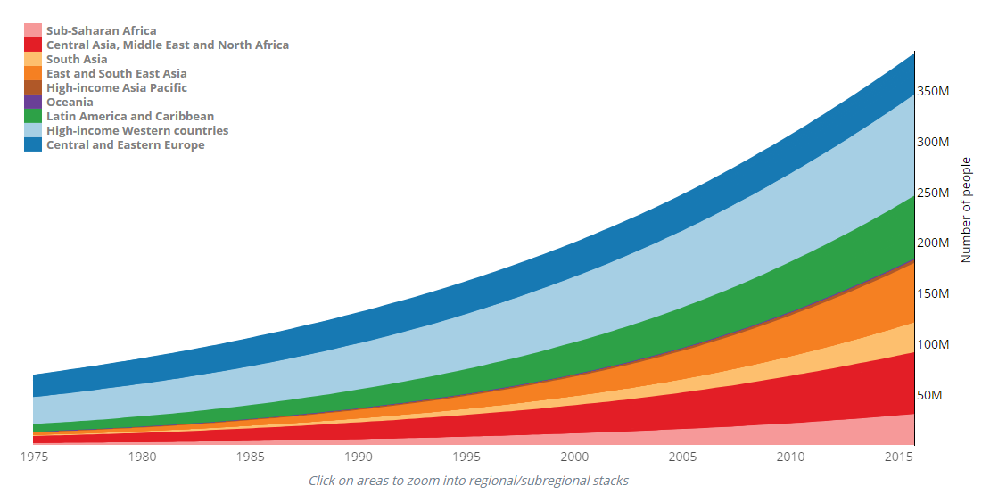
Míra obesity celosvětově roste
Men BMI ≥30 kg/m²
Women BMI ≥30 kg/m²
350M
350M
300M
300M
250M
250M
Number of people
Number of people
200M
200M
150M
150M
100M
100M
50M
50M
1975
1980
1985
1990
1995
2000
2005
2010
2015
1975
1980
1985
1990
1995
2000
2005
2010
2015
Sub-Saharan Africa
Central Asia, Middle East and North Africa
South Asia
East and South East Asia
High-income Asia Pacific
Oceania
Latin America and Caribbean
High-income English speaking countries and Western Europe
Central and Eastern Europe
M, million
Adapted from NCD Risk Factor Collaboration (NCD-RisC). Lancet 2017:390;2627–42
Notes:
NCD Risk Factor Collaboration (NCD-RisC). Lancet 2017:390;2627–42
Background
Underweight, overweight, and obesity in childhood and adolescence are associated with adverse health consequences throughout the life-course. Our aim was to estimate worldwide trends in mean body-mass index (BMI) and a comprehensive set of BMI categories that cover underweight to obesity in children and adolescents, and to compare trends with those of adults.
Methods
We pooled 2416 population-based studies with measurements of height and weight on 128·9 million participants aged 5 years and older, including 31·5 million aged 5–19 years. We used a Bayesian hierarchical model to estimate trends from 1975 to 2016 in 200 countries for mean BMI and for prevalence of BMI in the following categories for children and adolescents aged 5–19 years: more than 2 SD below the median of the WHO growth reference for children and adolescents (referred to as moderate and severe underweight hereafter), 2 SD to more than 1 SD below the median (mild underweight), 1 SD below the median to 1 SD above the median (healthy weight), more than 1 SD to 2 SD above the median (overweight but not obese), and more than 2 SD above the median (obesity).
Findings
Regional change in age-standardised mean BMI in girls from 1975 to 2016 ranged from virtually no change (−0·01 kg/m2 per decade; 95% credible interval −0·42 to 0·39, posterior probability [PP] of the observed decrease being a true decrease=0·5098) in eastern Europe to an increase of 1·00 kg/m2 per decade (0·69–1·35, PP>0·9999) in central Latin America and an increase of 0·95 kg/m2 per decade (0·64–1·25, PP>0·9999) in Polynesia and Micronesia. The range for boys was from a non-significant increase of 0·09 kg/m2 per decade (−0·33 to 0·49, PP=0·6926) in eastern Europe to an increase of 0·77 kg/m2 per decade (0·50–1·06, PP>0·9999) in Polynesia and Micronesia. Trends in mean BMI have recently flattened in northwestern Europe and the high-income English-speaking and Asia-Pacific regions for both sexes, southwestern Europe for boys, and central and Andean Latin America for girls. By contrast, the rise in BMI has accelerated in east and south Asia for both sexes, and southeast Asia for boys. Global age-standardised prevalence of obesity increased from 0·7% (0·4–1·2) in 1975 to 5·6% (4·8–6·5) in 2016 in girls, and from 0·9% (0·5–1·3) in 1975 to 7·8% (6·7–9·1) in 2016 in boys; the prevalence of moderate and severe underweight decreased from 9·2% (6·0–12·9) in 1975 to 8·4% (6·8–10·1) in 2016 in girls and from 14·8% (10·4–19·5) in 1975 to 12·4% (10·3–14·5) in 2016 in boys. Prevalence of moderate and severe underweight was highest in India, at 22·7% (16·7–29·6) among girls and 30·7% (23·5–38·0) among boys. Prevalence of obesity was more than 30% in girls in Nauru, the Cook Islands, and Palau; and boys in the Cook Islands, Nauru, Palau, Niue, and American Samoa in 2016. Prevalence of obesity was about 20% or more in several countries in Polynesia and Micronesia, the Middle East and north Africa, the Caribbean, and the USA. In 2016, 75 (44–117) million girls and 117 (70–178) million boys worldwide were moderately or severely underweight. In the same year, 50 (24–89) million girls and 74 (39–125) million boys worldwide were obese.
Interpretation
The rising trends in children's and adolescents' BMI have plateaued in many high-income countries, albeit at high levels, but have accelerated in parts of Asia, with trends no longer correlated with those of adults.
Funding
Wellcome Trust, AstraZeneca Young Health Programme.

Slide 10
Globalní prevalence obezity: 2016
Age-standardised adjusted estimates for adults with BMI ≥30 kg/m²
Prevalence of obesity, >18 years – Female¹
Prevalence of obesity, >18 years – Male²
Prevalence (%)
≥30
20 – 29.9
10.0 – 19.9
<10.0 or no data available
BMI, body mass index
1. World Health Organisation, Prevalence of obesity in ages 18+ females , 2016. Available at: http://gamapserver.who.int/mapLibrary/Files/Maps/Global_Obesity_2016_Female.png (Last accessed: February 2019); 2.World Health Organisation, Prevalence of obesity in ages 18+ males, 2016. Available at: http://gamapserver.who.int/mapLibrary/Files/Maps/Global_Obesity_2016_Male.png (Last accessed: February 2019).

Slide 11
Kardiovize Brno 2030
Jde o náhodný vzorek brněnské populace ve věku 25-64 let.
Účastníci studie byli osloveni na základě databází zdravotních pojišťoven
celkem bylo zařazeno 1975 osob v letech 2012-2015
metodika použita jako u post-MONICA studie
bylo stanoveno procento tělesného tuku bioimpedanční metodou přístrojem InBody 370

Slide 12
Struktura brněnské populace
obezita 17.4% dle BMI
nadváha 34.7% dle BMI
dohromady 52.1% (WHO pro ČR 63.4%, SR 61.0%)
zmnožená tuková tkáň i při normální hmotnosti normal weight obesity 21.5 % (definice dle Gallagherové)
dle obvodu pasu je pak obézních 31.59%.
obezita podle tělesného tuku 49.7%

Slide 13
Doba přežití klesá se stoupajícím BMI
100
Normální BMI =
téměř 80% šance
na dosáhnutí 70 let
80
60
BMI 35–40 =
~60% šance na dosáhnutí 70 let
Proportion still alive (%)
40
BMI range (kg/m²)
22.5–25
BMI 40–50 =
~50% šance na dosáhnutí 70 let
25–30
20
30–35
35–40
40–50
0
35
40
50
60
70
80
90
100
Age (years)
Data are based on male subjects; n=541,452
Prospective Studies Collaboration. Lancet 2009;373:1083–96
Notes:
BMI vs. lifespan in western Europe, year 2000
Estimated effects of the BMI that would be reached by about 60 years of age on survival from age 35 years, identifying European Union (EU) mortality rates in 2000 with those for BMI 25–30 kg/m² and combining the disease-specific EU mortality rates with disease-specific relative risks. The absolute differences in median survival (but probably not in survival to age 70 years) should be robust to changes in mortality rates, and therefore generalisable decades hence three main and two higher BMI categories (the two higher BMI categories account for just 2% of PSC participants, and so are indicated by dashed lines).
Prospective Studies Collaboration. Lancet. 2009;373:1083–96.
Abstract
BACKGROUND:
The main associations of body-mass index (BMI) with overall and cause-specific mortality can best be assessed by long-termprospective follow-up of large numbers of people. The Prospective Studies Collaboration aimed to investigate these associations by sharing data from many studies.
METHODS:
Collaborative analyses were undertaken of baseline BMI versus mortality in 57 prospective studies with 894 576 participants, mostly in western Europe and North America (61% [n=541 452] male, mean recruitment age 46 [SD 11] years, median recruitment year 1979 [IQR 1975-85], mean BMI 25 [SD 4] kg/m(2)). The analyses were adjusted for age, sex, smoking status, and study. To limit reverse causality, the first 5 years of follow-up were excluded, leaving 66 552 deaths of known cause during a mean of 8 (SD 6) further years of follow-up (mean age at death 67 [SD 10] years): 30 416 vascular; 2070 diabetic, renal or hepatic; 22 592 neoplastic; 3770 respiratory; 7704 other.
FINDINGS:
In both sexes, mortality was lowest at about 22.5-25 kg/m(2). Above this range, positive associations were recorded for several specific causes and inverse associations for none, the absolute excess risks for higher BMI and smoking were roughly additive, and each 5 kg/m(2) higher BMI was on average associated with about 30% higher overall mortality (hazard ratio per 5 kg/m(2) [HR] 1.29 [95% CI 1.27-1.32]): 40% for vascular mortality (HR 1.41 [1.37-1.45]); 60-120% for diabetic, renal, and hepatic mortality (HRs 2.16 [1.89-2.46], 1.59 [1.27-1.99], and 1.82 [1.59-2.09], respectively); 10% for neoplastic mortality (HR 1.10 [1.06-1.15]); and 20% for respiratory and for all other mortality (HRs 1.20 [1.07-1.34] and 1.20 [1.16-1.25], respectively). Below the range 22.5-25 kg/m(2), BMI was associated inversely with overall mortality, mainly because of strong inverse associations with respiratory disease and lung cancer. These inverse associations were much stronger for smokers than for non-smokers, despite cigarette consumption per smoker varying little with BMI.
INTERPRETATION:
Although other anthropometric measures (eg, waist circumference, waist-to-hip ratio) could well add extra information to BMI, and BMI to them, BMI is in itself a strong predictor of overall mortality both above and below the apparent optimum of about 22.5-25 kg/m(2). The progressive excess mortality above this range is due mainly to vascular disease and is probably largely causal. At 30-35 kg/m(2), median survival is reduced by 2-4 years; at 40-45 kg/m(2), it is reduced by 8-10 years (which is comparable with the effects of smoking). The definite excess mortality below 22.5 kg/m(2) is due mainly to smoking-related diseases, and is not fully explained.

Slide 14







BMI a všechny příčiny úmrtí
HUNT and UK Biobank studies
HUNT Study
Cardiovascular mortality
Other (non-cardiovascular, non-cancer mortality)
5
10.0
10.0
4
7.5
7.5
3
5.0
5.0
Hazard ratio for all cause mortality
2.5
2
2.5
1
1.0
1.0
20
30
40
10.0
UK Biobank
10.0
Cancer mortality
Body mass index
7.5
7.5
5.0
5.0
Hazard ratio for all cause mortality
2.5
2.5
1.0
1.0
20
30
40
20
30
40
Body mass index
Body mass index
Sun et al. BMJ 2019; 364: l1042

Slide 15
Možná vysvětlení
Obézní lépe tolerují katabolismus provázející akutní stavy, díky zásobám lépe tolerují pokles váhy („ tlustí budou hubení a hubení studení“)
Obézní se „zdravým“ metabolickým profilem mají nižší kardiovaskulární riziko než hubení s více riziky
Kouření: obézní nekuřák má lepší profil než hubený kuřák
Svalová hmota je jinak metabolický aktivní než tuk
Chronické onemocnění může vést k poklesu váhy

Slide 16
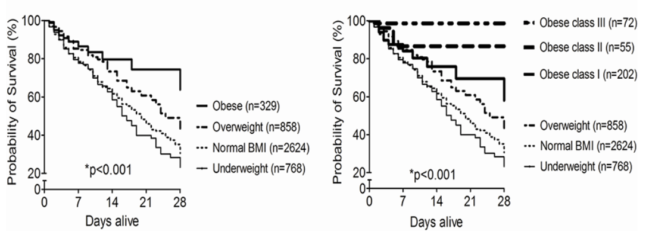
Přežívání pacientů na chirurgických JIP
(Wacharasint et all 2016)

Slide 17

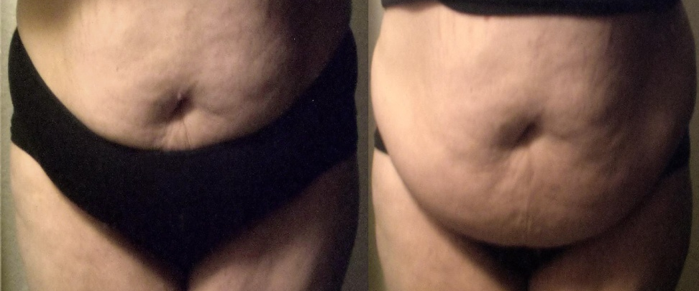
Není BMI jako BMI (BMI 33kg/m²)

Slide 18
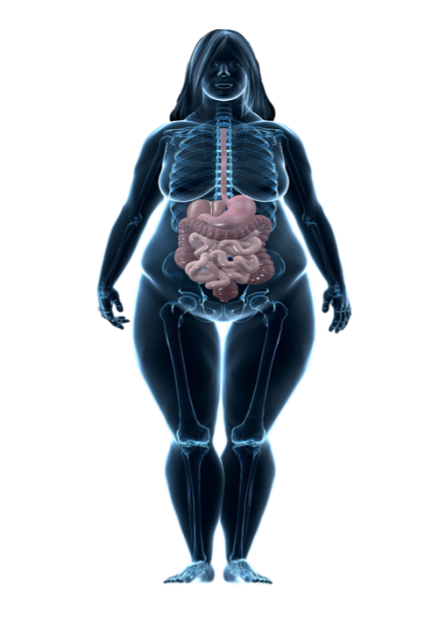

Obezit je asociována s mnohočetnými komplikacemi
Metabolickými, mechanickými a mentalními
Sleep apnoea
Metabolické
Deprese
CVD and rizikové faktory
CMP
Dyslipidemie
Hyperteze
ICHS
Srdeční selhávání
Plicní embolie
Úzkost
Mechanické
Ashma
Mentalní
NAFLD
Žl. kameny
Chronické bolesti zad
Nádory*
Neplodnost
Typ 2 diabetes mellitus
Prediabetes
Fyziologické funkce
Inkontinence
Tromboza
Arthrosa
Dna
CVD, cardiovascular disease; NAFLD, non-alcoholic fatty liver disease
*Including breast, colorectal, endometrial, esophageal, kidney, ovarian, pancreatic and prostate
Adapted from Sharma AM. Obes Rev. 2010;11:808-9; Guh et al. BMC Public Health 2009;9:88; Luppino et al. Arch Gen Psychiatry 2010;67:220–9; Simon et al. Arch Gen Psychiatry 2006;63:824–30; Church et al. Gastroenterology 2006;130:2023–30; Li et al. Prev Med 2010;51:18–23; Hosler. Prev Chronic Dis 2009;6:A48
Notes:
Sharma AM. Obes Rev. 2010;11:808-9
Abstract
Obese individuals can present with a wide range of medical and psychosocial problems, which can promote weight gain, provide important indications for treatment but, in some cases, also pose significant barriers to management. To ensure a complete assessment and consideration of these factors, I propose the use of a simple mnemonic consisting of four Ms or 'M, M, M, & M' that stand for Mental, Mechanical, Metabolic and Monetory, respectively, and may help the busy practitioner navigate through a thorough assessment of clients presenting with excess weight.
Guh et al. BMC Public Health. 2009;9:88.
Abstract
BACKGROUND:
Overweight and obese persons are at risk of a number of medical conditions which can lead to further morbidity and mortality. The primary objective of this study is to provide an estimate of the incidence of each comorbidity related to obesity and overweight using a meta-analysis.
METHODS:
A literature search for the twenty comorbidities identified in a preliminary search was conducted in Medline and Embase (Jan 2007). Studies meeting the inclusion criteria (prospective cohort studies of sufficient size reporting risk estimate based on the incidence of disease) were extracted. Study-specific unadjusted relative risks (RRs) on the log scale comparing overweight with normal and obese with normal were weighted by the inverse of their corresponding variances to obtain a pooled RR with 95% confidence intervals (CI).
RESULTS:
A total of 89 relevant studies were identified. The review found evidence for 18 comorbidities which met the inclusion criteria. The meta-analysis determined statistically significant associations for overweight with the incidence of type II diabetes, all cancers except esophageal (female), pancreatic and prostate cancer, all cardiovascular diseases (except congestive heart failure), asthma, gallbladder disease, osteoarthritis and chronic back pain. We noted the strongest association between overweight defined by body mass index (BMI) and the incidence of type II diabetes in females (RR = 3.92 (95% CI: 3.10-4.97)). Statistically significant associations with obesity were found with the incidence of type II diabetes, all cancers except esophageal and prostate cancer, all cardiovascular diseases, asthma, gallbladder disease, osteoarthritis and chronic back pain. Obesity defined by BMI was also most strongly associated with the incidence of type II diabetes in females (12.41 (9.03-17.06)).
CONCLUSION:
Both overweight and obesity are associated with the incidence of multiple comorbidities including type II diabetes, cancer and cardiovascular diseases. Maintenance of a healthy weight could be important in the prevention of the large disease burden in the future. Further studies are needed to explore the biological mechanisms that link overweight and obesity with these comorbidities.
Luppino et al. Arch Gen Psychiatry 2010;67:220–9
Abstract
CONTEXT:
Association between obesity and depression has repeatedly been established. For treatment and prevention purposes, it is important to acquire more insight into their longitudinal interaction.
OBJECTIVE:
To conduct a systematic review and meta-analysis on the longitudinal relationship between depression, overweight, and obesity and to identify possible influencing factors.
DATA SOURCES:
Studies were found using PubMed, PsycINFO, and EMBASE databases and selected on several criteria.
STUDY SELECTION:
Studies examining the longitudinal bidirectional relation between depression and overweight (body mass index 25-29.99) or obesity (body mass index > or =30) were selected.
DATA EXTRACTION:
Unadjusted and adjusted odds ratios (ORs) were extracted or provided by the authors.
DATA SYNTHESIS:
Overall, unadjusted ORs were calculated and subgroup analyses were performed for the 15 included studies (N = 58 745) to estimate the effect of possible moderators (sex, age, depression severity). Obesity at baseline increased the risk of onset of depression at follow-up (unadjusted OR, 1.55; 95% confidence interval [CI], 1.22-1.98; P < .001). This association was more pronounced among Americans than among Europeans (P = .05) and for depressive disorder than for depressive symptoms (P = .05). Overweight increased the risk of onset of depression at follow-up (unadjusted OR, 1.27; 95% CI, 1.07-1.51; P < .01). This association was statistically significant among adults (aged 20-59 years and > or =60 years) but not among younger persons (aged <20 years). Baseline depression (symptoms and disorder) was not predictive of overweight over time. However, depression increased the odds for developing obesity (OR, 1.58; 95% CI, 1.33-1.87; P < .001). Subgroup analyses did not reveal specific moderators of the association.
CONCLUSIONS:
This meta-analysis confirms a reciprocal link between depression and obesity. Obesity was found to increase the risk of depression, most pronounced among Americans and for clinically diagnosed depression. In addition, depression was found to be predictive of developing obesity.
Simon et al. Arch Gen Psychiatry 2006;63:824–30
Abstract
BACKGROUND:
Epidemiologic data suggest an association between obesity and depression, but findings vary across studies and suggest a stronger relationship in women than men.
OBJECTIVE:
To evaluate the relationship between obesity and a range of mood, anxiety, and substance use disorders in the US general population.
DESIGN:
Cross-sectional epidemiologic survey.
SETTING:
Nationally representative sample of US adults.
PARTICIPANTS:
A total of 9125 respondents who provided complete data on psychiatric disorder, height, and weight. Response rate was 70.9%.
MAIN OUTCOME MEASURES:
Participants completed an in-person interview, including assessment of a range of mental disorders (assessed using the World Health Organization Composite International Diagnostic Interview) and height and weight (by self-report).
RESULTS:
Obesity (defined as body mass index [calculated as weight in kilograms divided by the square of height in meters] of > or =30) was associated with significant increases in lifetime diagnosis of major depression (odds ratio [OR], 1.21; 95% confidence interval [CI], 1.09-1.35), bipolar disorder (OR, 1.47; 95% CI, 1.12-1.93), and panic disorder or agoraphobia (OR, 1.27; 95% CI, 1.01-1.60). Obesity was associated with significantly lower lifetime risk of substance use disorder (OR, 0.78; 95% CI, 0.65-0.93). Subgroup analyses found no difference in these associations between men and women, but the association between obesity and mood disorder was strongest in non-Hispanic whites (OR, 1.38; 95% CI, 1.20-1.59) and college graduates (OR, 1.44; 95% CI, 1.14-1.81).
CONCLUSIONS:
Obesity is associated with an approximately 25% increase in odds of mood and anxiety disorders and an approximately 25% decrease in odds of substance use disorders. Variation across demographic groups suggests that social or cultural factors may moderate or mediate the association between obesity and mood disorder.
Church et al. Gastroenterology 2006;130:2023–30
Abstract
BACKGROUND & AIMS:
There is a need for more work examining the potential of physical activity and/or weight control as a preventive and/or therapeutic option in the treatment of fatty liver diseases. The purpose of this study was to examine the association between cardiorespiratory fitness, body mass index (BMI), and waist circumference with markers of nonalcoholic fatty liver disease (NAFLD).
METHODS:
Participants consisted of 218 apparently healthy nonsmoking, nonalcoholic men aged 33-73 years. Cardiorespiratory fitness was assessed by a maximal treadmill test. Liver and spleen density were measured using a computed tomography scan. We defined the presence of NAFLD as the following 3 conditions being met: (1) liver to spleen density of 1.0 or less, (2) serum alanine transaminase level greater than 30 U/L, and (3) serum aspartate transaminase/alanine transaminase level less than 1.0.
RESULTS:
Twenty-four (11%) of the participants met the NAFLD definition. There was an inverse association between fitness categories, and a positive association for BMI categories (and waist circumference categories) with the prevalence of NAFLD (P for trend <.001 for all). Fitness and BMI were independent of each other in their associations with the prevalence of NAFLD. The addition of waist circumference to the regression model attenuated the association with prevalence of NAFLD for both fitness (P value changed from <.0001 to .06) and BMI (P value changed from <.001 to .22).
CONCLUSIONS:
Fitness (inversely) and BMI (directly) were associated with the prevalence of NAFLD. However, these associations were attenuated when abdominal obesity was included in the statistical mode
Li et al. Prev Med 2010;51:18–23
OBJECTIVE:
To estimate the prevalence of self-reported clinically diagnosed sleep apnea (diagnosed sleep apnea) according to body mass index (BMI, measure of total obesity) and waist circumference (measure of abdominal obesity) in US adults.
METHODS:
Data from a representative sample of 4309 US adults in the National Health and Nutrition Examination Surveys 2005-2006 were analyzed. Log-linear regression analyses with a robust variance estimator were performed to estimate the prevalence ratios (PR) and 95% confidence intervals (CIs).
RESULTS:
The overall crude and age-adjusted prevalence estimates of diagnosed sleep apnea were 4.7% (95% CI=4.0%-5.5%) and 4.5% (95% CI=3.9%-5.2%) in adults. Age-adjusted prevalence in men (6.1%, 95% CI=5.0%-7.3%) was higher than that in women (3.1%, 95% CI=2.1%-4.0%; P<0.01). Age-adjusted prevalence was higher for persons with total obesity (i.e., BMI > or = 30 kg/m(2)) (12.1% vs. 3.0% in men, P<0.01; 7.0% vs. 0.7% in women, P<0.01) or abdominal obesity (10.9% vs. 1.9% in men, P<0.01; 4.6% vs. 0.6% in women, P<0.01) than that for those without total obesity (BMI <30 kg/m(2)) or without abdominal obesity.
CONCLUSIONS:
These results from a nationally representative sample suggest that diagnosed sleep apnea is highly prevalent among adults with obesity in the general population, especially among men.

Slide 19
Pickwickův syndrom
První popis Charles Dickens
Výrazně obézní pacienti
Hypoventilace
Respirační insuficience
Častá koincidence se syndromem spánkové apnoe
Projevy Pickwickova
syndromu
Snížený parciální
tlak kyslíku
Vasokonstrikce
plicníchtepen
Plicní hypertenze
Cor pulmonale
vedoucí k pravostranné
kardiální insuf.
Pokles saturace
hemoglobinu
Vzestup
erytropoézy
Polycytémie
+
cyanosis
Probouzení
ze
spánku
Narušený spánek
Denní únava
Somnolence
Zmatenost
Pokles pH
+
vzestup parciálního
tlaku oxidu uhličitého
Vasodilatasce
mozkových cév
Bolesti hlavy
Vzestup
–HCO₃

Slide 20
Obezita je asociována s řadou nemocí
Relativní riziko je v porovnání s jedinci s normálním BMI
Male
Female
Pooled relative risk
Study-specific unadjusted relative risks (RRs) on the log scale comparing overweight with normal and obesity with normal were weighted by the inverse of their
corresponding variances to obtain a pooled RR with 95% confidence intervals (CI). Dotted line indicates relative risk in the normal population.
Guh et al. BMC Public Health 2009;9:88
Notes:
Diabetes diagnosis may have varied across the studies included in this meta-analysis
Guh et al. BMC Public Health. 2009;9:88.
Abstract
BACKGROUND:
Overweight and obese persons are at risk of a number of medical conditions which can lead to further morbidity and mortality. The primary objective of this study is to provide an estimate of the incidence of each comorbidity related to obesity and overweight using a meta-analysis.
METHODS:
A literature search for the twenty comorbidities identified in a preliminary search was conducted in Medline and Embase (Jan 2007). Studies meeting the inclusion criteria (prospective cohort studies of sufficient size reporting risk estimate based on the incidence of disease) were extracted. Study-specific unadjusted relative risks (RRs) on the log scale comparing overweight with normal and obese with normal were weighted by the inverse of their corresponding variances to obtain a pooled RR with 95% confidence intervals (CI).
RESULTS:
A total of 89 relevant studies were identified. The review found evidence for 18 comorbidities which met the inclusion criteria. The meta-analysis determined statistically significant associations for overweight with the incidence of type II diabetes, all cancers except esophageal (female), pancreatic and prostate cancer, all cardiovascular diseases (except congestive heart failure), asthma, gallbladder disease, osteoarthritis and chronic back pain. We noted the strongest association between overweight defined by body mass index (BMI) and the incidence of type II diabetes in females (RR = 3.92 (95% CI: 3.10-4.97)). Statistically significant associations with obesity were found with the incidence of type II diabetes, all cancers except esophageal and prostate cancer, all cardiovascular diseases, asthma, gallbladder disease, osteoarthritis and chronic back pain. Obesity defined by BMI was also most strongly associated with the incidence of type II diabetes in females (12.41 (9.03-17.06)).
CONCLUSION:
Both overweight and obesity are associated with the incidence of multiple comorbidities including type II diabetes, cancer and cardiovascular diseases. Maintenance of a healthy weight could be important in the prevention of the large disease burden in the future. Further studies are needed to explore the biological mechanisms that link overweight and obesity with these comorbidities.

Slide 21
Výsledky věk, BMI a hypertense v Brně
Pacienti s normální váhou mají 2.5× vyšší šanci na hypertenzi než pacienti s podváhou.
Pacienti s nadváhou mají 2.6× vyšší šanci na hypertenzi než pacienti s normální váhou.
Pacienti s obezitou mají 3.2× vyšší šanci na hypertenzi než pacienti s nadváhou.

Slide 22
Riziko vzniku některých nádorů roste v nejvyšší BMI kategorii¹
In 2014 around 631,000 individuals in the US had a diagnosis of a cancer associated with overweight or obesity, representing 40% of all diagnosed cancers²
Relative risk
Oesophagus:
adenocarcinoma
Gastric
cardia
Colorectal
Liver
Gallbladder
Pancreas
Breast*
Corpus
uteri
Ovary
RCC
Meningioma
Thyroid
MM
Relative risk of developing cancers with BMI ≥40 kg/m² vs. BMI 18.5–24.9 kg/m². *Post-menopausal. MM, multiple myeloma; RCC, renal cell carcinoma
1. Lauby-Secretan et al. N Engl J Med 2016;375:794–8 2. Centre for Disease Control and Prevention. Available here: https://www.cdc.gov/mmwr/volumes/66/wr/mm
6639e1.htm [accessed June 2018]
Notes:
Lauby-Secretan et al. N Engl J Med 2016;375:794–8
Evaluation and Conclusions
On the basis of the available data, we concluded that the absence of excess body fatness lowers the risk of most cancers. In addition, a review of studies in experimental animals and mechanistic data suggest a causal cancer-preventive effect of intentional weight loss, although evidence in humans remains to be established.

Slide 23
Redukce váhy zlepšuje komorbidity
Benefity 5–10% redukce váhy
Redukce rizika DM 2.typu¹
Redukce CV mortality²
Zlepšení lipidového profilu³
Redukce tlaku krve⁴
Zmírnění tíže obstrukční spánkové apnoe^{5,6}
Zlepšení se zdravím asociované kvality^{7,8}
1. Knowler et al. N Engl J Med 2002;346:393–403; 2. Li et al. Lancet Diabetes Endocrinol 2014;2:474–80; 3. Datillo et al. Am J Clin Nutr 1992;56:320–8;
4. Wing et al. Diabetes Care 2011;34:1481–6; 5. Foster et al. Arch Intern Med 2009;169:1619–26; 6. Kuna et al. Sleep 2013;36:641–9; 7. Warkentin et al.
Obes Rev 2014;15:169–82; 8. Wright et al. J Health Psychol 2013;18:574–86
Notes:
Diabetes was diagnosed using ADA criteria (Report of the Expert Committee on the Diagnosis and Classification of Diabetes Mellitus. Diabetes Care 1997;20:1183-97.) Prediabetes was diagnosed as follows a plasma glucose concentration of 95 to 125 mg per deciliter (5.3 to 6.9 mmol per liter) in the fasting state (≤125 mg per deciliter in the American Indian clinics) and 140 to 199 mg per deciliter (7.8 to 11.0 mmol per liter) two hours after a 75-g oral glucose load. These concentrations are elevated but are not diagnostic of diabetes according to the 1997 criteria of the American Diabetes Association. Before June 1997, the criterion for plasma glucose in the fasting state was 100 to 139 mg per deciliter (5.6 to 7.7 mmol per liter), or ≤139 mg per deciliter in the American Indian clinics.
Knowler et al. N Engl J Med 2002;346:393–403.
Abstract
BACKGROUND:
Type 2 diabetes affects approximately 8 percent of adults in the United States. Some risk factors--elevated plasma glucose concentrations in the fasting state and after an oral glucose load, overweight, and a sedentary lifestyle--are potentially reversible. We hypothesized that modifying these factors with a lifestyle-intervention programme or the administration of metformin would prevent or delay the development of diabetes.
METHODS:
We randomly assigned 3234 nondiabetic persons with elevated fasting and post-load plasma glucose concentrations to placebo, metformin (850 mg twice daily), or a lifestyle-modification programme with the goals of at least a 7 percent weight loss and at least 150 minutes of physical activity per week. The mean age of the participants was 51 years, and the mean body-mass index (the weight in kilograms divided by the square of the height in meters) was 34.0; 68 percent were women, and 45 percent were members of minority groups.
RESULTS:
The average follow-up was 2.8 years. The incidence of diabetes was 11.0, 7.8, and 4.8 cases per 100 person-years in the placebo, metformin, and lifestyle groups, respectively. The lifestyle intervention reduced the incidence by 58 percent (95 percent confidence interval, 48 to 66 percent) and metformin by 31 percent (95 percent confidence interval, 17 to 43 percent), as compared with placebo; the lifestyle intervention was significantly more effective than metformin. To prevent one case of diabetes during a period of three years, 6.9 persons would have to participate in the lifestyle-intervention program, and 13.9 would have to receive metformin.
CONCLUSIONS:
Lifestyle changes and treatment with metformin both reduced the incidence of diabetes in persons at high risk. The lifestyle intervention was more effective than metformin.
Li et al. Lancet Diabetes Endocrinol. 2014;2:474-480.
Abstract
BACKGROUND:
Lifestyle interventions among people with impaired glucose tolerance reduce the incidence of diabetes, but their effect on all-cause and cardiovascular disease mortality is unclear. We assessed the long-term effect of lifestyle intervention on long-term outcomes among adults with impaired glucose tolerance who participated in the Da Qing Diabetes Prevention Study.
METHODS:
The study was a cluster randomised trial in which 33 clinics in Da Qing, China-serving 577 adults with impaired glucose tolerance-were randomised (1:1:1:1) to a control group or lifestyle intervention groups (diet or exercise or both). Patients were enrolled in 1986 and the intervention phase lasted for 6 years. In 2009, we followed up participants to assess the primary outcomes of cardiovascular mortality, all-cause mortality, and incidence of diabetes in the intention-to-treat population.
FINDINGS:
Of the 577 patients, 439 were assigned to the intervention group and 138 were assigned to the control group (one refused baseline examination). 542 (94%) of 576 participants had complete data for mortality and 568 (99%) contributed data to the analysis. 174 participants died during the 23 years of follow-up (121 in the intervention group vs 53 in the control group). Cumulative incidence of cardiovascular disease mortality was 11·9% (95% CI 8·8-15·0) in the intervention group versus 19·6% (12·9-26·3) in the control group (hazard ratio [HR] 0·59, 95% CI 0·36-0·96; p=0·033). All-cause mortality was 28·1% (95% CI 23·9-32·4) versus 38·4% (30·3-46·5; HR 0·71, 95% CI 0·51-0·99; p=0·049). Incidence of diabetes was 72·6% (68·4-76·8) versus 89·9% (84·9-94·9; HR 0·55, 95% CI 0·40-0·76; p=0·001).
INTERPRETATION:
A 6-year lifestyle intervention programme for Chinese people with impaired glucose tolerance can reduce incidence of cardiovascular and all-cause mortality and diabetes. These findings emphasise the long-term clinical benefits of lifestyle intervention for patients with impaired glucose tolerance and provide further justification for adoption of lifestyle interventions as public health measures to control the consequences of diabetes.
Datillo et al. Am J Clin Nutr 1992;56:320–8.
Abstract
Studies designed to examine effects of weight reduction by dieting on total cholesterol (TC), low-density-lipoprotein cholesterol (LDL-C), high-density-lipoprotein cholesterol (HDL-C), very-low-density-lipoprotein cholesterol (VLDL-C), and triglycerides (TGs) have reported inconsistent results. The purpose of this study was to quantify effects of weight loss by dieting on lipids and lipoproteins through the review method of meta-analysis. Results from the 70 studies analyzed indicated that weight reduction was associated with significant decreases (P less than or equal to 0.001) and correlations (P less than or equal to 0.05) for TC (r = 0.32), LDL-C (r = 0.29), VLDL-C (r = 0.38), and TG (r = 0.32). For every kilogram decrease in body weight, a 0.009-mmol/L increase (P less than or equal to 0.01) in HDL-C occurred for subjects at a stabilized, reduced weight and a 0.007-mmol/L decrease (P less than or equal to 0.05) for subjects actively losing weight. Our results indicate that weight reduction through dieting can be a viable approach to help normalize plasma lipids and lipoproteins in overweight individuals.
Wing et al. Diabetes Care. 2011;34:1481-6
Abstract
OBJECTIVE:
Overweight and obese individuals are encouraged to lose 5-10% of their body weight to improve cardiovascular disease (CVD) risk, but data supporting this recommendation are limited, particularly for individuals with type 2 diabetes.
RESEARCH DESIGN AND METHODS:
We conducted an observational analysis of participants in the Look AHEAD (Action For Health in Diabetes) study (n=5,145, 40.5% male, 37% from ethnic/racial minorities) and examined the association between the magnitude of weight loss and changes in CVD risk factors at 1 year and the odds of meeting predefined criteria for clinically significant improvements in risk factors in individuals with type 2 diabetes.
RESULTS:
The magnitude of weight loss at 1 year was strongly (P<0.0001) associated with improvements in glycaemia, blood pressure, triglycerides, and HDL cholesterol but not with LDL cholesterol (P=0.79). Compared with weight-stable participants, those who lost 5 to <10% ([means±SD] 7.25±2.1 kg) of their body weight had increased odds of achieving a 0.5% point reduction in HbA1c (odds ratio 3.52 [95% CI 2.81-4.40]), a 5-mmHg decrease in diastolic blood pressure (1.48 [1.20-1.82]), a 5-mmHg decrease in systolic blood pressure (1.56 [1.27-1.91]), a 5 mg/dL increase in HDL cholesterol (1.69 [1.37-2.07]), and a 40 mg/dL decrease in triglycerides (2.20 [1.71-2.83]). The odds of clinically significant improvements in most risk factors were even greater in those who lost 10-15% of their body weight.
CONCLUSIONS:
Modest weight losses of 5 to <10% were associated with significant improvements in CVD risk factors at 1 year, but larger weight losses had greater benefits.
Foster et al. Arch Intern Med 2009;169:1619-26
Abstract
BACKGROUND:
The belief that weight loss improves obstructive sleep apnea (OSA) has limited empirical support. The purpose of this 4-center study was to assess the effects of weight loss on OSA over a 1-year period.
METHODS:
The study included 264 participants with type 2 diabetes and a mean (SD) age of 61.2 (6.5) years, weight of 102.4 (18.3) kg, body mass index (BMI) (calculated as weight in kilograms divided by height in meters squared) of 36.7 (5.7), and an apnea–hypopnea index (AHI) of 23.2 (16.5) events per hour. The participants were randomly assigned to either a behavioural weight loss programme developed specifically for obese patients with type 2 diabetes (intensive lifestyle intervention [ILI]) or 3 group sessions related to effective diabetes management (diabetes support and education [DSE]).
RESULTS:
The ILI participants lost more weight at 1 year than did DSE participants (10.8 kg vs 0.6 kg; P < .001). Relative to the DSE group, the ILI intervention was associated with an adjusted (SE) decrease in AHI of 9.7 (2.0) events per hour (P < .001). At 1 year, more than 3 times as many participants in the ILI group than in the DSE group had total remission of their OSA, and the prevalence of severe OSA among ILI participants was half that of the DSE group. Initial AHI and weight loss were the strongest predictors of changes in AHI at 1 year (P < .01). Participants with a weight loss of 10 kg or more had the greatest reductions in AHI.
CONCLUSIONS:
Physicians and their patients can expect that weight loss will result in significant and clinically relevant improvements in OSA among obese patients with type 2 diabetes. Trial Registration clinicaltrials.gov Identifier: NCT00194259.
Bischoff et al. Int J Obes (Lond). 2012;36:614-24.
Abstract
OBJECTIVES:
To determine the effectiveness of a structured multidisciplinary non-surgical obesity therapy programme on the basis of a temporary low-calorie-diet for 12 weeks, and additional intervention modules to enhance nutritional education, to increase physical activity and to modify eating behaviour.
DESIGN:
Prospective multicenter observational study in obese individuals undergoing a medically supervised outpatient-based 52-week treatment in 37 centers in Germany.
SUBJECTS:
A total of 8296 participants with a body mass index (BMI) of >30 kg m(-2) included within 8.5 years.
MEASUREMENTS:
Main outcome measures were body weight loss, waist circumference (WC), blood pressure, quality of life and adverse events.
RESULTS:
In females, initial body weight was reduced after the 1-year-intervention by 19.6 kg (95% confidence intervals 19.2-19.9 kg) and in males by 26.0 kg (25.2-26.8) according to per protocol analysis of 4850 individuals. Intention-to-treat (ITT) analysis revealed a weight reduction of 15.2 kg (14.9-15.6) in females and 19.4 kg (18.7-20.1) in males. Overall, the intervention resulted in mean reduction in WC of 11 cm; it reduced the prevalence of the metabolic syndrome by 50% and the frequency of hypertension from 47 to 29% of all participants (ITT, all P<0.001). The beneficial effects could be documented for up to 3 years and comprised significant improvement of health-related quality of life. The incidence of adverse effects was low; the only event repeatedly observed and possibly related to either the intervention or the underlying disease was biliary disorders.
CONCLUSION:
The present non-surgical intervention programme is a highly effective treatment of obesity grades I-III and obesity-related diseases, and therefore, could be a valuable basis for future weight maintenance strategies required for sustained success.
Warkentin et al. Obes Rev. 2014;15:169-82.
Abstract
The aim of this study was to examine the effect of weight loss on health-related quality of life (HRQL) in randomized controlled intervention trials (RCTs). MEDLINE, HealthStar and PsycINFO were searched. RCTs of any weight loss intervention and 20 HRQL instruments were examined. Contingency tables were constructed to examine the association between statistically significant weight loss and statistically significant HRQL improvement within five HRQL categories. In addition, Short Form-36 (SF-36) outcomes were pooled using random-effects models. Fifty-three trials were included. Seventeen studies reported statistically significant weight loss and HRQL improvement. No statistically significant associations between weight loss and HRQL improvement were found in any contingency table. Because of suboptimal endpoint reporting, quantitative data pooling could only be performed using 25% of SF-36 trials in any one model. Significant improvements in physical health were found: mean difference 2.83 points, 95% CI 0.55-5.1, for the physical component score, and mean difference 6.81 points, 95% CI 2.99-10.63, for the physical functioning domain score. Conversely, no significant improvements in mental health were found. No significant association was found between weight loss and overall HRQL improvement. Weight loss may be associated with modest improvements in physical, but not mental, health.

Slide 24
Intervence vedoucí k redukci hmotnosti jsou často následovány hmotnostním nárustem
5
0
–5
Weight change (kg)
–10
Very low-calorie diet
–15
Modified diet + behaviour therapy
Intervention
Very low-calorie diet + behaviour therapy
–20
0
1
2
3
4
5
Years post-intervention
Data are from diet and behavioural interventions
Wadden et al. Ann Intern Med 1993;119:688–93
Notes:
Wadden et al. Ann Intern Med 1993;119:688–93
Abstract
Recent studies of the treatment of obesity by moderate and severe caloric restriction show that patients treated in randomized trials using a conventional 1200 kcal/d reducing diet, combined with behavior modification, lose approximately 8.5 kg in 20 weeks. They maintain approximately two thirds of this weight loss 1 year later. Patients treated under medical supervision using a very-low-calorie diet (400 to 800 kcal/d) lose approximately 20 kg in 12 to 16 weeks and maintain one half to two thirds of this loss in the following year. Both dietary interventions are associated with increasing weight regain over time, although regain can be minimized with the recognition that obesity, in many cases, is a chronic condition that requires continuing care. Patients who participate in a formal weight-loss maintenance program, exercise regularly, or both are likely to achieve the best long-term results.

Slide 25
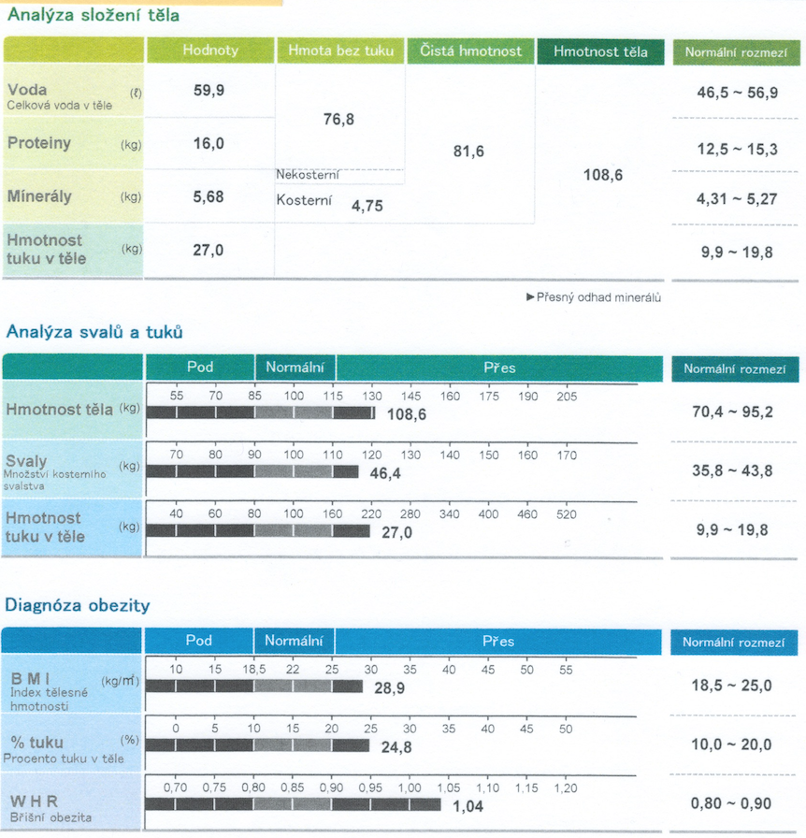
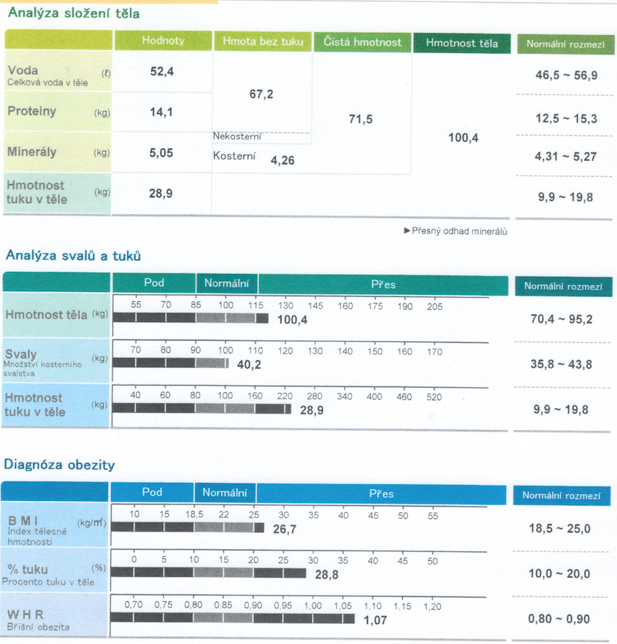
Úspěšné hubnutí ?!?

Slide 26
Hlad roste v závislosti na redukci váhy
Week 0
Week 10
Week 62
50 individuals with overweight/obesity lost weight
on a 10-week VLCD
Appetite was measured using VAS scores
at 0, 10 and 62 weeks
*
40
*
Hunger (mm)
20
95
All patients (ITT)
*
0
0
30
60
120
180
240
90
Weight (kg)
*
85
†
*
Completers
80
40
*
§
0
Desire to eat (mm)
0
8
10
18
26
36
44
52
62
20
Week
0
*p<0.001, §p=0.008, †p=0.09 vs mean at baseline (week 0)
0
30
60
120
180
240
Postprandial time (min)
Sumithran et al. N Engl J Med 2011;365:1597–604
Notes:
Sumithran et al. N Engl J Med. 2011;365:1597-604.
Abstract
BACKGROUND:
After weight loss, changes in the circulating levels of several peripheral hormones involved in the homeostatic regulation of body weight occur. Whether these changes are transient or persist over time may be important for an understanding of the reasons behind the high rate of weight regain after diet-induced weight loss.
METHODS:
We enrolled 50 overweight or obese patients without diabetes in a 10-week weight-loss program for which a very-low-energy diet was prescribed. At baseline (before weight loss), at 10 weeks (after program completion), and at 62 weeks, we examined circulating levels of leptin, ghrelin, peptide YY, gastric inhibitory polypeptide, glucagon-like peptide 1, amylin, pancreatic polypeptide, cholecystokinin, and insulin and subjective ratings of appetite.
RESULTS:
Weight loss (mean [±SE], 13.5±0.5 kg) led to significant reductions in levels of leptin, peptide YY, cholecystokinin, insulin (P<0.001 for all comparisons), and amylin (P=0.002) and to increases in levels of ghrelin (P<0.001), gastric inhibitory polypeptide (P=0.004), and pancreatic polypeptide (P=0.008). There was also a significant increase in subjective appetite (P<0.001). One year after the initial weight loss, there were still significant differences from baseline in the mean levels of leptin (P<0.001), peptide YY (P<0.001), cholecystokinin (P=0.04), insulin (P=0.01), ghrelin (P<0.001), gastric inhibitory polypeptide (P<0.001), and pancreatic polypeptide (P=0.002), as well as hunger (P<0.001).
CONCLUSIONS:
One year after initial weight reduction, levels of the circulating mediators of appetite that encourage weight regain after diet-induced weight loss do not revert to the levels recorded before weight loss. Long-term strategies to counteract this change may be needed to prevent obesity relapse. (Funded by the National Health and Medical Research Council and others; ClinicalTrials.gov number, NCT00870259.).

Slide 27
Efektivita existujících intervencí redukce váhy
Změna životního
stylu^{1,2}
3–5%
Nízkokalorické diety³
6–10%
IBT⁴
4–6%
Farmakoterapie
+ IBT^{5,6}
11–14%
Farmakoterapie⁷
3–10%
Bandáž žaludku⁸
7–23%
Žaludeční
sleeve⁹
12.9–28.2%
Gastrický
bypass⁸
24–38%
0
5
10
15
20
25
30
Weight loss (%)
1. Look AHEAD. Arch Intern Med 2010;170:1566–75; 2. Wing RR et al. Diabetes Care 2011;34:1481–6; 3. Tsai & Wadden. Obesity 2006;14:1283–1293; 4. Wadden et al. Obesity (Silver Spring) 2019;27:75-86; 5. Wadden et al. N Engl J Med 2005;353:2111–20; 6. Wadden et al. Obesity (Silver Spring) 2019; 27(1): 75-86 7. Wadden et al. Int J Obes (Lond) 2013;37:1443–51 8. Courcoulas et al. JAMA 2013;310:2416–25; 9. Berry et al. Obes Surg 2018;28:649–655
Notes:
Lifestyle modification or very-low calorie diets can lead to modest weight losses of up to 10% but with a great chance of weight regain
Evidence suggests that intensive behavioural therapy can deliver the weight loss of 4-6 %
Approved and available pharmacotherapeutic options can deliver weight loss in range of 3-10%
In contrast, bariatric surgery induces very large and sustained weight losses of 10–40%. However, only few patients are candidates for this invasive procedure.
Therefore, there has been a treatment gap for the majority of patients requiring a clinically relevant weight loss, and newly approved pharmacotherapies, together with lifestyle modification, may be a suitable treatment option for these individuals.

Slide 28
Co je GLP-1?
GLP-1 je peptid složený z 31 aminokyselin
Patří do inkretinové rodiny
Vylučován je hlavně z L-buněk ve střevě, ale také v mozku (nucleus tractus solitarius)
Human endogenous GLP-1
His
Ala
Glu
Gly
Thr
Phe
Thr
Ser
Asp
Val
Ser
Lys
Ala
Ala
Gln
Gly
Glu
Leu
Tyr
Ser
Glu
Phe
Ile
Ala
Trp
Leu
Val
Lys
Gly
Arg
Gly
Enzymatic degradation by DPP-4
t_{½}=1.5–2 min
DPP-4, dipeptidyl peptidase-4; GLP-1, glucagon-like peptide-1; t_{½}, half-life
Merchenthaler et al. J Comp Neurol 1999;403:261–80; Baggio, Drucker. Gastroenterology 2007;132:2131–57; Ducker, Nauck. Lancet 2006;368:1696–705
Notes:
Merchenthaler et al. J Comp Neurol. 1999;403:261-280.
Abstract
Glucagon-like peptide-1 (GLP-1) is derived from the peptide precursor pre-pro-glucagon (PPG) by enzymatic cleavage and acts via its receptor, glucagon-like peptide-1 receptor (GLP-1R). By using riboprobes complementary to PPG and GLP-1R, we described the distribution of PPG and GLP-1R messenger RNAs (mRNAs) in the central nervous system of the rat. PPG mRNA-expressing perikarya were restricted to the nucleus of the solitary tact or to the dorsal and ventral medulla and olfactory bulb. GLP-1R mRNA was detected in numerous brain regions, including the mitral cell layer of the olfactory bulb; temporal cortex; caudal hippocampus; lateral septum; amygdala; nucleus accumbens; ventral pallium; nucleus basalis Meynert; bed nucleus of the stria terminalis; preoptic area; paraventricular, supraoptic, arcuate, and dorsomedial nuclei of the hypothalamus; lateral habenula; zona incerta; substantia innominata; posterior thalamic nuclei; ventral tegmental area; dorsal tegmental, posterodorsal tegmental, and interpeduncular nuclei; substantia nigra, central gray; raphe nuclei; parabrachial nuclei; locus ceruleus, nucleus of the solitary tract; area postrema; dorsal nucleus of the vagus; lateral reticular nucleus; and spinal cord. These studies, in addition to describing the sites of GLP-1 and GLP-1R synthesis, suggest that the efferent connections from the nucleus of the solitary tract are more widespread than previously reported. Although the current role of GLP-1 in regulating neuronal physiology is not known, these studies provide detailed information about the sites of GLP-1 synthesis and potential sites of action, an important first step in evaluating the function of GLP-1 in the brain. The widespread distribution of GLP-1R mRNA-containing cells strongly suggests that GLP-1 not only functions as a satiety factor but also acts as a neurotransmitter or neuromodulator in anatomically and functionally distinct areas of the central nervous system.
Baggio & Drucker. Gastroenterology. 2007;132:2131-57.
Abstract
This review focuses on the mechanisms regulating the synthesis, secretion, biological actions, and therapeutic relevance of the incretin peptides glucose-dependent insulinotropic polypeptide (GIP) and glucagon-like peptide-1 (GLP-1). The published literature was reviewed, with emphasis on recent advances in our understanding of the biology of GIP and GLP-1. GIP and GLP-1 are both secreted within minutes of nutrient ingestion and facilitate the rapid disposal of ingested nutrients. Both peptides share common actions on islet beta-cells acting through structurally distinct yet related receptors. Incretin-receptor activation leads to glucose-dependent insulin secretion, induction of beta-cell proliferation, and enhanced resistance to apoptosis. GIP also promotes energy storage via direct actions on adipose tissue, and enhances bone formation via stimulation of osteoblast proliferation and inhibition of apoptosis. In contrast, GLP-1 exerts glucoregulatory actions via slowing of gastric emptying and glucose-dependent inhibition of glucagon secretion. GLP-1 also promotes satiety and sustained GLP-1-receptor activation is associated with weight loss in both preclinical and clinical studies. The rapid degradation of both GIP and GLP-1 by the enzyme dipeptidyl peptidase-4 has led to the development of degradation-resistant GLP-1-receptor agonists and dipeptidyl peptidase-4 inhibitors for the treatment of type 2 diabetes. These agents decrease hemoglobin A1c (HbA1c) safely without weight gain in subjects with type 2 diabetes. GLP-1 and GIP integrate nutrient-derived signals to control food intake, energy absorption, and assimilation. Recently approved therapeutic agents based on potentiation of incretin action provide new physiologically based approaches for the treatment of type 2 diabetes.
Drucker & Nauck. Lancet 2006;368:1696–705.
Abstract
Glucagon-like peptide 1 (GLP-1) is a gut-derived incretin hormone that stimulates insulin and suppresses glucagon secretion, inhibits gastric emptying, and reduces appetite and food intake. Therapeutic approaches for enhancing incretin action include degradation-resistant GLP-1 receptor agonists (incretin mimetics), and inhibitors of dipeptidyl peptidase-4 (DPP-4) activity (incretin enhancers). Clinical trials with the incretin mimetic exenatide (two injections per day or long-acting release form once weekly) and liraglutide (one injection per day) show reductions in fasting and postprandial glucose concentrations, and haemoglobin A1c (HbA1c) (1-2%), associated with weight loss (2-5 kg). The most common adverse event associated with GLP-1 receptor agonists is mild nausea, which lessens over time. Orally administered DPP-4 inhibitors, such as sitagliptin and vildagliptin, reduce HbA1c by 0.5-1.0%, with few adverse events and no weight gain. These new classes of antidiabetic agents, and incretin mimetics and enhancers, also expand beta-cell mass in preclinical studies. However, long-term clinical studies are needed to determine the benefits of targeting the incretin axis for the treatment of type 2 diabetes.

Slide 29
GLP-1 je vylučován při příjmu potravy
Meal
Meal
Meal
GLP-1
n=6
50
40
30
Plasma GLP-1 concentration (pmol/L)
20
10
0
9
13
19
22
24
Time (h)
Adapted from: Orskov et al. Scand J Gastroenterol 1996;31:665–70
Notes:
Orskov et al. Scand J Gastroenterol 1996;31:665–70.
Abstract
BACKGROUND:
The insulinotropic hormones gastric inhibitory polypeptide (GIP) and glucagon-like peptide-1 (GLP-1), secreted from the K-cells of the upper small intestine and from the L-cells of the lower small intestine, respectively, are thought to be responsible for intestinal stimulation of insulin secretion. If true, their plasma concentrations should parallel the meal-related diurnal changes in plasma insulin concentrations.
METHODS:
Using COOH-terminal assays, thought to reflect accurately their rates of secretion, we measured circulating levels of GIP and GLP-1 in six normal subjects for 15 h of a day, during which they ate three mixed meals.
RESULTS:
Both GIP and GLP-1 concentrations increased significantly and in parallel with insulin in response to all three meals. The plasma insulin concentrations correlated significantly with both GIP and GLP-1 values throughout the study period (correlation coefficients, 0.49 +/- 0.07 and 0.56 +/- 0.05; p < 0.001).
CONCLUSIONS:
These results support the notion that GLP-1 and GIP are important incretin hormones.

Slide 30
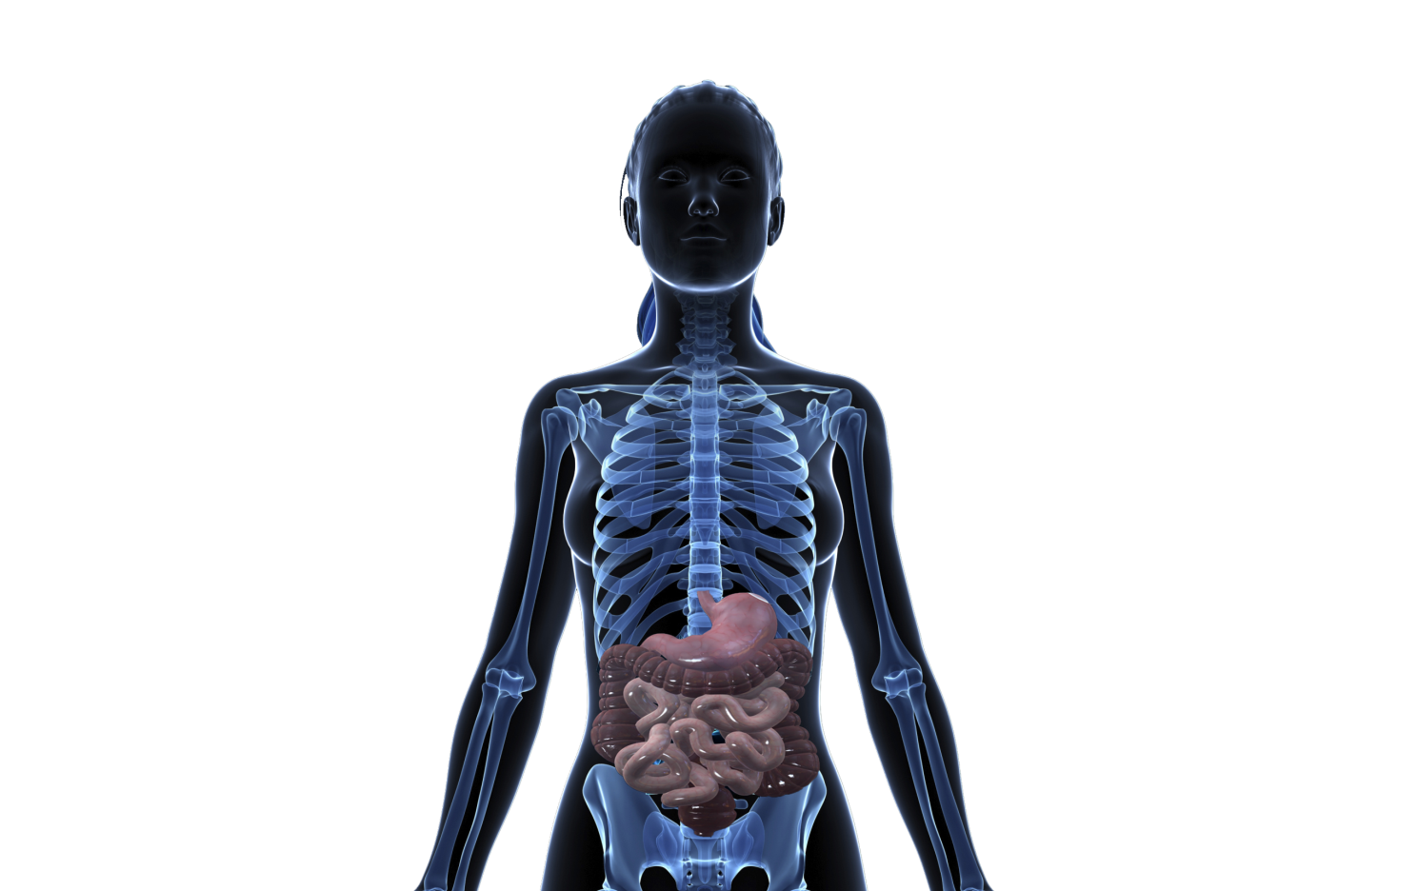

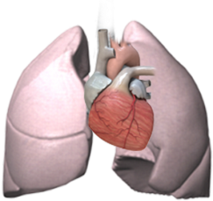
GLP-1 a jeho sekrece a exprese jeho receptorů
GLP-1 je vylučován:
GLP-1R is expressed in:
Neurony v zadním mozku
Mozek
L-buňky ve střevě
Plíce
Srdce (AV uzel)
Pancreas
Ledviny
GI trakt
AV, atrioventricular; GI, gastrointestinal; GLP-1R, glucagon-like peptide-1 receptor
Merchenthaler et al. J Comp Neurol 1999;403:261–80; Baggio, Drucker. Gastroenterology 2007;132:2131–57; Ban et al. Circulation 2008;117:2340–50;
Vrang et al. Prog Neurobiol 2010;92:442–62; Pyke et al. Endocrinology 2014;155:1280–90
Notes:
Merchenthaler et al. J Comp Neurol. 1999;403:261-280.
Abstract
Glucagon-like peptide-1 (GLP-1) is derived from the peptide precursor pre-pro-glucagon (PPG) by enzymatic cleavage and acts via its receptor, glucagon-like peptide-1 receptor (GLP-1R). By using riboprobes complementary to PPG and GLP-1R, we described the distribution of PPG and GLP-1R messenger RNAs (mRNAs) in the central nervous system of the rat. PPG mRNA-expressing perikarya were restricted to the nucleus of the solitary tact or to the dorsal and ventral medulla and olfactory bulb. GLP-1R mRNA was detected in numerous brain regions, including the mitral cell layer of the olfactory bulb; temporal cortex; caudal hippocampus; lateral septum; amygdala; nucleus accumbens; ventral pallium; nucleus basalis Meynert; bed nucleus of the stria terminalis; preoptic area; paraventricular, supraoptic, arcuate, and dorsomedial nuclei of the hypothalamus; lateral habenula; zona incerta; substantia innominata; posterior thalamic nuclei; ventral tegmental area; dorsal tegmental, posterodorsal tegmental, and interpeduncular nuclei; substantia nigra, central gray; raphe nuclei; parabrachial nuclei; locus ceruleus, nucleus of the solitary tract; area postrema; dorsal nucleus of the vagus; lateral reticular nucleus; and spinal cord. These studies, in addition to describing the sites of GLP-1 and GLP-1R synthesis, suggest that the efferent connections from the nucleus of the solitary tract are more widespread than previously reported. Although the current role of GLP-1 in regulating neuronal physiology is not known, these studies provide detailed information about the sites of GLP-1 synthesis and potential sites of action, an important first step in evaluating the function of GLP-1 in the brain. The widespread distribution of GLP-1R mRNA-containing cells strongly suggests that GLP-1 not only functions as a satiety factor but also acts as a neurotransmitter or neuromodulator in anatomically and functionally distinct areas of the central nervous system.
Baggio & Drucker. Gastroenterology. 2007;132:2131-57.
Abstract
This review focuses on the mechanisms regulating the synthesis, secretion, biological actions, and therapeutic relevance of the incretin peptides glucose-dependent insulinotropic polypeptide (GIP) and glucagon-like peptide-1 (GLP-1). The published literature was reviewed, with emphasis on recent advances in our understanding of the biology of GIP and GLP-1. GIP and GLP-1 are both secreted within minutes of nutrient ingestion and facilitate the rapid disposal of ingested nutrients. Both peptides share common actions on islet beta-cells acting through structurally distinct yet related receptors. Incretin-receptor activation leads to glucose-dependent insulin secretion, induction of beta-cell proliferation, and enhanced resistance to apoptosis. GIP also promotes energy storage via direct actions on adipose tissue, and enhances bone formation via stimulation of osteoblast proliferation and inhibition of apoptosis. In contrast, GLP-1 exerts glucoregulatory actions via slowing of gastric emptying and glucose-dependent inhibition of glucagon secretion. GLP-1 also promotes satiety and sustained GLP-1-receptor activation is associated with weight loss in both preclinical and clinical studies. The rapid degradation of both GIP and GLP-1 by the enzyme dipeptidyl peptidase-4 has led to the development of degradation-resistant GLP-1-receptor agonists and dipeptidyl peptidase-4 inhibitors for the treatment of type 2 diabetes. These agents decrease hemoglobin A1c (HbA1c) safely without weight gain in subjects with type 2 diabetes. GLP-1 and GIP integrate nutrient-derived signals to control food intake, energy absorption, and assimilation. Recently approved therapeutic agents based on potentiation of incretin action provide new physiologically based approaches for the treatment of type 2 diabetes.
Ban et al. Circulation. 2008; 117:2340-50.
Abstract
BACKGROUND:
The glucagon-like peptide 1 receptor (GLP-1R) is believed to mediate glucoregulatory and cardiovascular effects of the incretin hormone GLP-1(7-36) (GLP-1), which is rapidly degraded by dipeptidyl peptidase-4 (DPP-4) to GLP-1(9-36), a truncated metabolite generally thought to be inactive. Novel drugs for the treatment of diabetes include analogues of GLP-1 and inhibitors of DPP-4; however, the cardiovascular effects of distinct GLP-1 peptides have received limited attention.
METHODS AND RESULTS:
Here, we show that endothelium and cardiac and vascular myocytes express a functional GLP-1R as GLP-1 administration increased glucose uptake, cAMP and cGMP release, left ventricular developed pressure, and coronary flow in isolated mouse hearts. GLP-1 also increased functional recovery and cardiomyocyte viability after ischemia-reperfusion injury of isolated hearts and dilated preconstricted arteries from wild-type mice. Unexpectedly, many of these actions of GLP-1 were preserved in Glp1r(-/-) mice. Furthermore, GLP-1(9-36) administration during reperfusion reduced ischemic damage after ischemia-reperfusion and increased cGMP release, vasodilatation, and coronary flow in wild-type and Glp1r(-/-) mice, with modest effects on glucose uptake. Studies using a DPP-4-resistant GLP-1R agonist and inhibitors of DPP-4 and nitric oxide synthase showed that the effects of GLP-1(7-36) were partly mediated by GLP-1(9-36) through a nitric oxide synthase-requiring mechanism that is independent of the known GLP-1R.
CONCLUSIONS:
These data describe cardioprotective actions of GLP-1(7-36) mediated through the known GLP-1R and novel cardiac and vascular actions of GLP-1(7-36) and its metabolite GLP-1(9-36) independent of the known GLP-1R. Our data suggest that the extent to which GLP-1 is metabolized to GLP-1(9-36) may have functional implications in the cardiovascular system.
Vrang et al. Prog Neurobiol. 2010;92:442-462.
Abstract
The scientific understanding of preproglucagon derived peptides has provided people with type 2 diabetes with two novel classes of glucose lowering agents, the dipeptidyl peptidase IV (DPP-IV) inhibitors and GLP-1 receptor agonists. For the scientists, the novel GLP-1 agonists, and DPP-IV inhibitors have evolved as useful tools to understand the role of the preproglucagon derived peptides in normal physiology and disease. However, the overwhelming interest attracted by GLP-1 analogues as potent incretins has somewhat clouded the efforts to understand the importance of preproglucagon derived peptides in other physiological contexts. In particular, our neurobiological understanding of the preproglucagon expressing neuronal pathways in the central nervous system as well as the degree to which central GLP-1 receptors are targeted by peripherally administered GLP-1 receptor agonists is still fairly limited. The role of GLP-1 as an anorectic neurotransmitter is well recognized, but clarification of the neuronal targets and physiological basis of this response is further warranted, as is the mapping of GLP-1 sensitive neurons involved in a variety of neuroendocrine and behavioral responses. Further recent evidence points to GLP-1 as a central neuropeptide with neuroprotective capabilities potentially mitigating a wide array of neurodegenerative conditions. It is the aim of the present review to summarize our current understanding of preproglucagon derived peptides as neurotransmitters in the central nervous system.

Slide 31
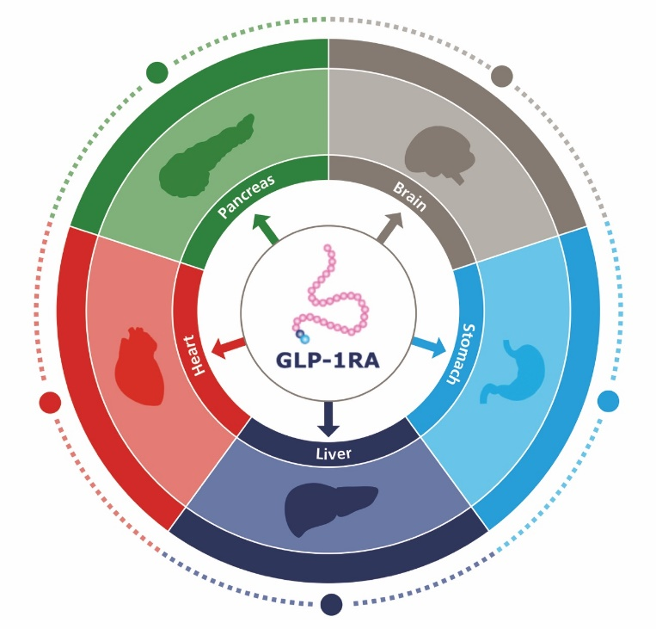
GLP-1 mají multifaktoriální efekt
Pancreas
Brain
⬆ Beta-cell function¹
⬇ Beta-cell apoptosis¹
⬆ Insulin biosynthesis¹
⬆ Glucose-dependent
insulin secretion¹
⬇ Glucose-dependent glucagon secretion¹
Body weight⁵
Food intake⁶
⬆ Satiety^{7,8}
Stomach
Gastric emptying⁹
Endogenous glucose
production¹⁰
⬆ Hepatic insulin sensitivity¹⁰
De novo lipogenesis¹⁰
Lipotoxicity¹⁰
⬇ Steatosis¹¹
⬇ Cardiovascular risk²
⬇ Fatty acid metabolism³
⬆ Cardiac function³
⬇ Systolic blood pressure³
⬇ Inflammation⁴
Heart
Liver
GLP-1RA, glucagon-like peptide-1 receptor agonist
Adapted from Campbell & Drucker. Cell Metab 2013;17:819–37; Pratley & Gilbert. Rev Diabet Stud 2008;5:73–94. Full reference list in slide notes.
Notes:
Campbell & Drucker. Cell Metab 2013;17:819–37
Abstract
Incretin peptides, principally GLP-1 and GIP, regulate islet hormone secretion, glucose concentrations, lipid metabolism, gut motility, appetite and body weight, and immune function, providing a scientific basis for utilizing incretin-based therapies in the treatment of type 2 diabetes. Activation of GLP-1 and GIP receptors also leads to nonglycemic effects in multiple tissues, through direct actions on tissues expressing incretin receptors and indirect mechanisms mediated through neuronal and endocrine pathways. Here we contrast the pharmacology and physiology of incretin hormones and review recent advances in mechanisms coupling incretin receptor signaling to pleiotropic metabolic actions in preclinical studies. We discuss whether mechanisms identified in preclinical studies have potential translational relevance for the treatment of human disease and highlight controversies and uncertainties in incretin biology that require resolution in future studies.
Pratley & Gilbert. Rev Diabet Stud 2008;5:73–94
Abstract
Until recently, the pathogenesis of type 2 diabetes mellitus (T2DM) has been conceptualized in terms of the predominant defects in insulin secretion and insulin action. It is now recognized that abnormalities in other hormones also contribute to the development of hyperglycemia. For example, the incretin effect, mediated by glucagon-like peptide-1 (GLP-1) and glucose-dependent insulinotropic peptide (GIP), is attenuated in T2DM. Intravenous administration of GLP-1 ameliorates hyperglycemia in patients with T2DM, but an extremely short half-life limits its utility as a therapeutic agent. Strategies to leverage the beneficial effects of GLP-1 include GLP-1 receptor agonists or analogs or dipeptidyl peptidase-4 (DPP-4) inhibitors-agents that act by slowing the inactivation of endogenous GLP-1 and GIP. The GLP-1 agonist exenatide has been shown to improve HbA1c and decrease body weight. However, exenatide is limited by its relatively short pharmacologic half-life, various gastrointestinal (GI) side effects, and the development of antibodies. Studies of a long-acting exenatide formulation suggest that it has improved efficacy and also promotes weight loss. Another prospect is liraglutide, a once-daily human GLP-1 analog. In phase 2 studies, liraglutide lowered HbA1c by up to 1.7% and weight by approximately 3 kg, with apparently fewer GI side effects than exenatide. DPP-4 inhibitors such as sitagliptin and vildagliptin result in clinically significant reductions in HbA1c, and are weight neutral with few GI side effects. This review will provide an overview of current and emerging agents that augment the incretin system with a focus on the role of GLP-1 receptor agonists and DPP-4 inhibitors.
1. Campbell JE, DJ Drucker. Cell Metab 2013;17:819–37; 2. Marso SP et al. N Engl J Med 2016;375:311–22; 3. Ryan D, Acosta A. Obesity 2015;23:1119–29; 4. Hogan AE et al. Diabetologia 2014;57:781–4; 5. Baggio LL, Drucker DJ. J Clin Invest 2014;124:4223–6; 6. Bagger JI et al. Clin Endocrinol Metab 2015;100:4541–52; 7. Flint A et al. J Clin Invest 1998;101:515–20; 8. Blundell J et al. Diabetes Obes Metab. 2017;19(9):1242–51; 9. Tong J, D'Alessio D. Diabetes 2014;63:407–9; 10. Armstrong MJ et al. J Hepatol 2016;64:399–408; 11. Armstrong MJ et al. Lancet 2016;387:679–90.
.

Slide 32
Liraglutide je jednodenní, lidský GLP-1 analog
Lidský endogenní GLP-1
His
Ala
Glu
Gly
Thr
Phe
Thr
Ser
Asp
Val
Ser
T_{½}= ~2 mins
Lys
Ala
Ala
Gln
Gly
Glu
Leu
Tyr
Ser
Glu
Phe
Liraglutide
Ile
Ala
Trp
Leu
Val
Lys
Gly
Arg
Gly
C-16 fatty acid
(palmitoyl)
97% aminokyselin stejných jako humánní GLP-1;
na molekulu je albumin vázaný acylací; jako heptamer
His
Ala
Glu
Gly
Thr
Phe
Thr
Ser
Asp
Val
Glu
Ser
Lys
Ala
Ala
Gln
Gly
Glu
Leu
Tyr
Ser
Je pomalu absorbován z podkoží
Resistenní k DPP-4
Long plasma half-life
(T_{½}=13 h)
Glu
Phe
Ile
Ala
Trp
Leu
Val
Arg
Gly
Arg
Gly
DPP-4, dipeptidyl peptidase-4; GLP-1, glucagon-like peptide-1; PK, pharmacokinetics; T_{½}, plasma half-life
Knudsen et al. J Med Chem 2000;43:1664–9; Degn et al. Diabetes 2004;53:1187–94
Notes:
Knudsen et al. J Med Chem 2000;43:1664–9.
Abstract
A series of very potent derivatives of the 30-amino acid peptide hormone glucagon-like peptide-1 (GLP-1) is described. The compounds were all derivatized with fatty acids in order to protract their action by facilitating binding to serum albumin. GLP-1 had a potency (EC(50)) of 55 pM for the cloned human GLP-1 receptor. Many of the compounds had similar or even higher potencies, despite quite large substituents. All compounds derivatized with fatty acids equal to or longer than 12 carbon atoms were very protracted compared to GLP-1 and thus seem suitable for once daily administration to type 2 diabetic patients. A structure-activity relationship was obtained. GLP-1 could be derivatized with linear fatty acids up to the length of 16 carbon atoms, sometimes longer, almost anywhere in the C-terminal part without considerable loss of potency. Derivatization with two fatty acid substituents led to a considerable loss of potency. A structure-activity relationship on derivatization of specific amino acids generally was obtained. It was found that the longer the fatty acid, the more potency was lost. Simultaneous modification of the N-terminus (in order to obtain better metabolic stability) interfered with fatty acid derivatization and led to loss of potency.
Degn et al. Diabetes 2004;53:1187–94.
Abstract
Glucagon-like peptide 1 (GLP-1) is potentially a very attractive agent for treating type 2 diabetes. We explored the effect of short-term (1 week) treatment with a GLP-1 derivative, liraglutide (NN2211), on 24-h dynamics in glycemia and circulating free fatty acids, islet cell hormone profiles, and gastric emptying during meals using acetaminophen. Furthermore, fasting endogenous glucose release and gluconeogenesis (3-(3)H-glucose infusion and (2)H(2)O ingestion, respectively) were determined, and aspects of pancreatic islet cell function were elucidated on the subsequent day using homeostasis model assessment and first- and second-phase insulin response during a hyperglycemic clamp (plasma glucose approximately 16 mmol/l), and, finally, on top of hyperglycemia, an arginine stimulation test was performed. For accomplishing this, 13 patients with type 2 diabetes were examined in a double-blind, placebo-controlled crossover design. Liraglutide (6 micro g/kg) was administered subcutaneously once daily. Liraglutide significantly reduced the 24-h area under the curve for glucose (P = 0.01) and glucagon (P = 0.04), whereas the area under the curve for circulating free fatty acids was unaltered. Twenty-four-hour insulin secretion rates as assessed by deconvolution of serum C-peptide concentrations were unchanged, indicating a relative increase. Gastric emptying was not influenced at the dose of liraglutide used. Fasting endogenous glucose release was decreased (P = 0.04) as a result of a reduced glycogenolysis (P = 0.01), whereas gluconeogenesis was unaltered. First-phase insulin response and the insulin response to an arginine stimulation test with the presence of hyperglycemia were markedly increased (P < 0.001), whereas the proinsulin/insulin ratio fell (P = 0.001). The disposition index (peak insulin concentration after intravenous bolus of glucose multiplied by insulin sensitivity as assessed by homeostasis model assessment) almost doubled during liraglutide treatment (P < 0.01). Both during hyperglycemia per se and after arginine exposure, the glucagon responses were reduced during liraglutide administration (P < 0.01 and P = 0.01). Thus, 1 week's treatment with a single daily dose of the GLP-1 derivative liraglutide, operating through several different mechanisms including an ameliorated pancreatic islet cell function in individuals with type 2 diabetes, improves glycemic control throughout 24 h of daily living, i.e., prandial and nocturnal periods. This study further emphasizes GLP-1 and its derivatives as a promising novel concept for treatment of type 2 diabetes.

Slide 33
Změny v tělesné váze
Screening 104 týdnů
Liraglutide 1.2–2.4 mg are not approved for weight management
Placebo
Liraglutide 1.2 mg
Liraglutide 2.4 mg
Orlistat
Liraglutide 1.8 mg
Liraglutide 3.0 mg
n=561
n=472
n=356
n=268
All on liraglutide/placebo switched to liraglutide 2.4 mg at week 52, then between 70–96 weeks (shaded) to 3.0 mg
ITT-LOCF from screening
–4.9 kg
–6.5 kg
Mean weight loss (kg)
–6.5 kg
–6.8 kg
–7.5 kg
–9.7 kg
Randomisation
Screening
-3
0
8
20
32
40
48
52
56
68
80
92
104
Week
Week
Week
Mean (±SE). Observed means with no imputation for individuals completing each scheduled visit.
ITT, intention to treat; LOCF, last observation carried forward; SE, standard error
Astrup et al. Int J Obes (Lond) 2012;36:843–54
Notes:
Astrup et al. Int J Obes (Lond). 2012;36:843-54
Abstract
Objective: Having demonstrated short-term weight loss with liraglutide in this group of obese adults, we now evaluate safety/tolerability primary outcome) and long-term efficacy for sustaining weight loss (secondary outcome) over 2 years.
Design: A randomised, double-blind, placebo-controlled 20-week study with 2-year extension (sponsor unblinded at 20 weeks, participants/investigators at 1 year) in 19 European clinical research centers.
Subjects: A total of 564 adults (n=90-98 per group; body mass index 30-40 kg m(-2)) enrolled, 398 entered the extension and 268 completed the 2-year trial. Participants received diet 500 kcal deficit per day) and exercise counseling during 2-week run-in, before being randomly assigned (with a telephone or web-based system) to once-daily subcutaneous liraglutide (1.2, 1.8, 2.4 or 3.0 mg, n=90-95), placebo (n=98) or open-label orlistat (120 mg × 3, n=95). After 1 year, liraglutide/placebo recipients switched to liraglutide 2.4 mg, then 3.0 mg (based on 20-week and 1-year results, respectively). The trial ran from January 2007-April 2009 and is registered with Clinicaltrials.gov, number NCT00480909.
Results: From randomisation to year 1, liraglutide 3.0 mg recipients lost 5.8 kg (95% confidence interval 3.7-8.0) more weight than those on placebo and 3.8 kg (1.6-6.0) more than those on orlistat (P≤ 0.0001; intention-to-treat, last-observation-carried-forward). At year 2, participants on liraglutide 2.4/3.0 mg for the full 2 years (pooled group, n=184) lost 3.0 kg (1.3-4.7) more weight than those on orlistat (n=95; P<0.001). Completers on liraglutide 2.4/3.0 mg (n=92) maintained a 2-year weight loss of 7.8 kg from screening. With liraglutide 3.0 mg, 20-week body fat decreased by 15.4% and lean tissue by 2.0%. The most frequent drug-related side effects were mild to moderate, transient nausea and vomiting. With liraglutide 2.4/3.0 mg, the 2-year prevalence of prediabetes and metabolic syndrome decreased by 52 and 59%, with improvements in blood pressure and lipids.
Conclusion: Liraglutide is well tolerated, sustains weight loss over 2 years and improves cardiovascular risk factors.

Slide 34
SCALE fáze 3a klinická zkoušení
Liraglutide 1.8 mg is not approved for weight management
SCALE Obezita a Prediabetes (1839)¹
SCALE Maintenance (1923)³
Liraglutide 3.0 mg n=2487
Liraglutide 3.0 mg
n=212
Weight management and delayed onset of diabetes
Prevention of
weight regain
Placebo n=1244
Placebo
n=210
SCALE Diabetes (1922)²
SCALE Sleep Apnoea (3970)⁴
Liraglutide 3.0 mg
n=423
Liraglutide 3.0 mg
n=180
Effect of liraglutide in subjects with obesity and moderate to severe OSA
Weight management in type 2 diabetes
Liraglutide 1.8 mg n=211
Placebo
n=179
Placebo
n=212
*SCALE, Sleep apnoea 3970 trial BMI ≥30 kg/m² plus co-morbidities;
BMI, body mass index; OSA, obstructive sleep apnoea; SCALE, Satiety and Clinical Adiposity – Liraglutide Evidence in individuals with and without diabetes
1. Pi-Sunyer et al. N Engl J Med 2015;373:11–22; 2. Davies et al. JAMA 2015;314:687–99; 3. Wadden et al. Int J Obes (Lond) 2013;37:1443–51;
4. Blackman et al. Int J Obes (Lond). 2016;40:1310-9
Notes:
Pi-Sunyer et al. N Engl J Med 2015;373:11–22
Abstract
BACKGROUND: Obesity is a chronic disease with serious health consequences, but weight loss is difficult to maintain through lifestyle intervention alone. Liraglutide, a glucagon-like peptide-1 analogue, has been shown to have potential benefit for weight management at a once-daily dose of 3.0 mg, injected subcutaneously.
METHODS: We conducted a 56-week, double-blind trial involving 3731 patients who did not have type 2 diabetes and who had a body-mass index (BMI; the weight in kilograms divided by the square of the height in meters) of at least 30 or a BMI of at least 27 if they had treated or untreated dyslipidemia or hypertension. We randomly assigned patients in a 2:1 ratio to receive once-daily subcutaneous injections of liraglutide at a dose of 3.0 mg (2487 patients) or placebo (1244 patients); both groups received counseling on lifestyle modification. The coprimary end points were the change in body weight and the proportions of patients losing at least 5% and more than 10% of their initial body weight.
RESULTS: At baseline, the mean (±SD) age of the patients was 45.1±12.0 years, the mean weight was 106.2±21.4 kg, and the mean BMI was 38.3±6.4; a total of 78.5% of the patients were women and 61.2% had prediabetes. At week 56, patients in the liraglutide group had lost a mean of 8.4±7.3 kg of body weight, and those in the placebo group had lost a mean of 2.8±6.5 kg (a difference of -5.6 kg; 95% confidence interval, -6.0 to -5.1; P<0.001, with last-observation-carried-forward imputation). A total of 63.2% of the patients in the liraglutide group as compared with 27.1% in the placebo group lost at least 5% of their body weight (P<0.001), and 33.1% and 10.6%, respectively, lost more than 10% of their body weight (P<0.001). The most frequently reported adverse events with liraglutide were mild or moderate nausea and diarrhea. Serious events occurred in 6.2% of the patients in the liraglutide group and in 5.0% of the patients in the placebo group.
CONCLUSIONS: In this study, 3.0 mg of liraglutide, as an adjunct to diet and exercise, was associated with reduced body weight and improved metabolic control. (Funded by Novo Nordisk; SCALE Obesity and Prediabetes NN8022-1839 ClinicalTrials.gov number, NCT01272219.).
Davies et al. JAMA 2015;314:687–99
IMPORTANCE:
Weight loss of 5% to 10% can improve type 2 diabetes and related comorbidities. Few safe, effective weight-management drugs are currently available.
OBJECTIVE: To investigate efficacy and safety of liraglutide vs placebo for weight management in adults with overweight or obesity and type 2 diabetes.
DESIGN, SETTING, AND PARTICIPANTS: Fifty-six-week randomized (2:1:1), double-blind, placebo-controlled, parallel-group trial with 12-week observational off-drug follow-up period. The study was conducted at 126 sites in 9 countries between June 2011 and January 2013. Of 1361 participants assessed for eligibility, 846 were randomized. Inclusion criteria were body mass index of 27.0 or greater, age 18 years or older, taking 0 to 3 oral hypoglycemic agents (metformin, thiazolidinedione, sulfonylurea) with stable body weight, and glycated hemoglobin level 7.0% to 10.0%.
INTERVENTIONS: Once-daily, subcutaneous liraglutide (3.0 mg) (n = 423), liraglutide (1.8 mg) (n = 211), or placebo (n = 212), all as adjunct to 500 kcal/d dietary deficit and increased physical activity (≥150 min/wk).
MAIN OUTCOMES AND MEASURES: Three coprimary end points: relative change in weight, proportion of participants losing 5% or more, or more than 10%, of baseline weight at week 56.
RESULTS: Baseline weight was 105.7 kg with liraglutide (3.0-mg dose), 105.8 kg with liraglutide (1.8-mg dose), and 106.5 kg with placebo. Weight loss was 6.0% (6.4 kg) with liraglutide (3.0-mg dose), 4.7% (5.0 kg) with liraglutide (1.8-mg dose), and 2.0% (2.2 kg) with placebo (estimated difference for liraglutide [3.0 mg] vs placebo, -4.00% [95% CI, -5.10% to -2.90%]; liraglutide [1.8 mg] vs placebo, -2.71% [95% CI, -4.00% to -1.42%]; P < .001 for both). Weight loss of 5% or greater occurred in 54.3% with liraglutide (3.0 mg) and 40.4% with liraglutide (1.8 mg) vs 21.4% with placebo (estimated difference for liraglutide [3.0 mg] vs placebo, 32.9% [95% CI, 24.6% to 41.2%]; for liraglutide [1.8 mg] vs placebo, 19.0% [95% CI, 9.1% to 28.8%]; P < .001 for both). Weight loss greater than 10% occurred in 25.2% with liraglutide (3.0 mg) and 15.9% with liraglutide (1.8 mg) vs 6.7% with placebo (estimated difference for liraglutide [3.0 mg] vs placebo, 18.5% [95% CI, 12.7% to 24.4%], P < .001; for liraglutide [1.8 mg] vs placebo, 9.3% [95% CI, 2.7% to 15.8%], P = .006). More gastrointestinal disorders were reported with liraglutide (3.0 mg) vs liraglutide (1.8 mg) and placebo. No pancreatitis was reported.
CONCLUSIONS AND RELEVANCE: Among overweight and obese participants with type 2 diabetes, use of subcutaneous liraglutide (3.0 mg) daily, compared with placebo, resulted in weight loss over 56 weeks. Further studies are needed to evaluate longer-term efficacy and safety.
TRIAL REGISTRATION: clinicaltrials.gov Identifier:NCT01272232.
Blackman et al. Int J Obes (Lond). 2016;40:1310-9
Abstract
BACKGROUND: Obesity is strongly associated with prevalence of obstructive sleep apnea (OSA), and weight loss has been shown to reduce disease severity.
OBJECTIVE: To investigate whether liraglutide 3.0 mg reduces OSA severity compared with placebo using the primary end point of change in apnea-hypopnea index (AHI) after 32 weeks. Liraglutide's weight loss efficacy was also examined.
SUBJECTS/METHODS: In this randomized, double-blind trial, non-diabetic participants with obesity who had moderate (AHI 15-29.9 events h⁻¹) or severe (AHI ⩾30 events h⁻¹) OSA and were unwilling/unable to use continuous positive airway pressure therapy were randomized for 32 weeks to liraglutide 3.0 mg (n=180) or placebo (n=179), both as adjunct to diet (500 kcal day⁻¹ deficit) and exercise. Baseline characteristics were similar between groups (mean age 48.5 years, males 71.9%, AHI 49.2 events h⁻¹, severe OSA 67.1%, body weight 117.6 kg, body mass index 39.1 kg m⁻², prediabetes 63.2%, HbA_{1c} 5.7%).
RESULTS: After 32 weeks, the mean reduction in AHI was greater with liraglutide than with placebo (-12.2 vs -6.1 events h⁻¹, estimated treatment difference: -6.1 events h⁻¹ (95% confidence interval (CI), -11.0 to -1.2), P=0.0150). Liraglutide produced greater mean percentage weight loss compared with placebo (-5.7% vs -1.6%, estimated treatment difference: -4.2% (95% CI, -5.2 to -3.1%), P<0.0001). A statistically significant association between the degree of weight loss and improvement in OSA end points (P<0.01, all) was demonstrated post hoc. Greater reductions in glycated hemoglobin (HbA_{1c}) and systolic blood pressure (SBP) were seen with liraglutide versus placebo (both P<0.001). The safety profile of liraglutide 3.0 mg was similar to that seen with doses ⩽1.8 mg.
CONCLUSIONS: As an adjunct to diet and exercise, liraglutide 3.0 mg was generally well tolerated and produced significantly greater reductions than placebo in AHI, body weight, SBP and HbA_{1c} in participants with obesity and moderate/severe OSA. The results confirm that weight loss improves OSA-related parameters.
Wadden et al. Int J Obes (Lond) 2013;37:1443–51
Abstract
Objective: Liraglutide, a once-daily human glucagon-like peptide-1 analog, induced clinically meaningful weight loss in a phase 2 study in obese individuals without diabetes. The present randomised phase 3 trial assessed the efficacy of liraglutide in maintaining weight loss achieved with a low-calorie diet (LCD).
Methods: Obese/overweight participants (18 years, body mass index 30 kg m⁻² or 27 kg m⁻² with comorbidities) who lost 5% of initial weight during a LCD run-in were randomly assigned to liraglutide 3.0 mg per day or placebo (subcutaneous administration) for 56 weeks. Diet and exercise counseling were provided throughout the trial. Co-primary end points were percentage weight change from randomisation, the proportion of participants that maintained the initial 5% weight loss, and the proportion that lost 5% of randomisation weight (intention-to-treat analysis). ClinicalTrials.gov identifier: NCT00781937.
Results: Participants (n=422) lost a mean 6.0% (s.d. 0.9) of screening weight during run-in. From randomisation to week 56, weight decreased an additional mean 6.2% (s.d. 7.3) with liraglutide and 0.2% (s.d. 7.0) with placebo (estimated difference −6.1% (95%class intervals −7.5 to −4.6), P<0.0001). More participants receiving liraglutide (81.4%) maintained the 5% run-in weight loss, compared with those receiving placebo (48.9%) (estimated odds ratio 4.8 (3.0; 7.7), P<0.0001), and 50.5% versus 21.8% of participants lost 5% of randomisation weight (estimated odds ratio 3.9 (2.4; 6.1), P<0.0001). Liraglutide produced small but statistically significant improvements in several cardiometabolic risk factors compared with placebo. Gastrointestinal (GI) disorders were reported more frequently with liraglutide than placebo, but most events were transient, and mild or moderate in severity.
Conclusion: Liraglutide, with diet and exercise, maintained weight loss achieved by caloric restriction and induced further weight loss over 56 weeks. Improvements in some cardiovascular disease-risk factors were also observed. Liraglutide, prescribed as 3.0 mg per day, holds promise for improving

Slide 35

SCALE souhrn - efektivita
Efektivita liraglutide 3.0 mg
SCALE Obesity and Prediabetes^{1,2}
SCALE
Diabetes³
SCALE Maintenance⁴
SCALE Sleep Apnoea⁵
-8.0%
-6.0%
81%
-12.2
Redukce váhy
po 1 roce
Redukce váhy
po 56 týdnech
Udržení ≥5% redukce váhy
po 1 roce
apnoe p/h
vs. 6.1 s placebem
80%
-1.3%
6.2%
-5.7%
Reduce rizika
DM 2.typu po 3 letech
pokles HbA_{1c}
proti baselině
Další pokles váhy
s liraglutidem 3.0 mg*
Váhové redukce
po 32 weeks
*Following lifestyle intervention induced weight loss of ≥5% over a 12 week run in period
1. Pi-Sunyer et al. N Engl J Med 2015;373:11–22; 2. le Roux et al. Lancet 2017;389:1399–409; 3. Davies et al. JAMA 2015;314:687–99;
4. Wadden et al. Int J Obes (Lond) 2013;37:1443–51; 5. Blackman et al. Int J Obes (Lond) 2016;40:1310–19
Notes:
1. Pi-Sunyer et al. N Engl J Med 2015;373:11–22
BACKGROUND: Obesity is a chronic disease with serious health consequences, but weight loss is difficult to maintain through lifestyle intervention alone. Liraglutide, a glucagon-like peptide-1 analogue, has been shown to have potential benefit for weight management at a once-daily dose of 3.0 mg, injected subcutaneously.
METHODS: We conducted a 56-week, double-blind trial involving 3731 patients who did not have type 2 diabetes and who had a body-mass index (BMI; the weight in kilograms divided by the square of the height in meters) of at least 30 or a BMI of at least 27 if they had treated or untreated dyslipidemia or hypertension. We randomly assigned patients in a 2:1 ratio to receive once-daily subcutaneous injections of liraglutide at a dose of 3.0 mg (2487 patients) or placebo (1244 patients); both groups received counseling on lifestyle modification. The coprimary end points were the change in body weight and the proportions of patients losing at least 5% and more than 10% of their initial body weight.
RESULTS: At baseline, the mean (±SD) age of the patients was 45.1±12.0 years, the mean weight was 106.2±21.4 kg, and the mean BMI was 38.3±6.4; a total of 78.5% of the patients were women and 61.2% had prediabetes. At week 56, patients in the liraglutide group had lost a mean of 8.4±7.3 kg of body weight, and those in the placebo group had lost a mean of 2.8±6.5 kg (a difference of -5.6 kg; 95% confidence interval, -6.0 to -5.1; P<0.001, with last-observation-carried-forward imputation). A total of 63.2% of the patients in the liraglutide group as compared with 27.1% in the placebo group lost at least 5% of their body weight (P<0.001), and 33.1% and 10.6%, respectively, lost more than 10% of their body weight (P<0.001). The most frequently reported adverse events with liraglutide were mild or moderate nausea and diarrhea. Serious events occurred in 6.2% of the patients in the liraglutide group and in 5.0% of the patients in the placebo group.
CONCLUSIONS: In this study, 3.0 mg of liraglutide, as an adjunct to diet and exercise, was associated with reduced body weight and improved metabolic control. (Funded by Novo Nordisk; SCALE Obesity and Prediabetes NN8022-1839 ClinicalTrials.gov number, NCT01272219.).
2. le Roux CW et al. Lancet. 2017;389:1399–1409
BACKGROUND:
Liraglutide 3·0 mg was shown to reduce bodyweight and improve glucose metabolism after the 56-week period of this trial, one of four trials in the SCALE programme. In the 3-year assessment of the SCALE Obesity and Prediabetes trial we aimed to evaluate the proportion of individuals with prediabetes who were diagnosed with type 2 diabetes.
METHODS:
In this randomised, double-blind, placebo-controlled trial, adults with prediabetes and a body-mass index of at least 30 kg/m2, or at least 27 kg/m2 with comorbidities, were randomised 2:1, using a telephone or web-based system, to once-daily subcutaneous liraglutide 3·0 mg or matched placebo, as an adjunct to a reduced-calorie diet and increased physical activity. Time to diabetes onset by 160 weeks was the primary outcome, evaluated in all randomised treated individuals with at least one post-baseline assessment. The trial was conducted at 191 clinical research sites in 27 countries and is registered with ClinicalTrials.gov, number NCT01272219.
FINDINGS:
The study ran between June 1, 2011, and March 2, 2015. We randomly assigned 2254 patients to receive liraglutide (n=1505) or placebo (n=749). 1128 (50%) participants completed the study up to week 160, after withdrawal of 714 (47%) participants in the liraglutide group and 412 (55%) participants in the placebo group. By week 160, 26 (2%) of 1472 individuals in the liraglutide group versus 46 (6%) of 738 in the placebo group were diagnosed with diabetes while on treatment. The mean time from randomisation to diagnosis was 99 (SD 47) weeks for the 26 individuals in the liraglutide group versus 87 (47) weeks for the 46 individuals in the placebo group. Taking the different diagnosis frequencies between the treatment groups into account, the time to onset of diabetes over 160 weeks among all randomised individuals was 2·7 times longer with liraglutide than with placebo (95% CI 1·9 to 3·9, p<0·0001), corresponding with a hazard ratio of 0·21 (95% CI 0·13-0·34). Liraglutide induced greater weight loss than placebo at week 160 (-6·1 [SD 7·3] vs -1·9% [6·3]; estimated treatment difference -4·3%, 95% CI -4·9 to -3·7, p<0·0001). Serious adverse events were reported by 227 (15%) of 1501 randomised treated individuals in the liraglutide group versus 96 (13%) of 747 individuals in the placebo group.
INTERPRETATION:
In this trial, we provide results for 3 years of treatment, with the limitation that withdrawn individuals were not followed up after discontinuation. Liraglutide 3·0 mg might provide health benefits in terms of reduced risk of diabetes in individuals with obesity and prediabetes.
3. Davies et al. JAMA 2015;314:687–99
IMPORTANCE: Weight loss of 5% to 10% can improve type 2 diabetes and related comorbidities. Few safe, effective weight-management drugs are currently available.
OBJECTIVE: To investigate efficacy and safety of liraglutide vs placebo for weight management in adults with overweight or obesity and type 2 diabetes.
DESIGN, SETTING, AND PARTICIPANTS: Fifty-six-week randomized (2:1:1), double-blind, placebo-controlled, parallel-group trial with 12-week observational off-drug follow-up period. The study was conducted at 126 sites in 9 countries between June 2011 and January 2013. Of 1361 participants assessed for eligibility, 846 were randomized. Inclusion criteria were body mass index of 27.0 or greater, age 18 years or older, taking 0 to 3 oral hypoglycemic agents (metformin, thiazolidinedione, sulfonylurea) with stable body weight, and glycated hemoglobin level 7.0% to 10.0%.
INTERVENTIONS: Once-daily, subcutaneous liraglutide (3.0 mg) (n = 423), liraglutide (1.8 mg) (n = 211), or placebo (n = 212), all as adjunct to 500 kcal/d dietary deficit and increased physical activity (≥150 min/wk).
MAIN OUTCOMES AND MEASURES: Three coprimary end points: relative change in weight, proportion of participants losing 5% or more, or more than 10%, of baseline weight at week 56.
RESULTS: Baseline weight was 105.7 kg with liraglutide (3.0-mg dose), 105.8 kg with liraglutide (1.8-mg dose), and 106.5 kg with placebo. Weight loss was 6.0% (6.4 kg) with liraglutide (3.0-mg dose), 4.7% (5.0 kg) with liraglutide (1.8-mg dose), and 2.0% (2.2 kg) with placebo (estimated difference for liraglutide [3.0 mg] vs placebo, -4.00% [95% CI, -5.10% to -2.90%]; liraglutide [1.8 mg] vs placebo, -2.71% [95% CI, -4.00% to -1.42%]; P < .001 for both). Weight loss of 5% or greater occurred in 54.3% with liraglutide (3.0 mg) and 40.4% with liraglutide (1.8 mg) vs 21.4% with placebo (estimated difference for liraglutide [3.0 mg] vs placebo, 32.9% [95% CI, 24.6% to 41.2%]; for liraglutide [1.8 mg] vs placebo, 19.0% [95% CI, 9.1% to 28.8%]; P < .001 for both). Weight loss greater than 10% occurred in 25.2% with liraglutide (3.0 mg) and 15.9% with liraglutide (1.8 mg) vs 6.7% with placebo (estimated difference for liraglutide [3.0 mg] vs placebo, 18.5% [95% CI, 12.7% to 24.4%], P < .001; for liraglutide [1.8 mg] vs placebo, 9.3% [95% CI, 2.7% to 15.8%], P = .006). More gastrointestinal disorders were reported with liraglutide (3.0 mg) vs liraglutide (1.8 mg) and placebo. No pancreatitis was reported.
CONCLUSIONS AND RELEVANCE: Among overweight and obese participants with type 2 diabetes, use of subcutaneous liraglutide (3.0 mg) daily, compared with placebo, resulted in weight loss over 56 weeks. Further studies are needed to evaluate longer-term efficacy and safety.
TRIAL REGISTRATION: clinicaltrials.gov Identifier:NCT01272232.
4. Blackman et al. Int J Obes (Lond) 2016;40:1310-9
BACKGROUND: Obesity is strongly associated with prevalence of obstructive sleep apnea (OSA), and weight loss has been shown to reduce disease severity.
OBJECTIVE: To investigate whether liraglutide 3.0 mg reduces OSA severity compared with placebo using the primary end point of change in apnea-hypopnea index (AHI) after 32 weeks. Liraglutide's weight loss efficacy was also examined.
SUBJECTS/METHODS: In this randomized, double-blind trial, non-diabetic participants with obesity who had moderate (AHI 15-29.9 events h(-1)) or severe (AHI ⩾30 events h(-1)) OSA and were unwilling/unable to use continuous positive airway pressure therapy were randomized for 32 weeks to liraglutide 3.0 mg (n=180) or placebo (n=179), both as adjunct to diet (500 kcal day(-1) deficit) and exercise. Baseline characteristics were similar between groups (mean age 48.5 years, males 71.9%, AHI 49.2 events h(-1), severe OSA 67.1%, body weight 117.6 kg, body mass index 39.1 kg m(-2), prediabetes 63.2%, HbA1c 5.7%).
RESULTS: After 32 weeks, the mean reduction in AHI was greater with liraglutide than with placebo (-12.2 vs -6.1 events h(-1), estimated treatment difference: -6.1 events h(-1) (95% confidence interval (CI), -11.0 to -1.2), P=0.0150). Liraglutide produced greater mean percentage weight loss compared with placebo (-5.7% vs -1.6%, estimated treatment difference: -4.2% (95% CI, -5.2 to -3.1%), P<0.0001). A statistically significant association between the degree of weight loss and improvement in OSA end points (P<0.01, all) was demonstrated post hoc. Greater reductions in glycated hemoglobin (HbA1c) and systolic blood pressure (SBP) were seen with liraglutide versus placebo (both P<0.001). The safety profile of liraglutide 3.0 mg was similar to that seen with doses ⩽1.8 mg.
CONCLUSIONS: As an adjunct to diet and exercise, liraglutide 3.0 mg was generally well tolerated and produced significantly greater reductions than placebo in AHI, body weight, SBP and HbA1c in participants with obesity and moderate/severe OSA. The results confirm that weight loss improves OSA-related parameters.
5. Wadden et al. Int J Obes (Lond) 2013;37:1443–51
OBJECTIVE: Liraglutide, a once-daily human glucagon-like peptide-1 analog, induced clinically meaningful weight loss in a phase 2 study in obese individuals without diabetes. The present randomized phase 3 trial assessed the efficacy of liraglutide in maintaining weight loss achieved with a low-calorie diet (LCD).
METHODS: Obese/overweight participants (≥18 years, body mass index ≥30 kg m(-2) or ≥27 kg m(-2) with comorbidities) who lost ≥5% of initial weight during a LCD run-in were randomly assigned to liraglutide 3.0 mg per day or placebo (subcutaneous administration) for 56 weeks. Diet and exercise counseling were provided throughout the trial. Co-primary end points were percentage weight change from randomization, the proportion of participants that maintained the initial ≥5% weight loss, and the proportion that lost ≥5% of randomization weight (intention-to-treat analysis). ClinicalTrials.gov identifier: NCT00781937.
RESULTS: Participants (n=422) lost a mean 6.0% (s.d. 0.9) of screening weight during run-in. From randomization to week 56, weight decreased an additional mean 6.2% (s.d. 7.3) with liraglutide and 0.2% (s.d. 7.0) with placebo (estimated difference -6.1% (95% class intervals -7.5 to -4.6), P<0.0001). More participants receiving liraglutide (81.4%) maintained the ≥5% run-in weight loss, compared with those receiving placebo (48.9%) (estimated odds ratio 4.8 (3.0; 7.7), P<0.0001), and 50.5% versus 21.8% of participants lost ≥5% of randomization weight (estimated odds ratio 3.9 (2.4; 6.1), P<0.0001). Liraglutide produced small but statistically significant improvements in several cardiometabolic risk factors compared with placebo. Gastrointestinal (GI) disorders were reported more frequently with liraglutide than placebo, but most events were transient, and mild or moderate in severity.
CONCLUSION: Liraglutide, with diet and exercise, maintained weight loss achieved by caloric restriction and induced further weight loss over 56 weeks. Improvements in some cardiovascular disease-risk factors were also observed. Liraglutide, prescribed as 3.0 mg per day, holds promise for improving the maintenance of lost weight.

Slide 36

Závěry
Obezita patří k rizikovým faktorům kardiovaskulárních onemocnění
Terapie je nutná stejně jako u hypertenze nebo dyslipidémie
Efektivitu režimových opatření výrazně zvyšuje farmakoterapie liraglutidem
Stanovení procenta tělesného tuku nebo vahy tukové hmoty by mělo patřit k standartní vyšetřením pacientů s kardiovaskulárním onemocněním

Slide 37

Děkuji za pozornost.
Kontakt:
robert.prosecky@gmail.com
Nemocnice Milosrdných bratří
Interní oddělení
Polní 3
Brno
+
Fakultní nemocnice u sv. Anny v Brně
I.interní kardioangiologická klinika Mezinárodní centrum klinického výzkumu
Kardiovize Brno 2030
Pekařská 53
Brno

