Slide 1
Electricity
Electric charge and Coulomb law
Vladan Bernard
Department of Biophysics

Slide 2
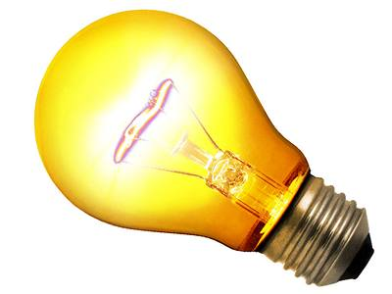
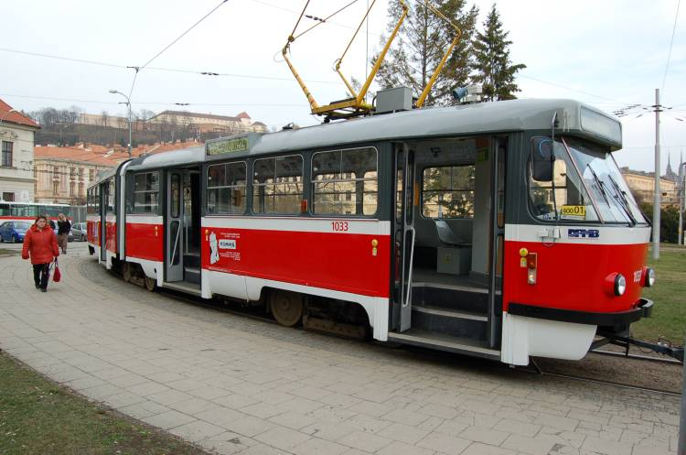
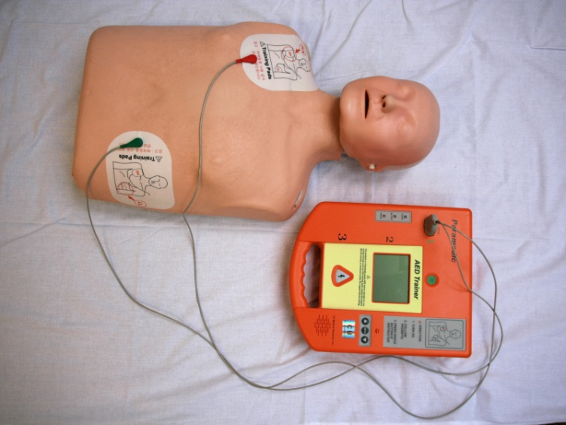
Theory of electricity
The theory of electricity is the part of physics dealing with properties of electric charge, the interactions between electric charges, and the conduction of electric charge in various materials.

Slide 3
Electricity
Electricity is the presence and motion of charged particles.
• Electric current is the flow of charged particles around an closed path – an electric circuit.
Electric Charge
The electric charge Q can be imagined as “amount of electricity” in units called coulombs (C). All electric charges are multiples of the electric charge of an electron.
Q_{e} = e = 1.602×10⁻¹⁹ C
There are two types of charge, which are labeled positive and negative.
Like charges repel Unlike charges attract
+
+
+
-
To charge an object means to transfer electrons from one object to another. They are not created or destroyed, just moved!

Slide 4
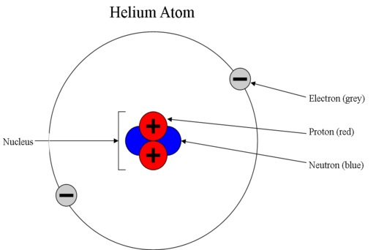
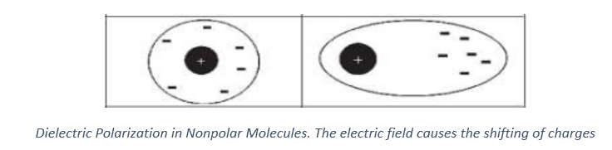
Electric charge
Most electric charge is carried by the electrons and protons within an atom. Electrons carry negative charge, while protons carry positive charge.
Protons and electrons create electric fields, which exert a force called the Coulomb force, which radiates outward in all directions.
Because protons are generally confined to the nuclei imbedded inside atoms, they are not nearly as free to move as are electrons. Therefore, when we talk about electric charge, we nearly always mean a surplus or deficit of electrons.
We are usually unaware of electric charge because most objects contain equal amounts of positive and negative charge that effectively neutralize each other.
-
+

Slide 5
Electric charge
It is a scalar physical quantity
E.ch. characterized by the electrical properties of bodies
The presence of e.ch. is important for the formation of an electric or magnetic field
It is bound to elementary particles
Electric charge can be „create“ by add or remove an proton or (namely) electron
The „Law of conservation of charge“ must be valid!
The process of „be positive/negative charged“ …

Slide 6
Law of conservation of charge
The algebraic sum of all the electric charges in any closed system is constant.
The only way to change the net charge of a system is to bring in charge from elsewhere, or remove charge from the system.
Charge can be created and destroyed, but only in positive-negative pairs.

Slide 7
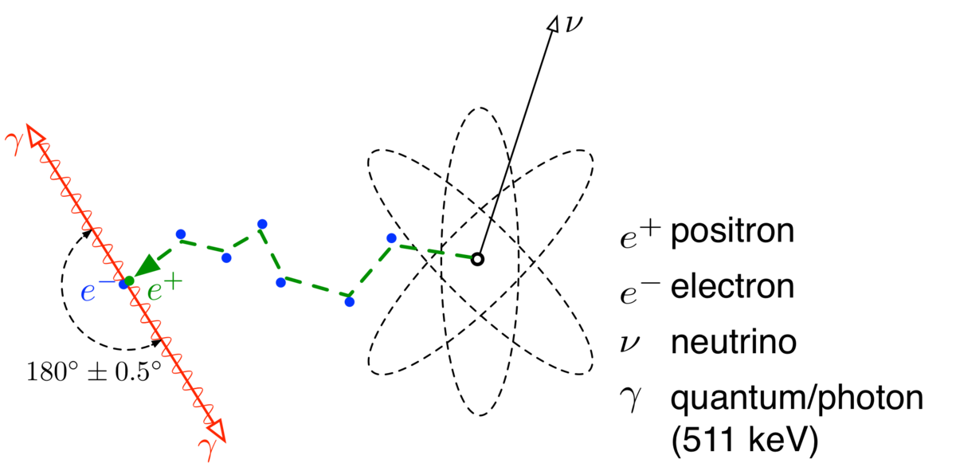
Electron-positron annihilation

Slide 8
Charges can only be in multiples of e-
Q_{e} = e = 1.602×10⁻¹⁹ Coulombs
charge of an electron - Coulombs

Slide 9
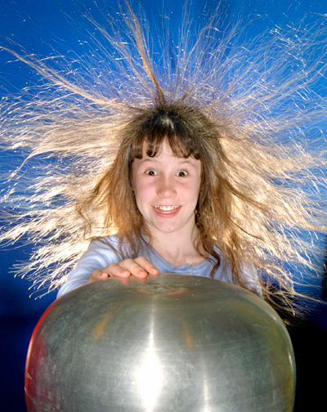
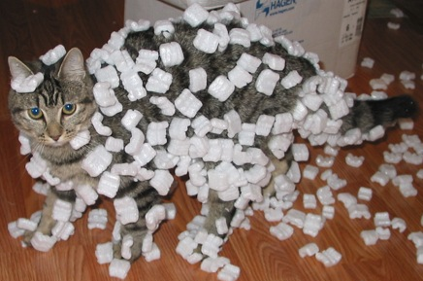
Electric charge is when …
Hair sticking out
Electrostatic forces

Slide 10
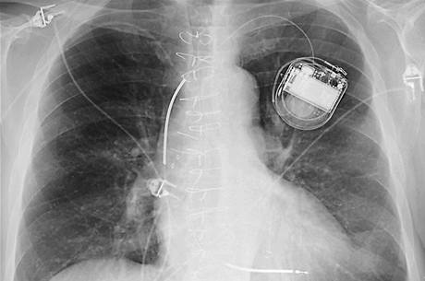

Electric charge is when …
defibrillator
cardiostimulator

Slide 11
How to make a electric charge?
The electric charge can be obtained by:
Direct contact
Electrostatic induction
Electromagnetic induction
Friction
Pyroelectric effect (heat)
Piezoelectric effect (force)
Fotoelectric effect (photon)
Ionization

Slide 12
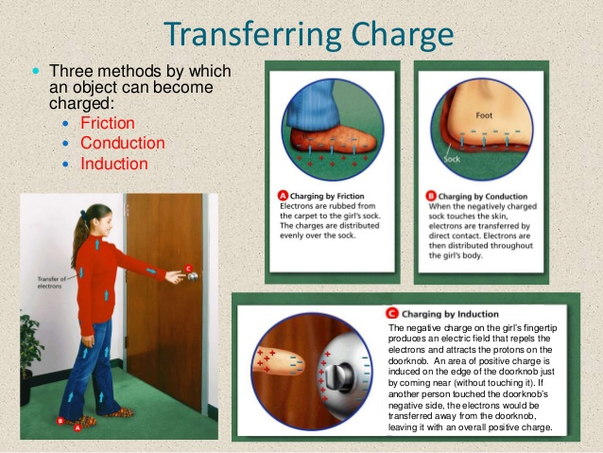
Haw to transfer charge?

Slide 13


Slide 14
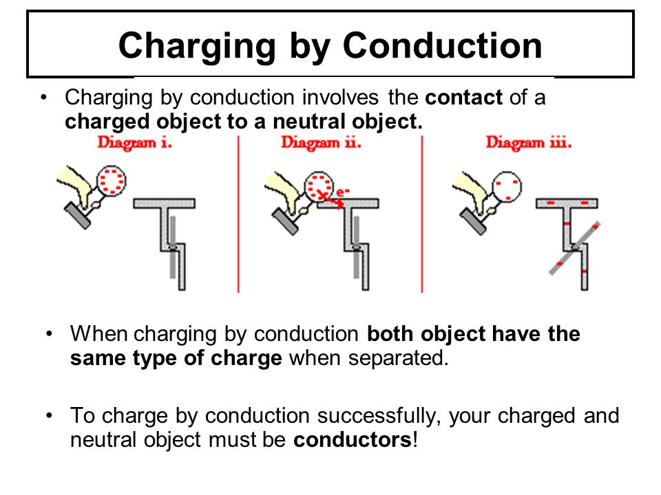

Slide 15
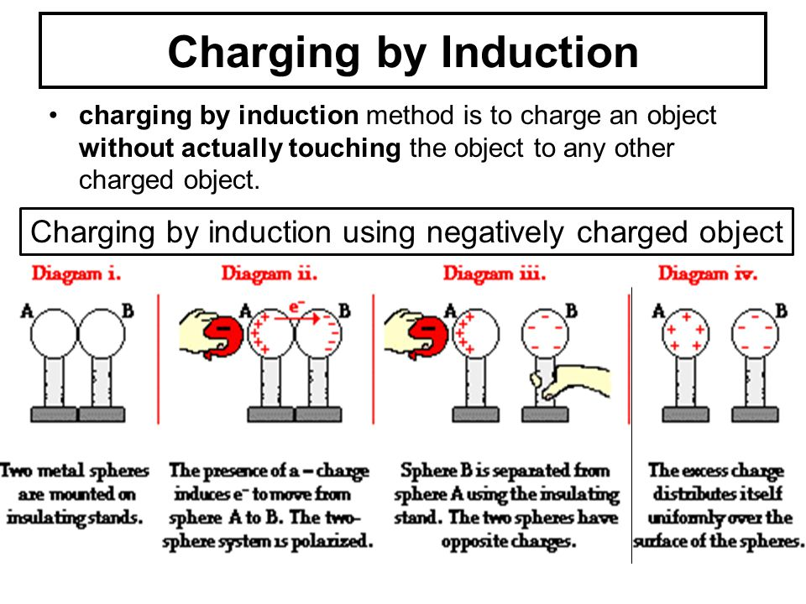

Slide 17
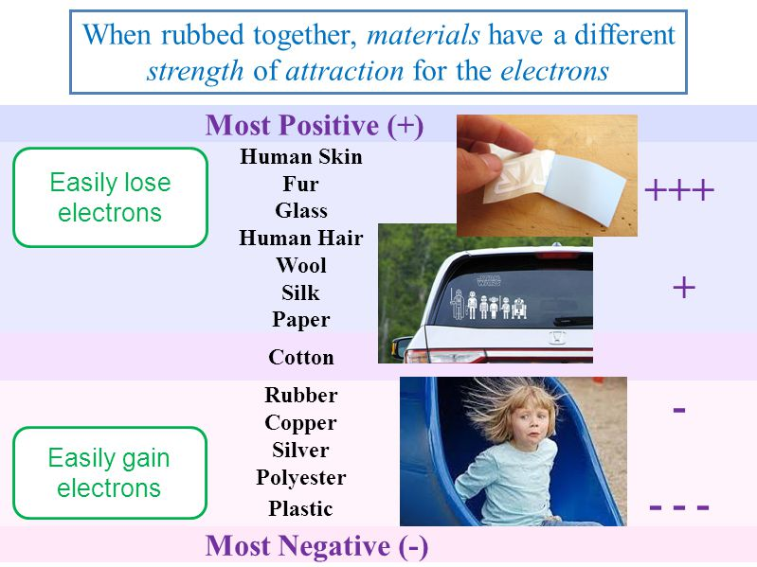

Slide 18
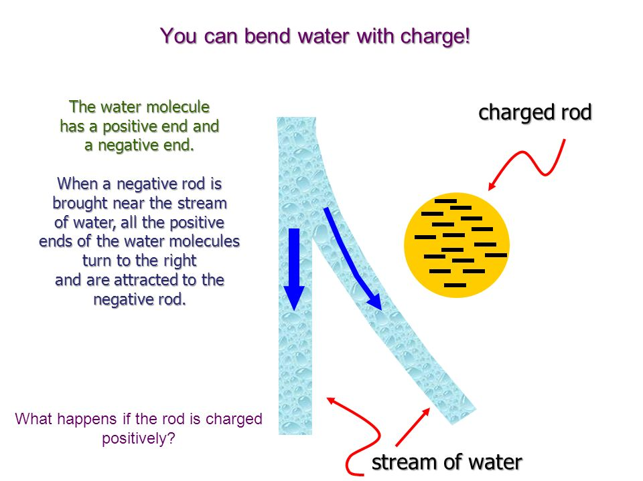
Why is static electricity more apparent in winter?
You notice static electricity much more in winter (with clothes in a dryer, or taking a sweater off, or getting a shock when you touch something after walking on carpet) than in summer because the air is much drier in winter than summer. Dry air is a relatively good electrical insulator, so if something is charged the charge tends to stay. In more humid conditions, such as you find on a typical summer day, water molecules, which are polarized, can quickly remove charge from a charged object.

Slide 19
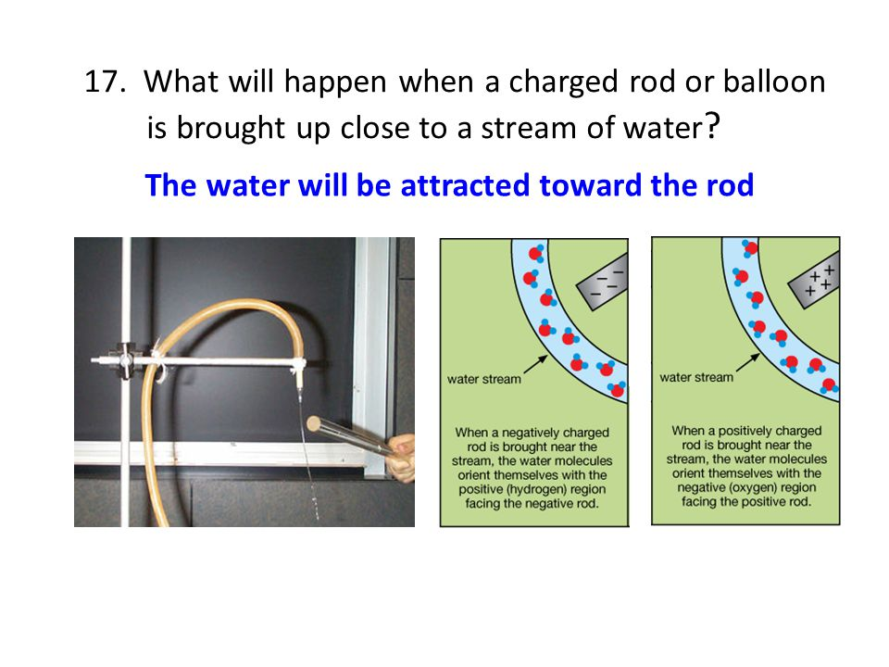

Slide 20
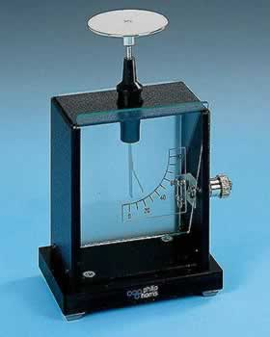

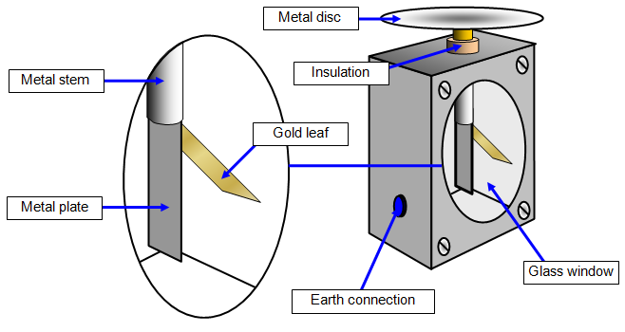
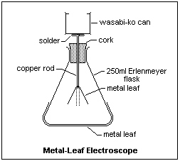
How to measure charge?
Electroscope

Slide 21
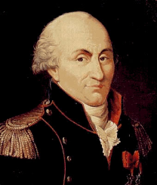
History
„Electron“ came from the Greek word for amber, ἤλεκτρον (ēlektron).
Thales of Miletus (624 – c. 546 BC) - Greek philosopher, mathematician and astronomer. Make an experiments with lodestone and amber - found attractive forces when rubbing it together.
Benjamin Franklin (1706 – 1790) - American statesman and inventor, started studying electricity in 1742. The book Experiments and Observations on Electricity. Theory of electrical fluid - Franklin expressed the opinion that every non electric body contains a certain amount of electric fluid (positive or negative). Part of the electric fluid can be transferred from one body to another during the friction.
Charles-Augustin Coulomb (1736-1806) - French physicist. The units of electric charge named after him : Coulomb. He developed the law descibed the force action between charges : Coulomb law

Slide 22
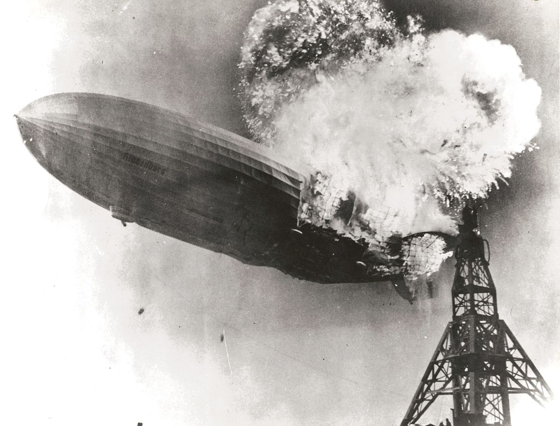
LZ 129 Hindenburg (Luftschiff Zeppelin)
Large German commercial passenger-carrying rigid airshift – destroyed 1937
Fire caused the spark that resulted from the accumulation of static charge… maybee

Slide 23
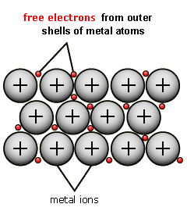
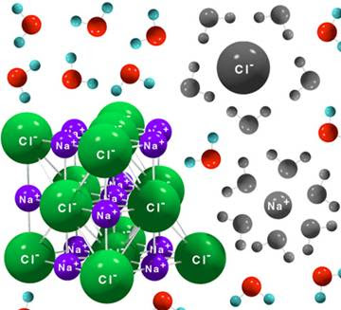
Basic types of electric charge carriers and conducting media: conductors
1st class conductors are metals in which electrons (which behaviour resembles gas) enable electrical phenomena.
2nd class conductors are electrolytes consisting of solutions of dissociated ionic compounds (e.g. NaCl). In this case, the anions and cations are the carriers of electric charge.

Slide 24
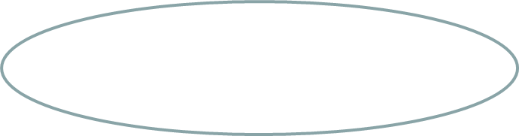
Example – effect of electric field
+ Electric field -
Conductors – electron flow
motion of charge
e
charge
e
force
-
+
e
e
dissociation - ionts
Electrolyte
mass
-
+
-
+
force
+
-
-
-
+
+

Slide 25
Coulomb’s law:
This law describes the force existing between electric charges at rest.
Q2
Q1
F
F =
[N],
·
where F is the electrostatic force, Q1, and Q2 are the interacting charges, r is the distance between the charges (centres of charged spheres), and ε is the electric permittivity of the medium between charges.
ε = ε₀ε_{r}
= k = 8.987x10⁹ N m² C⁻⁹
where ε₀ is the permittivity of vacuum (8.85×10⁻¹² C²m⁻²N⁻¹), a very important physical constant. ε_{r} is the relative permittivity (vacuum =1)

Slide 26
An example
Q1 = -20 nC
Q2= +80 nC
r= 10 cm
vacuum F= ???
r
Q2
Q1
insert values
F =
conversion of units
k = 8.987x10⁹ N m² C⁻⁹
calculation
F= 1.4 x 10⁻³ N
The value of force is 1.4 x 10⁻³ N.

Slide 27
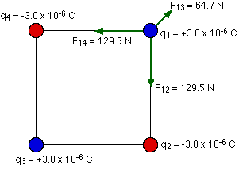
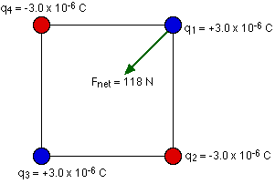
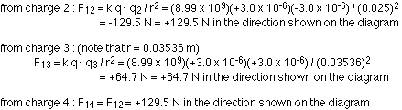
An example
Four charges are arranged in a square with sides of length 2.5 cm. The two charges in the top right and bottom left corners are +3.0 x 10-6 C. The charges in the other two corners are -3.0 x 10-6 C. What is the net force exerted on the charge in the top right corner by the other three charges?
To solve any problem like this, the simplest thing to do is to draw a good diagram showing the forces acting on the charge. You should also let your diagram handle your signs for you. Force is a vector, and any time you have a minus sign associated with a vector all it does is tell you about the direction of the vector. If you have the arrows giving you the direction on your diagram, you can just drop any signs that come out of the equation for Coulomb's law.
Consider the forces exerted on the charge in the top right by the other three:
You have to be very careful to add these forces as vectors to get the net force. In this problem we can take advantage of the symmetry, and combine the forces from charges 2 and 4 into a force along the diagonal (opposite to the force from charge 3) of magnitude 183.1 N. When this is combined with the 64.7 N force in the opposite direction, the result is a net force of 118 N pointing along the diagonal of the square.
The symmetry here makes things a little easier. If it wasn't so symmetric, all you'd have to do is split the vectors up in to x and y components, add them to find the x and y components of the net force, and then calculate the magnitude and direction of the net force from the components.

Slide 28
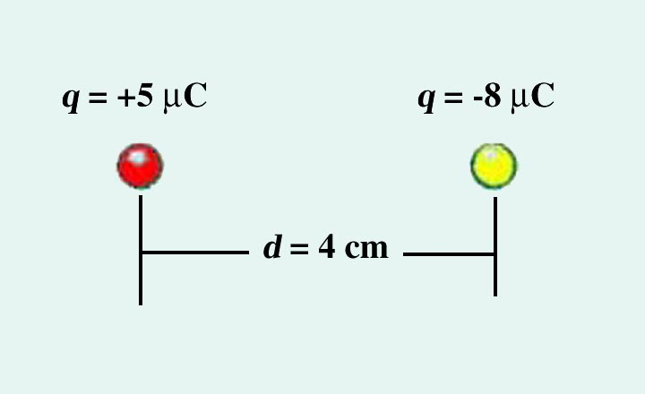
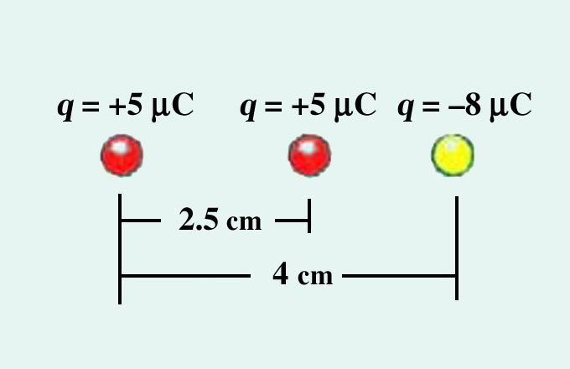
EXAMPLE 1 - Find the force between these two charges
EXAMPLE 2 - Find the net force on the left charge

Slide 29
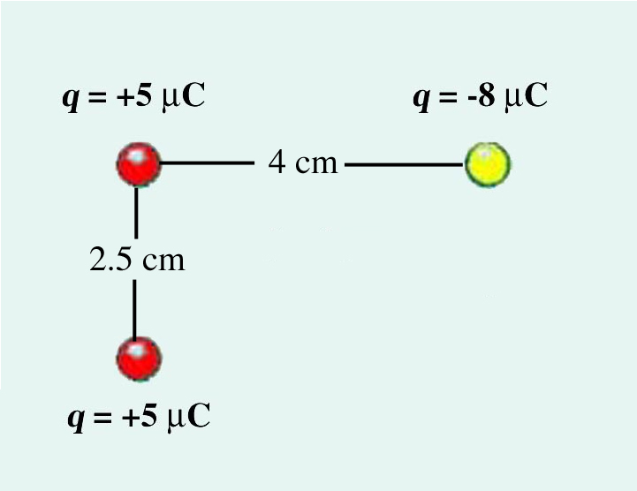
EXAMPLE 3 - Find the net force on the upper left charge
Fy
Fx

