Slide 1
Electric current
Vladan Bernard

Slide 2
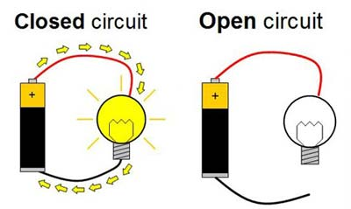
Circuit
Closed Circuit
Allows a complete path for electrons to travel
Open Circuit
Does not allow a complete path for the electrons to travel

Slide 3
While the switch is open:
Free electrons (conducting electrons) are always moving in random motion.
The random speeds are at an order of
10⁶ m/s.
There is no net movement of charge across a cross section of a wire.

Slide 4
What occurs in a wire when the circuit switch is closed?
Movement of charge because of electric force
Free electrons, while still randomly moving, immediately begin drifting due to the electric field, resulting in a net flow of charge.
Force of electric field

Slide 5
Potential Difference
Potential Difference: When the ends of an electric conductor are at different electric potentials (voltages)
Potential difference = voltage (in case of work per unit charge)
U=Δϕ ---- exist force which affected charged particle
Charge continues to flow until the ends of the conductor has the same voltage

Slide 6
Electric Current
Electric Current: the flow of electric charge
The loosely bound outer electrons of conductors carry the charge through circuits
Protons tightly bound to the nuclei of atoms
The electric current through a wire is a measure of the amount of charge with passes through it per second.

Slide 7
Definition – electric curent
Electric current = charge / time -I scalar
I = Q/t
Units: Amps (A)
An amper is the flow of 1 C of charge per second
NOTE: 1 C = the charge of 6,240,000,000,000,000,000 electrons (6.2*10¹⁸)

Slide 8
???
10²⁰ electrons passed through the electric conductor during 4 second. Find the electric current through this conductor.
The electric current of 0.5 A is flowing through the electric conductor. What electric charge is passing throughcduring each second? What electric charge will pass through the conductor during 1 minute?

Slide 9
result
I=Q/t=(1.6x10⁻¹⁹ *10²⁰)/4= 4 A
Q=It=(0.5 * 1)=0.5 C
Q=It=(0.5 * 60)= 30 C

Slide 10
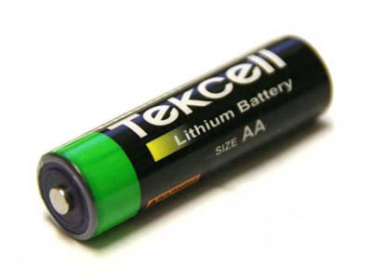
Current’s Direction
Electrons travel from – to +
Current is actually the opposite direction of the flow of electrons
+
-
electrons
-
-
-
electric current direction

Slide 11
Current’s Direction
Conventional current has the direction that the (+) charges would have in the circuit.
Branches in electric circuit – the electric current is divided into two (more) streams in electric node
I
I1
I
+
I2
I=I₁+I₂
-

Slide 12
Question ???
What is required in order to have an electric current flow in a circuit?
Answer:
A voltage source.
The circuit must be closed.
Calculate electric current of total charge 30 C flow through wire per 1 minute.
I=Q/t, t =1 min. 60 sec
I=30/60=0.5 A
Why is the bird on the wire safe?

Slide 13
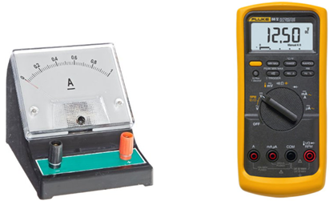
How to measure electric current?
Ammeter – device which measures electric current.
Multimeter (digital)
Ammeter must be placed in series.
-
+
A

Slide 14
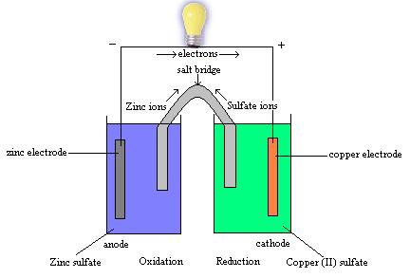
Voltage Sources
Voltage Source: A device which provides a potential difference in order to keep current flowing
Dry/Wet Cells: Convert chemical energy to electrical energy
Generators: Convert mechanical energy to electrical energy
The voltage available to electrons moving between terminals is called electromotive force, or emf.

Slide 15
Current vs. Voltage
Current – Flow rate, quantum of electric charge per time
Measured in Amperes
Ammeter- in series
Voltage – difference of potential, work per unit charge
Measured in Volts
Voltmeter- in parallel

Slide 16
Electric resistance
Electric Resistance: „ Like an ability of a material to resist the flow of charge“
Electric resistance - R
Units: Ohms (Ω)
The amount of charge that flows through a circuit depends on two things:
Voltage provided by source
Electric resistance of the conductor
Usually used graphic symbol

Slide 17
Electric resistance - factors
Thick wires have less resistance than thin wires
Short wires have less resistance than long wires
Higher temperatures usually cause more resistance
The resistance in some materials becomes almost zero at very low temperatures

Slide 18
Electric resistance – factors
The resistance depends on the geometry of the conductor. Therefore, a geometry independent quantity resistivity – specific resistance was introduced:
$$R=ρ\frac{l}{A}$$
l is lenght of a conductor, A is the cross-section area of conductor and ρ is the resistivity
$$R=R0(1+αt)$$
Resistance is depend on temperature:
Where R₀ is the resistance of the conductor at the temperature t=0°C, t is temperature (°C) of conductor and α is the temperature coefficient of resistance (tabelated value).

Slide 19
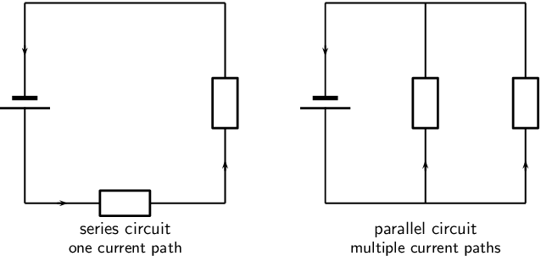
Resistor combination
The combination rules for any number of resistors in series or parallel can be derived with the use of Ohm's Law, the voltage law, and the current law.
R2
R1
R2
R1
I1
I2
I=I1+I2
I

Slide 20
Resistor Combinations

Slide 21
Example
R total ???
As the resistors are connected together in series the same current passes through each resistor in the chain and the total resistance, R_{T} of the circuit must be equal to the sum of all the individual resistors added together. That is: Rt=R1+R2+R3
and by taking the individual values of the resistors in our simple example above, the total equivalent resistance, R_{EQ} is therefore given as:
R_{EQ} = R₁ + R₂ + R₃ = 1kΩ + 2kΩ + 6kΩ = 9kΩ
So we see that we can replace all three individual resistors above with just one single “equivalent” resistor which will have a value of 9kΩ.

Slide 22
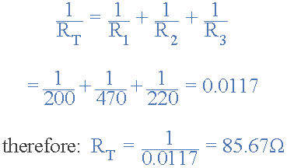
Example
Find the total resistance, R_{T} of the following resistors connected in a parallel network.
The total resistance R_{T} across the two terminals A and B is calculated as:

Slide 23
Ohm’s Law
The current in a circuit is:
Directly proportional to the voltage across the circuit
Inversely proportional to the resistance of the circuit
Therefore:
$$U=RI or R=\frac{U}{I} or I=\frac{U}{R}$$

Slide 24
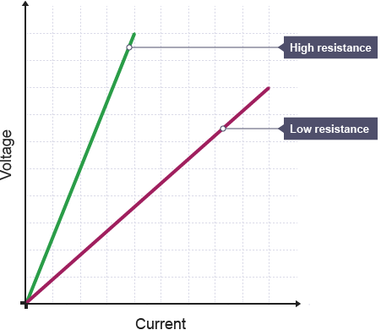
Ohm’s Law

Slide 25
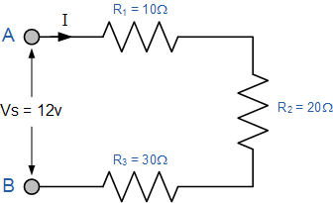
Using Ohms Law, calculate the equivalent series resistance, the series current, voltage drop and power for each resistor in the following resistors in series circuit.
All the data can be found by using Ohm’s Law, and we can present this data in tabular form (next slide).

Slide 26
Resistance | Current | Voltage | Power
R₁ = 10Ω | I₁ = 200mA | V₁ = 2V | P₁ = 0.4W
R₂ = 20Ω | I₂ = 200mA | V₂ = 4V | P₂ = 0.8W
R₃ = 30Ω | I₃ = 200mA | V₃ = 6V | P₃ = 1.2W
R_{T} = 60Ω | I_{T} = 200mA | V_{S} = 12V | P_{T} = 2.4W

Slide 27
Electric Power
The rate at which electrical energy is converted to other forms
Electric Power = Current x Voltage
P = IU
Units: Watts (W)
1 kilowatt (kW) = 1000 W

Slide 28
Example ???
What is the power when a voltage of 230 V drives a 1 A current through a device?
P=UI=230*1=230 W
How much current does a 50 W lamp draw when connected to 230 V?
P=UI I=P/U=50/230= 0.21 A

Slide 29
DC Electric Power
The electric power in watts associated with a complete electric circuit or a circuit component represents the rate at which energy is converted from the electrical energy of the moving charges to some other form, e.g., heat, mechanical energy, or energy stored in electric fields or magnetic fields. For a resistor in a D C Circuit the power is given by the product of applied voltage and the electric current: W=UI.
Convenient expressions for the power dissipated in a resistor can be obtained by the use of Ohm's Law.
The fact that the power dissipated in a given resistance depends upon the square of the current dictates that for high power applications you should minimize the current. This is the rationale for transforming up to very high voltages for cross-country electric power distribution.

Slide 30
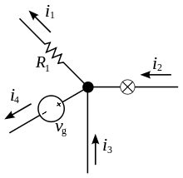
Kirchhoffś laws
Kirchhoff's circuit laws are two equalities that deal with the current and potential difference (commonly known as voltage) in the lumped element model of electrical circuits. They were first described in 1845 by German physicist Gustav Kirchhoff.
It is fact, that : The current entering any junction is equal to the current leaving that junction. i2 + i3 = i1 + i4
It is fact, that : Every electrical appliance in electric circuit has characteristic voltage U, obtained by

Slide 31
Kirchhoff's current law
The principle of conservation of electric charge implies that:
At any node (junction) in an electrical circuit, the sum of currents flowing into that node is equal to the sum of currents flowing out of that node or equivalently.
The algebraic sum of currents in a network of conductors meeting at a point is zero.
Recalling that current is a signed (positive or negative) quantity reflecting direction towards or away from a node.

Slide 32
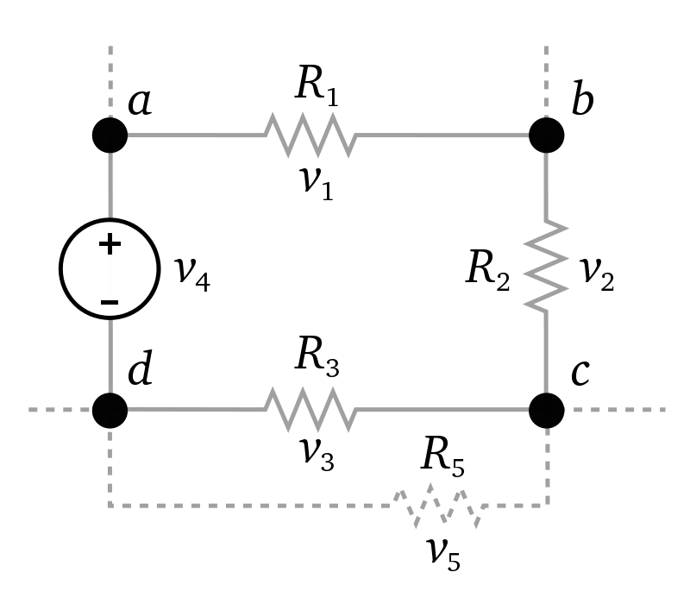
Kirchhoff's voltage law
This law is also called Kirchhoff's second law, Kirchhoff's loop (or mesh) rule, and Kirchhoff's second rule.
The principle of conservation of energy implies that
The directed sum of the electrical potential differences (voltage) around any closed network is zero, or:
More simply, the sum of the electromotive forces in any closed loop is equivalent to the sum of the potential drops in that loop, or:
The algebraic sum of the products of the resistances of the conductors and the currents in them in a closed loop is equal to the total electromotive forces available in that loop.
∑𝐼𝑅=∑𝑈_{𝑠𝑜𝑢𝑟𝑐𝑒𝑠}
The sum of all the voltages around a loop is equal to zero. U1 + U2 + U3 – U source4 = 0

Slide 33
Example

Slide 34
Capacity, electrical capacity
electrical capacity - an electrical phenomenon whereby an electric charge is stored
_
+
_
+
gap

Slide 35
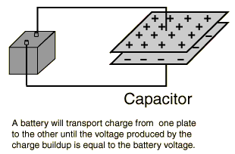
Plate capacitor
Capacitance of capacitor is typified by a parallel plate arrangement and is defined in terms of charge storage: C=Q/U, where Q = magnitude of charge stored on each plate and V = voltage applied to the plates.
U source
U on plates

Slide 36
Plate capacitor

Slide 37
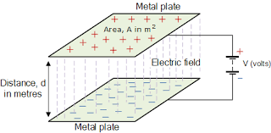
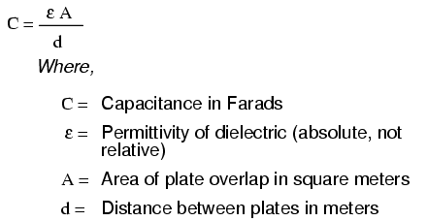
Plate capacitor

Slide 39
Example
A parallel plate capacitor consists of two metal plates, each of area , separated by a vacuum gap cm thick. What is the capacitance of this device? What potential difference must be applied between the plates if the capacitor is to hold a charge of magnitude on each plate?

Slide 40
solution
Making use of formula, the capacitance is given by
The voltage difference U between the plates and the magnitude of the charge Q stored on each plate are related via C=Q/U, U=Q/C. Hence, if Q=1x10⁻³ microcoulomb then :

