Slide 1
Semiconductors
Vladan Bernard

Slide 2
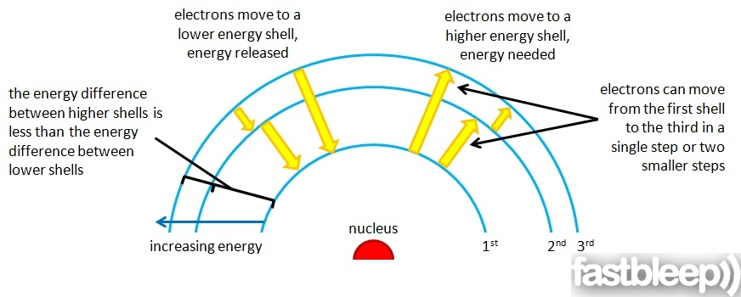
Atomic model
Atanoms are comprised of electrons, protons and neutrons
Electrons are found orbiting the nucleus of an atom at specific intervals, based upon their energy levels
The outermost orbits is the valence orbit

Slide 3
Orbitals - energy
Valence band electron are the furthest from the nucleus
Have higher energy levels than electron in lower orbits
The region beyond the valence band is called the conduction band
Electrons in the conduction band are easily made to be free electrons

Slide 4
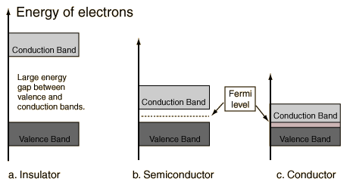
Conduction band

Slide 5
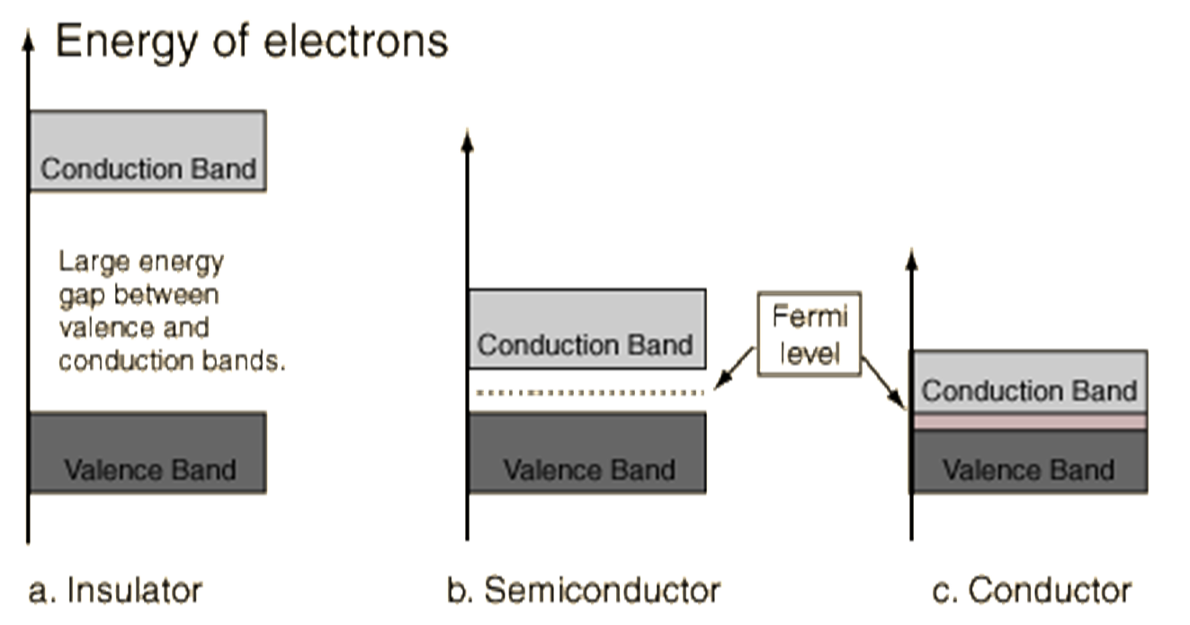
Insulator
E
The energy gap in an insulator is large enough that few, if any, electrons have enough thermal energy to reach the conduction band
E=5 eV

Slide 6
Semiconductor
E
In a semiconductor, the energy gap is small enough that same electrons have enough thermal energy to enter the conduction band
E=1 eV

Slide 7
Conductor
E
In conductor, same electrons are in the conduction band. These electrons are free to move between atoms. The electrons move randomly in a conductor, but if a electric field is applied across the wire, the electrons drift toward one end.

Slide 8
Semiconductors
„Semiconductors are crystalline or amorphous solids with distinct electrical characteristics. They are of high electrical resistance — higher than typical resistance materials, but still of much lower resistance than insulators. Their resistance decreases as their temperature increases, which is behavior opposite to that of a metal. Finally, their conducting properties may be altered in useful ways by the deliberate, controlled introduction of impurities ("doping") into the crystal structure, which lowers its resistance but also permits the creation of semiconductor junctions between differently-doped regions of the extrinsic semiconductor crystal. The behavior of charge carriers which include electrons, ions and electron holes at these junctions is the basis of diodes, transistors and all modern electronics.“ …wiki

Slide 9
Semiconductors
Semiconductors are materials whose electrical properties lie between Conductors and Insulators.
Examples : Silicon and Germanium
Their resistance decreases as their temperature increases
The semiconductor materials are used in electronic devices

Slide 10
Becouse of cristalline structure of semiconductor materials, valence electrons are shared between atoms
This sharing of valence electrons is called covalent bonding. Covalent bonding makes it more difficult for materials to move their electron into the conduction band
Atoms as silicon SI, gallium Ga, arsenide As

Slide 11
temperature el. current
When energy is applied to a semiconductor, more electron will move into the conduction band and current flow more easily through the material
The resistance of semiconductor materials decrease with increasing temperature
It is described as a negative temperature coefficient

Slide 12
Semiconductor doping
Intrinsic semiconductor X doped semiconductor
Doped semiconductor = impurities are added to intrinsic semiconductor materials to improve the electrical properties of the material
Two major classifications of dopin materials (when major atoms are tetravalent)
  trivalent – aluminium, gallium, boron -acceptor
  pentavalent – arsenic, phosphorous - donor

Slide 13
Doped semiconductor

Slide 14
Doped semiconductors
Doped semiconductors are classified in to P-type and N-type semiconductor
P-type: A P-type material is one in which holes are majority carriers i.e. they are positively charged materials (++++)
N-type: A N-type material is one in which electrons are majority charge carriers i.e. they are negatively charged materials (-----)

Slide 15
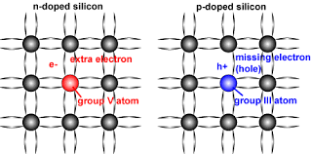
pentavalent trivalent

Slide 16
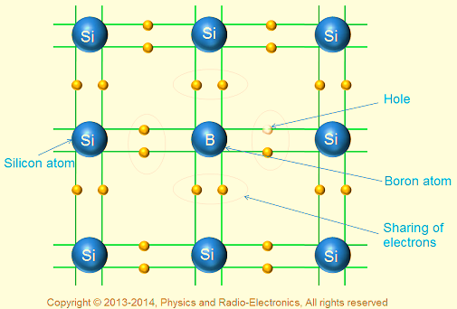
P-type semiconductor

Slide 17
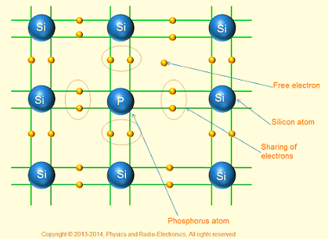
N-type semiconductor

Slide 18
???
The free electron density of a conductor.
Haw many free electrons exist in a cubic centimeter of copper? Each atom contributes one electron. The density ρ=8.92 g/cm³, atomic mass M=63.55 g/mol, N_{A}=6.02x10²³ atoms/mol.
free e⁻/cm³ = ???

Slide 19
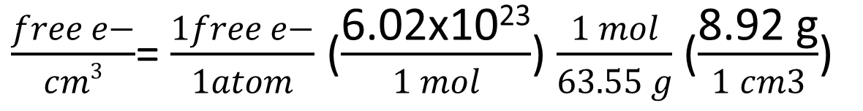
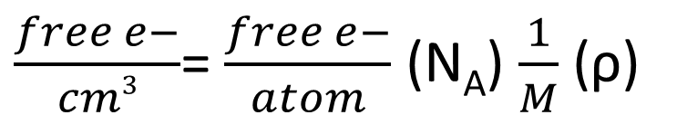
???
The free electron density of a conductor.
Haw many free electrons exist in a cubic centimeter of copper? Each atom contributes one electron. The density ρ=8.92 g/cm³, atomic mass M=63.55 g/mol, N_{A}=6.02x10²³ atoms/mol.
free e⁻/cm³ = ???
$\frac{free e−}{cm3}$= $\frac{free e−}{atom}$ (N_{A}) $\frac{1}{M}$ (ρ)
$\frac{free e−}{cm3}$= $\frac{1free e−}{1atom}$ ($\frac{\text{6.02}\text{x}\text{1023}}{1 mol}$) $\frac{1 mol}{63.55 g}$ ($\frac{\text{8.92 }\text{g}}{1 cm3}$)
8.45 x 10²² free e-/cm ³ in copper

Slide 20
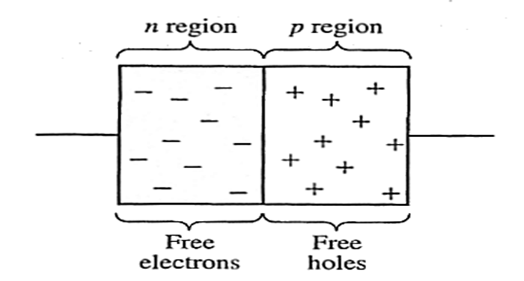
Diodes
Electronic devices created by bringing together a p-type and n-type region within the same semiconductor lattice. Used for rectifiers, LED etc
Negative
Positive

Slide 21
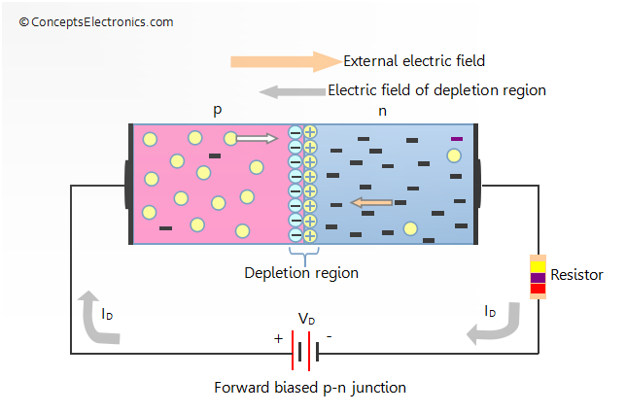
Forward biase junction
An external source can either opposite or aid the barrier potential
If the positive side of voltage source is connected to the p-type material, and the negative side to the n-type material, then the junction is said to be forward biased.
The maximum current flow

Slide 22
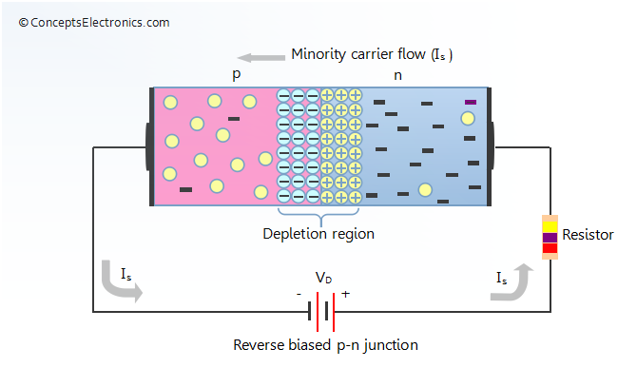
Reverse biase junction
Reverse bias occurs when the negative source is connected to the p-type material
Reverse bias strengthens the barrier potential
Current flow is minimal

Slide 23
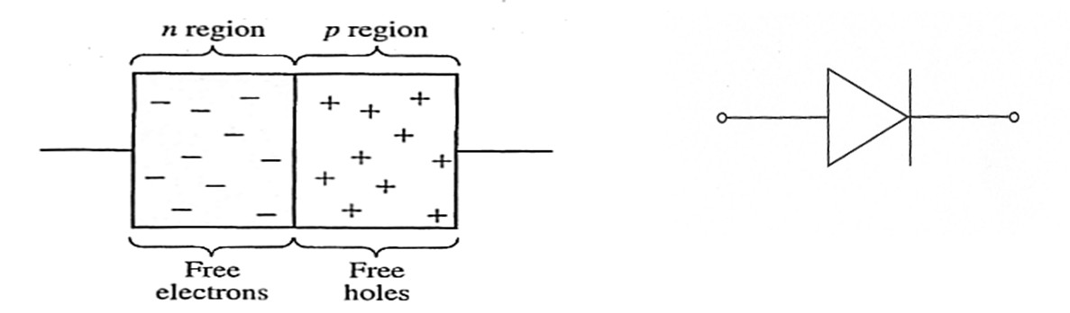
Diodes
It is represented by the following symbol, where the arrow indicates the direction of positive current flow.

Slide 24
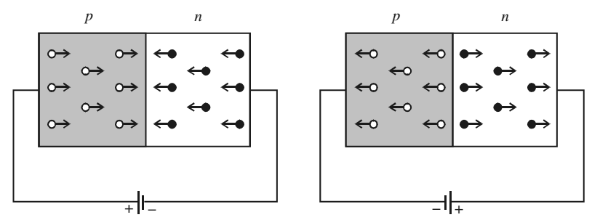
Diode
Forward Bias : Connect positive of the Diode to positive of supply…negative of Diode to negative of supply
Reverse Bias: Connect positive of the Diode to negative of supply…negative of diode to positive of supply.
Forward
Reverse

Slide 25
Diode
Characteristic:
Diode always conducts in one direction.
Diodes always conduct current when “Forward Biased” ( Zero resistance)
Diodes do not conduct when Reverse Biased
(Infinite resistance)

Slide 26
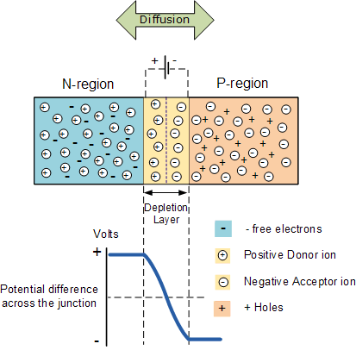
Depletion zone
When no voltage is applied, to the diode, electron from the N-type material fill holes from the P-material along the junction between the layers, forming a depletion zone.
In a depletion zone, the semiconductor material is returned to its original insulating state -- all of the holes are filled, so there are no free electrons or empty spaces for electrons, and charge can't flow.

Slide 27
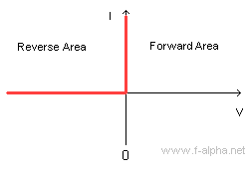
I-U characteristics of Ideal diode

Slide 28
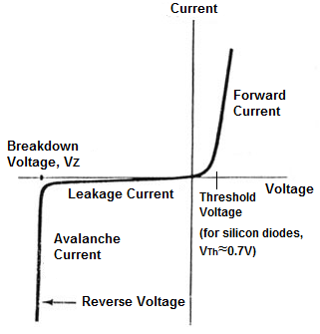
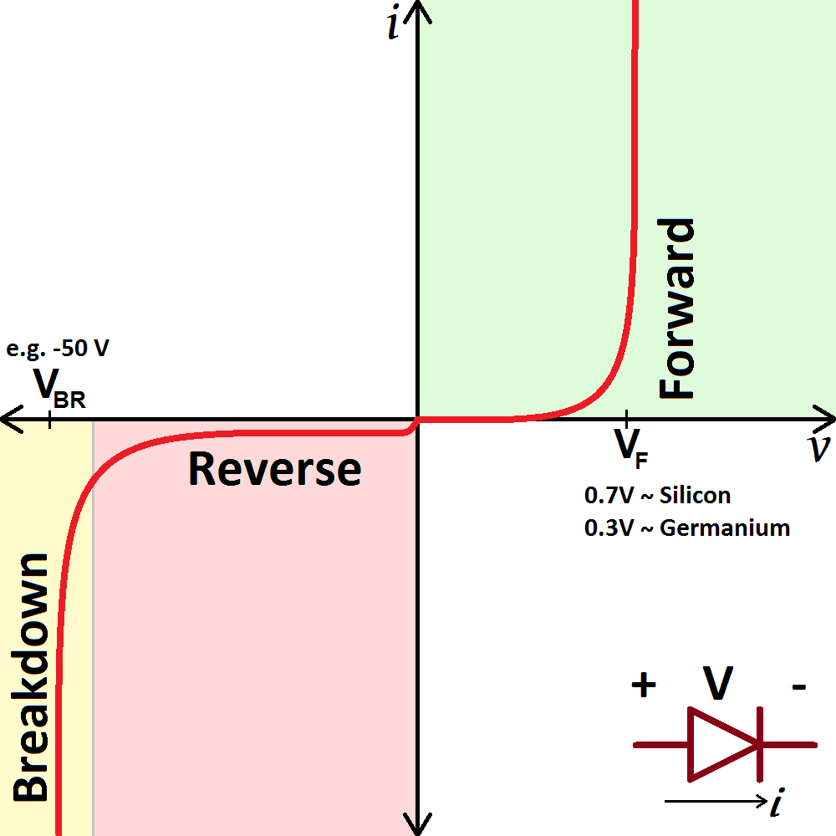
I-U Characteristics of Realistic Diode

Slide 29
Light Emitting Diode
LEDs are made from combination of gallium or aluminium with arsenic and phosporus
LEDs emit light when they are forward-biased (during process of recombination of electrons and holes)
LEDs can detect light (reverse action) – light fall on the PN junction produce electrons and holes – resulting in a electric current

