Slide 1
Electrolytes and electrolysis
Vladan Bernard

Slide 2
Electrolytes
„An electrolyte is a substance that produces an electrically conducting solution when dissolved in a polar solvent, such as water. The dissolved electrolyte separates into cations and anions, which disperse uniformly through the solvent. Electrically, such a solution is neutral. If an electric potential is applied to such a solution, the cations of the solution are drawn to the electrode that has an abundance of electrons, while the anions are drawn to the electrode that has a deficit of electrons.“
Electrolyte solutions can also result from the dissolution of some biological (e.g., DNA, polypeptides) and synthetic polymers (e.g., polystyrene sulfonate), termed "polyelectrolytes",

Slide 3
Definitions: Ionization, electrolytes
Definition: Ionization
- Substance acquires negative/positive charge by gaining/losing electrons
- In water: substance breaks up into ions
Example NaCl to Na+ and Cl-
• Definition: Electrolytes
- Substance that undergoes ionization
- In water: solution of electrolyte conducts energy – Examples: Salts, acids, bases

Slide 4
Definitions: Equilibrium, dissociation
Equilibrium
– Between ionic compound (NaCl) and free ions (Na+ + Cl-)
Dissociation
– Separation of ions (separation of Na+ and Cl-)
Free ions in water solution
Conduct electricity
NaCl
Na+
Cl-
Ionic compound, crystal lattic
NOT conduct electricity

Slide 5
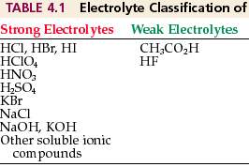
Electrolytes – weak and strong
Weak electrolytes
  Dissociates only partially (in equilibrium)
  NH4OH NH4+ OH-
Strong electrolytes
  Dissociates (breaks up) completely into ions (no equilibrium)
  NaOH Na+ OH-

Slide 6
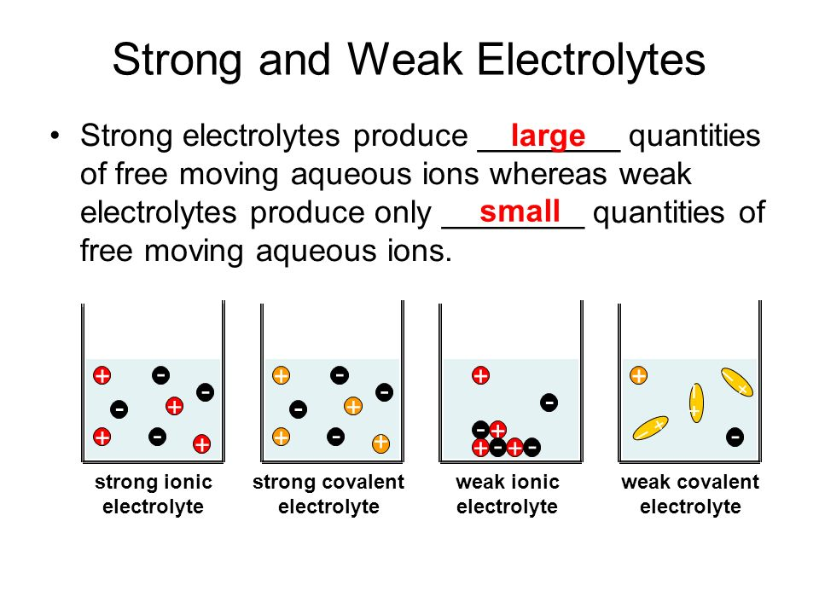

Slide 7
Ions

Slide 8
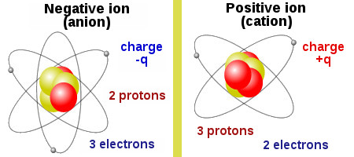
Ions
free charge carriers
Ions are two signs - positive +Q and negative -Q. To receive the atom (+) charge, it is enough to lose at least one electron in its orbit, then the balance will be disrupted and protons becomes larger than that of electrons. There is a deficit, the lack of electrons, atoms begin to crave to get a new electron. Such an atom turns into a positive ion, or else call it more cation. To obtain a negative ion (-), which is also called an anion sufficiently electrically neutral atom attached at least one extra electron.

Slide 9
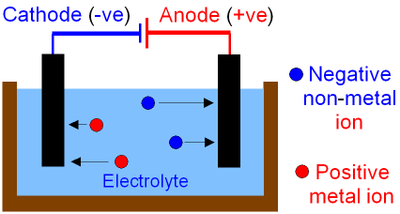
Electric current
If there is a electrolyte where only anions, they will move toward the anode, if the conductor is only cations, they will move toward the cathode.
If the electrolyte has both types of ions, then each of them will move to their side.

Slide 10
Electric current of free charges
Connected with Faraday´s law of electrolysis
Definition „ the mass m of substance liberated from an electrolyte solution is proportional to the product of the current I and the time t of current passage through the electrolyte“
m = AIt = AQ
A-electrochemical equivalent.

Slide 11
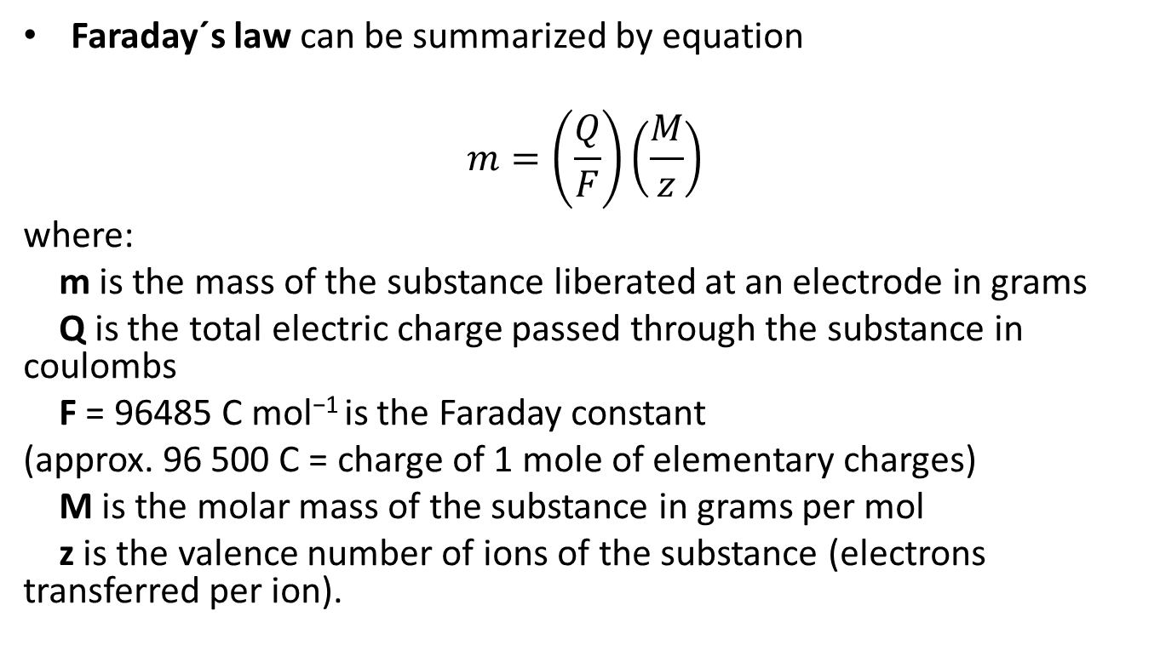
Faraday´s law can be summarized by equation
$$m=\left(\frac{Q}{F}\right)\left(\frac{M}{z}\right)$$
where:
m is the mass of the substance liberated at an electrode in grams
Q is the total electric charge passed through the substance in coulombs
F = 96485 C mol⁻¹ is the Faraday constant
(approx. 96 500 C = charge of 1 mole of elementary charges)
M is the molar mass of the substance in grams per mol
z is the valence number of ions of the substance (electrons transferred per ion).

Slide 12
Electric current – temperature effect
Another difference from the conduction current is the temperature dependence. For metals, the increase in temperature degrades their conductivity, resistance of metals by heating increases.
In the case of conductive liquids inverse dependence. The increase in temperature improves motility ions upon heating of the conductive fluid resistance decreases.

Slide 13
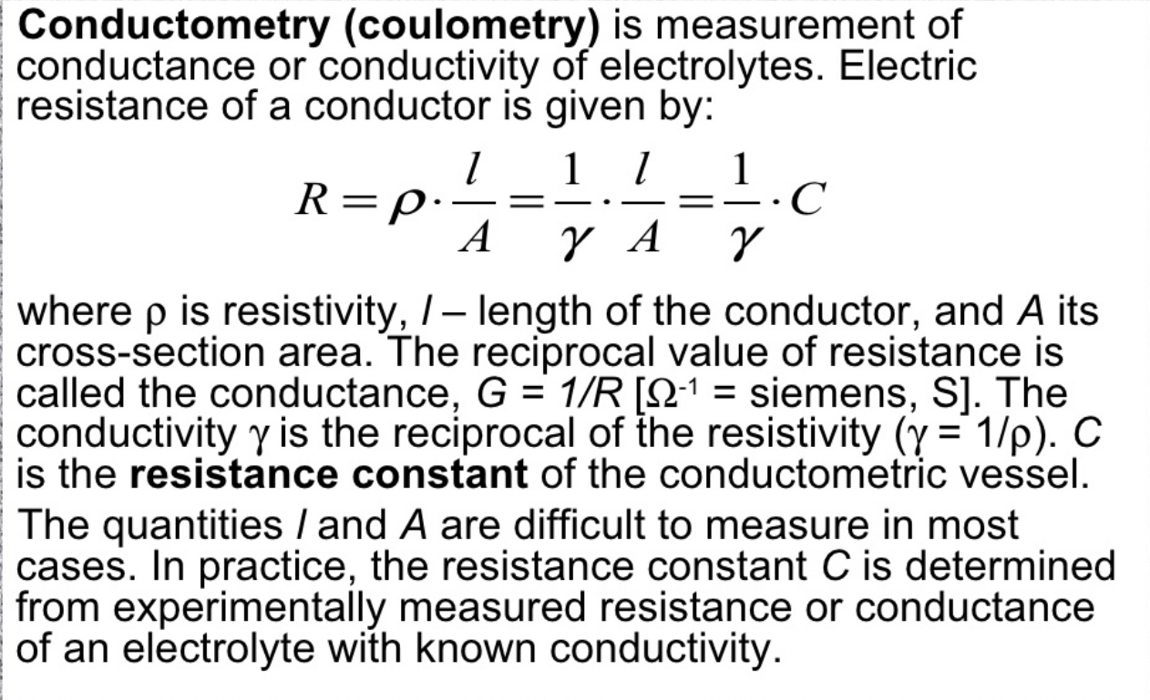
Conductometry

Slide 14
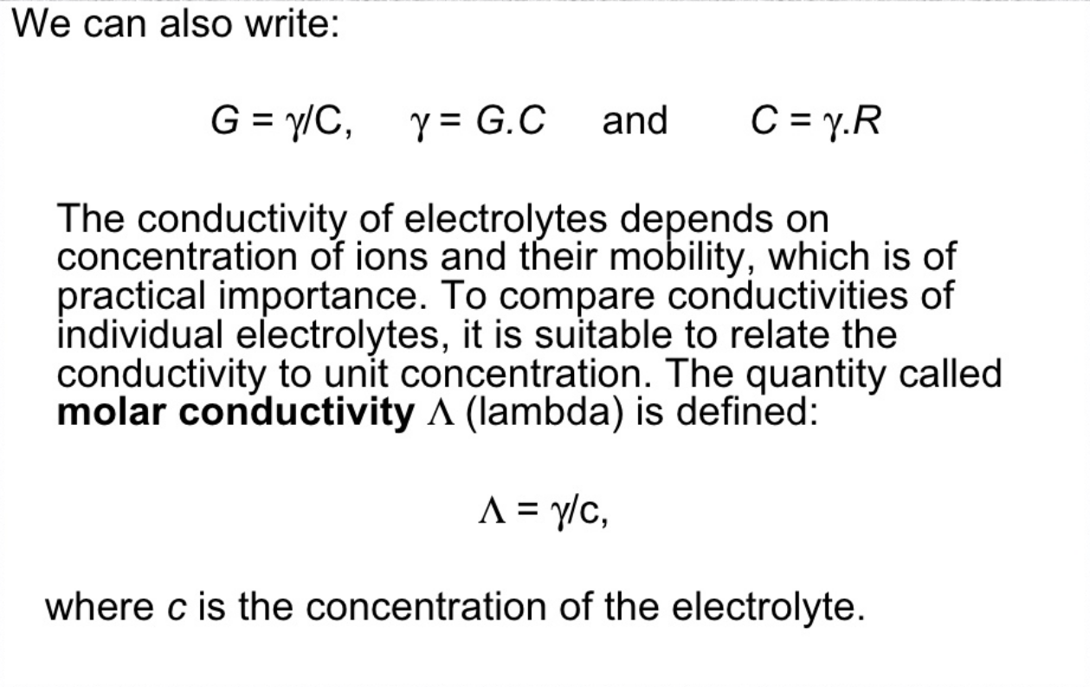
Conductometry

Slide 15
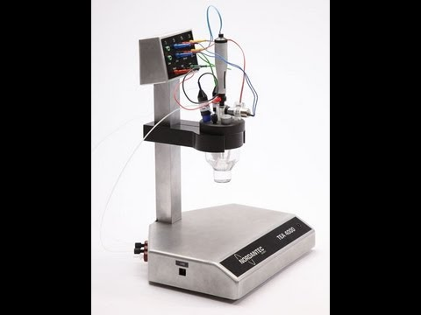
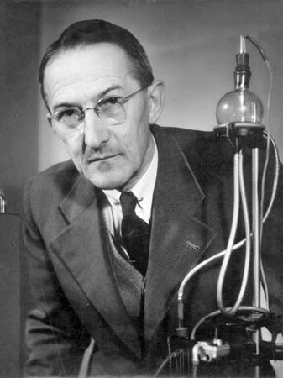
Conductometers
Analyzing quality of water
Measuring presence of ionts in solutions
Polarographic methods
Jaroslav Heyrovský (1890-1967)
Czech chemist and inventor. Heyrovský was the inventor of the polarographic method, father of the electroanalytical method, and recipient of the Nobel Prize in 1959 for his discovery and development of the polarographic methods of analysis.

Slide 16
Electrolysis
In chemistry and manufacturing, electrolysis is a technique that uses a direct electric current (DC) to drive an otherwise non-spontaneous chemical reaction.
Electrolysis is commercially important as a stage in the separation of elements from naturally occurring sources such as ores using an electrolytic cell.
Rust removal from small iron or steel objects by electrolysis can be done.
Electroplating, where a thin film of metal is deposited over a substrate material. Electroplating is used in many industries for either functional or decorative purposes, as in vehicle bodies and nickel coins.

Slide 17
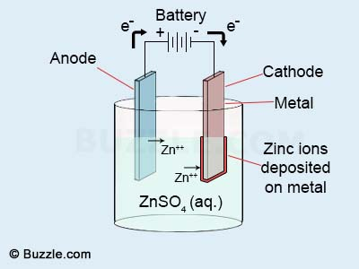
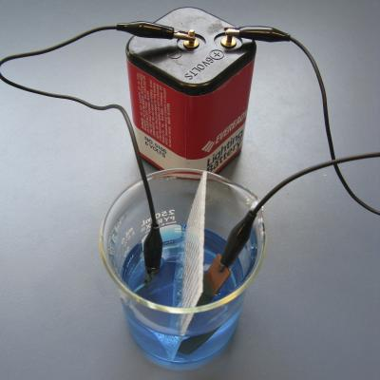
Electroplating
https://www.youtube.com/watch?v=OxhCU_jBiOA

