Slide 1
Magnetism
Electromagnetism
Vladan Bernard

Slide 2
Magnetism
„ Magnetism is a force generated in matter by the motion of electrons within its atoms. Magnetism and electricity represent different aspects of the force of electromagnetism, which is one part of Nature's fundamental electroweak force. The region in space that is penetrated by the imaginary lines of magnetic force describes a magnetic field. The strength of the magnetic field is determined by the number of lines of force per unit area of space. Magnetic fields are created on a large scale either by the passage of an electric current through magnetic metals or by magnetized materials called magnets. The elemental metals-iron, cobalt, nickel, and their solid solutions or alloys with related metallic elements-are typical materials that respond strongly to magnetic fields. Unlike the all-pervasive fundamental force field of gravity, the magnetic force field within a magnetized body, such as a bar magnet, is polarized-that is, the field is strongest and of opposite signs at the two extremities or poles of the magnet… „

Slide 3
Magnetism
Is the study of magnetic fields and their effect on materials.
The effect is due to unbalanced spin of electrons in atom.
It is readily observed every day – from the simple magnet that attracts nails and other metals to cassette tapes to magnet-driven trains.
  Magnetism is closely linked with electricity.
  Magnetic fields affect moving charges, and moving charges produce magnetic fields.
  Changing magnetic field can even create electric fields.
  These phenomena signify an underlying unity of electricity and magnetism, which James Clerk Maxwell first described in the 19th century.
  The ultimate source of any magnetic field is electric current.

Slide 4
Magnetism
Applications
  Magnetism is one of the most important fields in physics.
  Large electromagnets are used to pick up heavy loads.
  Magnets are used in such devices as holders, motors, and loudspeakers.
  Magnetic tapes and disks are used routinely in sound-and video-recording equipment and to store computer data.
  Intense magnetic fields are used in magnetic resonance imaging (MRI) devices to explore the human body with better resolution and greater safety than x-rays can provide.
  Giant superconducting magnet are used in the cyclotrons that guide particles into targets at nearly the speed of light.•

Slide 5
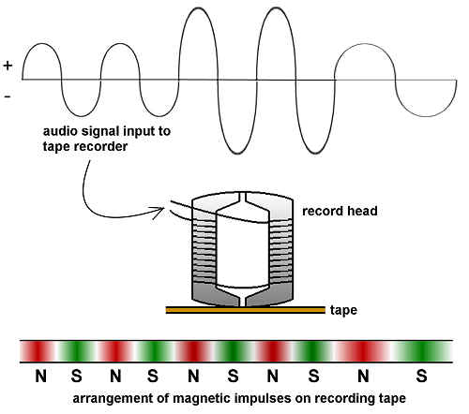
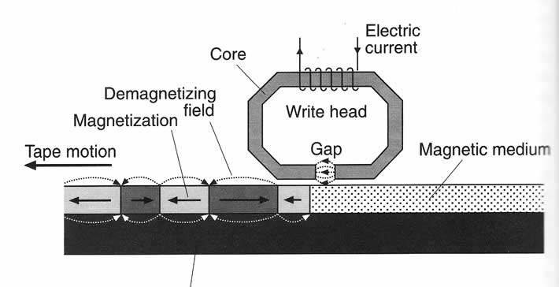
Magnetic tape principle

Slide 6

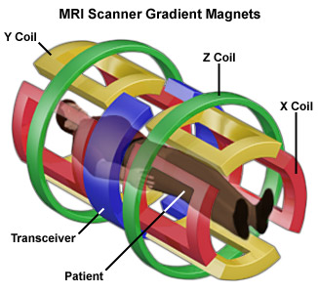
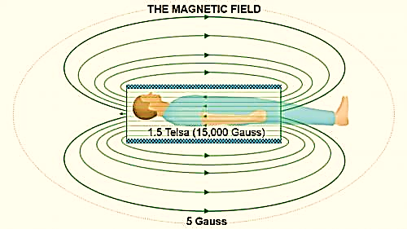
MRI diagnostic

Slide 7
Nature of magnetism
The Greeks discovered that certain iron ores found in the place could attract other pieces or iron, they called it magnetites.
Magnetism was most probably first observed in a form of the mineral magnetite called lodestone, which consists of iron oxide-a chemical compound of iron and oxygen.
Magnetites are classified as natural magnet.
The Englishman William Gilbert (1540-1603) was the first to investigate the phenomenon of magnetism systematically using scientific methods. He also discovered that the Earth is itself a weak magnet.
Early theoretical investigations into the nature of the Earth's magnetism were carried out by the German Carl Friedrich Gauss (1777-1855).
Danish physicist Hans Christian Oersted (1777-1851) first suggested a link between electricity and magnetism.
The Scotsman, James Clerk Maxwell (1831-1879), was a man who provided the theoretical foundation to the physics of electromagnetism in the nineteenth century by showing that electricity and magnetism represent different aspects of the same fundamental force field.

Slide 8
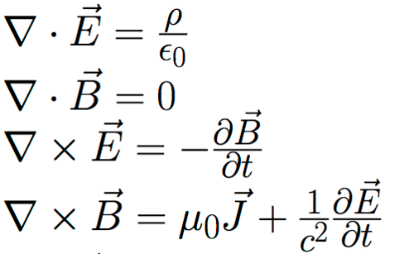
Maxwell´s equations :c))))

Slide 9
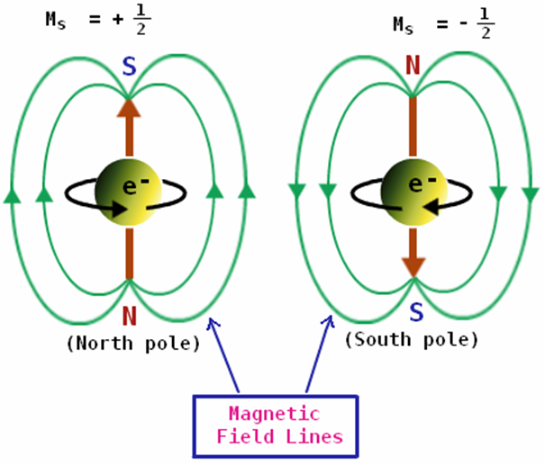
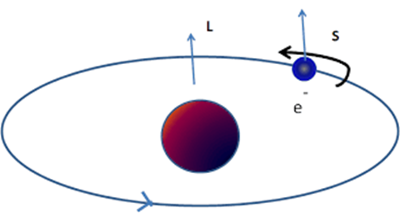
Origin of magnetism
Magnetism arises from two types of motions of electrons in atoms-one is the motion of the electrons in an orbit around the nucleus, similar to the motion of the planets in our solar system around the sun, and the other is the spin of the electrons around its axis, analogous to the rotation of the Earth about its own axis.

Slide 10
Origin of magnetism
It is now believed that magnetism is due to the spin of electrons within the atoms.
Since the electron is a charged particle, the concept implies that magnetism is a property of a charged particle in motion.
The orbital and the spin motion independently impart a magnetic moment on each electron causing each of them to behave as a tiny magnet.
In a large fraction of the elements, the magnetic moment of the electrons cancel out because of the Pauli exclusion principle , which states that each electronic orbit can be occupied by only two electrons of opposite spin.
However, a number of so-called transition metal atoms, such as iron, cobalt, and nickel, have magnetic moments that are not cancelled; these elements are, therefore, common examples of magnetic materials.

Slide 11
Origin of magnetism
Simply put:
The power of attraction of a magnet depends on the arrangement of the atoms.
All atoms are in themselves tiny magnet formed into groups called DOMAINS.
The magnetic strength is increased if the domains are induced to fall into line by the action of another magnet.

Slide 12
Origin of magnetism of Earth
The Earth's geomagnetic field is the result of electric currents produced by the slow convective motion of its liquid core in accordance with a basic law of electromagnetism which states that a magnetic field is generated by the passage of an electric current.
Hydromatic dynamo in Earth´s core
Earth´s core is molten iron (plus other stuff)
According to this model, the Earth's core should be electrically conductive enough to allow generation and transport of an electric current.

Slide 13
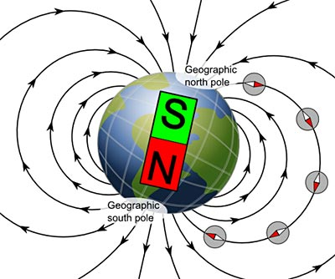
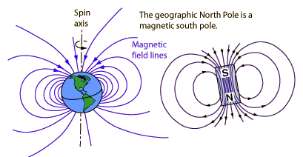
Earth as magnet
The magnetic north pole of the Earth is inclined at an angle of 11 degrees away from its geographical north pole.
https://www.youtube.com/watch?v=t2NqVJtNp6Y

Slide 14
Magnets
Magnets usually have two poles.
The end of the magnet which points north when magnet is free to turn on a vertical axis is the north-seeking pole, simply the N pole.
The opposite end which points south is the south-seeking pole or S pole.
Magnets come in many shapes and sizes, but each has at least two poles.
If you cut a magnet into pieces, every piece will still have at least two poles.

Slide 15
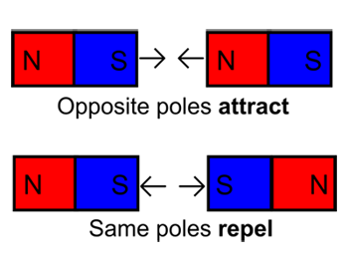
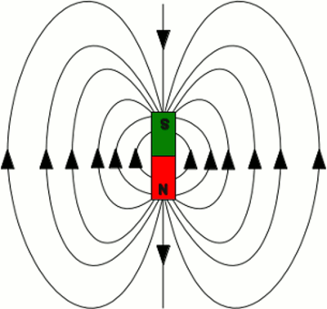
Magnets
Forces: Force line:

Slide 16

Magnetic field
Force acting between two magnetic poles:
(well known rule describing the force acting between the two poles “like repel-unlike attract“.)
$$F=\frac{m1 m2}{4πμd2}$$
Where m₁ and m₂ is the magnetic „strenghů of the poles, μ is the magnetic permeability /Hm⁻¹ – henry per meter/. The magnetic permeability can be described as combination of relative permeability μ_{r} and permeability of vacuum μ₀ (µ₀ = 4π×10⁻⁷ Hm⁻¹); d is distance between poles.

Slide 17
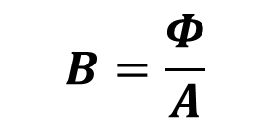

Magnetic flux and magnetic flux density
The magnetic flux φ passing through the area A is defined as the total number of magnetic force lines passing through an area A.
$$Φ=N/A$$
The magnetic flux density B at a point is the magnetic flux in a unit area placed at right-angles to the magnetic force lines. Unit is Wbm-2=T (tesla).
$$B=\frac{Φ}{A}$$

Slide 18
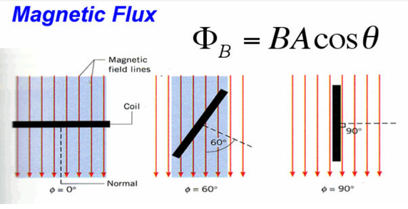
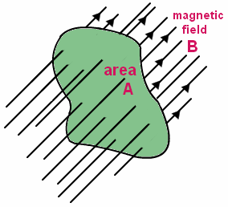
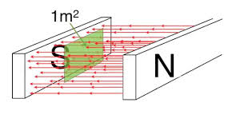
Magnetic flux and magnetic flux density

Slide 19
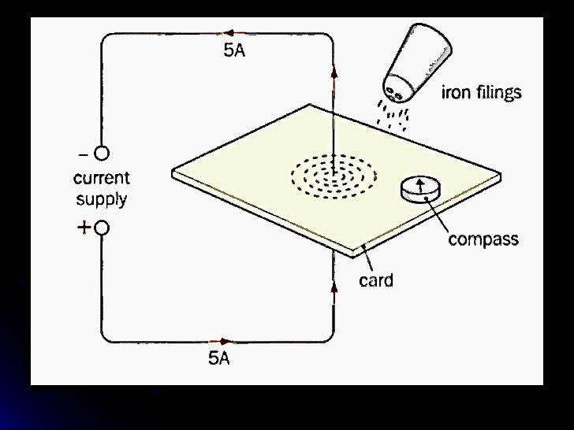
The magnetic field around a long straight wire
Diagram shows a wire carrying a current of about 5 amps
If you sprinkle some iron filings on to the horizontal card and tap it gently, the iron filings will line up along the lines of flux as shown.

Slide 20
The magnetic field around a long straight wire
You can place a small compass on the card to find the direction of the magnetic field.
The current flowing up the wire, the compass will point anti‑clockwise, as shown.

Slide 21
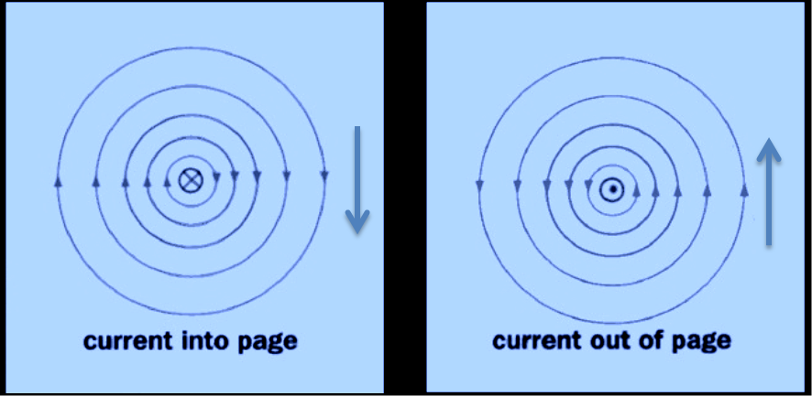
Vector lines
The diagrams show the magnetic field as you look down on the card
Imagine the current direction as an arrow. When the arrow moves away from you, into the page, you see the cross (x) of the tail of the arrow.
As the current flows towards you, you see the point of the arrow ‑ the dot in the diagram. Can you see that the further from the wire the circles are, the more widely separated they become? What does this tell you? The flux density is greatest close to the wire.

