Slide 1
Public health
Europe
EU
Czech
perspective

Slide 2
European perspective

Slide 3
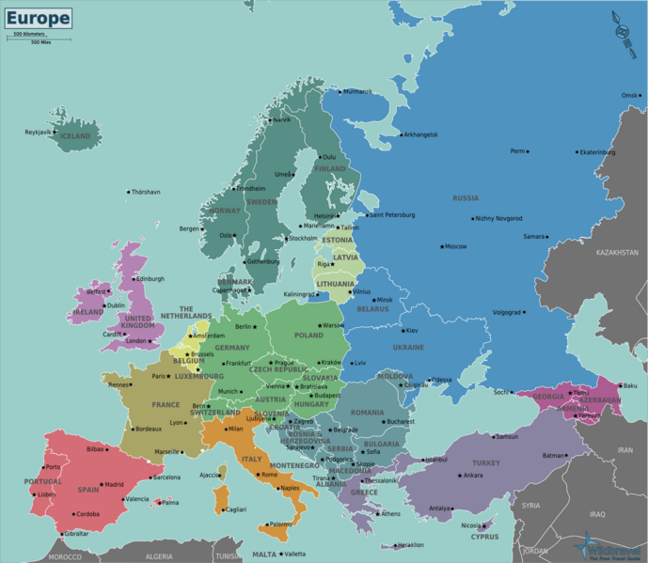
EUROPE
Basic facts
750 million people
6 time zones
50 sovereign states
Each responsible for its own health policy
Vast differences among individual regions
Living standards
Lifestyle
Diet
Life expectancy
No common public health policy

Slide 4
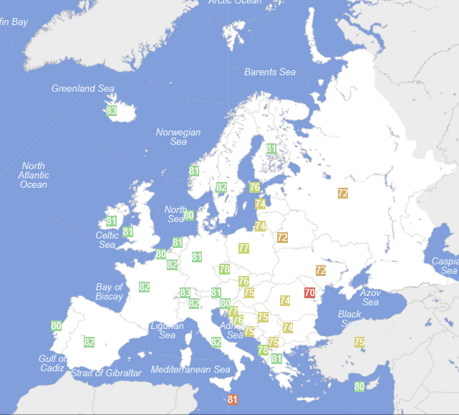
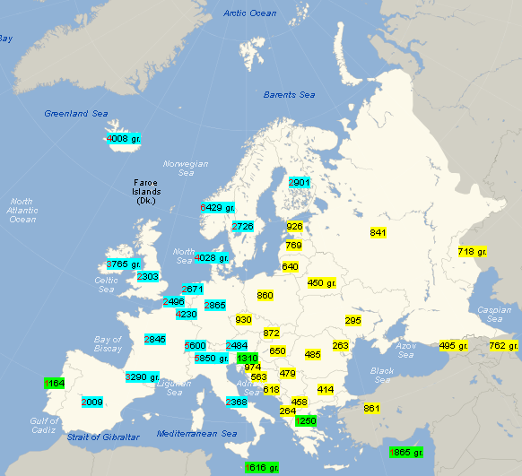
European gap in life expectancy/income

Slide 5
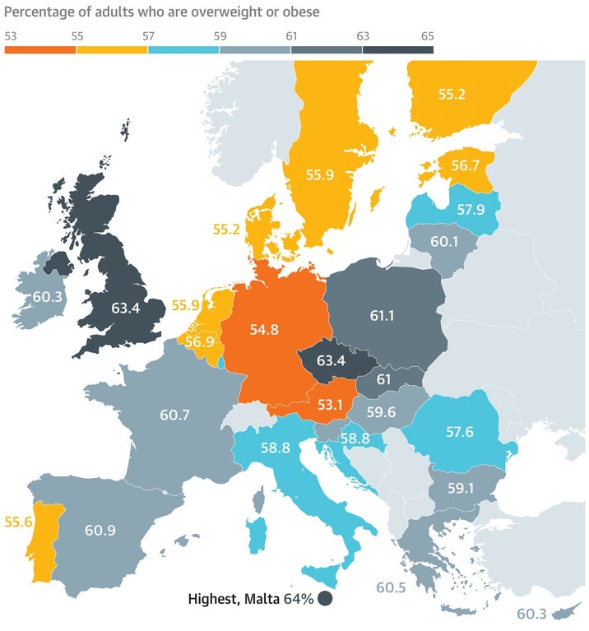
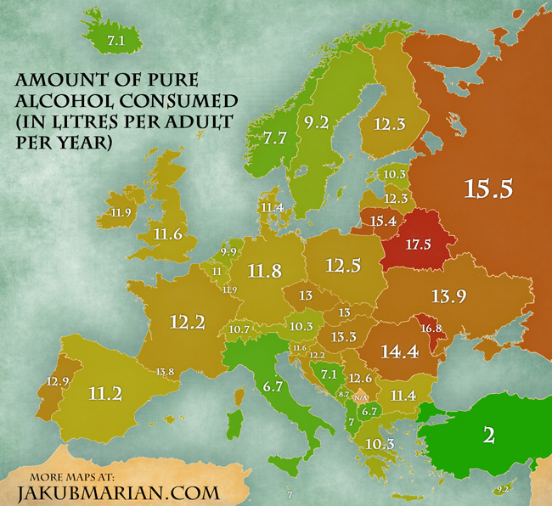
Other lifestyle differences

Slide 6
What do European states have in common
/healthcare and public health perspective/
Christian tradition
catholic and orthodox church used to be a major healthcare provider
Hospitals were established in monasteries,
Medical schools were run by churches
Welfare state
Concept from 19th century
Solidarity, social policies, welfare spending
Result
Health is (mistakenly) percieved to be a public service
Much higher emphasis is on the provision of healthcare than public health
All European countries guarantee free (or heavily subsidized) access to Healthcare
Public (and obligatory) health insurance

Slide 7
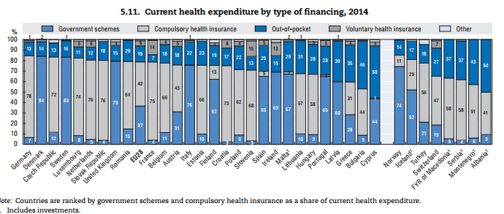

Slide 8

European union perspective

Slide 9
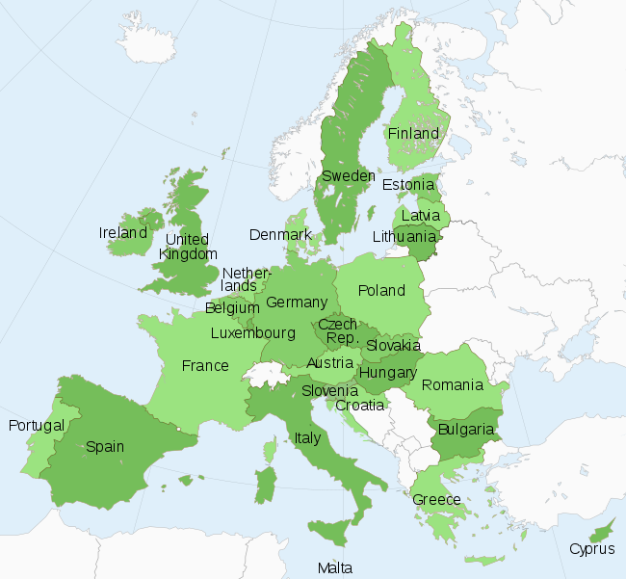
European union
Basic facts
27 countries
550 million citizens
It is not a state but …
Union of sovereign states
Common policies in certain areas
Free movement of citizens, goods, services
Common currency (in most countries)

Slide 10
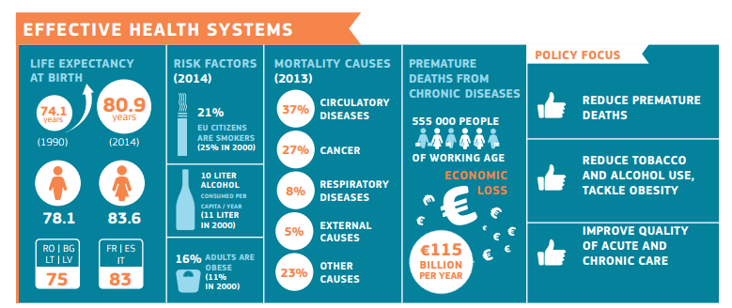
Public Health Objectives and challenges

Slide 11
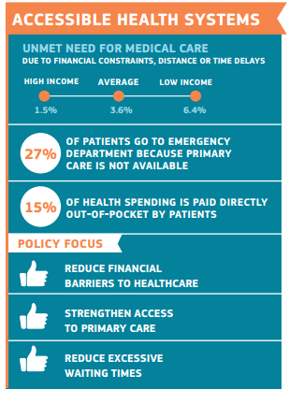

Slide 12
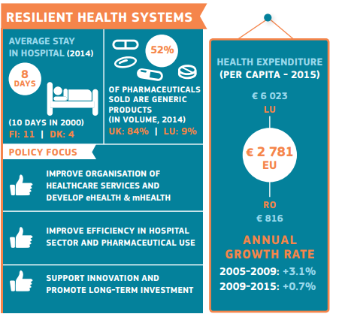

Slide 13
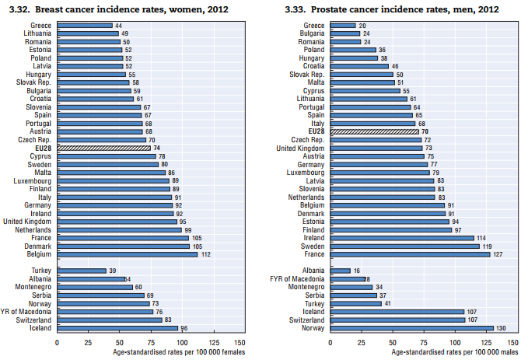

The regional differences are again huge

Slide 14
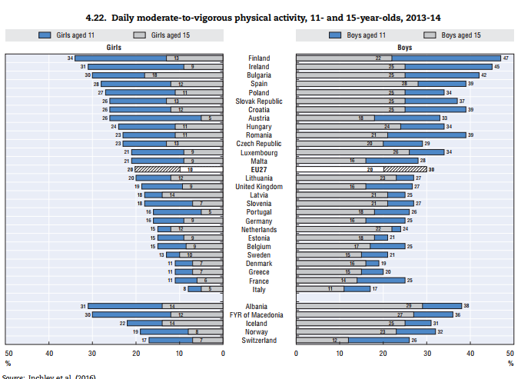
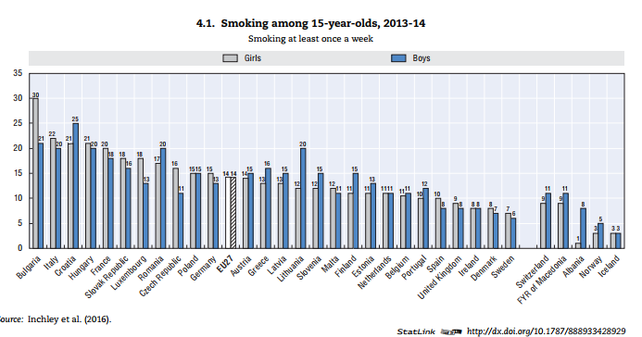
Health determinants are completely different

Slide 15
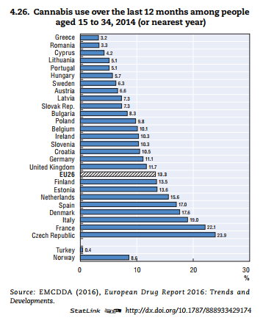
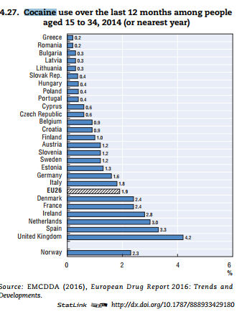

Slide 16
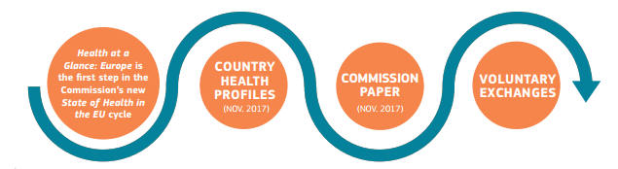
What can EU do about it (and what should be left for national sates).

Slide 17
1. Health in all policies
Since health is determined to a large extent by factors outside the health area, an effective health policy must involve all relevant policy areas, in particular:
  social and regional policy
  taxation
  environment
  education
  research.
All EU policies are required by the EU treaty to follow this "Health in all Policies" (HIAP) approach. But to be fully effective, this approach needs to be extended to national, regional and local policies.

Slide 18
Agencies on EU level
Consumers, Health and Food Executive Agency (Chafea) –
European Centre for Disease Prevention and Control (ECDC) –
European Environment Agency (EEA)
European Monitoring Centre for Drugs and Drug Addiction (EMCDDA)
European Medicines Agency (EMA) –
European Chemicals Agency (ECHA) –
European Food Safety Authority (EFSA) –
European Agency for Safety and Health at Work (EU-OSHA) –
Eurofound
implements the EU Health Programme, Consumer Programme and Better Training for Safer Food initiative.
works to strengthen Europe's defences against infectious diseases.
provides reliable, independent information on the environment.
supplies comprehensive information on drugs and drug addiction in Europe.
protects and promotes public and animal health by evaluating medicines for human and veterinary use.
ensures chemical substances are registered, evaluated, authorised and restricted consistently across the EU.
provides independent scientific advice and clear communication on risks to food and feed safety.
supplies information needed by EU employers and workers to address safety and health issues.
– provides expertise on living and working conditions, industrial relations and managing change for key EU social policy actors.

Slide 19
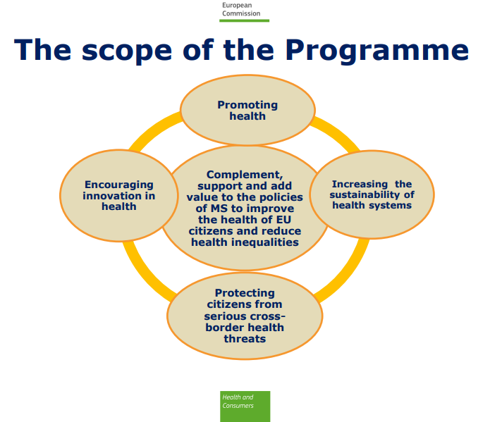
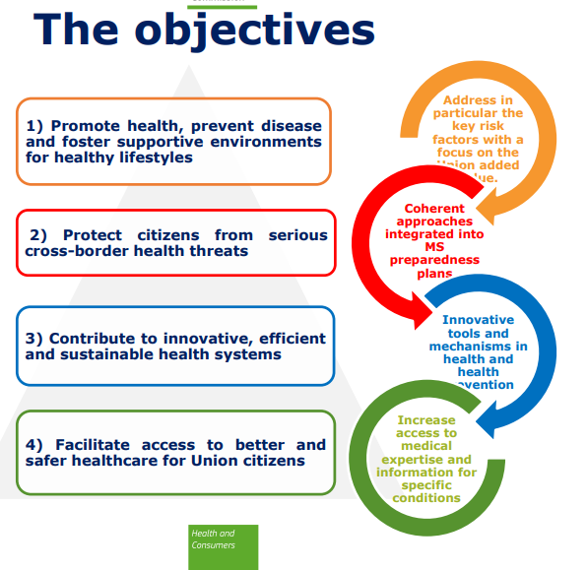
Third EU Health Programme 2014-2020

Slide 20
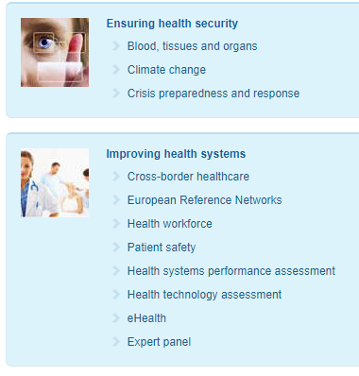
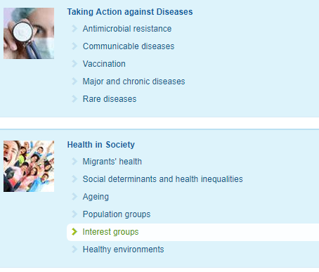
Where is EU taking action (?)

Slide 21
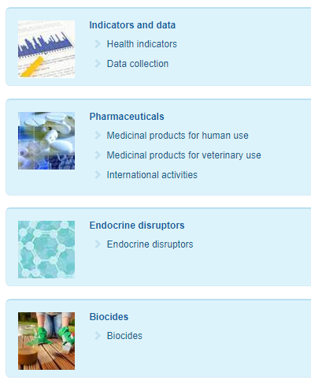
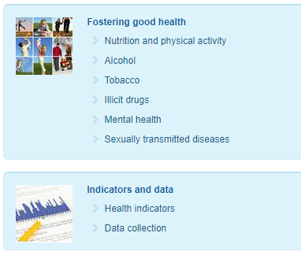

Slide 22
Further actions
Movement of workforce
Health professional
Movement of goods
Safety standards
Marketing rules
Cross-border provision of healthcare

Slide 23
Czech republic
Public health action perspective

Slide 24
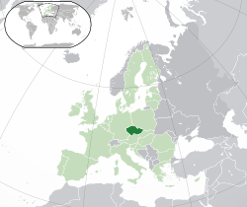
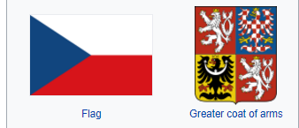
Czech republic

Slide 25
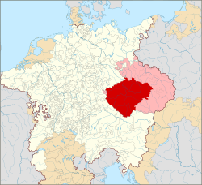
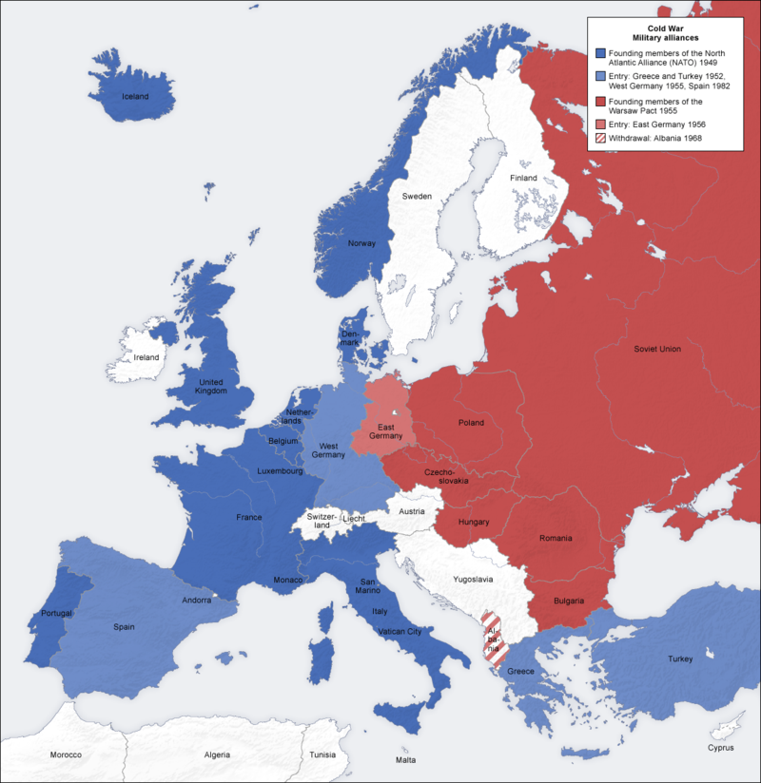
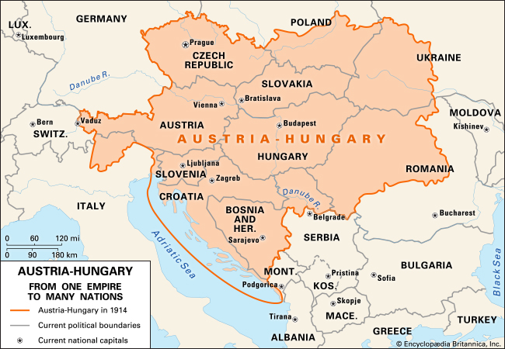
Historical context

Slide 26
Current situation and problems
Health in all policies
Little attention to core health policies
Many agencies with partial public health interest
Public health as a punitive action
Welfare-based system
Compulsory health insurance
Healthcare is provided for free in every necessary medical condition
Hospital is forbidden to accept any payment for necessary treatment
Patients pay only cosmetic treatments or „above the standard treatment“

Slide 27


Slide 28

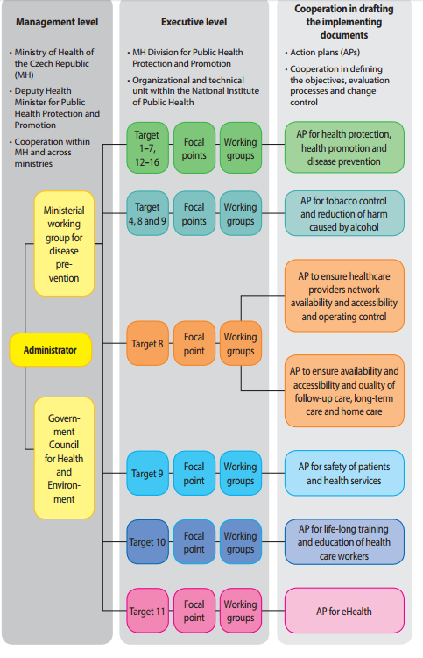

Slide 29
Law in public health

Slide 30
How to improve public health by legal regulations
Institutions
Incentives

Slide 31
Institutions vs. Incentives
Institutions
Hygiene (sanitation)
Incentives
Economic incentives
Food inspection
Drug inspection
Supervision of technology
Environmental
Punitive
Motivational

Slide 32



Drug (medicine control)
Areas of scope
Drug safety
Marketing
Market access
Price regulation

Slide 33
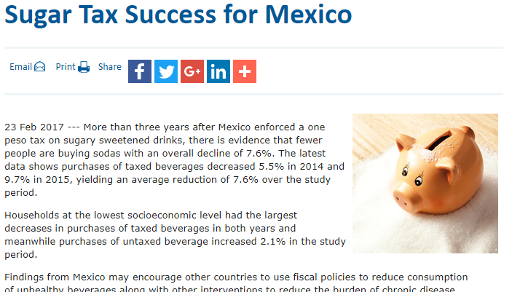
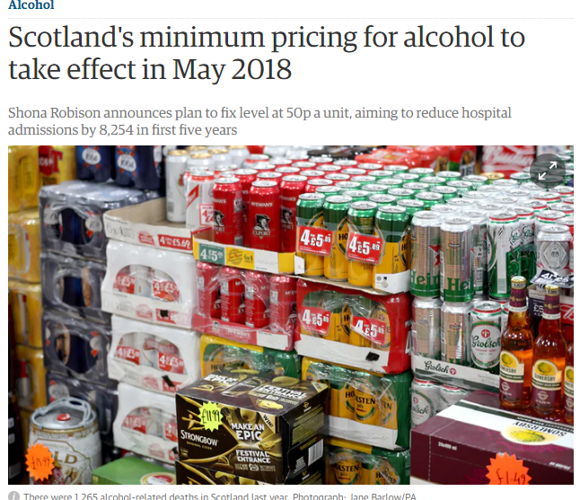
Incentives
Economic incentives
  Consumption taxes, minimum sales price

Slide 34
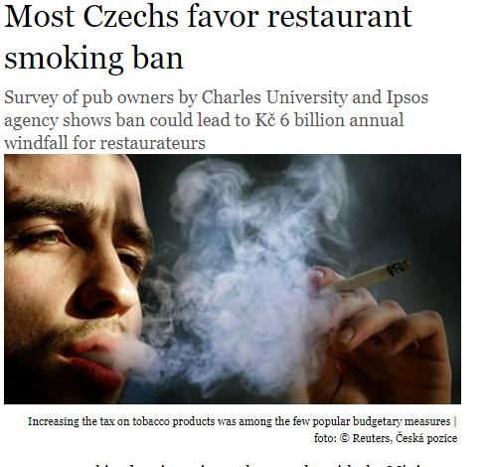
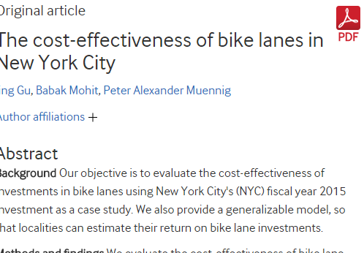
Incentives
Behavioural, environmental incentives and bans

Slide 35
Compulsory healthcare
Vaccination
Quarantines
Compulsory treatment in psychiatry

Slide 36
GENERALLY available healthcare

Slide 37
Financing of healthcare
Current problems of free healthcare

Slide 38
Outline
System of public insurance in Czechia (CZE)
Rights of a patient towards Provider of Healthcare and towards Insurer
Cost effectiveness assessment in CZE
Economic Implications
Rationing
Case study 1: Rationing of expensive medicines
Case study 2: Prescription of innovative medicines

Slide 39
System of public insurance in Czechia
Insurer
Healthcare provider
Chooses insurer (compulsory)
Receives healthcare from insurer’s network
Legal duty to create adequate network of Healthcare providers
Legal duty to provide Healthcare
Patient
Contractual relationship
+ imperative norms
Non-contractual relationship
Regulated exclusively by Public law
Contractual relationship, content strictly regulated

Slide 40
Legislative solution
Constitution / Charter of fundamental rights and freedoms
Free access to medical healthcare is a basic human right
Under conditions set by law
Act on public health insurance
Medicines are integral part of healthcare and every insured person has a right for free medicines (Art. 11 and Art. 13 of the APHI)
The physician prescribing this medicine has ultimate responsibility to prescribe only those medicines that are truly needed
Ultimate objective (principle?)
If the patient truly needs a medicine, he shall get it (for free, or at a marginal cost)

Slide 41
Health technology assessment (or lack thereof) in CZE
State instute for drug control
State institute for drug control (again!)
Step 1 Assesment of medicinal effects of a drug
EMEA
Insurance companies are just parties discussed in the administrative procedure, but they have no competence to decide or veto
The economic element is evaluated by „cost effectiveness“
Step 2 Introduction to the insurance system

Slide 42

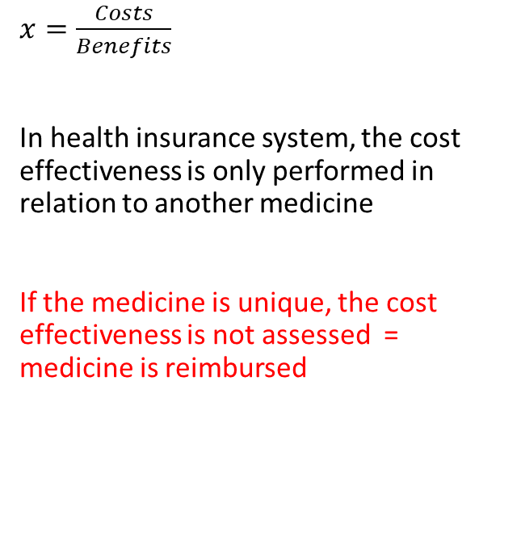
Cost effectiveness
$x=\frac{Costs}{Benefits}$
In health insurance system, the cost effectiveness is only performed in relation to another medicine
If the medicine is unique, the cost effectiveness is not assessed = medicine is reimbursed

Slide 43
Economic implications
The entity which decides about reinbursement is not the one that will actually reimburse it
New drugs are parachuting into the system without moderation
reluctance of a national legislator to act; Process is accelerated by EMEA
Result – the health insurance budgets are bloating
The costs of special „centric“ medicines of the largest insurance company have risen from 4,2 billion to 7,2 billion in five years
The cost increase between 2014 and 2015 is 12 percent
Regardless of whether the system can afford it
Impossible not to reimburse „medicine without alternative“

Slide 44
So - who does the rationing?
The most expensive drugs are labelled as „centric“
distributed only by selected „centres“ app. 60 providers
There are approximately 160 „centric“ drugs, 0,4% of clients are recipients of centric dugs, generate 23% of total expenses on drugs
„Centric“ healthcare providers
budget caps for each diagnostic group
ultimate entities that are responsible for rationing
Health insurance companies
also responsible to provide adequate healthcare
Contract
Contract

Slide 45
What if the budget cap is reached ?
Case study no. 1

Slide 46
System of public insurance in Czechia
Insurer
Healthcare provider
Chooses insurer (compulsory)
Receives healthcare from insurer’s network
Legal duty to create adequate network of Healthcare providers
Legal duty to provide Healthcare
Patient
Contractual relationship
+ imperative norms
Non-contractual relationship
Regulated exclusively by Public law
Contractual relationship, content strictly regulated

Slide 47
Conflicting perspectives
Healthcare provider
I don’t care about the contract between those two
My obligation to provide healthcare ends where the budget cap is
Patient
My right to medicine is guaranteed by law and constitution
I cannot treat patients if the insurer does not cover them
Insurer
I have contracted adequate healthcare,
If provider cannot treat all the patients within the budget, he shouldn’t have signed the contract in the first place

Slide 48
Perspective of a physician
Will I be prosecuted if I refuse to prescribe centric medicine due to budget restrictions?
Will I be prosecuted if I prescribe the medicine despite the budget cap?
Am I allowed to prescribe cheaper medicine, or should I wait untill the next budget period?

Slide 49
Perspective of rationing
Who should make difficult decisions?

Slide 50
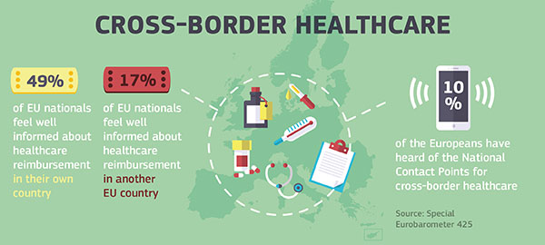
Cross border provision of healthcare within the EU

Slide 51
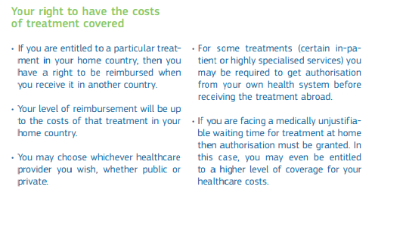

Slide 52
