Slide 1
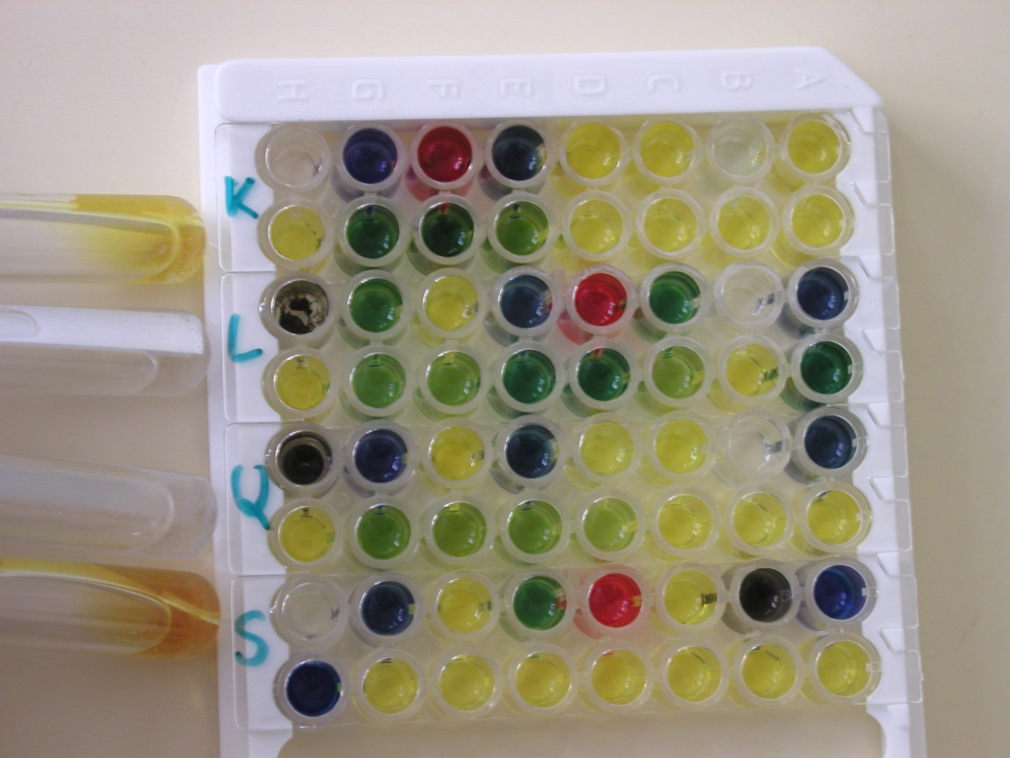
Enterotest
Biochemical test used for enterobacteriaceae identification

