Slide 1
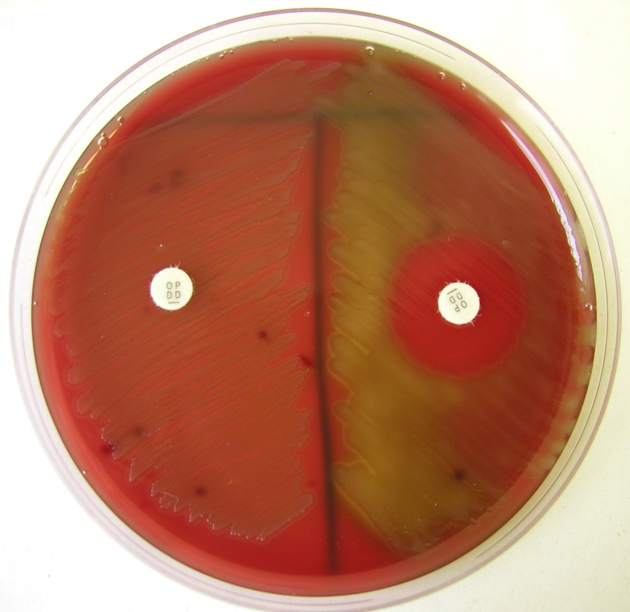
Optochin susceptibility test (streptococci)
S. pneumoniae is optochin-susceptible (on the right)
viridans streptococci are optochin resistant (on the left)

