Slide 1
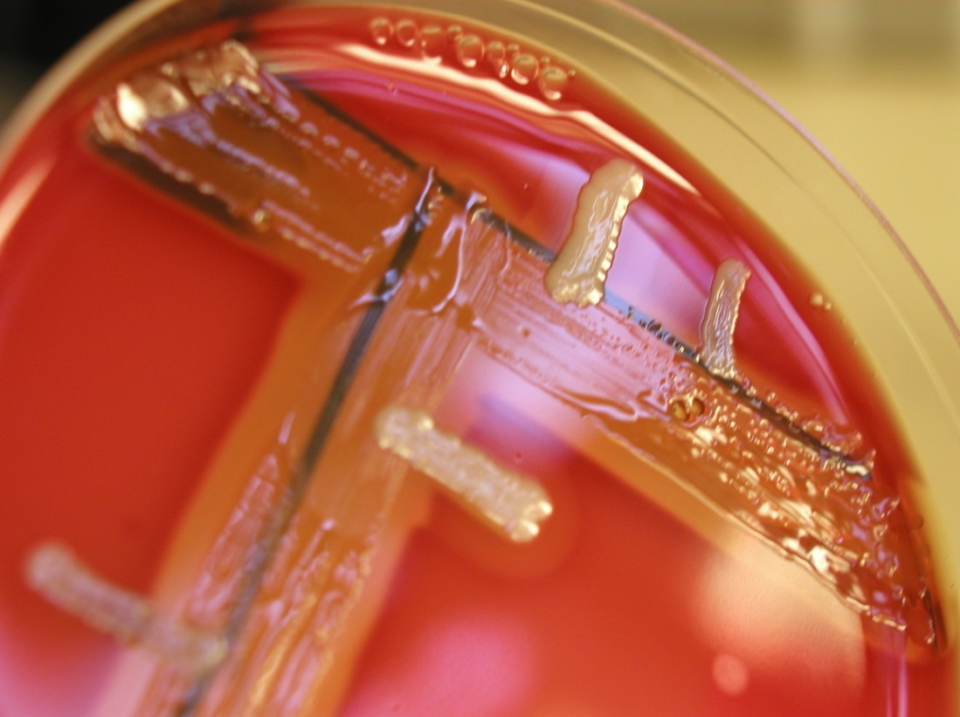
Hyaluronidase
S. aureus (circle) is hyaluronidase-positive
Negative result is typical for coagulase-negative staphylococci

