Slide 1
Basic medical terminology
Seminar 6 and 7

Slide 2
3rd declension: specific features
genitive ending: -is
all 3 genders are included (cortex m., radix f., femur n.)
nom. sg. – various endings (sanguis, excisio, abductor, rete, latus, femur, abdomen, cavitas)
!The GENDER CANNOT be determined on the basis of the NOMINATIVE and GENITIVE form!

Slide 3
3rd declension nouns
Two main groups:
Consonant stems: typically nouns with different number of syllables in Nom. and Gen. (genitive is longer than and different from nominative) = absolute majority of 3rd declension nouns
I- stems: nouns with the same number of syllables in Nom. and Gen. (m. + f.) + nouns with two or more consonants preceding the genitive ending –is (m. + f.) + neuters ending in –e, –al, –ar in Nom. sg. (i.e. rete, calcar, cochlear, animal)

Slide 4
3rd declension paradigms
Consonant stems (Latin + Greek) |  | I-stems (Latin) |  | I-stems (Greek)
DOLOR | CORPUS | PELVIS | RETE | DOSIS
M. + F. | N. | M. + F. | N. | F.

Slide 5
Consonant stems: paradigms DOLOR (m., f.)+ CORPUS (n.)
= typically nouns with different number of syllables in Nom. and Gen. (genitive is longer than and different from nominative)
stem in nom. sg. and gen. sg. differs
pulm-o//pulmon-is
fem-ur//femor-is
rad-ix//radic-is
In order to decline a 3rd declension noun properly (both consonant stems and i-stems), it is necessary to know its GENITIVE form.
1. pulm-o
2. pulmon-is
4. pulmon-em
6. pulmon-e

Slide 6
DOLOR
 | Sg. | Pl.
nom. | dolor | dolor-es
gen. | dolor-is | dolor-um
accus. | dolor-em | dolor-es
abl. | dolor-e | dolor-ibus

Slide 7
CORPUS
 | Sg. | Pl.
nom. | corpus | corpor-a
gen. | corpor-is | corpor-um
accus. | corpus | corpor-a
abl. | corpor-e | corpor-ibus

Slide 8
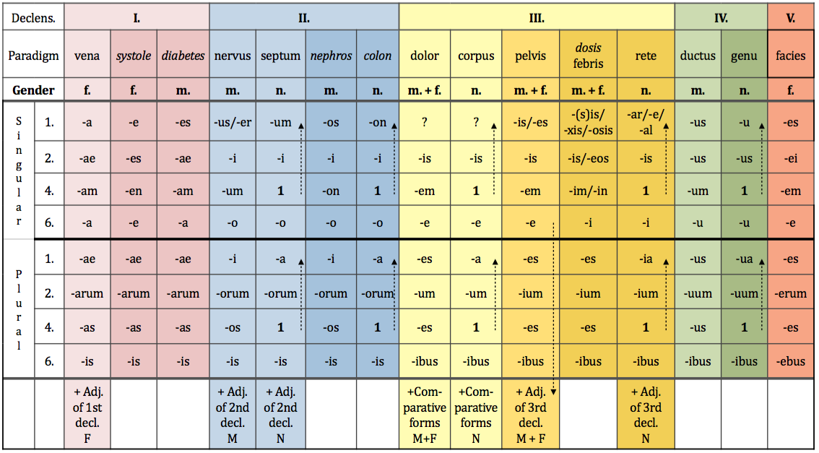
Consonant-stem paradigms

Slide 9
Consonant stems: nouns of Greek origin
Nouns of Greek origin declined according to
consonant-stem paradigms
= nouns with typical endings:
: -itis, itidis, f. → inflammation
e.g. hepatitis, itidis, f. (follows paradigm DOLOR)
: -(o)ma, (o)matis, n. → tumour diseases/swellings
e.g. oedema, matis, n. (follows paradigm CORPUS)

Slide 10
3rd declension nouns + adjectives
M F N
SG.
1. dolor magnus cavitas magna foramen magnum
2. doloris magni cavitatis magnae foraminis magni
4. dolorem magnum (in) cavitatem magnam foramen magnum
6. dolore magno (in) cavitate magna foramine magno
PL.
1. dolores magni cavitates magnae foramina magna
2. dolorum magnorum cavitatum magnarum foraminum magnorum
4. dolores magnos (in) cavitates magnas foramina magna
6. doloribus magnis (in) cavitatibus magnis foraminibus magnis

Slide 11
Latin I-stems: paradigms PELVIS (m., f.) + RETE (n.)
Masculines and feminines
A) nouns having the same number of syllables in Nom. and Gen. sg.
ca-na-lis, ca-na-lis, m.
pel-vis, pel-vis, f.
pu-bes, pu-bis, f.
B) nouns having a group of consonants preceding the genitive ending -is
(i.e. the genitive stem ends in a group of consonants)
pars, part-is, f.
dens, dent-is, m.
Neutres
= nouns ending in nom. sg. in –e, –al, –ar
: only few words: animal, alis, n.; calcar, aris, n.; cochlear, aris, n.; rete, is, n.

Slide 12
3rd declension paradigms
Consonant stems (Latin + Greek) |  | I-stems (Latin) |  | I-stems (Greek)
DOLOR | CORPUS | PELVIS | RETE | DOSIS
M. + F. | N. | M. + F. | N. | F.

Slide 13
PELVIS
I-STEM MASCULINE AND FEMININE GENDER NOUNS
 | Sg. | Pl.
nom. | pelvis | pelv-es
gen. | pelv-is | pelv-ium
accus. | pelv-em | pelv-es
abl. | pelv-e | pelv-ibus

Slide 14
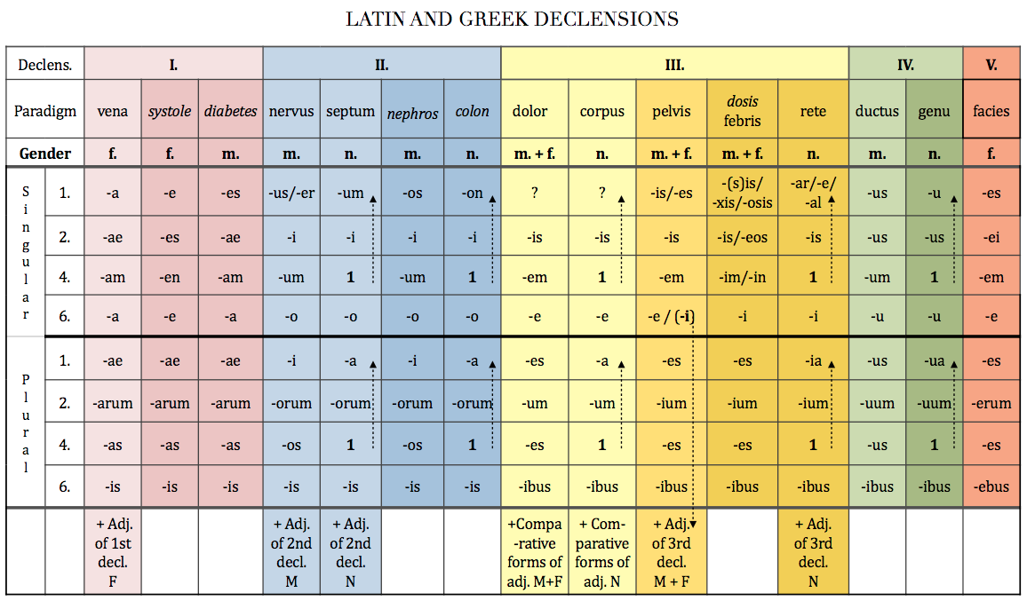
DOLOR vs. PELVIS
P

Slide 15
Consonant stems vs. i-stems (M. + F.)
 | Sg. | Pl.
nom. | dolor | dolor-es
gen. | dolor-is | dolor-um
accus. | dolor-em | dolor-es
abl. | dolor-e | dolor-ibus
 | Sg. | Pl.
nom. | pelvis | pelv-es
gen. | pelv-is | pelv-ium
accus. | pelv-em | pelv-es
abl. | pelv-e | pelv-ibus
CONSONANT-STEM MASCULINE AND FEMININE GENDER NOUNS
I-STEM MASCULINE AND FEMININE GENDER NOUNS

Slide 16
RETE
I-STEM NEUTRE GENDER NOUNS
 | Sg. | Pl.
nom. | rete | ret-ia
gen. | ret-is | ret-ium
accus. | rete | ret-ia
abl. | ret-i | ret-ibus

Slide 17
CORPUS vs. RETE
P

Slide 18
Consonant stems vs. i-stems (M. + F.)
 | Sg. | Pl.
nom. | corpus | corpor-a
gen. | corpor-is | corpor-um
accus. | corpus | corpor-a
abl. | corpor-e | corpor-ibus
 | Sg. | Pl.
nom. | rete | ret-ia
gen. | ret-is | ret-ium
accus. | rete | ret-ia
abl. | ret-i | ret-ibus
CONSONANT-STEM NEUTER
GENDER NOUNS
I-STEM NEUTER GENDER NOUNS

Slide 19
Greek I-stems: paradigm DOSIS
Nouns declined according to the paradigm dosis
= feminine nouns of Greek origin ending in -sis, -xis, -osis
+ some Latin words: febris, is, f.; tussis, is, f.; pertussis, is, f.; sitis, is, f.;
tuberculosis, is, f.; axis, is, m. (these nouns do not have the Greek endings -eos, -in)
 | Sg. | Pl.
nom. | dosis | dos-es
gen. | dos-is / -eos | dos-ium
accus. | dos-im / -in | dos-es
abl. | dos-i | dos-ibus
-osis, is, f. →
degenerative or
non-inflammatory disease
(e.g. nephrosis, is, f.)

Slide 20
EXCEPTIONS
os, ossis, n. = bone → gen. pl. –ium
vas, vasis, n. = vessel
: in sg. follows paradigm CORPUS vas-vasis-vas-vase
: in pl. follows paradigm SEPTUM vasa-vasorum-vasa-vasis

Slide 21
Identify the stems of the given nouns
Nom. Sg. Gen. sg. Stem
abdomen
dolor
latus
abductor
encephalitis
lien
amputatio
excisio
luxatio
apex
extensor
margo
abdominis
abdomin-
doloris
dolor-
lateris
later-
abductoris
abductor-
encephalitidis
encephalitid-
lienis
lien-
amputationis
amputation-
excisionis
excision-
luxationis
luxation-
apicis
apic-
extensoris
extensor-
marginis
margin-

Slide 22
Give nominative forms of the given nouns
Ex.: Injectionis > Injectio, feminine, DOLOR
cervicis
solutionis
tumoris
femoris
vertebrae
sacchari
systoles
oculi
cancri
phalangis
ossis
oris
coli
colli
extremitatis
capitis
ganglii
cervix
solutio
tumor
femur
vertebra
saccharum
systole
oculus
cancer
phalanx
os
os
colon
collum
extremitas
caput
ganglion

Slide 23
Write down the stems and the paradigm words
os, ossis, n.
cutis, is, f.
mors, tis, f.
pulmo, onis, m.
trauma, atis, n.
basis, is /eos, f.
animal, alis, n.
latus, eris, n.
tussis, is, f.
pubes, is, f.
oss-
cut-
mort-
pulmon-
traumat-
bas-
animal-
later-
tuss-
pub-
corpus
pelvis
pelvis
dolor
corpus
dosis
rete
corpus
dosis
pelvis

Slide 24
Assign nouns/adjectives to declension paradigms
vena
nervus
dolor
systole
septum
corpus
• musculus • vulnus • ulcus • digitus • albus
• cavitas • vas • arterias • diarrhoes •
• ligamenta • aqua • crura • symptoma
• tumor • ren • abdomen • systolen • apex
• luxatio • ostio • os • radios • cor

Slide 25
Form non-agreed attributes
Cavitas + septum nasi
Operatio + cervix uteri
Corpus + vertebra thoracica
Fractura + os sacrum
Luxatio + crus
Morbus infectiosus + abdomen
Dolor acutus + caput
Cavitas septi nasi
Operatio cervicis uteri
Corpus vertebrae thoracicae
Fractura ossis sacri
Luxatio cruris
Morbus infectiosus abdominis
Dolor acutus capitis

Slide 26
Change into plural
sphincter
foramen nutricium
dolor chronicus
vas longum
musculus adductor
femur fractum
cartilago thyroidea
vulnus punctum
sphincteres
foramina nutricia
dolores chronici
vasa longa
musculi adductores
femora fracta
cartilagines thyroideae
vulnera puncta

Slide 27
Fill in synonyms
English Latin Greek
_____________ ___________ soma
_____________ os, oris _____________
kidney _____________ _____________
_____________ _____________ gaster
brain _____________ _____________
_____________ organum _____________
_____________ _____________ hepar
stitch _____________ _____________
_____________ vulnus __________
body
corpus
mouth
stoma
ren
nephros
stomach
ventriculus
cerebrum
encephalon
organ
organon
liver
iecur
sutura
r(h)aphe
injury, wound
trauma

