Slide 1
Introduction to
Basic Medical Terminology
(aVLLT0121)
autumn 2019

Slide 2
Course requirements and rules
STUDY MATERIALS
– materials available in the IS
– textbook: Prucklová, R. – Severová, M.: Introduction to Latin and
Greek Terminology in Medicine. Praha: KLP, 2012 (Units 1–7)
– drill on the IS (https://is.muni.cz/auth/dril/?lang=en)
TESTING
– 2 progress tests (pass limit = 70%)
– credit test (pass limit: 60–70%)
– rules for testing
– access to test results
CLASS ATTENDANCE AND SUBSTITUTIONS

Slide 3
Latin in medical terminology
= universal, precise and flexible system of terms used in:
anatomical nomenclature (= definite set of terms denoting parts and structures of the human body)
– first worldwide official standard terminology appeared in 1895
(Basiliensia Nomina Anatomica), since then it has been
periodically updated and changed to implement new findings
and/or understanding of the anatomical structures
– current terminology, approved by FCAT (Federative Committee
on Anatomical Terminology), was published in 1998 as
TERMINOLOGIA ANATOMICA (cf. http://www.unifr.ch)

Slide 4
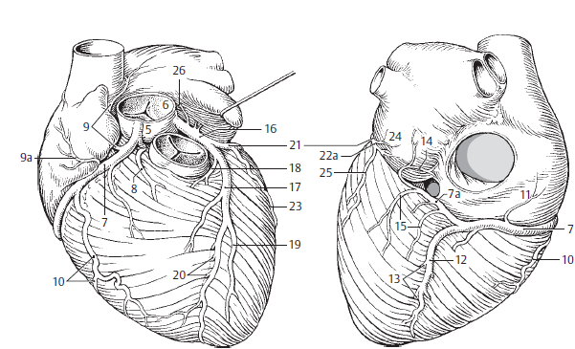
Anatomical structures
5 bulbus aortae
6 arteria coronaria dextra
rami atrioventriculares
8 ramus coni arteriosi
9 ramus nodi sinuatrialis
10 ramia atriales
11 ramus marginalis dexter
12 ramus atrialis intermedius
13 ramus interventricularis posterior
14 rami interventriculares septales
15 ramus nodi atrioventricularis
16 ramus posterolateralis dexter
17 arteria coronaria sinistra
18 ramus interventricularis major
19 ramus coni arteriosi
20 ramus lateralis
21 rami interventriculares septales
22 ramus circumflexus
23 ramus atrialis anastomoticus

Slide 5
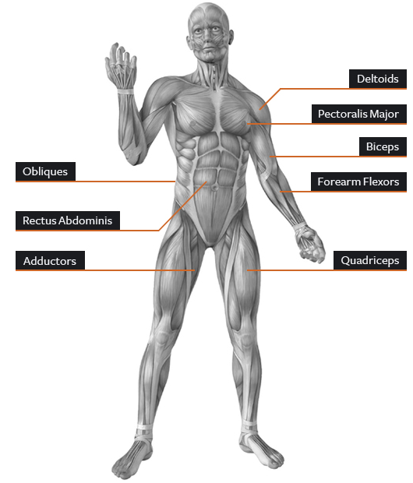
Anatomical structures
Musculus deltoideus
Musculus pectoralis major
Musculi obliqui abdominis
Musculus biceps brachii
Musculus rectus abdominis
Musculus flexor carpi
Musculi adductores
m. adductor longus
m. adductor brevis
Musculus quadriceps femoris

Slide 6
Latin in medical terminology
= universal, precise and flexible system of terms used in:
clinical terminology (= non-definite set of terms denoting diseases, health conditions or causes of death)
– the first international classification of diseases
was adopted in 1893
– current terminology ICD-10 (International Classification
of Diseases) is approved by WHO and published every ± 10 years (www.who.int/classifications/icd/en/)
– widely used in medical documentation, e.g. in medical reports,
surgical and hospital reports, pathological reports (central Europe,
Russia and former republics of USSR, partly Western Europe –
Germany, Austria)

Slide 7
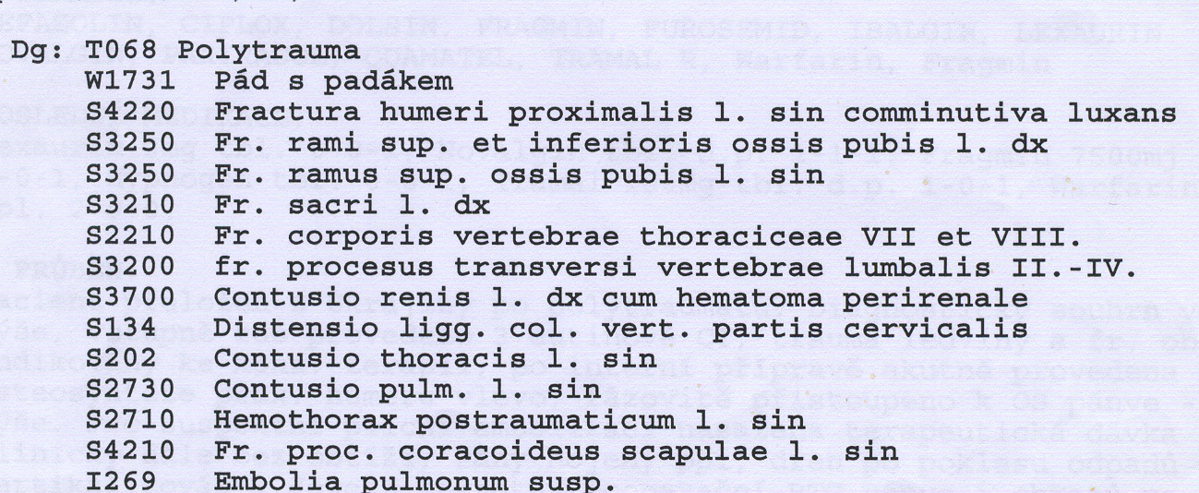
Clinical diagnosis
ICD http://apps.who.int/classifications/icd10
S20.2 = Contusion of thorax

Slide 8
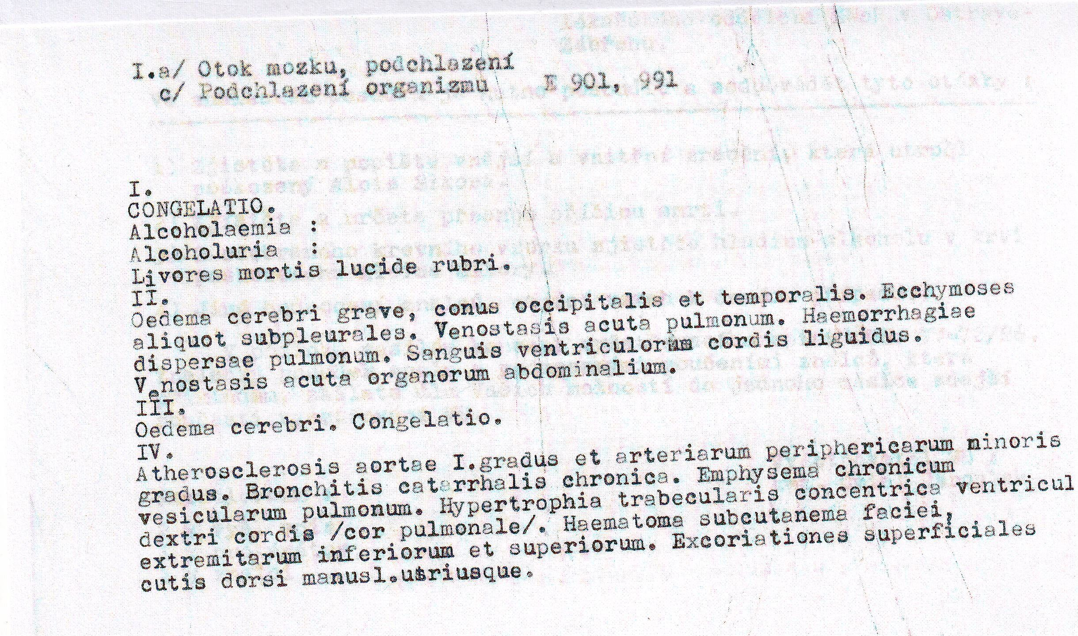
Dissection protocol

Slide 9
Latin in medical terminology
= universal, precise and flexible system of terms used in:
pharmacological terminology = definite set of terms used in European Pharmacopoea to denote:
  essential medicines (acidum phosphoricum)
  classes of medicines (antipyretica, spasmolytica)
  forms of medicines (solutio, injectio, tabuletta)
  drugs (calendula officinalis)
prescriptions
  the main part of the prescription (including the name and quantity of the medicine as well as the way of its administration) is usually written in Latin, using a system of standard abbreviations

Slide 10
Medical prescription

Slide 11
Learning outcomes
At the end of the course, you will be able to:
understand the structure of anatomical terms and apply them correctly (this makes the memorizing of anatomical terminology much easier!)
understand the principles of forming more complex (anatomical and clinical) terms
understand and write a clinical diagnosis
write a medical prescription

Slide 12
Latin pronunciation

Slide 13
Vowels
A | Ā | B | C | D | E | Ē | F | G | H | I | Ī | K | L | M | N
O | Ō | P | Q | R | S | T | U | Ū | V | X | Y | Y | Z
Vowels
Long Short
Ā (father) frāctūra A (cut) lingua
Ē (sad) artēria E (met) vertebra
Ī (intrigue) spīna I (intrigue) digitus
I (yes) > J
Ō (door) sensōrius O (on) skeleton
Ū (boom) ruptūra U (put) uterus
Y (analysis) hypophysis Y (lady) tympanum
Diphtongs
AE=Ē (care) anaemia
OE=Ē (care) lagoena
Greek words
OE (o-e) dyspnoe
EU (e-u) euthanasia

Slide 14
Read aloud
hypnosis
ala
olla
eupnoe
ileus
mucus
haematoma
iliacus
ossa
diploe
cubitus
venae
diameter
sacralis
ulcus
iris
sutura
sigmoideus
depressor
area
oesophagus
melior
meatus
leucocytus

Slide 15
Consonants
A | Ā | B | C | D | E | Ē | F | G | H | I | Ī | K | L | M | N
O | Ō | P | Q | R | S | T | U | Ū | V | X | Y | Ŷ | Z
Consonant/group of consonants | Pronunciation | Example
1: c + a, o, u, consonants c + ae, oe, e, i, y | [k] medical [ts] | camera, costa, cultivatio, cranium caecus, coeliacia, centrum, circulatio, cynismus
2: ch | [x = Greek chi] | chirurgia, cholera

Slide 16
Consonants II
Consonant/group of consonants | Pronunciation | Example
3: g gu + vowel | [g] ground [gv] | gramma, gastritis lingua, sanguis
4: h | [h] house | herba, haematologia
5: j/i + vowel | [y] yes | iniectio/injectio, maior/major
6: p p + h | [p] present [f] physiology | pneumonia, pulmo phantasia, pharmacia
7: qu+ vowel | [kv] | aqua, quadriceps
8: r r+h | [r] rupture [r] | vertebra, ruptura rheuma, rhinitis

Slide 17
Consonants III
Consonant/group of consonants | Pronunciation | Example
9: s/ss s between two vowels and following after l, r, n s between a vowel and m | [s] some [z] zebra [z] zebra | serum, fossa nasus, incisura, pulsus, inversus, tonsilla, suspensio spasmus
10: t ti ti + vowel s/t/x + ti + vowel t+h | [t] tongue [ty] [tsi] [ty] [t] | trauma, tactus tibia operatio, substantia ostium, mixtio therapia, thermometrum
11: z | [z] zone | zoologia

Slide 18
Read aloud
cancer, medicamentum, lingua
thorax, pulsus, contusio
corpus, exitus, functio
hemispherium, angulus, fractura
intestinum, aqua, pharmacon
oedema, musculus, defectus
medicus, operatio, infarctus
homo, bronchus, duodenum
angina, haemorrhagia, spasmus
encephalon, bacterium, acne
migraena, pharynx, dysenteria
inflammatio, leucaemia, virus
laparoscopia, typhus, organismus
therapia, digitus, gingiva
gangraena, diagnosis, tonsilla
injectio, lympha, oxygenium
vademecum, insufficientia, chirurgia

Slide 19
Grammatical categories of Latin nouns and adjectives

Slide 20
Morphological typology of languages:
English vs. Latin
analytic / isolating languages
= rely mainly on word order to convey meaning > contain very little inflection (e.g. Chinese, English – fixed word order = SVOMPT
keeps sentences understandable)
synthetic languages
= word order is less important, individual words express their grammatical functions/relations by means of prefixes and suffixes, higher degree of inflection
– agglutinative (e.g. Turkish, Hungarian, Japanese, Finnish)
– fusional = inflectional (e.g. Latin, Greek, Czech, Russian,
Romance languages)
– polysynthetic (Eskimo languages)

Slide 21
Number and gender
Number
singular (sg. = 1)
plural (pl. = 2 and more)
Gender
masculine (nervus, i, m.)
feminine (vena, ae, f.)
neutral (cerebrum, i, n.)

Slide 22
Case
Case expresses the grammatical function of
a word in a sentence/phrase.
There are six cases in Latin, but only four of them are used in medical terminology:
1. nominative (nom.) – expresses subject
2. genitive (gen.) – expresses possession (“of”)
4. accusative (accus.) – prepositional case
6. ablative (abl.) – prepositional case

Slide 23
Case
case | function | use | vocabulary system
nominative | subject of a phrase | ANATOMY corpus ulnae (= body of elbow bone) | 1st part of the dictionary entry
genitive | possessive case = English „of“ | ANATOMY caput femoris (= head of thigh bone) | 2nd part of the dictionary entry
accusative | after prepositions | CLINICAL DIAGNOSES post operationem (after operation) sine complicationibus (= without complications)
ablative

Slide 24
Case: English vs. Latin
English: (fixed) word order gives the information on the grammatical function of each word in a sentence/phrase
e.g. Teacher gives a book to the student.
(subject – verb – direct object – indirect object)
Latin: the form of each word expresses its grammatical function in a sentence/phrase (> loose word order)
e.g. Magister librum discipulo dat.

Slide 25
Case: English vs. Latin
English: change of the word order > meaning change
soft ulcer in duodenum x ulcer in soft duodenum
  the grammatical function of a word is conveyed by WORD ORDER (Subject-Verb-Object rule)
Latin: change of the word order > nothing happens
soft ulcer of/in duodenum:
ulcus molle duodeni = ulcus duodeni molle
  the grammatical function of a word is conveyed by its ENDING!!!

Slide 26
Case: example
status post implantationem osteoprotheseos coxae sine complicationibus
NOMINATIVE
= state/condition
GENITIVE
= of osteoprothesis
= of hip joint
ACCUSATIVE
= after implantation
ABLATIVE
= without complications
= state after the implantation of osteoprothesis of hip joint without
complications

Slide 27
How does a dictionary entry look like?
English: one single form of a noun is given
Latin: a noun is presented in the following way
MUSCULUS, I, M. = MUSCLE
OS, OSSIS, N. = BONE
English translation
nominative singular
genitive ending/or full genitive form
gender
ALL these pieces of information are EQUALLY important
and should be learned by heart!!!

Slide 28
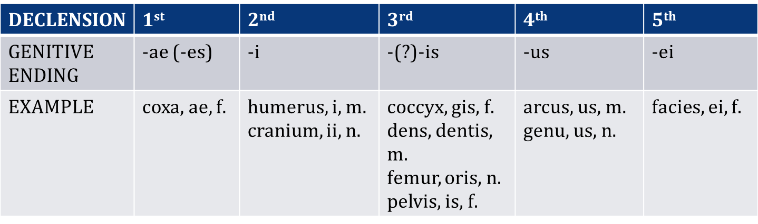
Latin declensions
declensions are groups of nouns (+ adjectives) declined in the same way (i.e. they share one and the same set of case endings)
there are 5 declensions in Latin
the declension of a noun can be identified on the basis of the genitive singular ending

Slide 29
Latin declensions
Nouns are divided into 5 declensions on the basis of their stem sound (see gen. pl.!):
1st declension – a-stems – ven-a-rum
2nd declension – o-stems – nerv-o-rum
3rd declension
  i-stems – pelv-i-um
  consonant stems – dolo-r-um, pon-t-um, sectio-n-um
  4th declesion – u-stems – duct-u-um
5th declension – e-stems – faci-e-rum

Slide 30
How to decline a Latin noun?
1. find the right declension paradigm
(on the basis of gen. sg. + gender)
2. find the stem of the noun
= part of the word, which remains after the
removal of the ending of genitive singular
3. attach individual case endings to the stem
ven-a
ven-ae
humer-us
humer-i
diamet-er
diametr-i
dol-or
dolor-is
corp-us
corpor-is
de-ns
dent-is
arc-us
arc-us
gen-u
gen-us
faci-es
faci-ei

Slide 31
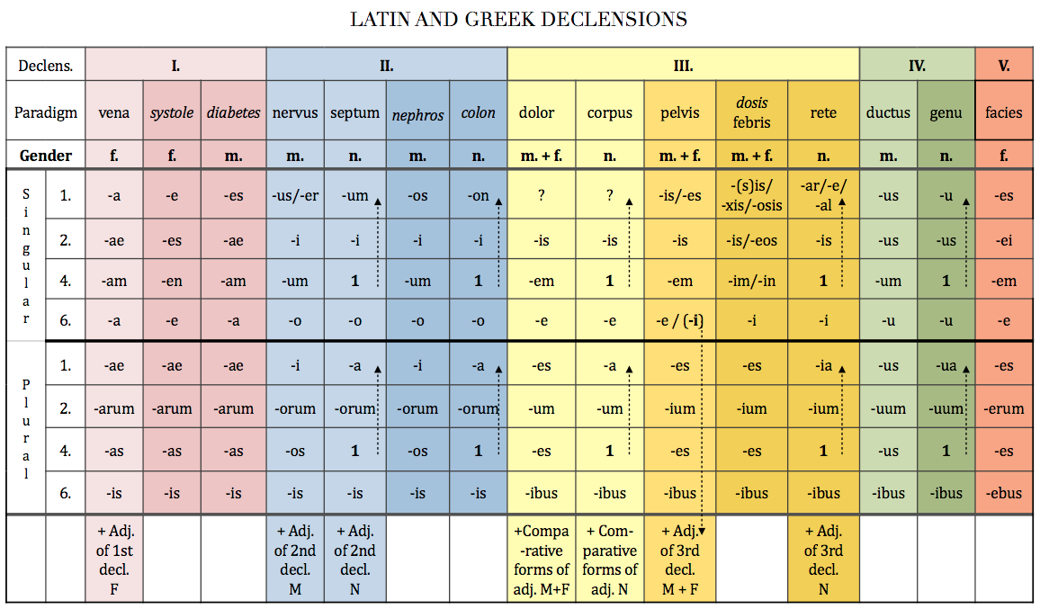
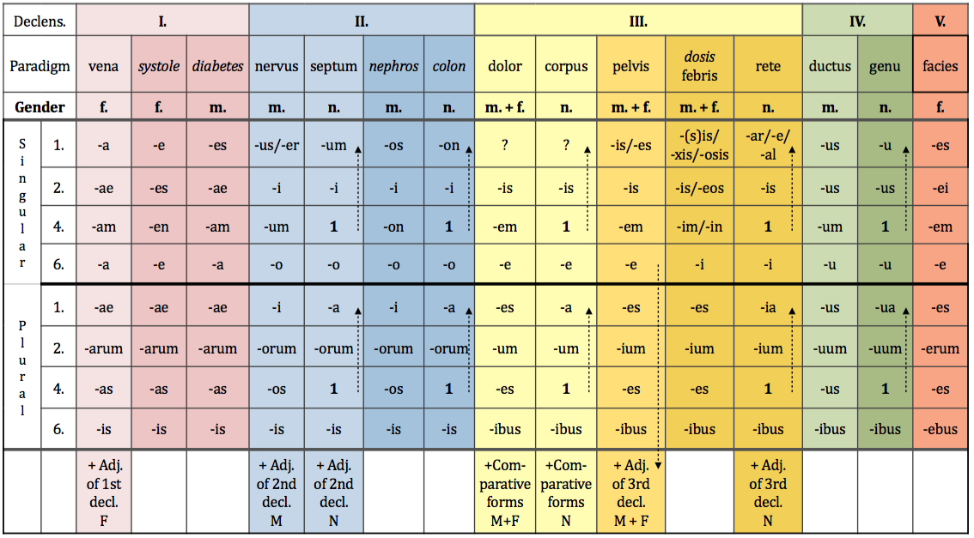

Slide 32
Adjectives
= words that describe nouns
Noun-adjective agreement in Latin
= a Latin adjective always corresponds with the
respective noun in gender, number and case!!!!
Noun + adjective = agreed attribute
Examples: fractura ulnae dextrae complicata
vertebrae thoracicae
ad lagoenam fuscam
cum anaemia perniciosa
Why do you think this is so?

Slide 33
Prepositions
= words that express relations (spacial, temporal etc.) between nouns
  with ACCUSATIVE with ABLATIVE
  in (direction) = towards, into – in venam in (location) = inside – in vena
  sub (direction) = under – sub tibiam sub (location) = under – sub tibia
  ad = towards, to – ad cranium e/ex = out of – e scatula
  ante / post = before / after – ante / post operationem a/ab = from, by – a medico
  extra / intra = outside / inside of – extra / intra pulmones sine = without – sine insufficientia
  contra = against – contra tussim cum = with – cum digito medio
  per = through – per rectum pro = for the sake of – pro adulto
  prope (motion) = near to – prope ulnam
  propter = because of – propter anaemiam
  circum = around – circum oculum
  inter = between – inter costas
  secundum = according to – secundum Geppert

