Slide 1
Basic medical terminology
Seminar 4

Slide 2
Revision
What is the difference between a non-agreed attribute and an agreed attribute? Give examples.
How do we recognize adjectives of the 1st and 2nd declension? How do we decline them?
What is tricky about the adjectives with the -er ending in Nom. sg. m.? Give examples.
How do we find the right form of an adjective for a particular noun?

Slide 3
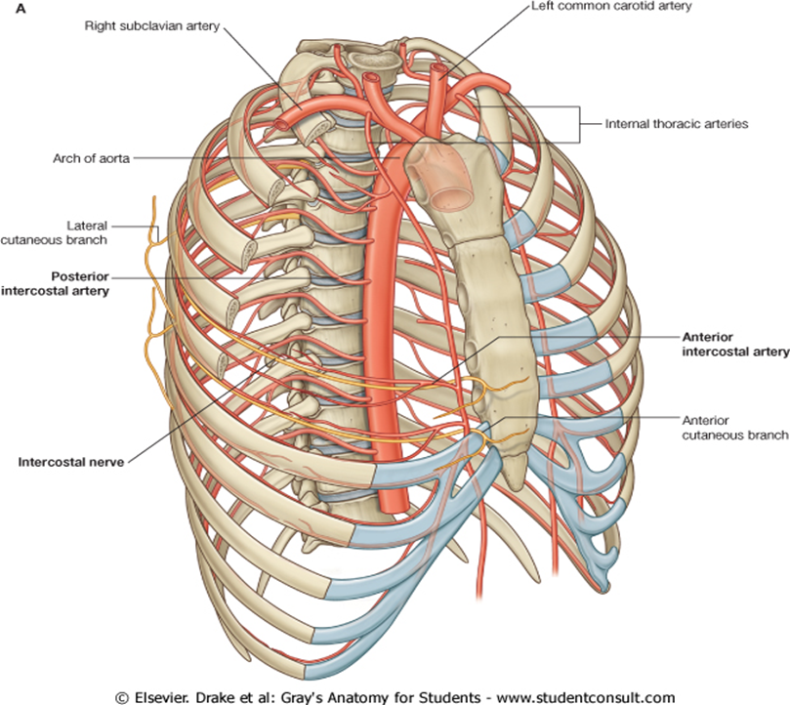
Practice
Internal thoracic artery/-ies?
Notes:
Artheria thoracica interna

Slide 4
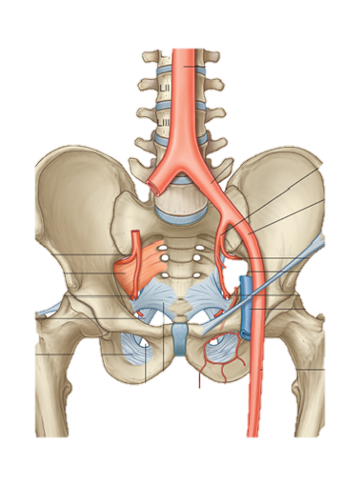
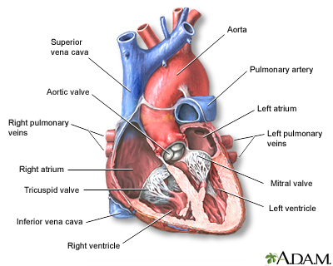
Arch of aorta?
Practice
External/internal
iliac artery?

Slide 5
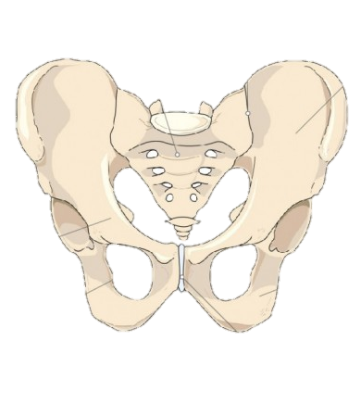
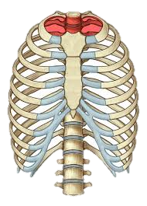
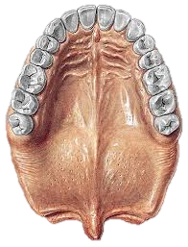
Practice
Aperture of pelvis?
Thoracic aperture?
Median
raphe?
Notes:
Apertura pelvis (pelvica); apertura thoracica; r(h)aphe mediana

Slide 6
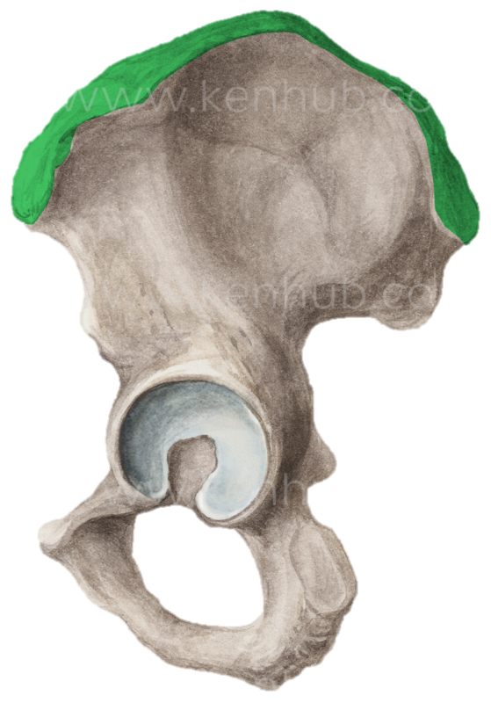
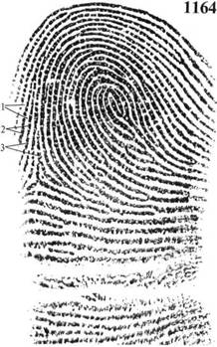
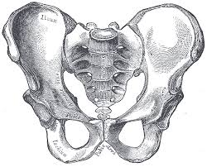
Practice
Iliac crest?
Ridges of skin (dermal ridges)?
Pubic crest?
Notes:
cristae cutis

Slide 7
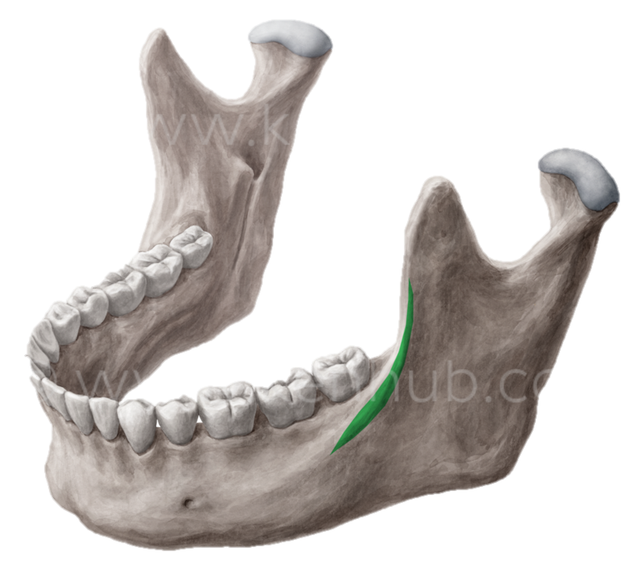
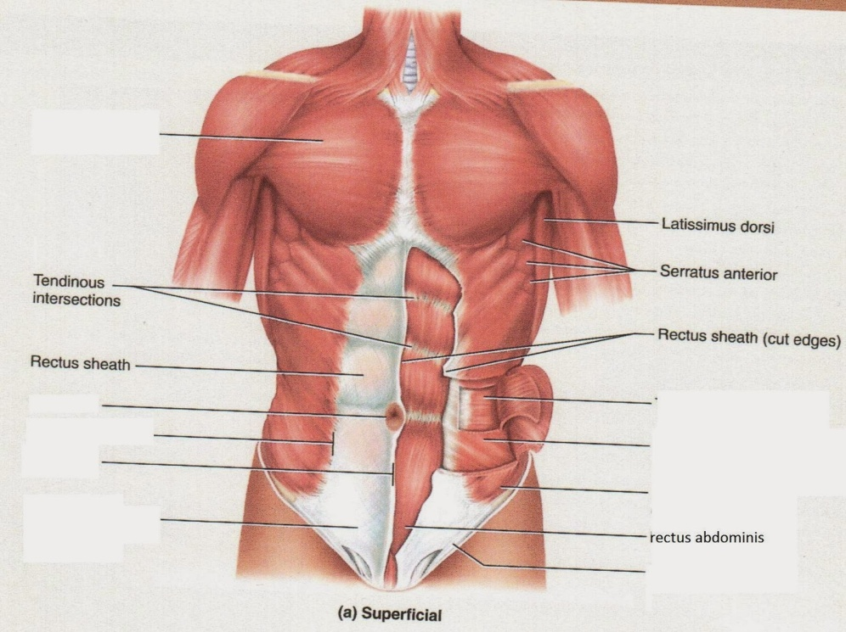
Practice
Oblique line of lower jaw?
White line?

Slide 8
Practice
Oblique line of lower jaw?
White line?

Slide 9
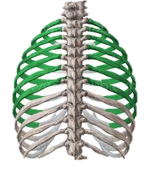
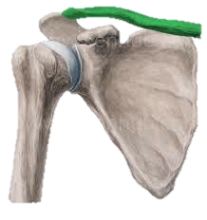
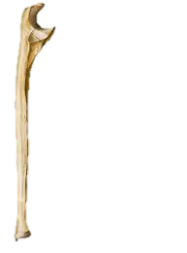
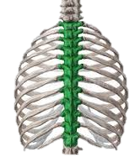
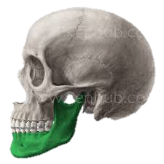
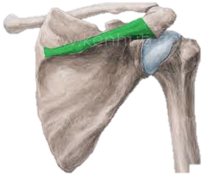
Practice
1
2
3
4
5
6
7
8
Notes:
1. Tibia dextra, 2. Costae verae, 3. clavicula dextra, 4. ulna dextra, 5. mandibula sinistra, 6. fibula dextra, 7. spina scapulae dextrae, 8. vertebrae thoracicae

Slide 10
Ordinal numerals 1-12
primus, a, um
secundus, a, um
tertius, a, um
quartus, a, um
quintus, a, um
sextus, a, um
septimus, a, um
octavus, a, um
nonus, a, um
decimus, a, um
undecimus, a, um
duodecimus, a, um
costa vera prima
vertebra thoracica secunda
costa vera tertia
vertebra coccygea quarta
costa vera quinta
vertebra thoracica sexta
costa vera septima
vertebra thoracica octava
costa spuria nona
vertebra thoracica decima
costa sinistra undecima
vertebra thoracica duodecima

Slide 11
Costae
Costa vera sinistra
Costa prima
Costa secunda
Costa tertia
Costa quarta
Costae verae
Incisurae costarum
Costa spuria sinistra
Costae spuriae

Slide 12
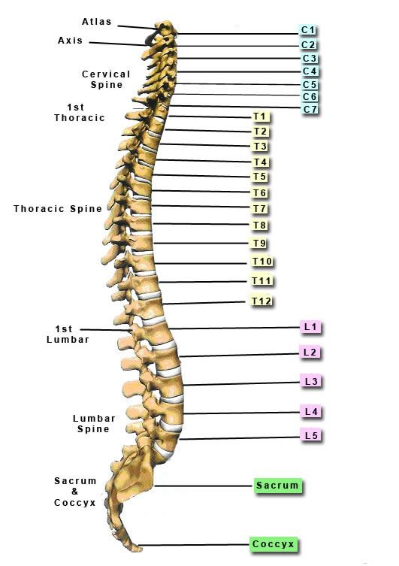
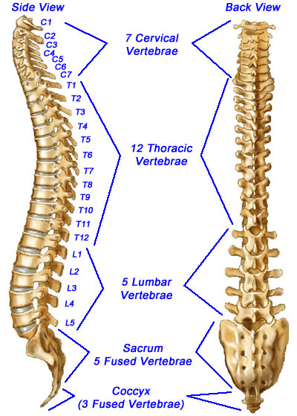
Vertebrae

Slide 13
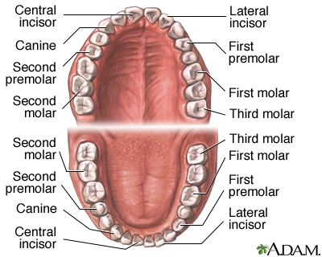
Dentes

Slide 14
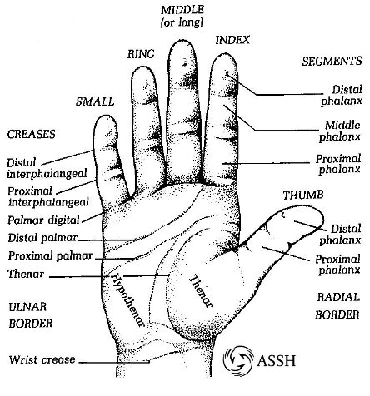
Digiti

Slide 15
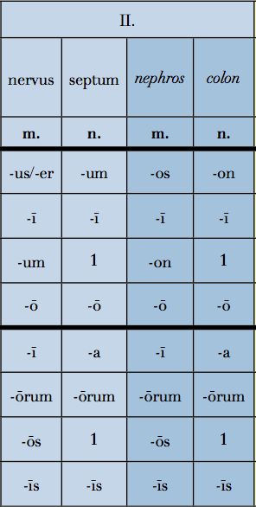
2nd declension (o-stems): Latin and Greek paradigms
Latin Greek
….
Gen. sg. -I
Gender: M./N. (+ F. = exceptions)
Nom. sg. -US/-ER/-OS = M. (F.)
Nom. sg. -UM/-ON = N.

Slide 16
Nervus vs. Nephros
NERVUS = paradigm for 2nd declension masculines (and feminines) of Latin origin
NEPHROS = paradigm for 2nd declension masculines of Greek origin
: differences between the paradigms
= nom. sg. (-US vs. -OS)
= accus. sg. (-UM vs. -ON)
Female exceptions:
methodus, i, f.
periodus, i, f.
diameter, tri, f.
-os
-on

Slide 17
Septum vs. Colon
SEPTUM = paradigm for 2nd declension neuters of Latin origin
COLON = paradigm for 2nd declension neuters of Greek origin
: differences between the paradigms
= nom. sg. (-UM vs. -ON)
= accus. sg. (-UM vs. -ON)
RULE FOR all Latin NEUTERS!
nom. (sg./pl.) = accus. (sg./pl.)
nom. pl. = accus. pl. = -A
-um
-on
-um
-on
-a
-a
-a
-a

Slide 18
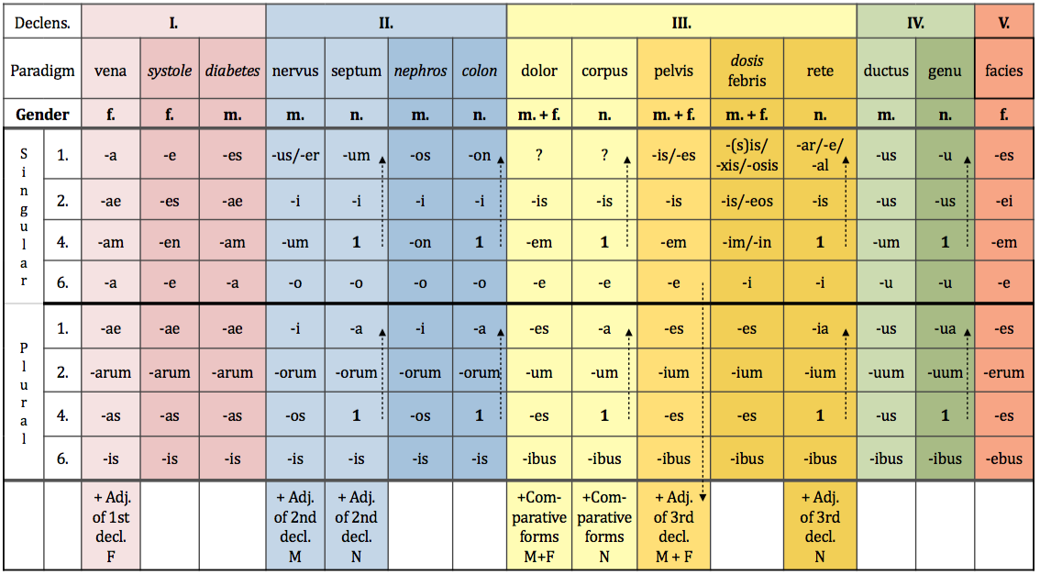
Neuter paradigms
SEPTUM = paradigm for 2nd declension neuters of Latin origin
COLON = paradigm for 2nd declension neuters of Greek origin
: differences between the paradigms
= nom. sg. (-UM vs. -ON)
= accus. sg. (-UM vs. -ON)
RULE FOR all Latin NEUTERS!
nom. (sg./pl.) = accus. (sg./pl.)
nom. pl. = accus. pl. = -A
-um
-on
-um
-on
-a
-a
-a
-a

