Slide 1
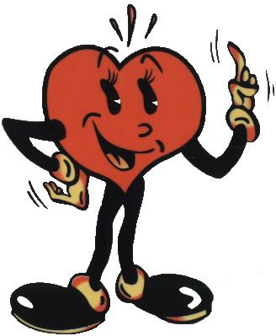
First Aid 2019
Lukáš Dadák, M.D.
Dept. of Anesthesia &ICU
FN USA
15740@mail.muni.cz

Slide 2
Run of semestr
Lectures weekly (ex 11.12.2019)
Excerc. a 2 weeks (one topic for 2 weeks)
https://is.muni.cz/auth/el/1411/podzim2019/aVLPO011c/index.qwarp
Test in 3 parts (BLS adult, BLS child, et. al)
Oral exam in 2019:
2 topics
1 min of BLS, AED,...

Slide 3
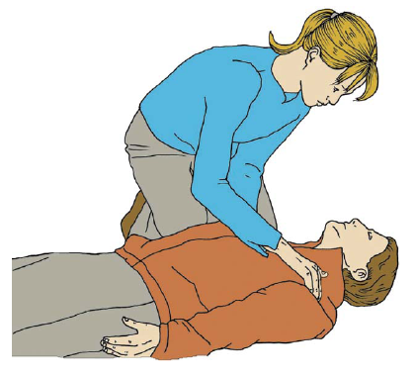
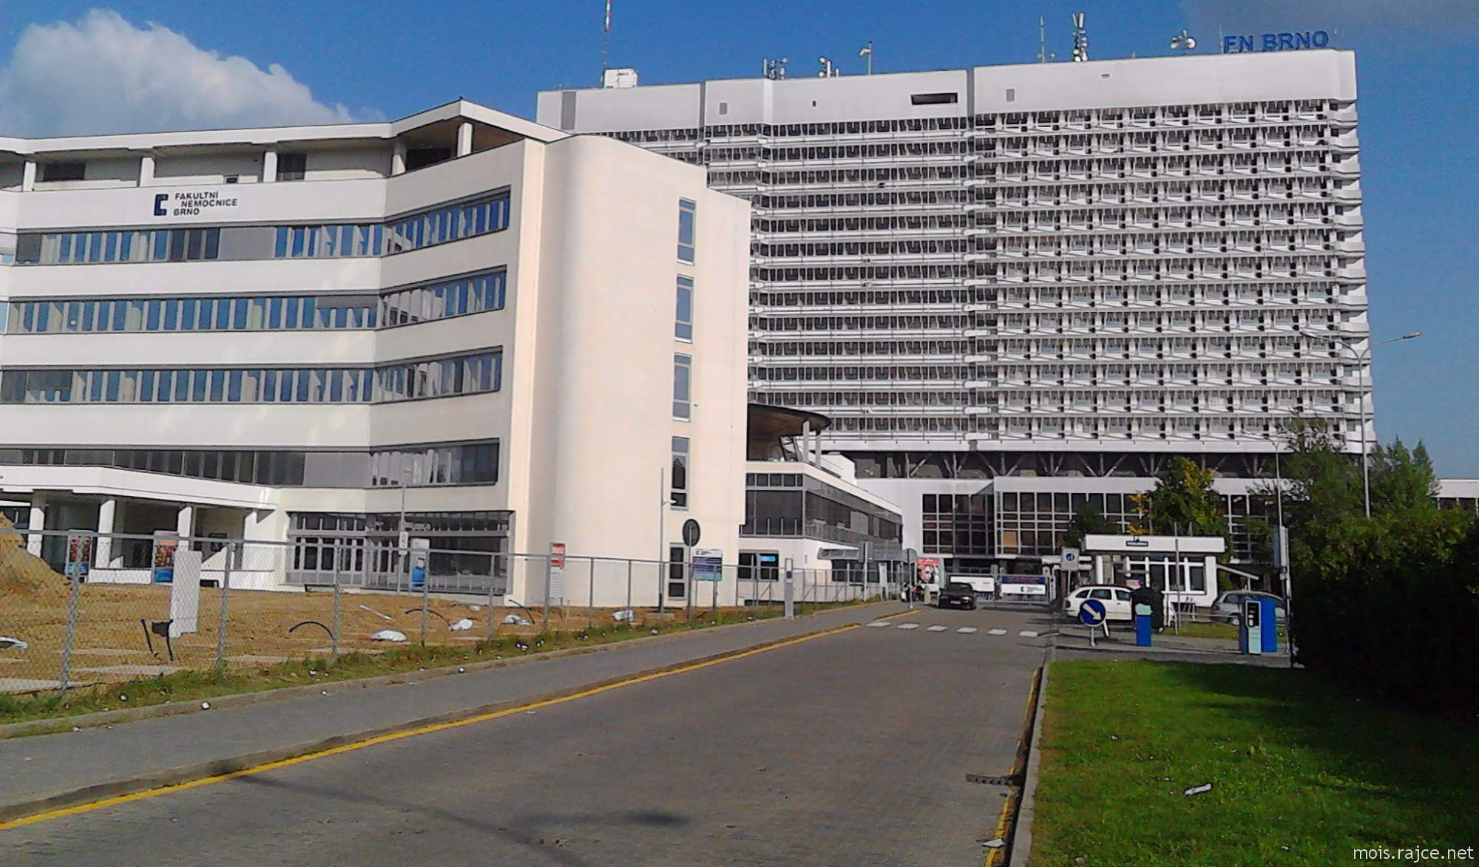
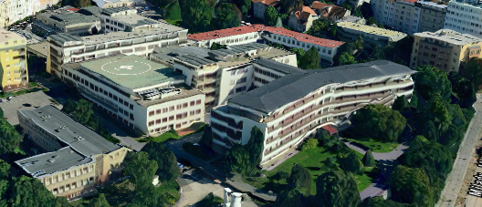
Departments:
ARK FNUSA
15740@mail.muni.cz
KARIM FN Brno
Malaska.Jan@fnbrno.cz
KDAR FN Brno
Stoudek.Roman@fnbrno.cz

Slide 4
How to survive?
Do not kill the patient.
Reason of lectures
- to pass the exam
- to learn important information for life

Slide 5
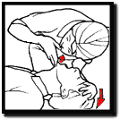
Study materials
is.muni.cz
www.cprguidelines.org

Slide 6
How to survive
D
R'
S
A
B
C

Slide 7
How to survive
Danger
Responce
Shout for Help
Airways
Breathing
Circulation

Slide 8
Danger

Slide 9
Danger
to you
to other
to the casualty
make sure that no one gets hurt. You will not be able to help if you are also a casualty
only proceed if it is safe to do so.

Slide 10
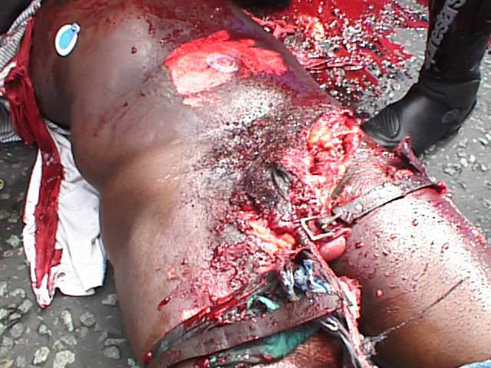

Slide 11
Danger
look & listen & feel
  vehicle on the street
  gas in the house
  fire
  poison, infection
  electricity
Position the patient on their back.

Slide 12
Basic Vital signs:
RESPONSE = consciousness
A+B breathing
C circulation
Primary Survey = 20s

Slide 13
Resposiveness
Shout ‚Are You O.K.?‘
Shake Shoulder
opening eyes
movement
words
unconsciousness

Slide 14
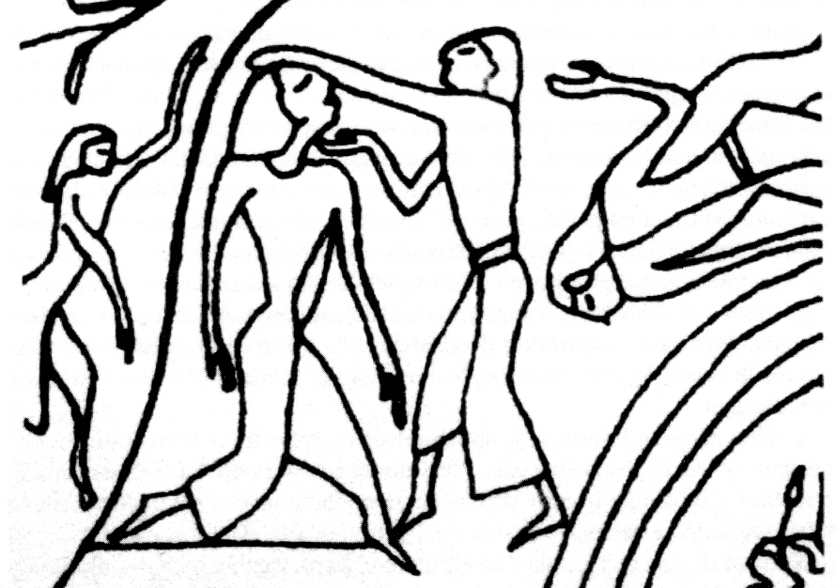
Airway + B
on the back
open it and keep it open - unconscious
Tilt the head back

Slide 15
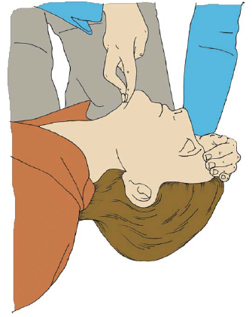
Airway + B
open it and keep it open
Tilt the head back

Slide 16
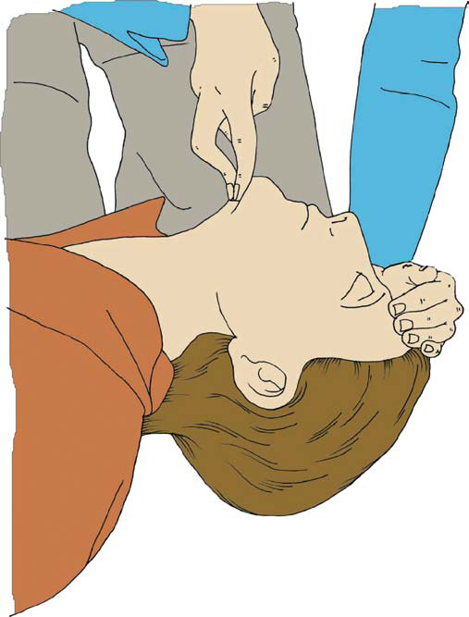
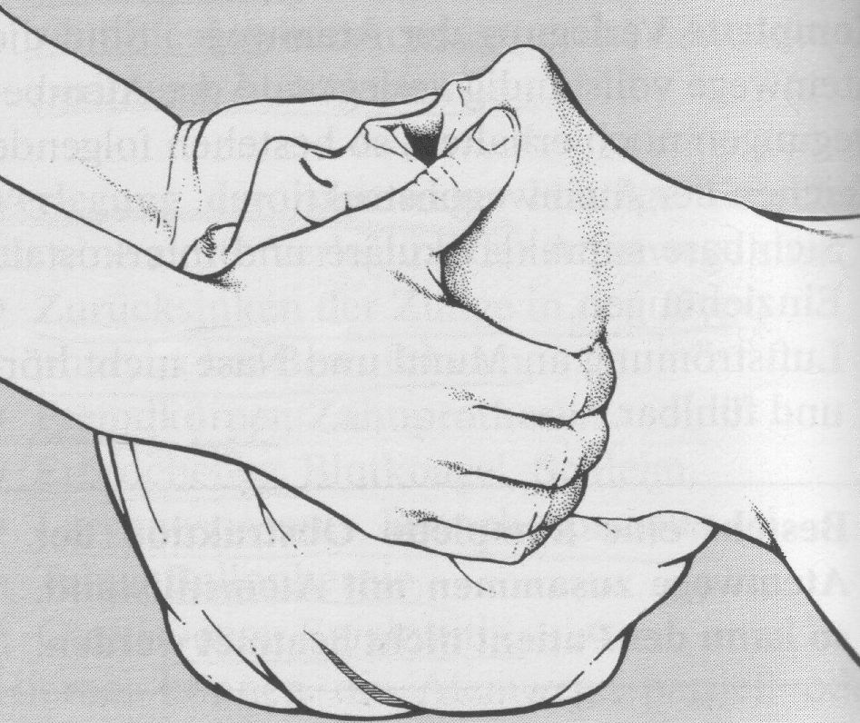
Keep airway open
haed tilt, chin lift Esmarch man.

Slide 17
Clear airway if necessary
do not loose time when nothing visible!
with the casualty supported on the side,
tilt the head backwards and slightly down.
Open the mouth and clear any foreign object.
Only remove dentures if loose or broken.

Slide 18
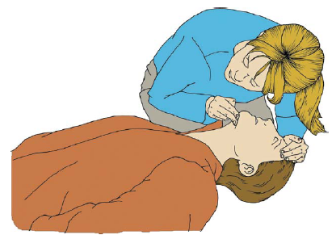
Breathing ?
Normal = look & listen & feel
  movement of chest wall [reg., 10-20/ min]
  air flow
abnormal breathing - "agonal respiration" and is the result of the brain's breathing center sending out signals even though circulation has ceased.
The key point - sound like grunting, gasping or snoring. It disappears in 2-3 minutes.
No breathing

Slide 19
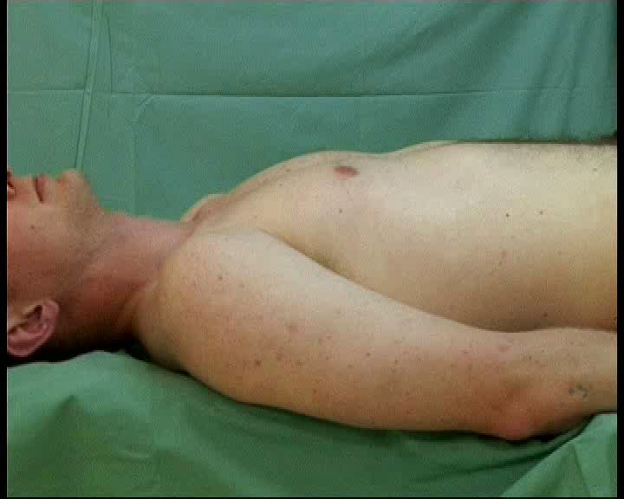
A+B:

Slide 20
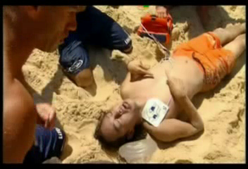
Gasping during ACLS

Slide 21
Circulation
Signs:
normal consciousness
normal breathing
movement
cough
only for living victims
{pulsations are checked by two fingers on a.carotis}
Any doubt = NO circulation

Slide 22
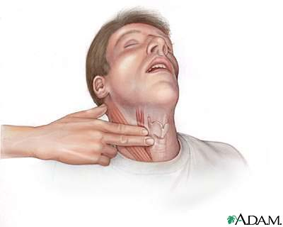
Puls on neck artery

Slide 23
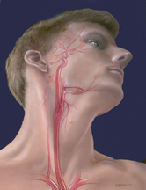
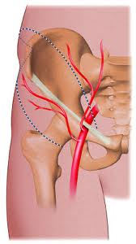
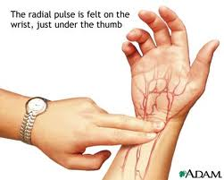
Puls
  neck / femoral a.
  radial a.

Slide 24

Circulation - puls
i/regular
frequency (beat per 10s * 6 = beats/ min)
signs of shock ...

Slide 25
Capilary refill time
compress the skin 5s, releave pressure
Time needed for refill of blood
Finger = perifery / Chest – central
  less than 2s
  usefull in children

Slide 26
ABC – stable and what next?
managing life-threatening problems - bleeding, recovery position
look for
  bleeding
  burns
  fractures. Note any tenderness, swelling, wounds or deformity
… Secondary Survey

Slide 27
Examine the casualty
… Secondary Survey
in the following order:
  head and neck
  chest (including shoulders)
  abdomen (including hip bone)
  upper limbs
  lower limbs
  back
call medical aid as soon as possible

Slide 28
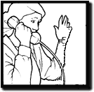
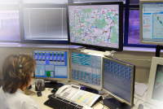
Emergency Call
Introduce yourself 155 (112)
Where
what
when
how many
severity of injuries
Do not hang up!!

Slide 29


No consciousness + No breathing = No circulation
Sudden Cardiac Arrest
CardioPulmonary Resuscitation
Basic Life Support
Advanced Cardiac Support (ACLS)
30:2

Slide 30



Guidelines
2015
www.cprguidelines.eu

Slide 31
Sudden Cardiac Arrest
arrhythmia during Myocardium infarction = no puls, no flow
hypoxia – breathing disorder
hypovolemia = bleeding
hypothermia → arrhythmia
ion disorders – internal enviroment
intoxication
trauma of Thorax / heart (Pneumothorax /Tamponade)
pulmonary embolism

Slide 32
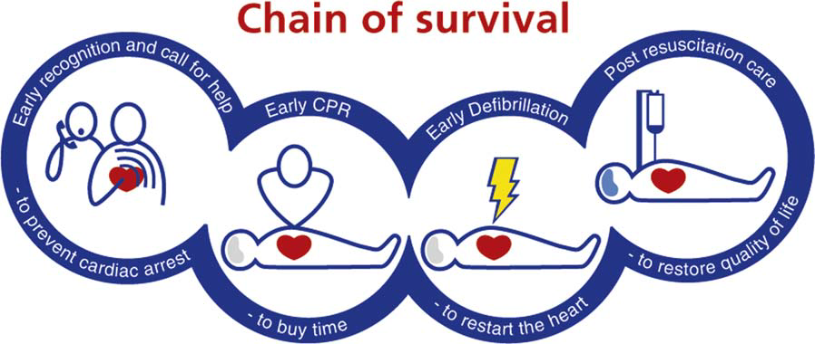
SCA → survival = 20%
Early

Slide 33


Slide 34
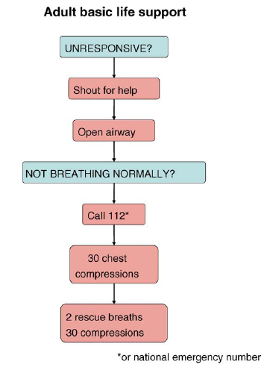
Adult basic life support
Medical Emergency Service
155

Slide 35
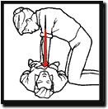
Chest compressions
Place the heel of one hand on the
breastbone -- right between the nipples.
In the centre of the chest
Place the heel of your other hand on top of the first hand.
Position your body directly over your hands. Your shoulders should be in line with your hands. DO NOT lean back or forward.
Give 30 chest compressions. at least 100/minute (not more than 120/min)
Press down on the sternum at leats 5 cm, not more than 6cm

Slide 36
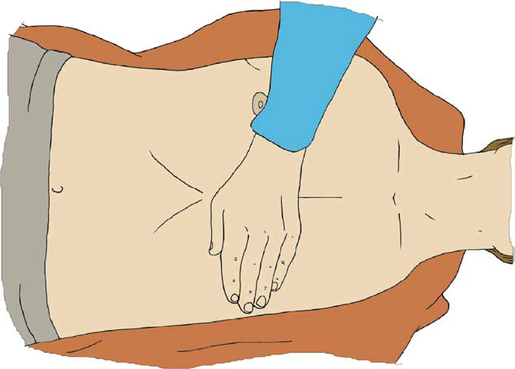

Slide 37
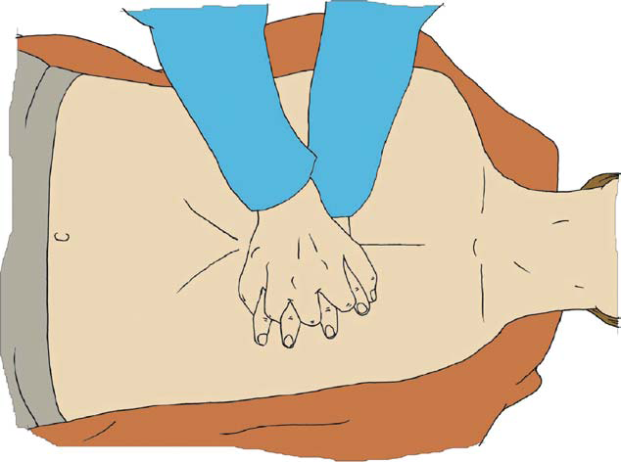

Slide 38
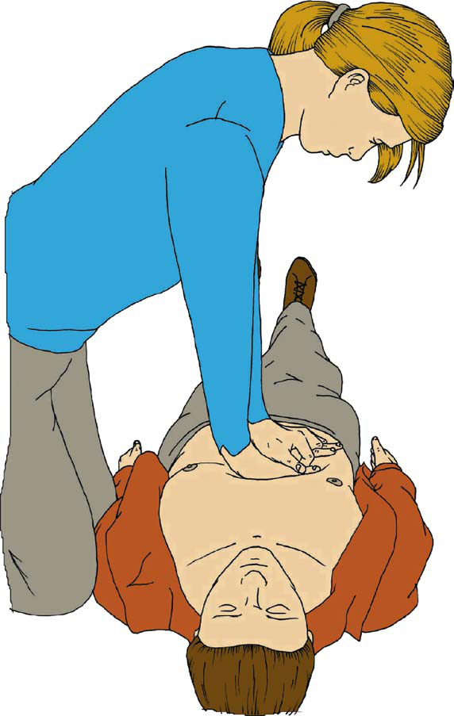

Slide 39
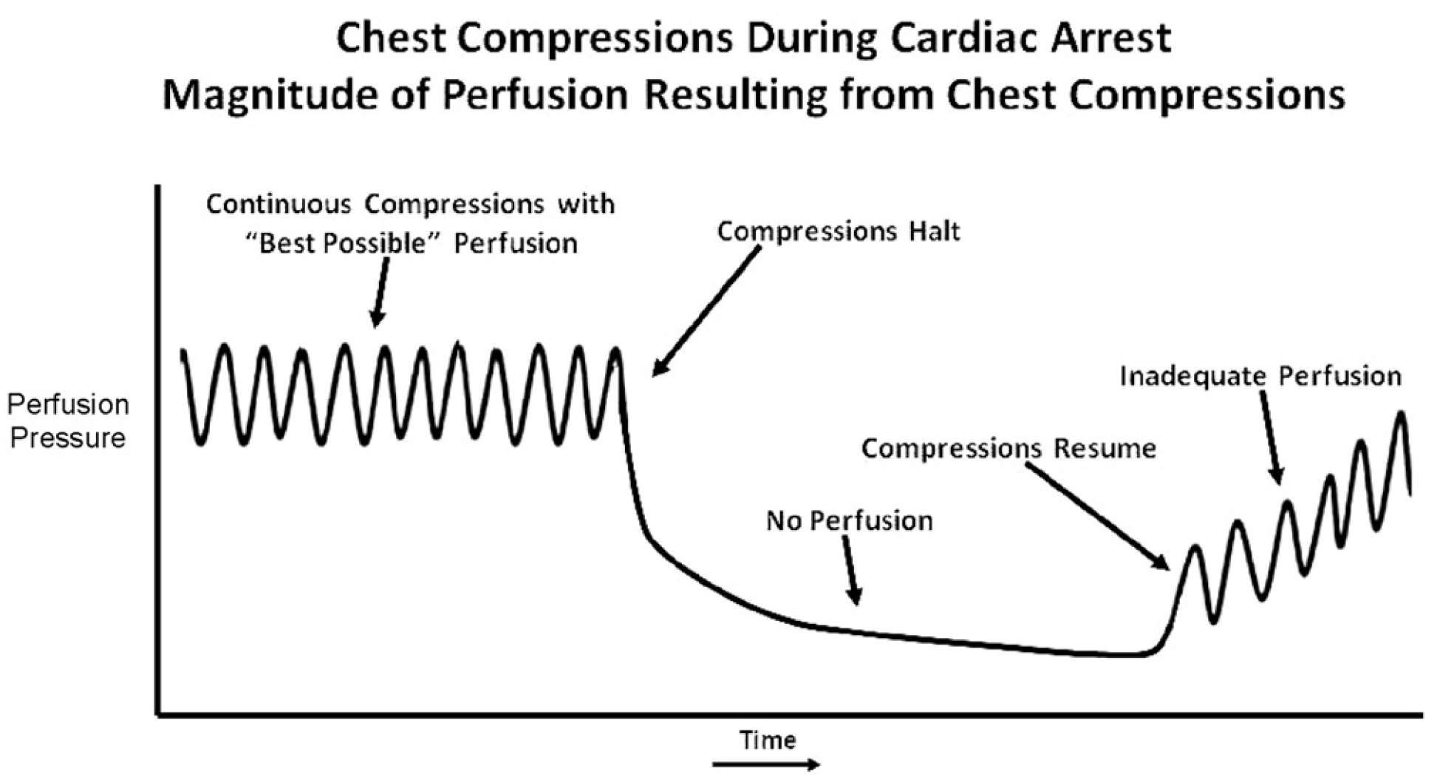
Do not stop compression ...

Slide 40
Stop compressions
2 rescue breath
(AED to check the rhytm and to defibrilate)
There is no routine „halt“ to check restorations of life.

Slide 41
mouth-to-mouth breathing
1. Knee beside the head of casualty.
2. Keep the casualty's head tilted back.
3. Pinch the casualty's nostrils with your fingers
4. Lift the jaw forward with your other hand.
5. Take a normal breath and open your mouth wide.
6. Place your mouth firmly over the casualty's mouth making an airtight seal.
7. Breathe into the casualty's mouth.
8. Remove your mouth and turn your head to observe the chest fall and listen or feel for exhaled air.
9. If the chest does not rise and fall, check head tilt position first, then check for and clear foreign objects in the airway.
10. Give 2 breaths, then go back to 30 compressions

Slide 42
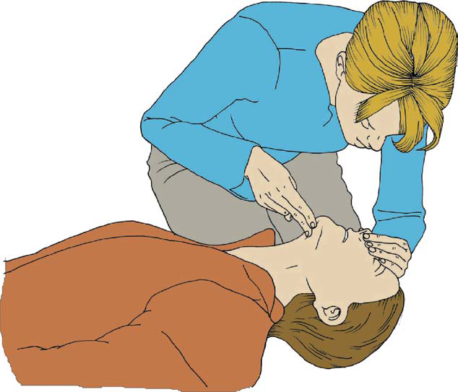
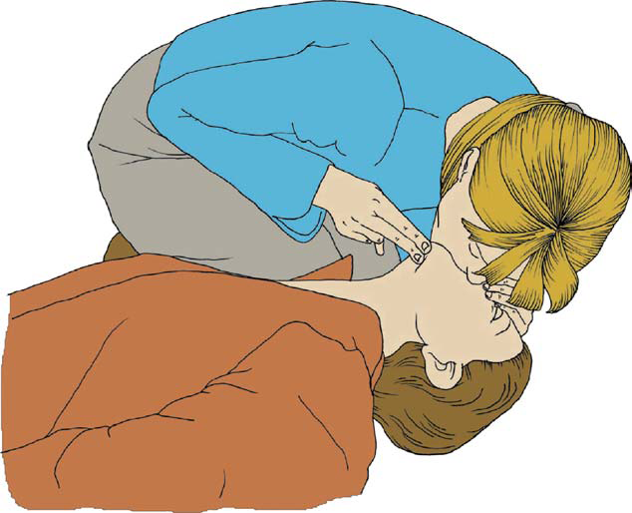

Slide 43
Mouth to nose
the victim’s mouth is seriously injured
cannot be opened,
the rescuer is assisting a victim in the water,
a mouth-to-mouth seal is difficult to achieve.
There is no published evidence on the safety, effectiveness or feasibility of mouth to-tracheostomy ventilation, but it may be used for a victim with a tracheostomy tube or tracheal stoma

Slide 44
3 thinks are the most important:
Compressions
Compressions
Compressions

Slide 45
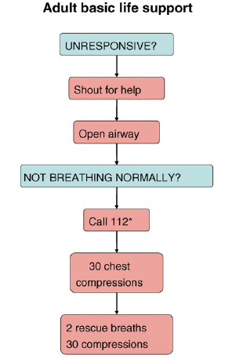
BLS
When to start BLS:
  always when victim is
  unconsciousness,
  no breath
When not to start:
  end stage disease, no prognosis
  trauma with no hope for life (decapitation)
  signs (indication) of death (patch)
  time factor (15 – 30 minutes from stop of circulation)

Slide 46

When ...
When to stop CPR:
  restoring vital functions
  (normal breathing, movement) → recovery pos.
  EMS takes care of victim
  no power to continue with CPR
  new danger

Slide 47
Do not stop BLS
compression only / 30:2
… continue …
Stop to recheck the victim only if he starts
breathing normally; otherwise do not interrupt
resuscitation.

Slide 48
Risk to the rescuer
The safety of both rescuer and victim are
paramount during a resuscitation attempt.
There have been few incidents :
tuberculosis,
meningitis
severe acute respiratory distress syndrome
(SARS)
Notes:
The safety of both rescuer and victim are
paramount during a resuscitation attempt.
There have been few incidents of rescuers suffering adverse effects from undertaking CPR, with only isolated reports of infections such as tuberculosis
(TB) and severe acute respiratory distress syndrome
(SARS) Transmission of HIV during CPR
has never been reported. There have been no
human studies to address the effectiveness of barrier
devices during CPR; however, laboratory studies
have shown that certain filters, or barrier
devices with one-way valves, prevent oral bacterial
transmission from the victim to the rescuer during
mouth-to-mouth ventilation.35,36 Rescuers should
take appropriate safety precautions where feasible,
especially if the victim is known to have a
serious infection, such as TB or SARS.

Slide 49
Risk to the rescuer
Transmission of HIV nor Hepatitis has never been reported.
Barrier devices with one-way valves, prevent oral bacterial transmission from the victim to the rescuer during mouth-to-mouth ventilation.
Notes:
The safety of both rescuer and victim are
paramount during a resuscitation attempt.
There have been few incidents of rescuers suffering adverse effects from undertaking CPR, with only isolated reports of infections such as tuberculosis
(TB) and severe acute respiratory distress syndrome
(SARS) Transmission of HIV during CPR
has never been reported. There have been no
human studies to address the effectiveness of barrier
devices during CPR; however, laboratory studies
have shown that certain filters, or barrier
devices with one-way valves, prevent oral bacterial
transmission from the victim to the rescuer during
mouth-to-mouth ventilation.35,36 Rescuers should
take appropriate safety precautions where feasible,
especially if the victim is known to have a
serious infection, such as TB or SARS.

Slide 50
Barrier Devices
Can increase dead space
can increase resistance of airways
Can protect you
can increase will to ventilate

Slide 51
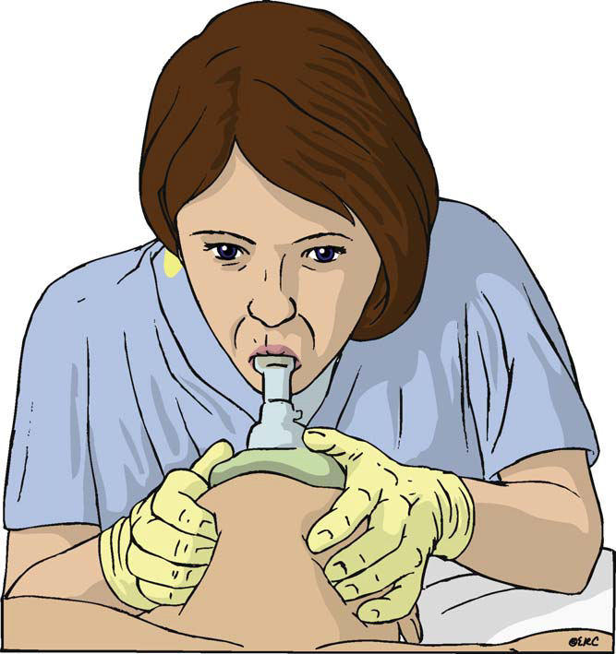
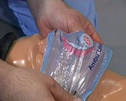

Slide 52
„Top-less“
Chest-compression-only CPR may be used as follows:
• If you are not able or are unwilling to give rescue breaths, give chest compressions only
continuous,
at a rate of 100 min⁻¹

Slide 53
Precordial thump
Not part of BLS
reserved :
witnessed cardiac arrest when no defibrillator is immediately available

Slide 54
EMS Brno 2008..2009

Slide 55
First aid before arrival

