Slide 1
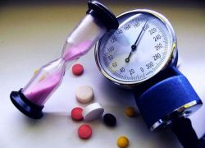
Antihypertensives

Slide 2
Definition of ARTERIAL
HYPERTENSION
Definition : repeated increase of blood pressure (systolic-diastolic) 140/90 mmHg or higher in patients older than 18 years in at least two of three measurements in two different checks
The most often disease of cardiovascular system
AH + hyperlipidemia +DM + nicotine addiction
premature atherosclerosis & ischemic heart disease
prevalence in elderly 20-50 %, 35 % in CZ

Slide 3
Classification
Ethiology
Primary – essential
Secondary
Primary – essential
App. 90 % of all patients with HT
Multifactorial disease without organic reason

Slide 4
Classification
Ethiology
Primary – essential
Secondary
Secondary hypertension
  Nephropathy – the most often
  Endocrine – suprarenal gland (hyperaldosteronismus)
  Renovascular – renal arthery disease
  Iatrogenic – long-term use of corticosteroids, NSA, sympatomimetics, HAT
  Gestation – HT in pregnancy

Slide 5
Treatment goals in hypertensive patients
SBP < 140 mm Hg
low- moderate CV risk
diabetes
previous stroke or TIA
SBD between 150 and 140 mm Hg
elderly < 80 years
elderly > 80 years in good condition
DBP < 90 mmg Hg
always recommended, except diabetes ( < 85 mm Hg)

Slide 6
Blood Pressure regulation
decrease / increase
Peripheral resistence (vasoconstriction/vasodilatation)
decrease / increase
Blood volume, cardiac output

Slide 7
THERAPY OF ARTERIAL HYPERTENSION
1. NON-PHARMACOLOGICAL
2. PHAMACOLOGICAL
decrease the risk of cardiovascular disease / target BP ↓ 140/90 mm Hg (high-risk 140/85 mm Hg)

Slide 8
2. PHARMACOLOGICAL
WHEN ?
WITH ?
MONOTHERAPY (app. 30 % of the patients)
COMBINATION, lower doses /Fixed combination - better compliance, more problematic titration /
Next steps
+ drug
Increase the dose
Changes - 4-6 weeks interval, urgent situation immediatelly

Slide 9
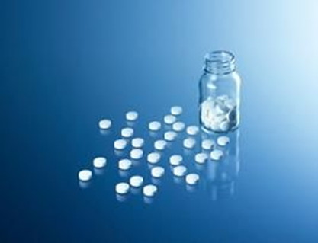
Drug classes
1st line treatment
ACEi
AT-II inhibitors
CCB
Diuretics
BB
2nd line treatment
Central acting drugs
α₁-lytics
Renin inhibitors

Slide 10
PHARMACOTHERAPY
diuretics
β-blockers
Ca²⁺ blockers
Central drugs
BLOOD PRESSURE
Heart output
ACE inhibitors
AT rcp antagonists
Renin inhibitors
Peripheral resistance
α1 blockers
Direct vasodilitans

Slide 11
1. ACEi
2. AT₁₋antagonists
R-A-A-S
Hyperactivation leads to ↑ TK
↑ blood volume (aldosteron) +
↑ peripheral resistence (A II)
AT II actions include also…
induction of growth, cell migration, mitosis of vascular smooth muscle cells, increased synthesis of collagen type I and III in fibroblasts, leading to thickening of the vascular wall and myocardium, and fibrosis.

Slide 12
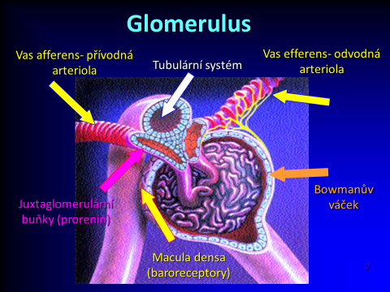
Physiology
RENIN
juxtaglomerular apparatus; as prorenin
Signal from baroreceptors (decreased BP)
Signal from chemoreceptors (decreased Na load)
Stimulation of β₁ adrenergnic receptors
RENIN / PRORENIN are hormons

Slide 13
Physiology
RENIN
PD effect
PROTEOLYTIC ENZYME
endopeptidase acts on angiotensinogen splitting off a decapeptid angiotensin I
inactive, but converted to AT II (potent vasoconstrictor)
NON-PROTEOLYTIC ACTIVITY
induction of synthesis of TGF-β a PAI-1 ⇨ fibroproduction and remodelation of tissues ⇨ etiopathogenesis of CVD (!)
Notes:
PAI plazminogen aktivátor inhibitor

Slide 14
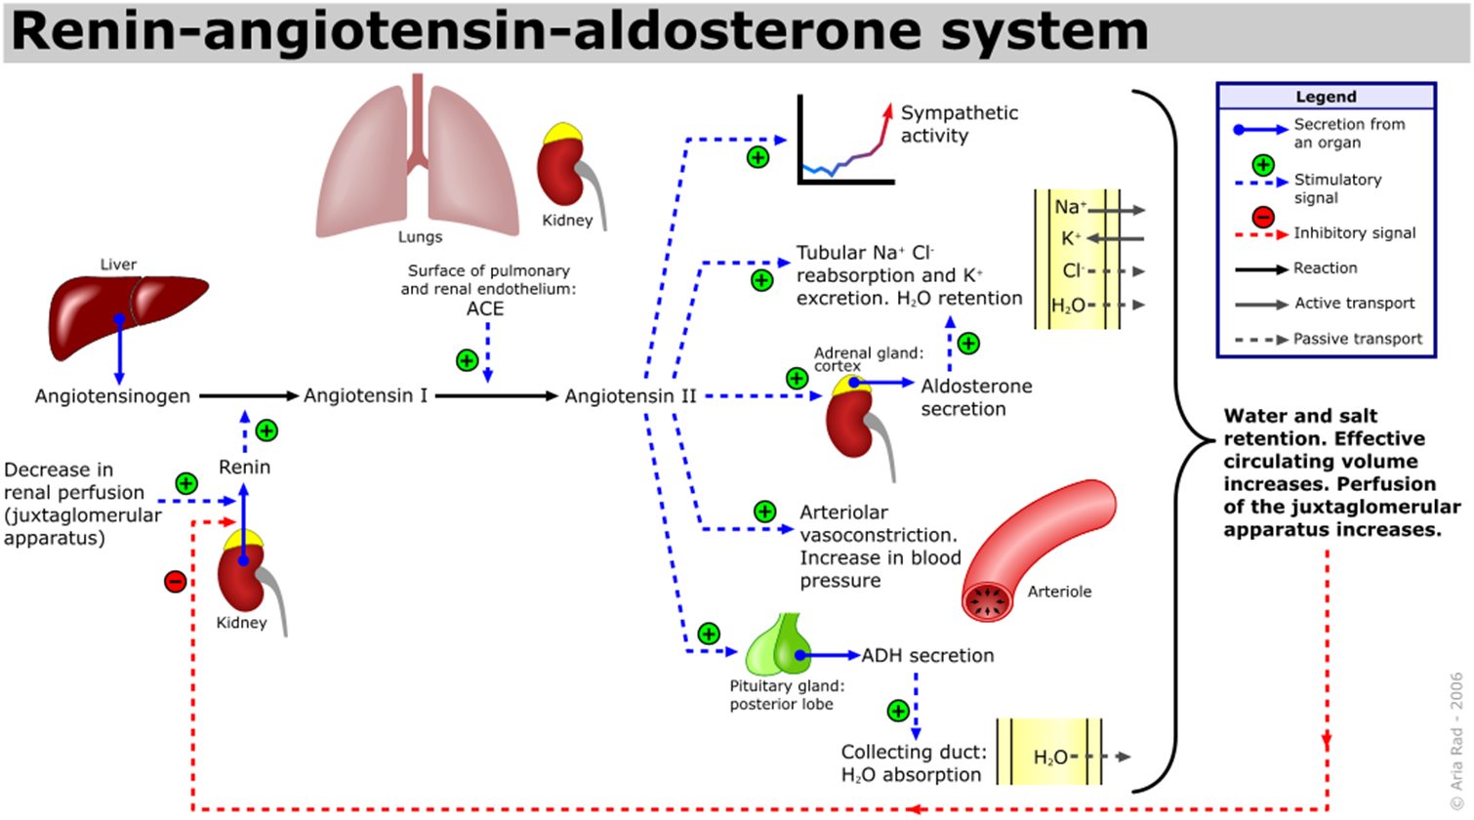
RAAS

Slide 15
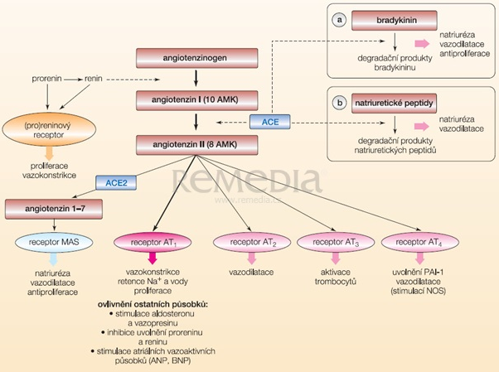
R-A-AS
(13 AMK)
TGF-β
+ degradační produkty AIII a AIV
Lokální zánětlivá reakce
Protrombotický efet – inhibice fibrinolýzy
Agonisté potenciální léčiva??
Zvýšení exprese při vzniku zánětu – např. při aterosklerotickém postižení cévní stěny

Slide 16
R-A-AS - final step ALDOSTERON
the main mineralocorticoid hormone
produced by the zona glomerulosa of the adrenal gland
by acting on the mineralocorticoid receptors in the distal tubules
and collecting ducts of the nephron
Na⁺ + H2O reabsorption
Tubular secretion K⁺ (antiport Na-K)
Stimulation of aldosteron production:
ACTH
AT II
↑ K⁺ ionts
Inhibition of production:
Negative feadback regulation

Slide 17
Inhibition of R-AA-S
Different level…
Beta – blockers (inhibition of renin secretion)
Renin inhibitors (inhibition of conversion angiotensionogen to AT I)
ACEi (inhibition of conversion of AT I to AT II)
sartans (antagonization of AT₁-rcp)
Antagonisation of aldosteron receptor

Slide 18
Možnosti ovlivnění RAAS léčivy
Betablockers
Renin inhibitors
ACE inhibitors
Sartans
aldosteron rcp antagonists

Slide 19
1. ACEi
MECHANISM OF ACTION
1. Reversible antagonisation of ACE (dipeptidase)
2. Block od bradykinine degradation ⇨ prolongation of vasodilatation and natriuretic effect
↓peripheral resistence
↓ aldosteron
↓ sensitivity of baroreceptors
BP ↓

Slide 20
PK
ACEi
Given orally
Bioavailability 50-75 %
Liver metabolisation (to the active metabolite)
Renal elimination /glomerular filtration/
Variable half-life
13-36 hrs ramipril(ate)
30-120 hrs perindopril(ate)

Slide 21
ACEi
ADVANTAGE
Safe and effective drugs in monotherapy as well as combination
Favorable profile on carbohydrates (diabetic patients)
Cardioprotective effect
Renoprotective effect (↓ albuminuria)

Slide 22
Classification accoring to t_{1/2} :
Short-acting (3x/ per day)
t_{1/2} = app. 2 hrs, effect app. 8 hrs
CAPTOPRIL (not used)
Intermediatte (1-2x/ per day)
t_{1/2} = app. 6-12 hrs, effect app. up to 24 hrs
ENALAPRIL*, LISINOPRIL, FOSINOPRIL
Long-acting (1x/ per day)
t_{1/2} = app. 13-36 hrs (perindopril 120 hrs)
TRANDOLAPRIL, RAMIPRIL, PERINDOPRIL
* i.v. (hypertensive crisis)  lowest onset of action

Slide 23
ADVERSE EFFECTS
ACEi
Dry irritant cough. The most common
↓ degradation of bradykinin
Hyperkalemia. (↓ aldosteron ⇨ inhibition of Na/K antiport)
lab monitoring K, urea and kreatinine level (mainly during the first period of tretament)
Angiooedema. allergic/ hereditary angioedema
Teratogenity. KI in gravidity (second and third trimestr)
(hypotension )

Slide 24
INDICATION
ACEi
Arterial hypertension* /suitable in DM pts. /
Chronic Heart Failure* – /↓ LVF, remodelation and hypertrophy of left ventricule/
Secondary prophylaxy of trombotic complication *
(IM, stroke)
Diabetic /non-DM/ nephropathy
Long-time administration of ACEI for clinical benefit
* The best RR in RCT: PERINDOPRIL, RAMIPRIL

Slide 25
ACEi
CONTRAINDICATION
GRAVIDITY *
Hypercalemia
Bilateral stenosis of renal arteries with clinically significant ↓ GF (relative KI)
Angioedema in anamnesis
Primary hyperaldosteronism
(non-responders)
* All RAAS acting drugs

Slide 26
ACEi
Alternative synthesis of AT-II not inhibited by ACEi
Angiotenzinogen
RENIN
Angiotenzin I
catepsin
t-PA
Antagonisation of AT₁ receptor ?
CAGE
ACE
Angiotenzin II
CAGE chymostatin sensitive AT-II generated enzyme (veins)
t-PA – tissue plazminogen activator
catepsin – serum protease

Slide 27
2. AT₁ RECEPTOR ANTAGONISTS – SARTANS (ARB)
MECHANISM OF ACTION
Non-competitive/competitive antagonisms of AT₁ receptor (selective)
⇨ ↓ peripheral vascular resistance
⇨ vazodilatation
⇨ ↓ volume
ACE not affected – cough not present
↓ BP

Slide 28
PHARMACOKINETICS
Sartans
EPROSARTAN
LOSARTAN - prodrug - CYP2C9 metabolisation. Drug interaction!!
VALSARTAN – nephroprotective drug
CANDESARTAN – EBM efficacy in CHF
OLMESARTAN
IRBESARTAN
TELMISARTAN - long half-life
Strong inhibitor of P-glp, hepatal elimination
Partial agonist of PPAR-γ receptor → better metabolic profile
Biological half-life

Slide 29
Angiotensin receptor blockers ( ARB)
most used

Slide 30
Sartans
ADVERSE EFFECT
(hypotension)
Hyperkalemia
angioedema less common
At the beginning and during the treatment lab monitoring – kalium, urea and creatinine

Slide 31
INDICATION
Sartans
Arterial Hypertension (ACEI a sartans, both effective)
Chronic Heart Failure (ACEi better, only for – pouze pro candesartan EBM data for ↓cardiovascular complications)
Diabetic nephropathy with proteinuria (data for telmisartan and valsartan)
Cough after ACEi
CONTRAINDICATION
Pregnancy, lactation
Hyperkaemia
Angioedema in anamnesis
Bilateral stenosis of renál arteries (relative contraindication)

Slide 32
DRUG INTERACTION of RAAS drugs
LITHIUM ⇨ ↑ plazmatic level of LITHIUM (based on PK)
NSAID, ASA (more than 3g/day)
⇨ ↓ antihypertensive effect
⇨ ↑risk of renal function
⇨ ↑risk hyperkalemia
(PD interaction)
LOSARTAN + strong inhibitor of CYP2C9 (FLUCONAZOL) ⇨ ↓ level of active metabolitace (50%)
TELMISARTAN (strong inhibitor of P-glycoprotein) + DIGOXIN ⇨ ↑digoxin level

Slide 33
Combination - dual effect
ARNI =
Angiotenzin receptor blocker / neprilysin inhibitor
Entresto®
VALSARTAN + SACUBITRIL prodrug
NEPRILYSIN = enzyme catalysed degradation of endogenous vasodilatative natriuretic petides
neprilysine inhibition ⇨ prolongation of effects
⇨ ↓ BP

Slide 34
skupina ARNI
INDICATION:
Hypertension + symptomatic chronic heart failure with ↓left ventricular fraction in adult patients
CONTRAINDICATION:
Hypersensitivity
Concomitant therapy with ACE inhibitors
Angioedema
Concomitant therapy with renin inhibitors

Slide 35
RENIN INHIBITORS
Second line treatment of hypertension !
MECHANISM OF ACTION
Selective direct renin inhibitor
Binds to active site of renin, changes its steric confirmation and inhibits its binding to angiotensinogen ⇨ block conversion of angiotenzinogen to angiotensin I

Slide 36
DRUGS
ALISKIREN
Registered
Oral form, non-peptide, LW
Combination with diuretics, ARBs – additive effect
PHARMACOKINETICS
Bioavalability 15%, effect is not influenced by food
long T1/2 (about 24 hrs)
First pass efect
Biliary excretion (78 %) and kidney excretion (< 10%)

Slide 37
INDICATION
Essential hypertension
CONTRAINDICATION
Hypersensitivity, allergic reaction in anamnesis
Gravidity (mainly 2. a 3. trimester), lactation
Bilateral stenosis of arteria renalis
Severe nephropathy

Slide 38
ADVERSE EFFECTS
diarhhoea (the most often)
veretigo
atralgia
Hyperkalemia
Oedema ( < 1%)
In combination with sartans ↑ stroke in older patients

Slide 39
3. Ca CHANNEL BLOCKERS
Previous lecture
For the treatment of hypertension:
DIHYDROPYRIDINES
↓peripheral vascular resistance (vazodilatation)
vasoselective (relatively)

Slide 40
4. DIURETICS
Next lecture
5. β blockers β sympatolytics)
From previous lecture…

Slide 41
Drugs for second line treatment of hypertension

Slide 42
CENTRAL ANTIHYPERTENSIVES
Central α₂-agonists
Imidazolin I₁ receptor agonists
Central α₂-agonists + peripheral α₁-antagonists
α₁-receptor antagonists
VASODILATANS (direct)
  Nitrates
  PDE-5 inhibitors
  Endotelin-1 antagonists
  Syntetic analogs of prostacyclines
Previous lecture
Notes:
Poznámka Jitky:
U tohoto slidu možno připomenout, že není jen arteriální hypertenze, ale i portální, plicní apod.

Slide 43
CENTRAL ANTIHYPERTENSIVES
Indirectly acting vasodilatators – the central control of sympathetically mediated vasoconstriction:
central α₂ rcp. (brain stem)
imidazoline rcp. (ventrolateral medulla)
ACTIVATION ⇨ reducing sympathetis activity
Peripheral activation:
peripheral presynaptic α₂ rcp.
⇨ ↓NA
Imidazolin receptors in kidney
⇨ stimulation of Na⁺/H⁺ pump in proximal tubulus
METHYLDOPA KLONIDIN
MOXONIDIN RILMENIDIN

Slide 44
CENTRAL ANTIHYPERTENSIVES
Central α₂ agonists
METHYLDOPA
MoA:
Activation of central α₂ rcp. in brain stem and peripheral presynaptic α₂ rcp.
indirect sympatholytic activity - false NRA precursor/ prodrug
α –metyldopa → α –methylnorepinephrine → activation
of α₂ adrenergic receptors
CLONIDIN
MoA:
Activation of central α₂ rcp and imidazolin I₂ receptors

Slide 45
METHYLDOPA
Disadvantages:
Short half-life ⇨ more time daily
INDICATION:
Hypertension in pregnancy
Hypertension in patient with renal insufficiency
Patients with anxiety
Without metabolic effect - in combination for patients with DM, HLP
GF is not affected
ADVERSE EFFECT:
Sedation, nasal congestion, dry mouth, orthostatic hypotension
Methyldopa combined with diuretics

Slide 46
Central α₂ agonists
CLONIDIN
INDICATION:
Hypertensive crisis (ICU) – on request
Essential hypertension - obsolent
ADVERSE EFFECTS:
rebound fenomen

Slide 47
CENTRAL ANTIHYPERTENSIVES
Imidazoline I₁ receptor agonists
MOXONIDIN, RILMENIDIN
Mechanism of action:
I₁ receptor stimulation (medulla oblongata, kidney)
Inhibition of sympathetic stimulation of heart, veins and kidney
↓renin secretion
↓ vasopresin secretion

Slide 48
I₁ rcp agonists
ADVERSE EFFECTS
Selective agonists of I₁ receptors ⇨ minimal effect on α₂ – rcp. ⇨
less AE
Positive metabolic profile
Stimulation of Na excretion
↓ insulin resistence
↑glucose tolerance
INDICATION: prevention of diabetic nephropathy
CONTRAINDICATION: chronic heart failure

Slide 49
CENTRAL ANTIHYPERTENSIVES
Central α₂ –rcp agonists + peripheral α₁ – rcp antagonists
URAPIDIL MoA:
Agonistic effect α₂ a 5HT_{1A} rcp. in CNS
Antagonistic effect α₁ rcp. in vessels
Dual action
↓ sympatic tonus
vasodilatation
⇨ ↓peripheral resistence without reflex tachycardia
Significant antihypertensive effect
i.v. administration – rapid onset

Slide 50
INDICATION:
Rezistant hypertension
Severe hypertension (stroke)
Emergent hypertension crisis (ICU)
Perioperative hypertension
Well titrated (i.v. infusion)
Rapid onset (maximal effect 2-5 minutes)
AE:
Sedation (higher dosis)
Bradycardia
CONTRAINDICATION:
Pregnancy, lactation
Liver insufficiency

Slide 51
PERIPHERAL α₁-receptor antagonists
MoA
Selective reversible antagonisation of peripheral α₁ receptors – relaxation of vascular smooth muscle
↓peripheral vascular resistence
Slight increase of hert output

Slide 52
TERAZOSIN
DOXAZOSIN
uroselective, blocks α_{1A}
TAMSULOSIN
ALFUZOSIN
INDICATION
    In combination – severe hypertension
Vasospasm (Raynaud fenomen)
INDICATION
    BHP
    Not used for hypertension
ADVERSE EFFECTS
CONTRAINDICATION
Ortostatic hypotension
Reflex tachycardia
Impotency
Oedema, cephalea, fatigue
heart failure

Slide 53
COMBINATION OF DRUGS
MONOTHERAPY - 30 % of the patients
Combination - two or more drugs
fixed combination ( 2 v 1) - better compliance

Slide 54

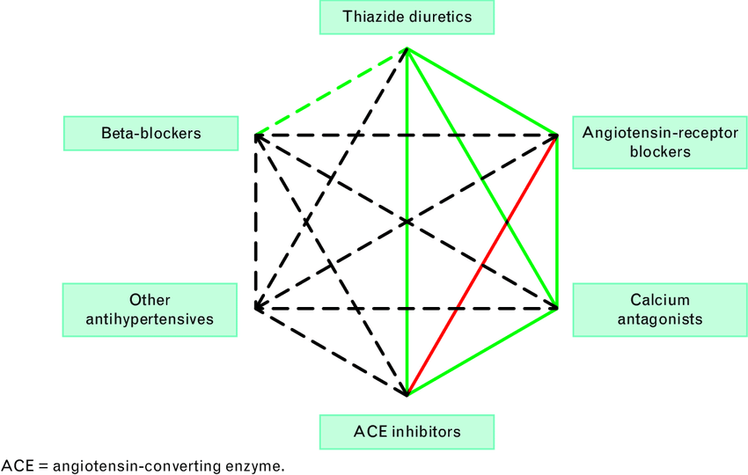

Slide 55
HYPERTENSION IN GRAVIDITY
HT: Systolic BP ≥ 140 mm Hg or diastolic BP ≥ 90 mm Hg
If systolic BP ≥ 170 mm Hg or diastolic BP ≥ 110 mm Hg – emergent situation with hospitalisation

Slide 56
PHARMACOTHERAPY
ACEi and sartans are contraidicated !
Relative contraindication – thiazide diuretics
Pre-existing hypertension
chronic medication, if not contraindicated
Gestational hypertension
METHYLDOPA (1st line)
Metoprolol, atenolol – third trimester
Pre-eclampsia – diuretics not recommended
Severe hypertension LABETALOL i.v.

Slide 57
Thank you for your attention

