Slide 1
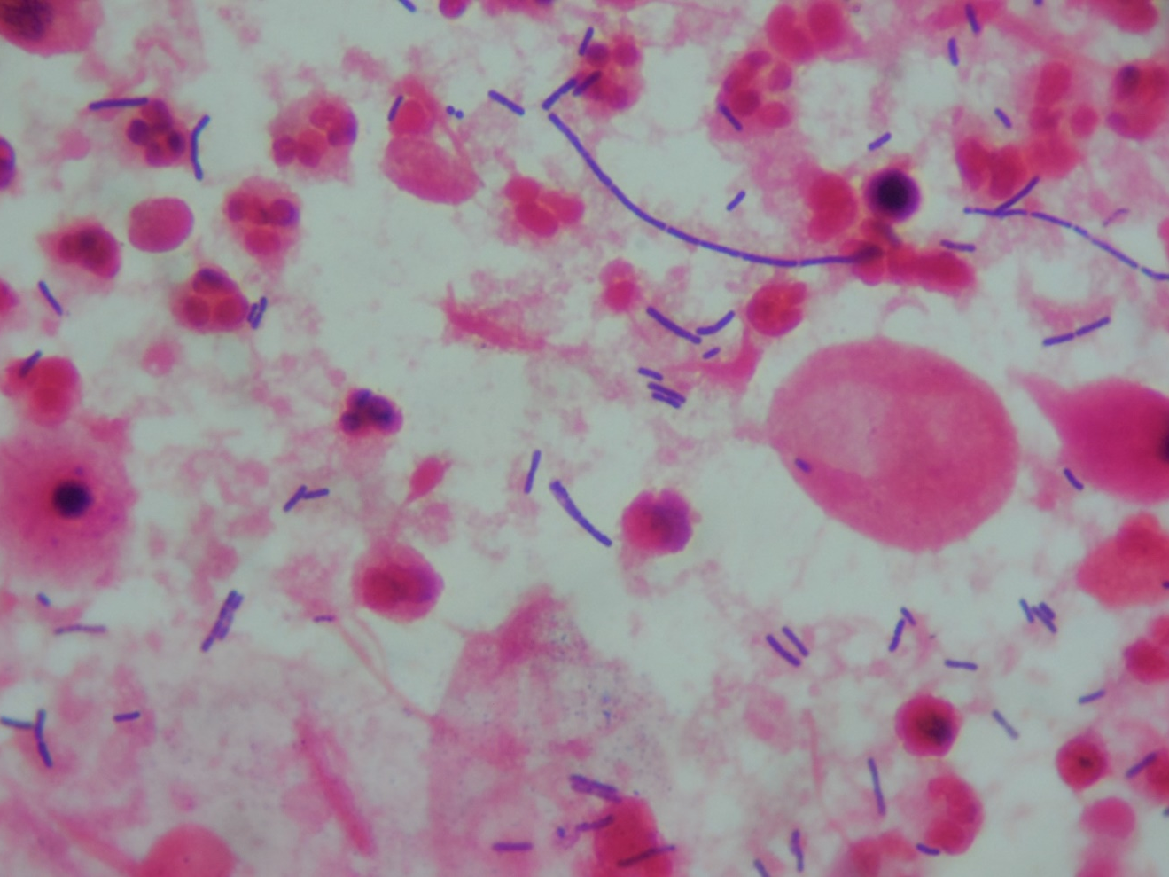
Vaginal swab
Lactobacillus sp., white blood cells

