Slide 1
3rd declension
consonant + i-stems

Slide 2
Specific features of the 3rd declension
All 3 genders included (cortex m., radix f., femur n.)
Nom. Sg. – no fixed ending (sanguis, excisio, abductor, rete, latus, femur, abdomen, cavitas)
Nominative form does not imply gender!!!
Two main groups (m+f) differ only in Gen. Pl: -um / -ium
nominative and genitive differ Consonant stems (dolor):
e.g. tumor, tumoris, m.
nominative and genitive are identical or the stem ends with double consonant
I- stems (pelvis)
e.g. cutis, cutis, f.; dens, dentis, m.

Slide 3
Consonant / i-stems
Two main groups (m+f) that differ only in Gen. Pl: -um / -ium
Consonant stems (dolor) nominative and genitive differ (more frequent):
e.g. tumor, tumoris, m.
I- stems (pelvis) nominative and genitive are identical, or the stem ends with double consonant
e.g. cutis, cutis, f.; dens, dentis, m.

Slide 4
The difference between paradigms PELVIS and DOLOR
 | Sg. | Pl.
nom. | dolor | dolor-es
gen. | dolor-is | dolor-um
ak. | dolor-em | dolor-es
abl. | dolor-e | dolor-ibus
 | Sg. | Pl.
nom. | pelvis | pelv-es
gen. | pelv-is | pelv-ium
ak. | pelv-em | pelv-es
abl. | pelv-e | pelv-ibus
CONSONANT-STEM MASCULINE AND FEMININE GENDER NOUNS
I-STEM MASCULINE AND FEMININE GENDER NOUNS

Slide 5
Nouns declined like rete?
Only the following three neuters:
animal, alis, n.
calcar, aris, n.
cochlear, aris, n.

Slide 6
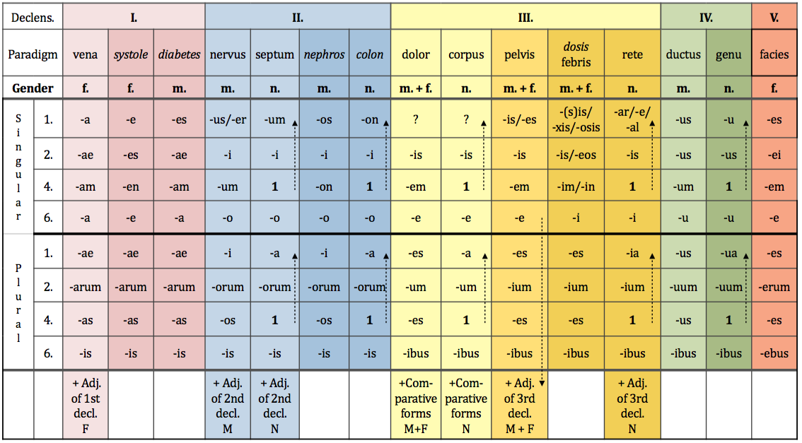
Words of Greek origin

Slide 7
Nouns declined like dosis
feminine nouns of Greek origin ending in –sis, -xis, or –osis
*in the dictionary you can identify them according to the double Genitive ending –is/-eos
+ some Latin nouns:
febris, is, f.
sitis, is, f.
tussis, is, f.
pertussis, is, f.
tuberculosis, is, f.

Slide 8
EXCEPTIONS
os, ossis n. bone → gen. pl.–ium
vas, vasis, n. vessel
in sg. follows paradigm CORPUS vas-vasis-vas-vase
in pl. follows paradigm SEPTUM vasa-vasorum-vasa-vasis
GREEK NOUNS typical endings
-itis, itidis, f. → inflammation
-(o)ma//-(o)matis, n. → tumour types/swellings

Slide 9
Agreed attribute (nouns of 3rd declension + adjectives of 1st and 2nd declension
1. cavitas magna dolor magnus foramen magnum
2. cavitatis magnae doloris magni foraminis magni
4. (in) cavitatem magnam dolorem magnum foramen magnum
6. (in) cavitate magna dolore magno foramine magno
1. cavitates magnae dolores magni foramina magna
2. cavitatum magnarum dolorum magnorum foraminum magnorum
4. (in) cavitates magnas dolores magnos foramina magna
6. (in) cavitatibus magnis doloribus magnis foraminibus magnis

Slide 10
What is the nominative form of these nouns?
cervicis
solutionis
tumoris
femoris
vertebrae
sacchari
systoles
oculi
cancri
phalangis
ossis
oris
coli
colli
extremitatis
capitis
ganglii

Slide 11
Assign nouns to declensions and paradigms
• musculus • vulnus • ulcus • digitus • albus •
• cavitas • vas • arterias • diarrhoen •
• ligamenta • aqua • crura • symptoma
• tumor • ren • abdomen • systolen • apex • cortex
• luxatio • ostio • os • radios • cor

Slide 12
ADD Greek and Latin synonyms
English Latin Greek
_____________ ___________ soma
_____________ os, oris _____________
kidney _____________ _____________
_____________ _____________ colon
brain _____________ _____________
_____________ organum _____________
_____________ _____________ hepar
suture _____________ _____________
_____________ vulnus __________

Slide 13
Change to nominative plural
musculus sphincter
foramen nutricium
dolor chronicus
vas longum
musculus adductor
femur fractum
cartilago thyreoidea
vulnus punctum

