Slide 1

BASIC MEDICAL TERMINOLOGY I
INTRODUCTION

Slide 2

Requirements
See the course requirements in IS, but basically:
  ACTIVE attendance
  regular preparation before each session
  passing the credit test

Slide 3
Why Latin/Greek?
universal, precise and flexible system of terms denoting:
  anatomical structures
  medicaments, instructions for pharmacists
  medical documentation (diagnoses, procedures)
Application:
  clinical diagnoses
  dissection protocols
  medical prescriptions
  medical documentation --- communication between doctors from different environments/countries/fields of study

Slide 4
ANATOMICAL NOMENCLATURE
First worldwide official standard terminology appeared 1895 (Basiliensia Nomina Anatomica) since then it was periodically updated and changed to implement new findings and/or understanding of the anatomical structures
Current terminology is approved by FCAT (Federative Committee on Anatomical Terminology) and published in 1998 as TERMINOLOGIA ANATOMICA
(cf. http://www.unifr.ch)

Slide 5
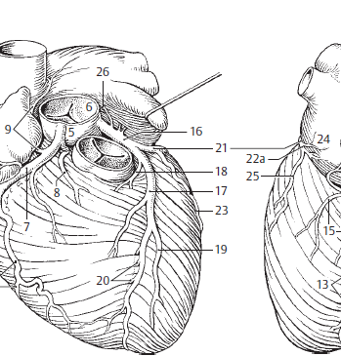
5 bulbus aortae
6 arteria coronaria dextra
rami atrioventriculares
8 ramus coni arteriosi
9 ramus nodi sinuatrialis
10 ramia atriales
11 ramus marginalis dexter
12 ramus atrialis intermedius
13 ramus interventricularis posterior
14 rami interventriculares septales
15 ramus nodi atrioventricularis
16 ramus posterolateralis dexter
17 arteria coronaria sinistra
18 ramus interventricularis major
19 ramus coni arteriosi
20 ramus lateralis
21 rami interventriculares septales
22 ramus circumflexus
23 ramus atrialis anastomoticus

Slide 6
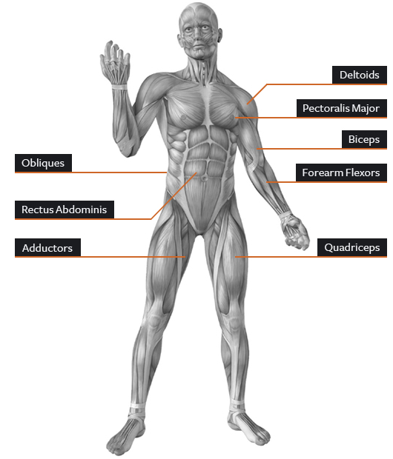
Musculus deltoideus
Musculus pectoralis major
Musculi obliqui abdominis
Musculus biceps brachii
Musculus rectus abdominis
Musculus flexor carpi
Musculi adductores
m. adductor longus
m. adductor brevis
Musculus quadriceps femoris

Slide 7
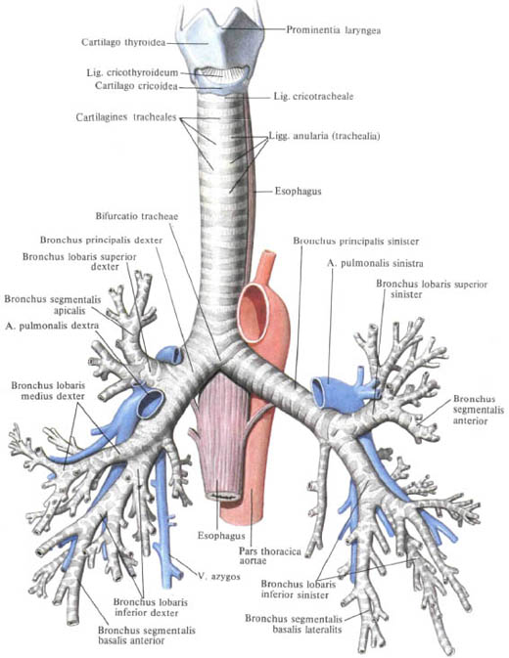
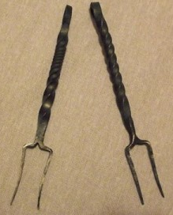
Many medical terms are based
on metaphors and similes,
i.e. they are formed from words
of non-medical origin
E.g. bifurcatio = bifurcation
1. a division into two
branches.
      2. the point at which
      division into two
      branches occurs.
furca = a two-pronged fork
bifurcatio tracheae

Slide 8
CLINICAL TERMINOLOGY
Non-definite set of terms that names diseases, health conditions or causes of death
First authoritative list of diseases and causes of death 1868 (Nomenclature of diseases), 1893 Bertillon's classification of diseases
Current terminology ICD-10 (International Classification of Diseases) is approved by WHO and published every ± 10 years (www.who.int/classifications/icd/en/)
Widely used in medical documentation e.g. medical reports, surgical and hospital reports, pathological reports (central Europe, Russia and former republics of USSR, partiallly also in Western Europe - Germany, Austria)

Slide 9
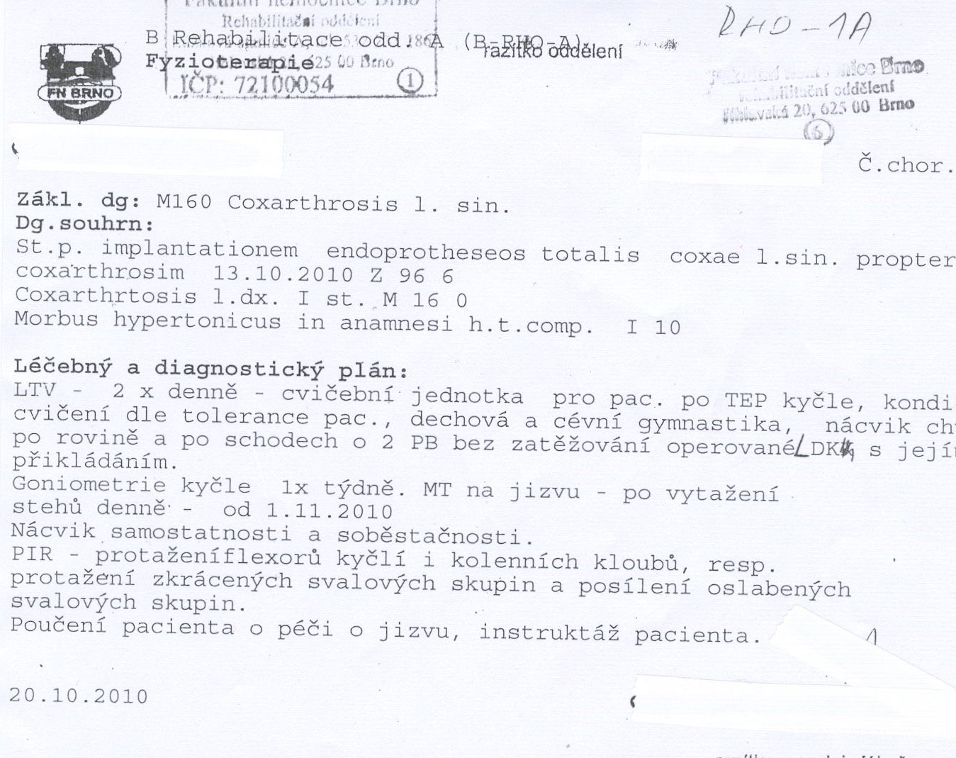
Medical records

Slide 10
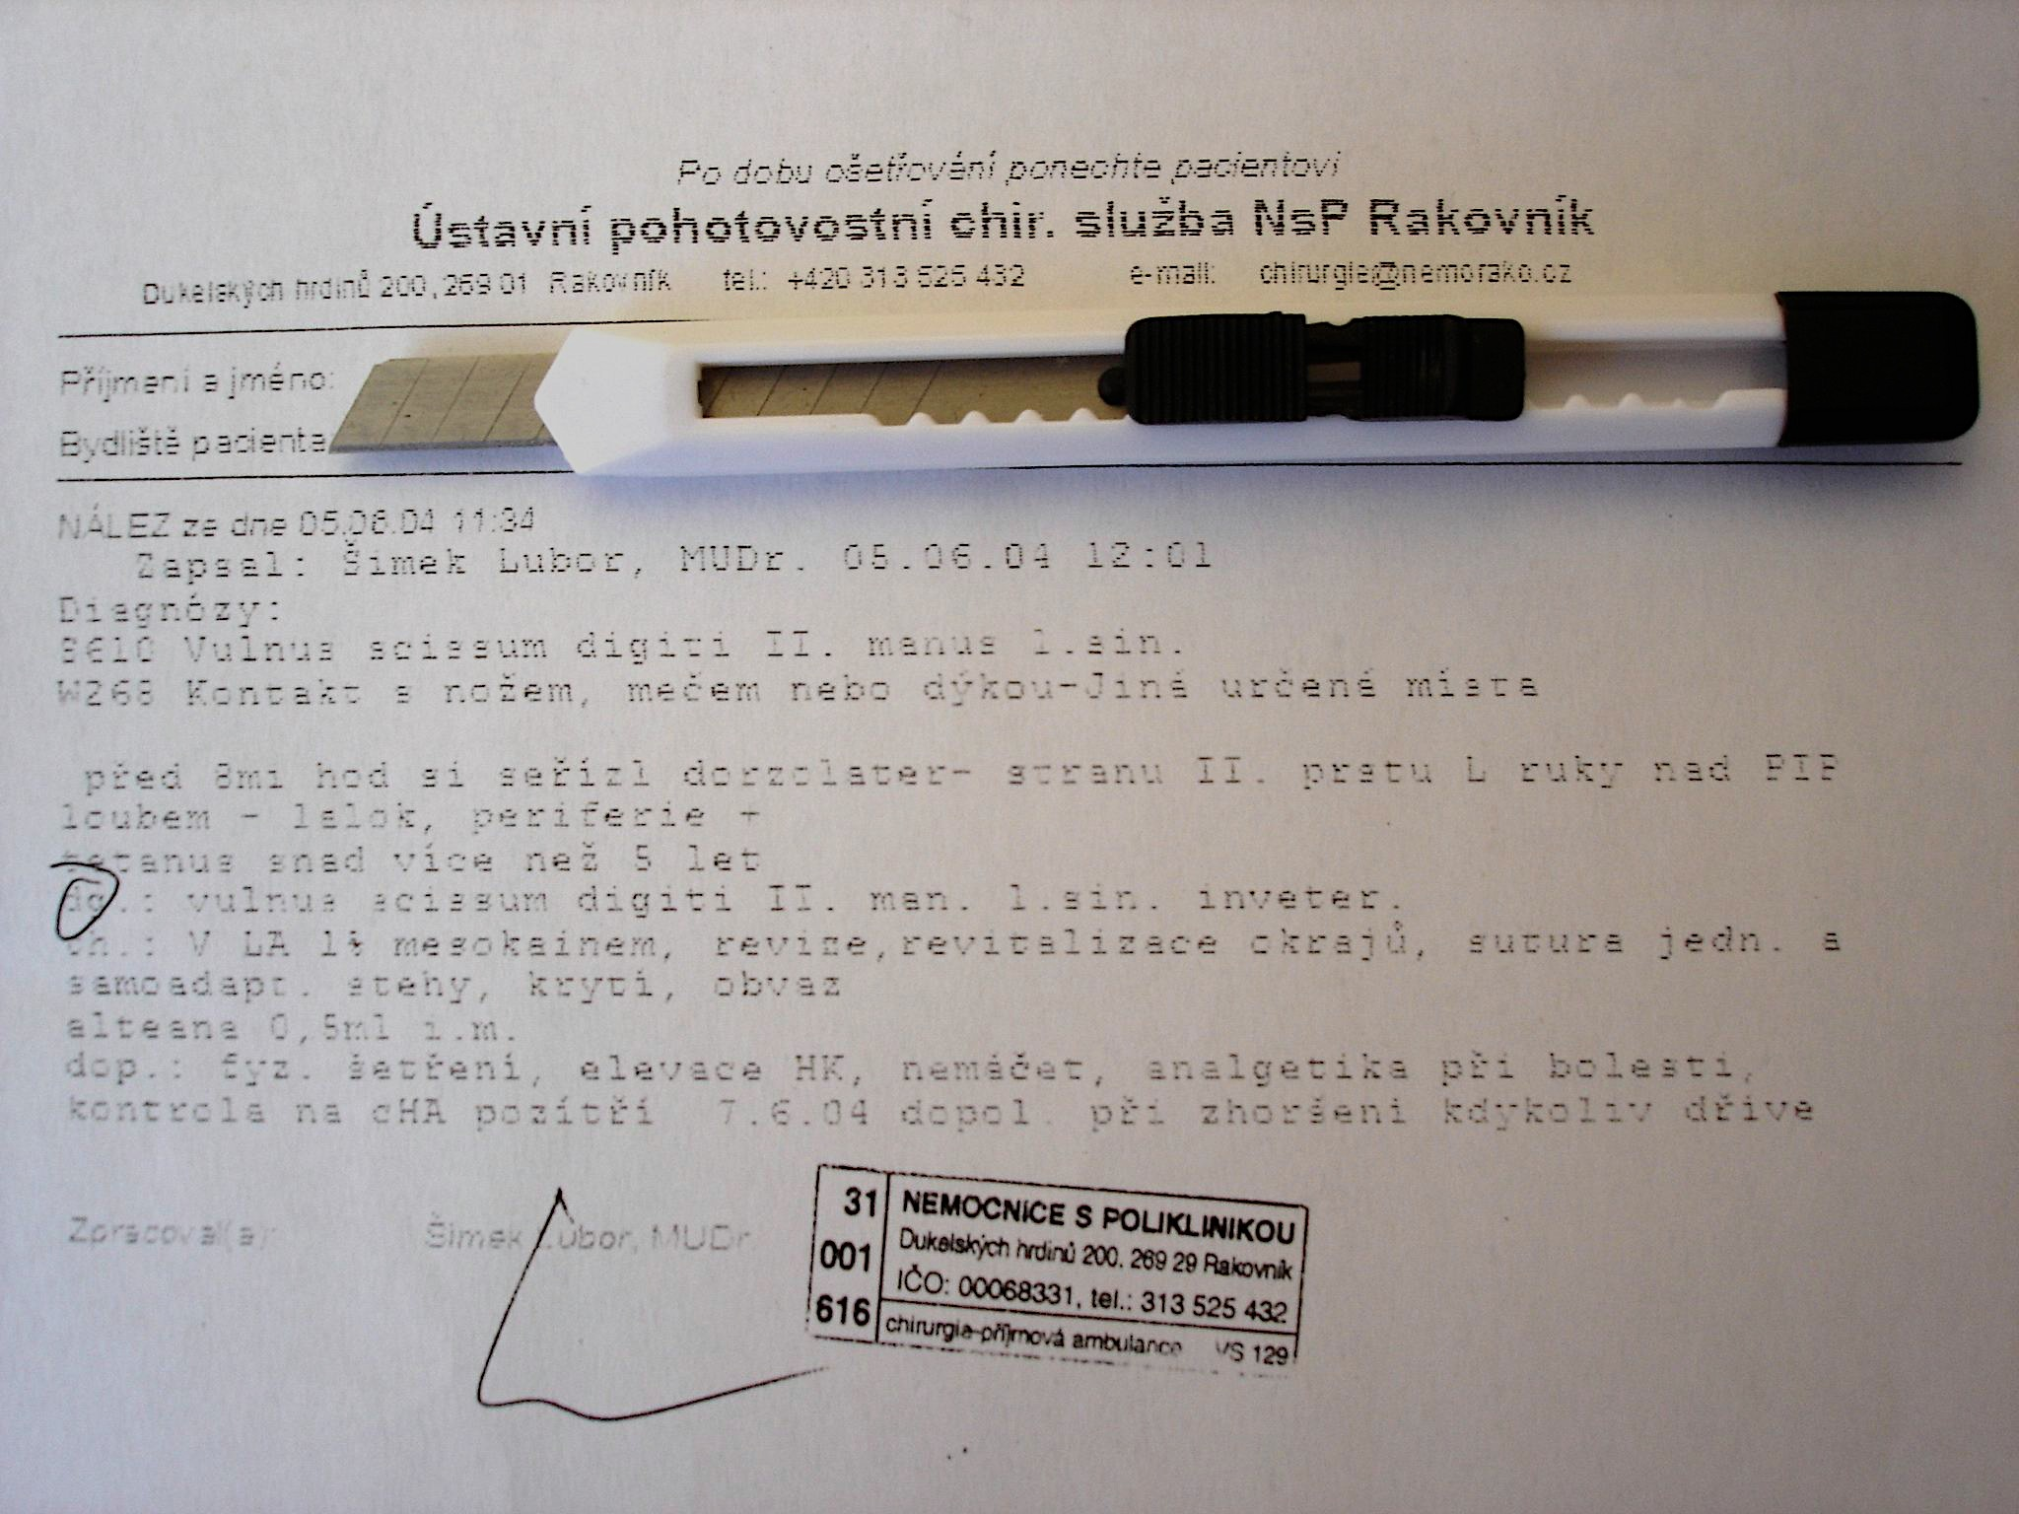

Slide 11

WORD COMPOUNDING
card-i-a
card-i-acus
card-i-alis
peri-card-ium
endo-card-ium
myo-card-ium
card-itis
peri-card-itis
card-i-o-logia
card-i-o-graphia
card-i-o-my-o-pathia
root
suffix
prefix
combining element

Slide 12
Medical prescriptions

Slide 13

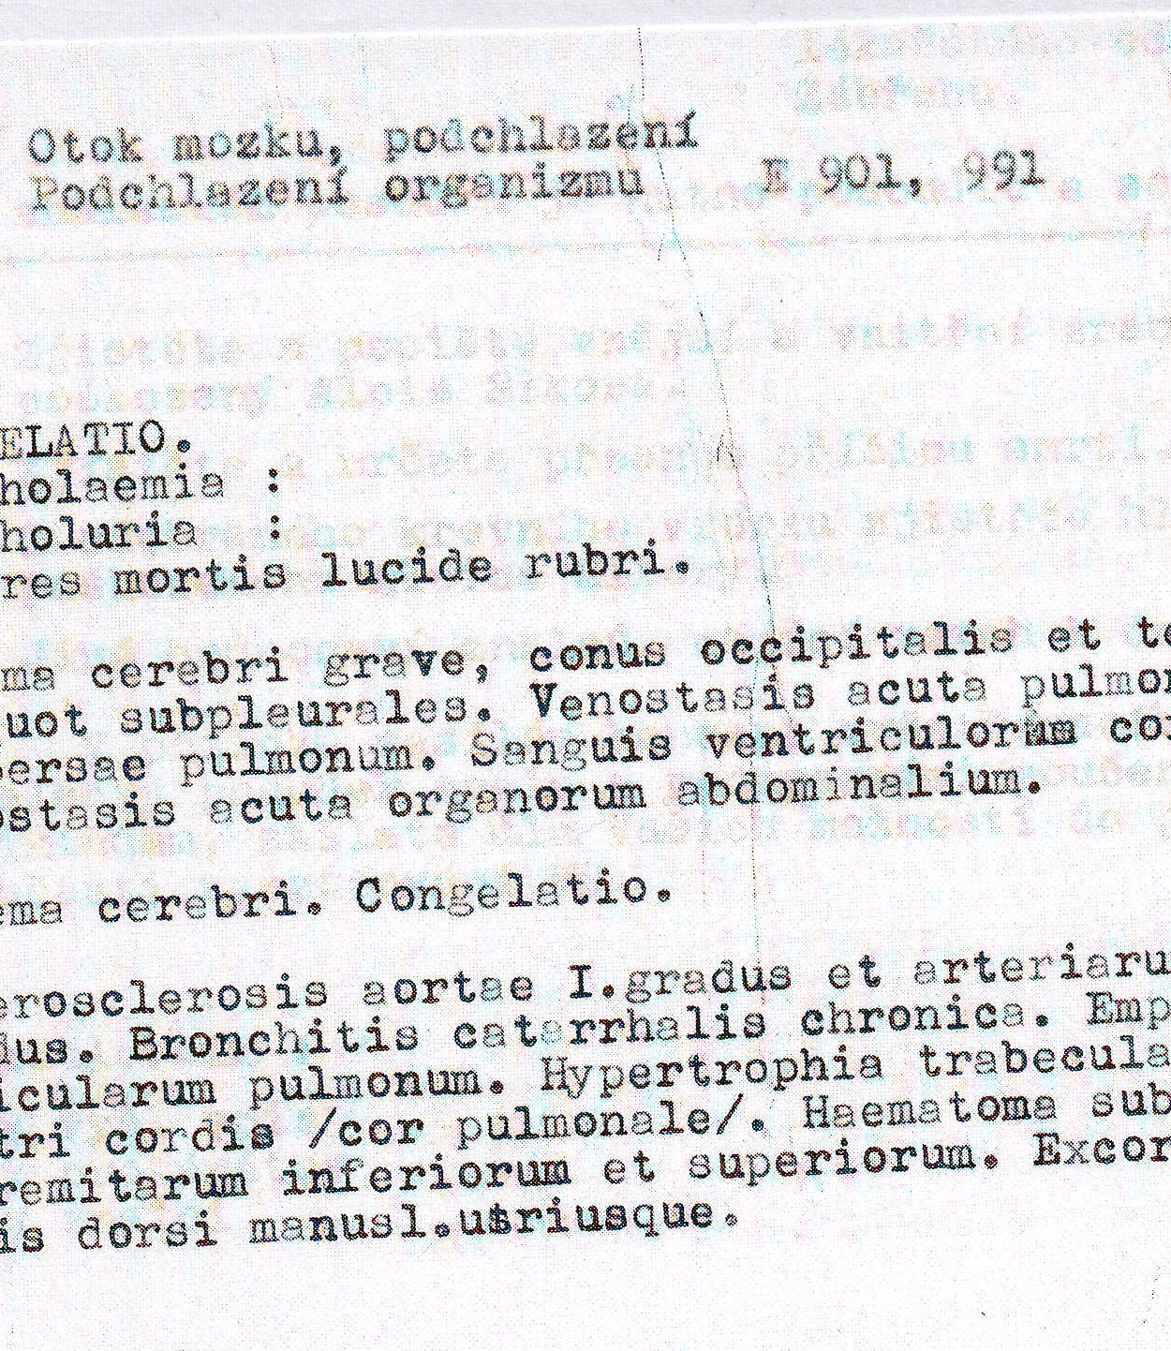
Dissection protocols

Slide 14
Learning outcomes
apply relevant Latin anatomical terms correctly and with understanding;
recognize and explain grammatical concepts and categories relevant to the acquisition of Greek-Latin medical terminology;
recognize the semantic structure of selected anatomical and clinical one-word terms;
explain syntactic structure of complex terms;
derive adjectives from nouns and vice-versa using common suffixes;
form simple compound words denoting inflammatory and non-inflammatory diseases, as well as the basic types of tumours (-itis, -osis, -oma)
translate anatomical terms and simple clinical diagnoses (with focus put on fractures and basic types of injuries, i.e. traumatology.

Slide 15
Latin pronunciation

Slide 16
cancer, medicamentum, lingua
thorax, pulsus, contusio
corpus, exitus, functio
hemispherium, angulus, fractura
intestinum, aqua, pharmacon
oedema, musculus, defectus
medicus, operatio, infarctus
homo, bronchus, duodenum
angina, haemorrhagia, spasmus
encephalon, bacterium, acne
migraena, pharynx, dysenteria
inflammatio, leucaemia, virus
laparoscopia, typhus, organismus
therapia, digitus, gingiva
gangraena, diagnosis, tonsilla
injectio, lympha, oxygenium
vademecum, insufficientia, chirurgia

Slide 17
Vowels
A | Ā | B | C | D | E | Ē | F | G | H | I | Ī | K | L | M | N
O | Ō | P | Q | R | S | T | U | Ū | V | X | Y | Y | Z
Vowels
Long Short
Ā (father) frāctūra A (cut) lingua
Ē (sad) artēria E (met) vertebra
Ī (intrigue) spīna I (intrigue) digitus
I (yes) > J
Ō (door) sensōrius O (on) skeleton
Ū (boom) ruptūra U (put) uterus
Y (analysis) hypophysis Y (lady) tympanum
Diphtongs
AE=Ē (care) anaemia
OE=Ē (care) lagoena
Greek words
OE (o-e) dyspnoe
EU (e-u) euthanasia

Slide 18
Consonants
A | Ā | B | C | D | E | Ē | F | G | H | I | Ī | K | L | M | N
O | Ō | P | Q | R | S | T | U | Ū | V | X | Y | Ŷ | Z
Consonant/group of consonants | Pronunciation | Example
1: c + a, o, u, consonants c + ae, oe, e, i, y | [k] medical [ts] tsar | camera, costa, cultivatio, cranium caecus, coeliacia, centrum, circulatio, cynismus
2: ch | [x] loch | chirurgia, cholera

Slide 19
Consonants
Consonant/group of consonants | Pronunciation | Example
3: g gu + vowel | [g] ground [gv] | gramma, gastritis lingua, sanguis
4: h | [h] house | herba, haematologia
5: j + vowel | [y] yes | iniectio/injectio, maior/major
6: p p + h | [p] present [f] physiology | pneumonia, pulmo phantasia, pharmacia
7: qu+ vowel | [kv] quarrel | aqua, quadriceps
8: r r+h | [r] rupture [r] | vertebra, ruptura rheuma, rhinitis

Slide 20
Consonants
Consonant/group of consonants | Pronunciation | Example
9: s/ss s between two vowels and following after l, r, n | [s] some [z] zebra | serum, fossa nasus, incisura, pulsus, tonsilla, inversus, suspensio
10: t ti + vowel s/t/x + ti + vowel t+h | [t] tongue [tsi] [ty] [t] | trauma, tactus operatio, substantia tibia, ostium, mixtio therapia, thermometrum
11: z | [z] zone | zoologia

Slide 21
Basic grammatical concepts

Slide 22
Gender
Masculine (e.g. nervus)
Feminine (e.g. fractura)
Neutral (e.g. cerebrum)
Not always intuitive – you have to learn the gender of each noun !!!
Why?
to properly inflect the noun and connect adjectives to it

Slide 23
Number
Singular (=1)
Plural (=2 and more)

Slide 24
Case
ENGLISH: the order of the words in a sentence/phrase gives the information on their grammatical function
e.g. complicated fracture of the left humerus
(adjective – noun – non-agreed attribute (of…) – WORD ORDER MATTERS
LATIN: the form of each word in a sentence/phrase gives the information on its grammatical function
e.g. Fractura humeri sinistri complicata = fractura complicata humeri sinistri – ENDINGS MATTER

Slide 25
Latin v
English
English: meaning changes if we change word order
soft ulcer in duodenum x ulcer in softduodenum
  the function of a word is conveyed by WORD ORDER (Subject-Verb-Object rule)
Latin: meaning does not change
soft ulcer of/in duodenum
ulcus molle duodeni = ulcus duodeni molle
etc.
  the function of a word is conveyed by its ENDING!!!

Slide 26
Function of case in medical terms
case | function | use | vocab system
NOMINATIVE | subject of the phrase always first in the sentence!! | ANATOMY corpus ulnae (= body of ulnar bone) | 1st dictionary entry
GENITIVE | ~ English „of“ | ANATOMY caput femoris (= head of thigh bone) | 2nd dictionary entry
ACCUSATIVE | after prepositions | CLINICAL DIAGNOSES post operationem (after the operation) sine complicationibus (=without complications)
ABLATIVE

Slide 27
status post implantationem osteoprotheseos coxae sine complicationibus
NOMINATIVE
= state/condition
GENITIVE
= of osteoprothesis
= of hip bone
ACCUSATIVE
= after implantation
ABLATIVE
= without complications
= state after the implantation of osteoprothesis of hip bone without complications

Slide 28
DICTIONARY ENTRY
CAUTION! When learning new words ALL THREE FORMS are EQUALLY important for the future ability to use the noun in context.
English noun is presented only in its single form
(nominative singular)
Latin noun is presented in three forms
Muscle = MUSCULUS, I, M.
Bone = OS, OSSIS, N.
Basic form
(full nominative)
Genitive ending/or even full Genitive form if the word is short
Gender abbreviation

Slide 29
Genitive ending (2nd info) = Declension
DECLENSION | 1st | 2nd | 3rd | 4th | 5th
GENITIVE ENDING | -ae (-es) | -i | -(?)-is | -us | -ei
EXAMPLE | coxa, ae, f. | humerus, i, m. cranium, ii, n. | coccyx, gis, f. dens, dentis, m. femur, oris, n. pelvis, is, f. | arcus, us, m. genu, us, n. | facies, ei, f.
Declensions are groups of nouns (or adjectives) that use the same set of case endings.
Without learning Genitive form, you cannot classify the noun into a proper declension group, thus, you cannot use it properly in a sentence.

Slide 30
Declension
= a group of nouns that share the same case endings
(have the same set of case endings), see the declension table
Each noun belongs to one of 5 declensions:
1st declension – a-stems – ven-a-rum
2nd declension – o-stems – nerv-o-rum
3rd declension
  i-stems – pelv-i-um
  consonant stems – dolo-r-um, pon-t-um, sectio-n-um
4th declesion – u-stems – duct-u-um
5th declension – e-stems – faci-e-rum

Slide 31
GENITIVE STEM
IT IS CRUCIAL TO KNOW THE STEM TO CREATE ALL OTHER CASES, because the endings are always attached to the stem of the word !!!
how do I know the stem?
remove the genitive ending, what stays is the stem!
dol-or
dolor-is
corp-us
corpor-is
de-ns
dent-is
humer-us
humer-i
diamet-er
diametr-i
arc-us
arc-us
gen-u
gen-us
ven-a
ven-ae
faci-es
faci-ei

Slide 32
Adjectives
= words describing nouns
Adjectives always have to correspond with the noun to which they belong in gender, number and case!!!!
fractura ulnae dextrae complicata
vertebrae thoracicae
ad lagoenam fuscam
cum anaemia perniciosa
Why do you think this is so?

Slide 33
Prepositions
with accusative
with ablative
  See the Overview: Basic grammatical concepts in IS

Slide 34
Follow-up exercise
Assign the terms given in Handout 1 to their declensions
Write down the full Genitive and stem of each term

