Slide 1
What are the genitive endings of Latin declensions?
What is stem?
How can we identify the stem of a Latin noun?
How do I decide to what declension the word belongs to?

Slide 2
When do we use?
Nominative?
Genitive?
Accusative?
Ablative?

Slide 3
Use the declension table to form plural of the following words
COXA
TENDO
NERVUS
GENU

Slide 4
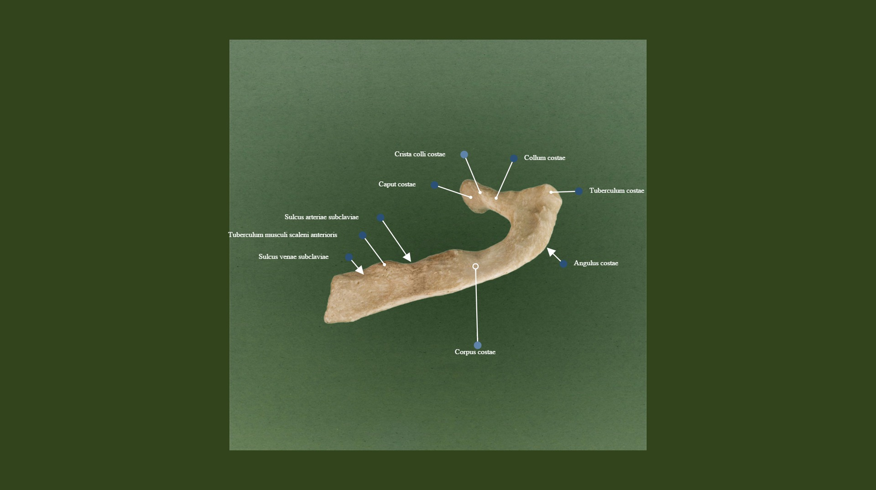
Anatomical nomenclature non-agreed attribute
http://terminologia-anatomica.org/cs/ImageSet/ViewSet/2085?imageId=496

Slide 5
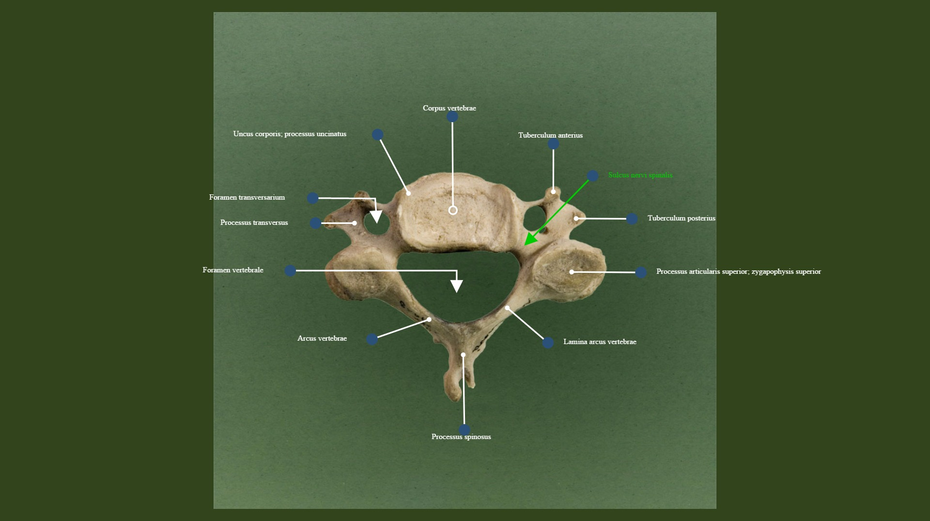
Anatomical nomenclature agreed v non-agreed attribute
http://terminologia-anatomica.org/cs/ImageSet/ViewSet/2002?imageId=420

Slide 6
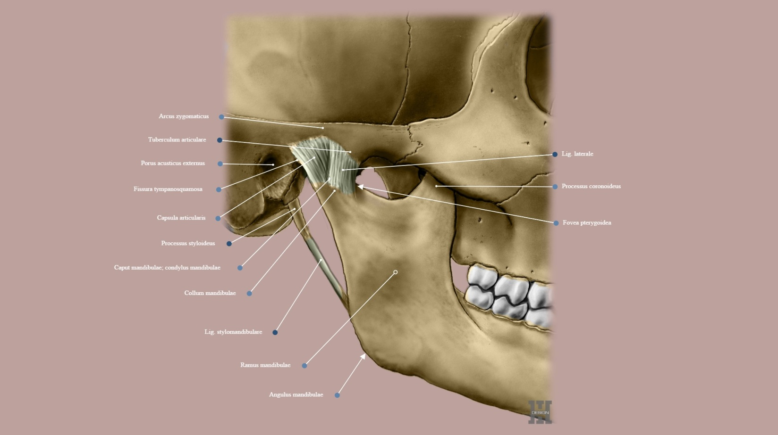
Which anatomical terms use adjectives and which Genitive?
http://terminologia-anatomica.org/cs/ImageSet/ViewSet/2315?imageId=804&imageAnnotationId=21594&mobile=false

Slide 7
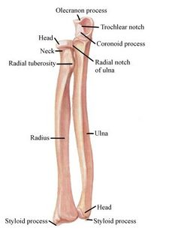
Adjective or Genitive?
NOUN + NOUN, if we speak of a part of the structure, e.g. caput radii
NOUN+ ADJECTIVE, if we speak of a structure connected to the neighbouring one, e.g. incisura radialis
BOTH in some terms like:
ossa tarsi/tarsalia
ossa carpi/carpalia
ossicula auditus/auditoria
cavitas abdominis/abdominalis
cavitas thoracis/thoracica
cavitas pelvis/pelvina

Slide 8
THE ORDER OF ADJECTIVES AFTER NOUN
The most general adjectives are put first, the most specifying last (the other way round as in English), see:
abductor
flexor indicis
adductor digitorum longus
musculus extensor pollicis brevis
levator carpi
depressor hallucis
compressor
Thus, the terms like lateralis-medialis, longus-brevis, superficialis-profundus, maximus-minimus, etc. are usually put at the end of the anatomical term

Slide 9
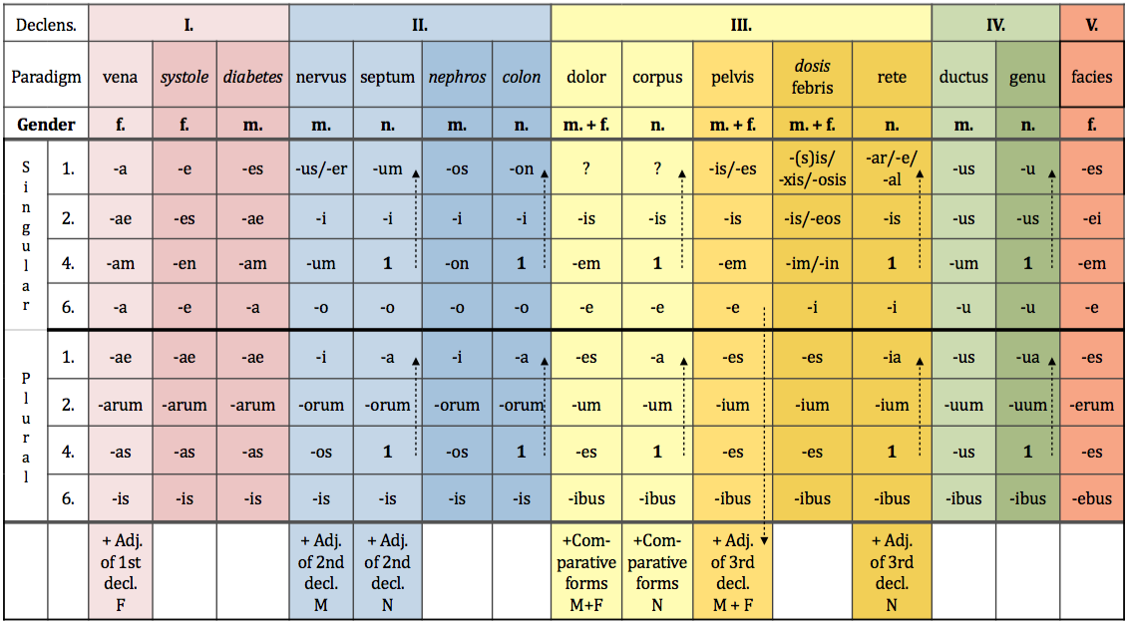
Genitive singular and plural

Slide 10
NON-AGREED ATTRIBUTE
noun + noun in GENITIVE
Equivalent to: of
EX: Fractura costae //fractura costarum
Fracture of rib Fracture of ribs
English does not always use of, where Latin uses Genitive!
rib fracture = fracture of rib
scapular notch = notch of scapula

Slide 11
Name parts of bones
ex: caput + costa > caput costae head of rib
caput + femur >
caput + fibula >
caput + humerus >
caput + phalanx >
caput + radius >
caput + talus >
caput + ulna >

Slide 12
Prepositions and prepositional phrases
Denote:
spatial relations sub, infra, post, ante, supra, a/ab, ad
temporal relations post, ante, intra
causal relations propter, e/ex
other cum, sine
Can be connected with:
Accusative case
Ablative case
Both Accusative and Ablative cases

Slide 13
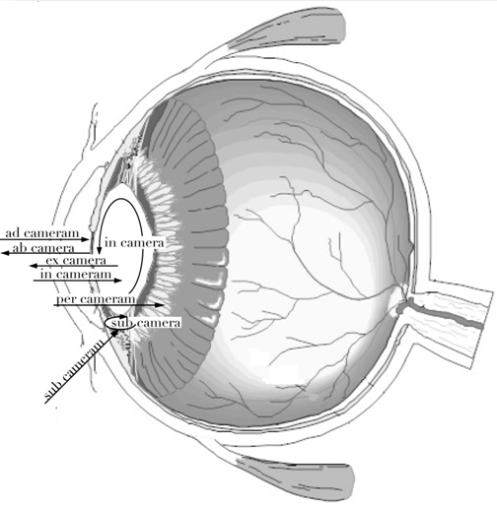

Slide 14
Form prepositional phrases

Slide 15
LATIN1st declension
In the 1st declension we decline nouns that have:
Genitive sg. ending | -AE
Nominative sg. ending | -A
Gender | Mostly F Never N Exceptions M
EXCEPTIONS!!!
NOUNS OF THE 1st Declension that are of masculine gender are:
Names of specialists – dentista, ae, m.
Names of muscles – antagonista, ae, m.

Slide 16
GREEK1st declension
Greek origin words of 1st declension have these typical endings:
Nominative sg. | -E | -ES *diabetes *ascites
Genitive sg. | -ES | -AE
Gender | F | M

Slide 17
Latin and Greek 1st declension
Latin Greek

