Slide 1
Schizophrenia and other psychotic disorders

Slide 2

Psychosis, schizophrenia
What does „psychosis“ mean?
What does „schizophrenia“ mean?
Is there any difference between them?

Slide 3

Psychosis, schizophrenia
Psychosis:
symptom, not illness
halucinations, delusions, thought disorder
Schizophrenia:
- one of the psychoses, diagnosis

Slide 4
Definition of SCH
The schizophrenic disorders are characterized in general by fundamental and characteristic distortions of thinking and perception, and affects that are inappropriate or blunted. Clear consciousness and intellectual capacity are usually maintained although certain cognitive deficits may evolve in the course of time.
The most important psychopathological phenomena include
  thought echo
  thought insertion or withdrawal
  thought broadcasting
  delusional perception and delusions of control
  influence or passivity
  hallucinatory voices commenting or discussing the patient in the third person
  thought disorders and negative symptoms.

Slide 5
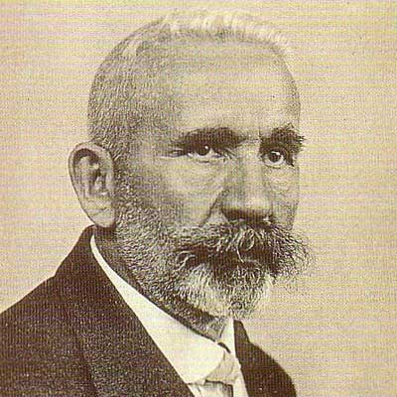
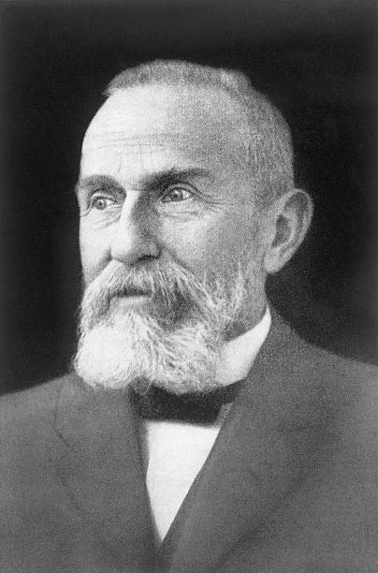
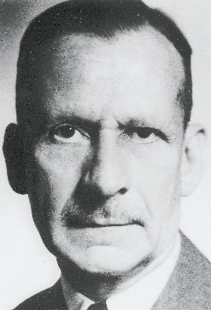
History
Emil Kraepelin: This illness develops relatively early in life, and its course is likely deteriorating and chronic; deterioration reminded dementia („Dementia praecox“), but was not followed by any organic changes of the brain, detectable at that time.
Eugen Bleuler: He renamed Kraepelin’s dementia praecox as schizophrenia (1911); he recognized the cognitive impairment in this illness, which he named as a „splitting“ of mind.
Kurt Schneider: He emphasized the role of psychotic symptoms, as hallucinations, delusions and gave them the privilege of „the first rank symptoms” even in the concept of the diagnosis of schizophrenia.

Slide 6
4 A (Bleuler) – „four“ A
Bleuler maintained, that for the diagnosis of schizophrenia are most important the following four fundamental symptoms:
  affective blunting
  disturbance of association (fragmented thinking)
  autism
  ambivalence (fragmented emotional response)
Bleuler thought, that they are „primary” for this diagnosis.
The other known symptoms, hallucinations, delusions, which are appearing in schizophrenia very often also, he used to call as a “secondary symptoms”, because they could be seen in any other psychotic disease, which are caused by quite different factors — from intoxication to infection or other disease entities.

Slide 7


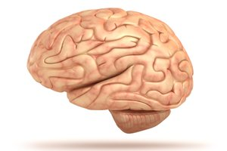
Symptoms
Positive – „plus“, an excess or distortion or normal function
Negative – „minus“, „lost“ functions
Cognitive
(Affective)

Slide 8
Positive symptoms
Halucinations
Delusions
Formal thought disorder
Bizarre behaviour

Slide 9
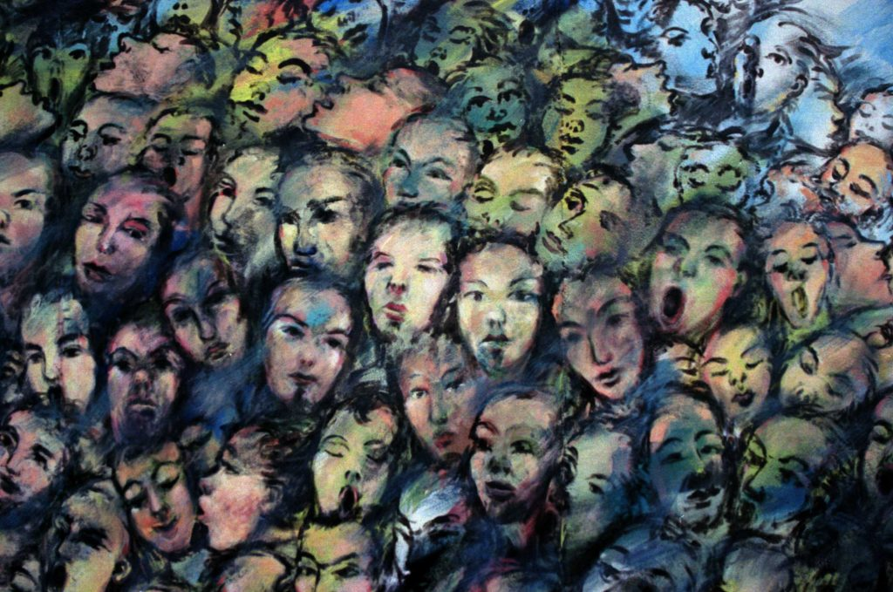
Halucinations
What types of halucinations do you know?
Which are typical for SCH?
Can you imagine „hearing voices“?

Slide 10
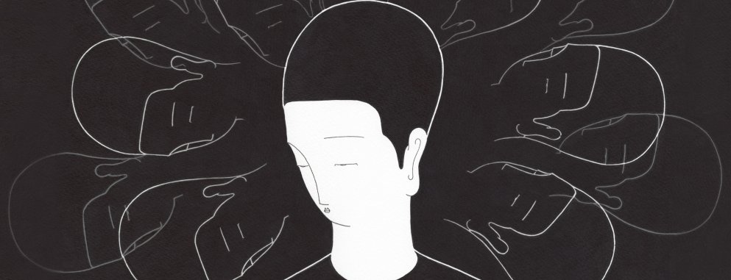
Halucinations
Disturbance of perception
Auditory:
„hearing voices“, usual more, words or sentences, usually unplesant
commenting, imperative, giving advice
Intrapsychical:
hearing own thoughts, thought broadcasting, thought insert, externalization, control
Tactile, olfactory – not so typical
Visual – not typical (delirium)

Slide 11

Delusions
Disturbance of thinking/thought
Delusion - a mistaken belief that is held with strong conviction
3 types:
Macromanic – immortality, grandeur, inventory, erotomania, …
Micromanic- nihilistic, autoaccusative, hypochondric, …
Paranoid – paranoid, persecutory, control, jealousy, dysmorfofobic, …

Slide 12
Formal thought disorder
Disorganized thinking (and speech, and behaviour)
Organized (logical) – tangencial - disorganized

Slide 13
Negative symptoms
Alogie – relative absence of thoughts and speech
Affective flattening – little expressed emotion
Avoliation – apathy – lack of initiation and persistence
Anhedonia – asociality – lack of pleasure feeling
Attentional impairment

Slide 14
Cognitive symptoms
Impaired memory and attention
Difficulty thinking through complicated processes, making sense of information
Impaired ability to organize
Poor decision-making
Difficulty in interpreting social cues

Slide 15


Other symptoms
Sleep distorsion
Paralogia
Catatonia
Ambivalency (having simultaneous conflicting reactions, beliefs, or feelings towards some object)
Anosognosia

Slide 16
The Criteria of Diagnosis (ICD-10)
For the diagnosis of schizophrenia is necessary
presence of one very clear symptom - from point a) to d)
or the presence of the symptoms from at least two groups - from point e) to h)
for one month or more:
the hearing of own thoughts, the feelings of thought withdrawal, thought insertion, or thought broadcasting
the delusions of control, outside manipulation and influence, or the feelings of passivity, which are connected with the movements of the body or extremities, specific thoughts, acting or feelings, delusional perception
hallucinated voices, which are commenting permanently the behavior of the patient or they talk about him between themselves, or the other types of hallucinatory voices, coming from different parts of body
permanent delusions of different kind, which are inappropriate and unacceptable in given culture

Slide 17
The Criteria of Diagnosis
the lasting hallucination of every form
blocks or intrusion of thoughts into the flow of thinking and resulting incoherence and irrelevance of speach, or neologisms
catatonic behavior
„the negative symptoms”, for instance the expressed apathy, poor speech, blunting and inappropriatness of emotional reactions
expressed and conspicuous qualitative changes in patient’s behavior, the loss of interests, hobbies, aimlesness, inactivity, the loss of relations to others and social withdrawal
Diagnosis of acute schizophorm disorder (F23.2) – if the conditions for diagnosis of schizophrenia are fulfilled, but lasting less than one month
Diagnosis of schizoaffective disorder (F25) - if the schizophrenic and affective symptoms are developing together at the same time

Slide 18

Types of schizophrenia
F20 Schizophrenia
F20.0 Paranoid schizophrenia
F20.1 Hebephrenic schizophrenia
F20.2 Catatonic schizophrenia
F20.3 Undifferentiated schizophrenia
F20.4 Post-schizophrenic depression
F20.5 Residual schizophrenia
F20.6 Simple schizophrenia
F20.8 Other schizophrenia
F20.9 Schizophrenia, unspecified

Slide 19
F20.0 Paranoid Schizophrenia
is characterized mainly by delusions of persecution, feelings of passive or active control, feelings of intrusion, and sometimes by megalomanic tendencies also. The delusions are not usually systemized too much, without tight logical connections and are often combined with hallucinations of different senses, mostly with hearing voices.

Slide 20
F20.2 Catatonic Schizophrenia
is characterized mainly by motoric activity, which might be strongly increased (hypekinesis) or decreased (stupor), or automatic obedience and negativism.
  productive form — which shows catatonic excitement, extreme and often aggressive activity.
  (rare symptoms: echopraxia, echolalia, echomimia)
  stuporose form — characterized by general inhibition of patient’s behavior or at least by retardation and slowness, followed often by mutism, negativism, fexibilitas cerea or by stupor.

Slide 21
movie
Catatonic symptoms

Slide 22
F20.3 Undifferentiated Schizophrenia
Psychotic conditions meeting the general diagnostic criteria for schizophrenia but not conforming to any of the subtypes in F20.0-F20.2, or exhibiting the features of more than one of them without a clear predominance of a particular set of diagnostic characteristics.
This subgroup represents also the former diagnosis of atypical schizophrenia.

Slide 23
F20.4 Postschizophrenic Depression
A depressive episode, which may be prolonged, arising in the aftermath of a schizophrenic illness. Some schizophrenic symptoms, either „positive“ or „negative“, must still be present but they no longer dominate the clinical picture.
These depressive states are associated with an increased risk of suicide.

Slide 24
F20.5 Residual Schizophrenia
A chronic stage in the development of schizophrenia with clear succession from the initial stage with one or more episodes characterized by general criteria of schizophrenia to the late stage with long-lasting negative symptoms and deterioration (not necessarily irreversible).

Slide 25
F20.6 Simple Schizophrenia
Simple schizophrenia is characterized by early and slowly developing initial stage with growing social isolation, withdrawal („introvertization“), small activity, passivity, avolition and dependence on the others.
The patients are indifferent, without any initiative and volition. There is not expressed the presence of hallucinations and delusions.

Slide 26
What is the incidence of SCH?
When (what age) does SCH start?

Slide 27
Incidence, onset
Schizophrenia occurs with regular frequency nearly everywhere in the world in 1 % of population and begins mainly in young age (mostly around 16 to 25 years).
Men usually earlier then women.
Women: second peak of incidence – year 37 or 38.
Onset after 40 is very unusual.
(Women – better prognosis, more „affective“ symptom, later onset then men)

Slide 28
Course of Illness
Course of schizophrenia:
  continuous without temporary improvement
  episodic with progressive or stable deficit
  episodic with complete or incomplete remission
Typical stages of schizophrenia:
  prodromal phase
  active phase
  residual phase

Slide 29
Suicidality, lenght of life
Approximately 5-6% of SCH patients commite suicide.
Schizophrenia shorten life of approximately 15 years.

Slide 30

Genetics of Schizophrenia
Many psychiatric disorders are multifactorial (caused by the interaction of external and genetic factors) and from the genetic point of view very often polygenically determined.
Relative risk for schizophrenia is around:
  1% for normal population
  5.6% for parents
  10.1% for siblings
  12.8% for children

Slide 31

Etiology of Schizophrenia
The etiology and pathogenesis of schizophrenia is not known
It is accepted, that schizophrenia is „the group of schizophrenias“ which origin is multifactorial:
  internal factors – genetic, inborn, biochemical
  external factors – trauma, infection of CNS, stress

Slide 32
Etiology of Schizophrenia - Dopamine Hypothesis
The most influential and plausible are the hypotheses, based on the supposed disorder of neurotransmission in the brain, derived mainly from
  the effects of antipsychotic drugs that have in common the ability to inhibit the dopaminergic system by blocking action of dopamine in the brain
  dopamine-releasing drugs (amphetamine, mescaline, diethyl amide of lysergic acid - LSD) that can induce state closely resembling paranoid schizophrenia
Classical dopamine hypothesis of schizophrenia: Psychotic symptoms are related to dopaminergic hyperactivity in the brain. Hyperactivity of dopaminergic systems during schizophrenia is result of increased sensitivity and density of dopamine D2 receptors in the different parts of the brain.

Slide 33
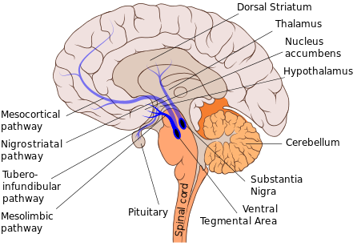
Positive symptoms – hyperdopaminergic state in mesolimbic pathway
Negative symptoms – hypodopaminergic state in mesocortical area

Slide 34
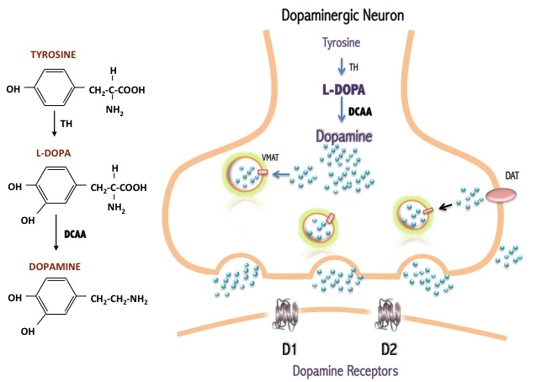
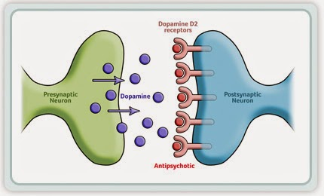

Slide 35
Etiology of Schizophrenia - Contemporary Models
Dopamine hypothesis revisited: various neurotransmitter systems probably takes place in the etiology of schizophrenia (norepinephric, serotonergic, glutamatergic, some peptidergic systems); based on effects of atypical antipsychotics especially.
Contemporary models of schizophrenia conceptualize it as a neurocognitive disorder, with the various signs and symptoms reflecting the downstream effects of a more fundamental cognitive deficit:
  the symptoms of schizophrenia arise from “cognitive dysmetria” (Nancy C. Andreasen) (a dysfunction in cortical-subcortical-cerebellar circuitry)
  concept of schizophrenia as a neurodevelopmental disorder (Daniel R. Weinberger)

Slide 36
Etiology of Schizophrenia - Neurodevelopmental Model
Neurodevelopmental model supposes in schizophrenia the presence of “silent lesion” in the brain, mostly in the parts, important for the development of integration (frontal, parietal and temporal), which is caused by different factors (genetic, inborn, infection, trauma...) during very early development of the brain in prenatal or early postnatal period of life.
It does not interfere too much with the basic brain functioning in early years, but expresses itself in the time, when the subject is stressed by demands of growing needs for integration, during formative years in adolescence and young adulthood.

Slide 37
Abnormities in brain structure
Nonspecific, not visible on basic MRI
cortical gray matter loss (i.e. superior temporal and inferior frontal regions)
disrupted neural connectivity

Slide 38
Treatment of schizophrenia
Antipsychotics
Individual psychotherapy
Family therapy
Social sklil training
Supported employment etc
ECT or rTMS in the minority of patient
(ECT – usually pharmacoresistant patients with affective symptoms, rTMS – vocal hallucinations, negative symptoms)

Slide 39
Antipsychotics
The acute psychotic schizophrenic patients will respond usually to antipsychotic medication.
According to current consensus we use in the first line therapy the newer atypical antipsychotics, because their use is not complicated by appearance of extrapyramidal side-effects, or these are much lower than with classical antipsychotics.
conventional antipsychotics (classical neuroleptics) | chlorpromazine, chlorprotixene, levopromazine, thioridazine
 | flupentixol, fluphenazine, haloperidol, melperone, perphenazine
atypical antipsychotics | amisulpride, aripiprazole, clozapine, olanzapine, quetiapine, paliperidone, risperidone, sertindole, sulpiride, ziprasidone

Slide 40

LAI: Long-acting injectable antipsychotics
Some of the antipsychotics are availble also in the form of long-acting injections.

Slide 41

How long should pharmacotherapy last?
After first episode – 2 years
After second episode – 5 years
After third and other episodes, in patients with chronic course, in patients with repetitive suicidal behaviour – longer, usually the whole life

Slide 42
F21 Schizotypal disorder
eccentric behavior,
deviations of thinking and affectivity, which are similar to that occurring in schizophrenia,
but without psychotic features and expressed symptoms of schizophrenia of any type.

Slide 43
F22.0 Delusional Disorder
A disorder characterized by the development of one delusion or of the group of similar related delusions, which are persisting unusually long, very often for the whole life.
Other psychopathological symptoms — intrusion of thoughts etc. are not present and are excluding this diagnosis.
It begins usually in the middle age.

Slide 44
F23 Acute and Transient Psychotic Disorders
The criteria should be the following features:
  acute beginning (to two weeks)
  quickly changing “polymorphic symptoms”
  presence of typical schizophrenic symptoms
Complete recovery usually occurs within a few months, often within a few weeks or even days.
The disorder may or may not be associated with acute stress, defined as usually stressful events preceding the onset by one to two weeks.

Slide 45
F24 Induced Delusional Disorder
A delusional disorder shared by two or more people with close emotional links. Only one of the people suffers from a genuine psychotic disorder; the delusions are induced in the other(s) and usually disappear when the people are separated.

Slide 46
F25 Schizoaffective Disorders
Episodic disorders in which both affective and schizophrenic symptoms are prominent (during the same episode of the illness or at least during few days) but which do not justify a diagnosis of either schizophrenia or depressive or manic episodes.
Patients suffering from periodic schizoaffective disorders, especially with manic symptoms, have often good prognosis with full remissions without any remaining defects.
They are divided in different subgroups:
  F25.0 Schizoaffective disorder, manic type
  F25.1 Schizoaffective disorder, depressive type
  F25.2 Schizoaffective disorder, mixed type
  F25.8 Other schizoaffective disorders
  F25.9 Schizoaffective disorder, unspecified

