Slide 1
Chest trauma
Petráš M.,. Klinika úrazové chirurgie LF MU a TC FN Brno

Slide 2
Introduction
vital structures – chest trauma is often sudden and dramatic
heart, great vessels, tracheobronchial tree and lungs
abdominal injuries are common with chest trauma
the most common type of injuries is blunt
serious pathological consequences – hypoxia, hypovolaemia, myocardial failure

Slide 3
Physiology
ventilation
the mechanical process of moving air into and out of the lungs
respiration
the exchange of oxygen and carbon dioxide between the outside atmosphere and the cell of the body

Slide 4
Anatomy
skin
bones
12 pair of ribs
ribs 1-7: join at sternum with cartilage end-points
ribs 8-10: join at sternum with combined cartilage at 7th rib
ribs 11-12: no anterior attachment
sternum
thoracic spine

Slide 5
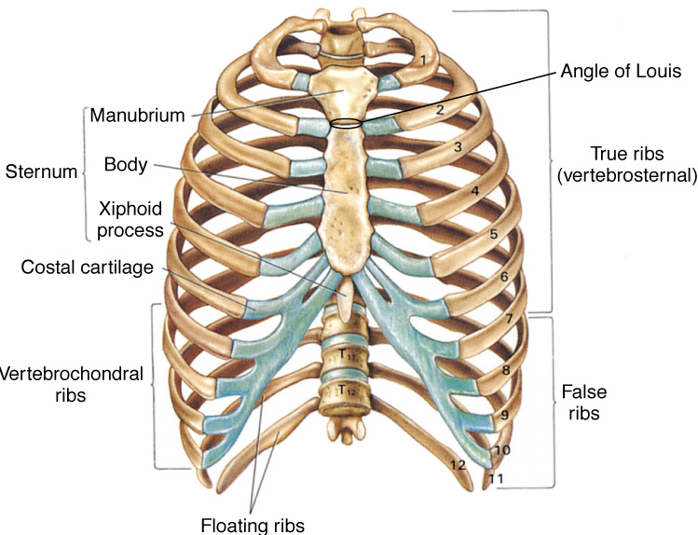

Slide 6
Anatomy
topographical thoracic reference lines
midclavicular line
anterior axillary line
mid-axillary line
posterior axillary line
intercostal space
artery, vein and nerve on inferior margin of each rib

Slide 7
Anatomy
muscles of respiration
diaphragm
intercostal muscles
contract to elevate the ribs and increase thoracic diameter
increase depth of respiration
sternocleidomastoid
raise upper rib and sternum

Slide 8
Anatomy
trachea
hollow & cartilage supported structure
bronchi
right & left extend for 3 centimeters
enters lungs at pulmonary hilum
also where pulmonary arteries & veins enter
further subdivide and terminate as alveoli
basic unit of structure & function in the lungs
single cell membrane
lungs
right = 3 lobes
left = 2 lobes

Slide 9
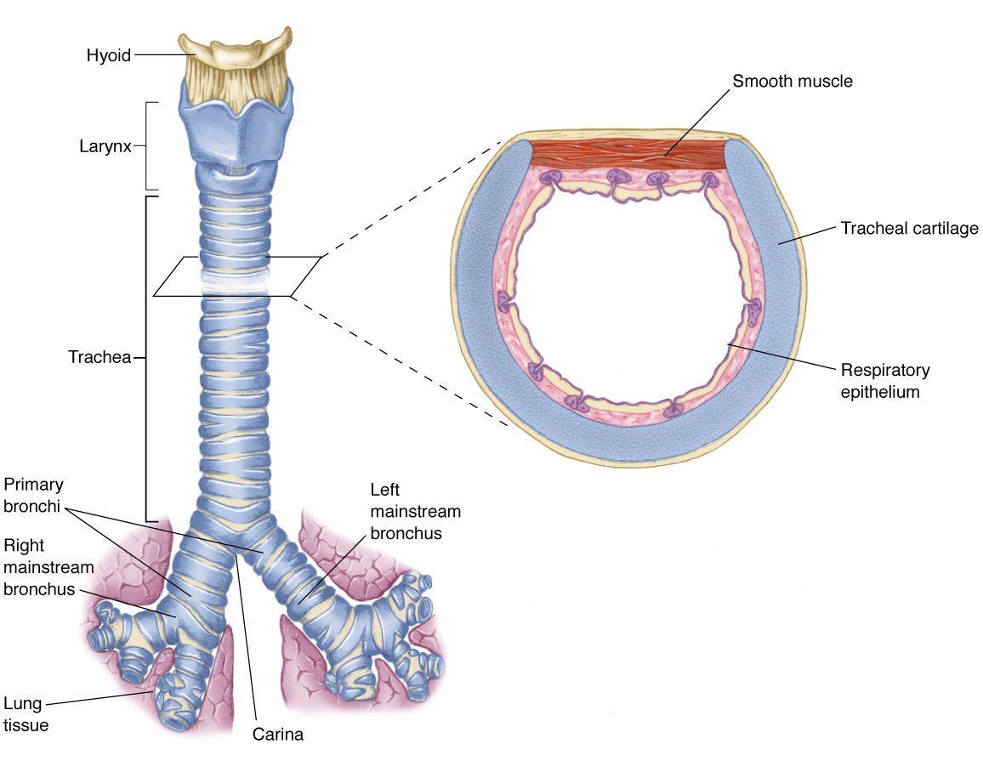

Slide 10
Anatomy
pleura
visceral pleura
cover lungs
parietal pleura
lines inside of thoracic cavity
pleural space
POTENTIAL SPACE
Air in Space = PNEUMOTHORAX
Blood in Space = HEMOTHORAX
serous (pleural) fluid within

Slide 11
Anatomy
mediastinum
central space within thoracic cavity
boundaries
lateral: lungs
inferior: diaphragm
superior: thoracic outlet
structures
heart
great vessels
esophagus
trachea
nerves
vagus
phrenic
thoracic duct

Slide 12
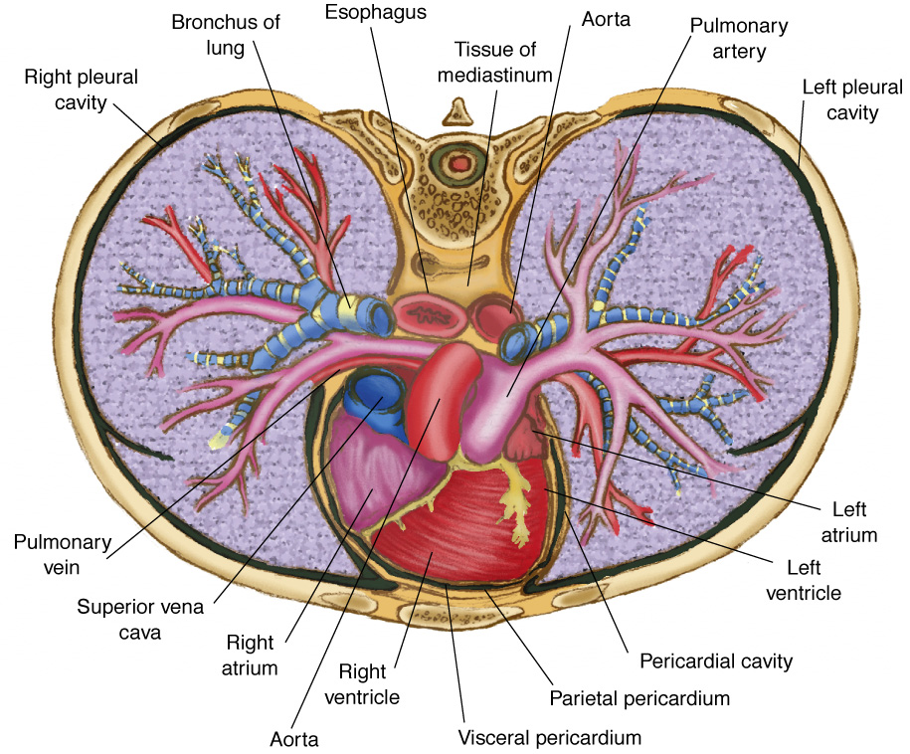

Slide 13
Classifications
skeletal injury
pulmonary injury
heart and great vessel injury
diaphragmatic injury

Slide 14
Classification mechanism of injury
blunt thoracic injuries - most common
forces distributed over a large area
deceleration
compression
age factors
pediatric thorax: more cartilage = absorbs forces
geriatric thorax: calcification & osteoporosis = more fractures
penetrating thoracic injuries

Slide 15
Pathophysiology
impairments in cardiac output
blood loss
increased intrapleural pressures
blood in the pericardial sac
vascular disruption
impairments in gas exchange
atelectasis
contused lung tissue
disruption of the respiratory tract

Slide 16
Assessment findings
pulse
deficit
tachycardia
bradycardia
blood pressure
narrowed pulse pressure
hypertension
hypotension

Slide 17
Assessment findings
respiratory rate and effort
tachypnea
bradypnea
laboured
other evidence of respiratory distress

Slide 18
Assessment findings
Skin
diaphoresis
pallor
cyanosis
open wounds
other evidence of trauma

Slide 19
Assessment - neck
position of trachea
subcutaneous emphysema
jugular venous distention
penetrating wounds

Slide 20
Assessment - chest
contusions
tenderness
asymmetry
lung sounds
absent or decreased
unilateral
bilateral
location
bowel sounds in hemothorax

Slide 21
Rib fractures
incidence
is the most common thoracic injury
most often elderly patients
older ribs are more brittle and rigid
ribs 3 to 8 are fractured most often
they are thin and poorly protected
lower ribs fracture are associated with spleen and liver injury

Slide 22
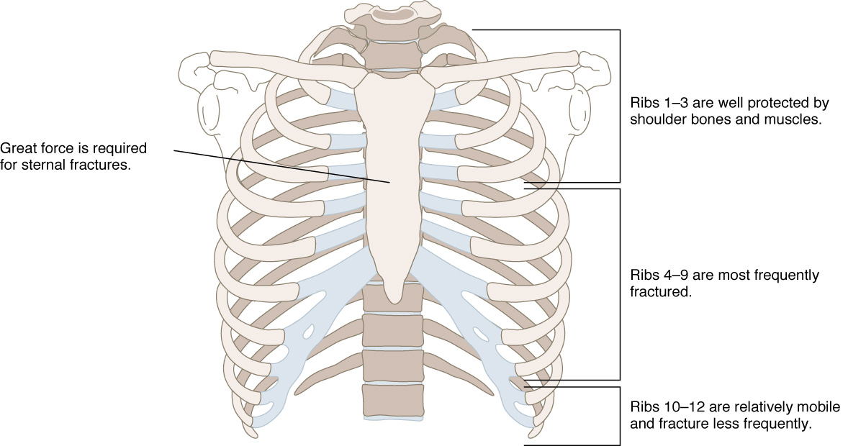

Slide 23
Rib fractures
signs and symptoms
localized pain
crepitus

Slide 24
Rib fractures
management
analgesics – for pain and improve chest
excursion
oxygen
encourage coughing and deep breathing
position of comfort

Slide 25
Flail chest
3 or more ribs broken in 2 or more places
segment of the chest that becomes free to move with the pressure changes of respiration

Slide 26
Flail chest
signs and symptoms
chest pain
crepitus
respiratory distress
tachypnea
paradoxical chest wall movement

Slide 27
Flail chest
management
analgesics
oxygen
position of comfort
stabilize the flail segments
endotracheal intubation, positive pressure ventilation

Slide 28
Sternal fracture
high association with myocardial or lung injury
myocardial contusion
myocardial rupture
cardiac tamponade
pumonary contusion
association with thoracic vertebrae fractures

Slide 29
Sternal fracture
management
analgesics
high –concentration oxygen
restrict fluids if pulmonary contusion suspected
transport to cardiology if myocardial injury suspected

Slide 30
Pulmonary injury Closed pneumothorax
occurs when lung tissue is disrupted and air leaks into the pleural space
incidence
10% to 30% in blunt chest trauma
morbidity/ mortality
extent of atelectasis
associated injuries

Slide 33
Pulmonary injury Closed pneumothorax
signs and symptoms
- absent or decreased breath sounds on the injured
side
- hyperresonant percussion
- tachypnea
- dyspnea
- chest pain referred to the shoulder or arm on the
injured side
- respiratory distress

Slide 34
Pulmonary injury Closed pneumothorax
Management
analgesics
position of comfort
high –concentration oxygen
positive-pressure ventilation if necessary
if respiration is rate <12 or >28 per minute, ventilatory assistance with a bag-valve mask may be indicated

Slide 35
Pulmonary injury Closed pneumothorax
management
tube thoracostomy – pleural decompression
4nd intercostal space in mid-axillary line
TOP OF RIB

Slide 37
Pulmonary injury Open pneumothorax
incidence
gunshot wounds
knife wounds
falls
motor vehicle collisions
If the chest wound opening is greater than two-thirds the diameter of the trachea, air follows the path or least resistance through the chest wall with each inspiration

Slide 38
Pulmonary injury Open pneumothorax
signs and symptoms
- decreased breath sounds on the injured side
- a defect in the chest wall
- a sucking sound on inhalation
- subcutaneous emphysema
- tachypnea
- tachykardia
- respiratory distress

Slide 39
Pulmonary injury Open pneumothorax
management
analgesics
high – flow oxygen
positive-pressure ventilation if necessary
ventilatory assistance with a bag-valve mask
circulation – treat for shock with crystalloid infusion
cover site with sterile occlusive dressing taped on three sides
tube thoracostomy, videothoracoscopy, thoracotomy – in- hospital management

Slide 40
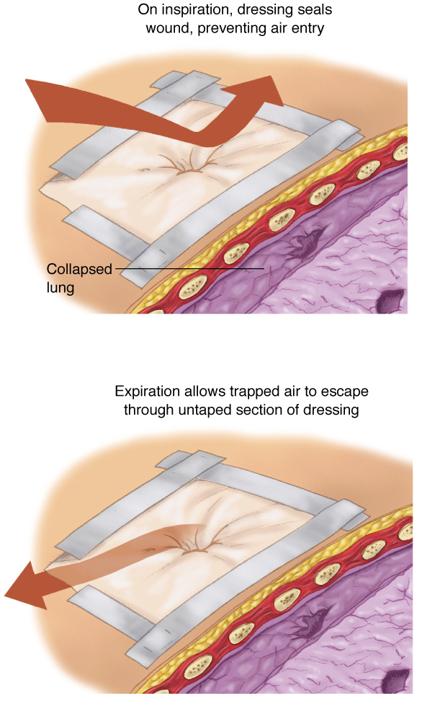

Slide 41
Pulmonary injury Tension pneumothorax
occurs when air enters the pleural space from a lung injury or through the chest wall without a means of exit
results in death if it is not immediately recognized and treated
when air is allowed to leak into the pleural space during inspiration and becomes trapped during exhalation, an increase in the pleural pressure results

Slide 42
Pulmonary injury Tension pneumothorax
increased pleural pressure produces mediastinal shift
mediastinal shift results in:
- compression of the uninjured lung
- compression of the superior and inferior vena
cava, decreasing venous return to the
heart
progression of simple or open pneumothorax

Slide 44
Pulmonary injury Tension pneumothorax
signs and symptoms
- absent breath sounds on the injured side
- hyperresonance to percussion
- subcutaneous emphysema
- tachypnea and increasing dyspnea
- tachykardia
- cynosis
- hypotension
- jugular venous distention
- extreme anxiety
- respiratory distress

Slide 45
Pulmonary injury Tension pneumothorax
management
emergency care is directed at reducing the pressure in the pleural space
occlude open wound
needle thoracostomy
tube thoracostomy – in-hospital management
4nd intercostal space in mid-axillary line
TOP OF RIB

Slide 46
Pulmonary injury Tension pneumothorax
management
pleural decompression should only be
employed if the patient demonstrates
significant dyspnea and distinct signs and
symptoms of tension pnemothorax

Slide 47
Pulmonary injury Hemothorax
accumulation of blood in the pleural space caused by bleeding from
-penetrating or blunt lung injury
-chest wall vessels
-intercostal vessels
-myocardium

Slide 48
Pulmonary injury Hemothorax
incidence
-associated with pnemothorax – it is called a
hemopnemothorax
-blunt or penetring trauma
-rib fractures are frequent cause
hypovolemia results as blood accumulates in the pleural space

Slide 50
Pulmonary injury Hemothorax
signs and symptoms
- diminished or decreased breath sounds on the injured side
- hypotension
- tachypnea
- dyspnea
- narrowed pulse pressure
- pale, cool, moist skin
- respiratory distress

Slide 51
Pulmonary injury Hemothorax
management
analgesics
high – flow oxygen
positive-pressure ventilation if necessary
ventilatory assistance with a bag-valve mask
circulation – volume-expanding fluids to correct hypovolemia
tube thoracostomy
videothoracoscopy or thoracotomy - if it is blood loss by tube thoracostomy more than 2000ml or next 3 hours is blood loss more than 500ml/hours

Slide 52
Pulmonary injury Contusion
30-75% of patients with significant blunt chest trauma
frequently associated with rib fracture
younger patients – also without rib fracture
signs and symptoms
- cough
- tachypnea
- tachycardia
- dyspnea
- cyanosis
- respiratory distress

Slide 53
Pulmonary injury Contusion
management
analgesics
high – flow oxygen
positive-pressure ventilation if necessary
ventilatory assistance with a bag-valve mask
respiratory rehabilitation
antibiotics
bronchoscopy

Slide 54
Cardiovascular injuries Myocardial contusion
injury may reduce strength of cardiac contractions
reduced cardiac output
progressive problems
myocardial necrosis
dysrhythmias
cardiogenic shock
S/S
tachycardia and/or irregular rhythm
retrosternal pain
associated injuries
rib/sternal fractures

Slide 55
Cardiovascular injuries Myocardial contusion
management
monitor ECG
Alert for dysrhythmias

Slide 56
Cardiovascular injuries Pericardial tamponade
restriction to cardiac filling caused by blood or other fluid within the pericardium
occurs in <2% of all serious chest trauma
however, very high mortality
results from tear in the coronary artery or penetration of myocardium
blood seeps into pericardium and is unable to escape
200-300 ml of blood can restrict effectiveness of cardiac contractions

Slide 57
Cardiovascular injuries Pericardial tamponade
increased intrapericardial pressure
- does not allow the heart to expand and refill with blood
- results in a decrease in stroke volume and cardiac output
myocardial perfusion decreases due to pressure effects on the walls of the heart and decreased diastolic pressures
ischemic dysfunction may result in infarction
removal of as little as 20ml of blood may drastically improve cardiac output

Slide 58
Cardiovascular injuries Pericardial tamponade
signs and symptoms
- tachycardia
- respiratory distress
- Becks triad - narrowing pulse pressure
- neck vein distention
- muffled heart sounds
- ECG changes

Slide 59
Cardiovascular injuries Pericardial tamponade
management
high flow O2
IV therapy
pericardiocentesis – needle insertion through the skin incision directed toward the left shoulder at a 45 degree angle to the abdominal wall.

Slide 60
Cardiovascular injuries Aortic rupture
occurs almost exclusively with extreme blunt thoracic trauma - rapid deceleration in high-speed motor vehicle crashes
- falls from great heights
85-95% of these patients die at the scene as result of massive hemorrhage
signs & symptoms
rapid and deterioration of vitals
retrosternal pain

Slide 61
Cardiovascular injuries Aortic rupture
IV therapy
mild hypotension may be protective
keep patient calm
endovascular repair
operativ repair – is associated with high mortality

