Slide 1

Acute peripheral arterial occlusion
Tomáš Novotný
II. chirurgická klinika LF MU a FN u sv. Anny

Slide 2
Acute ischemia
result of a sudden deterioration in the arterial blood supply
Causes
  arterial embolism
  arterial thrombosis
  other causes
    trauma
    iatrogenic causes
    occlusion of a vascular reconstruction

Slide 3
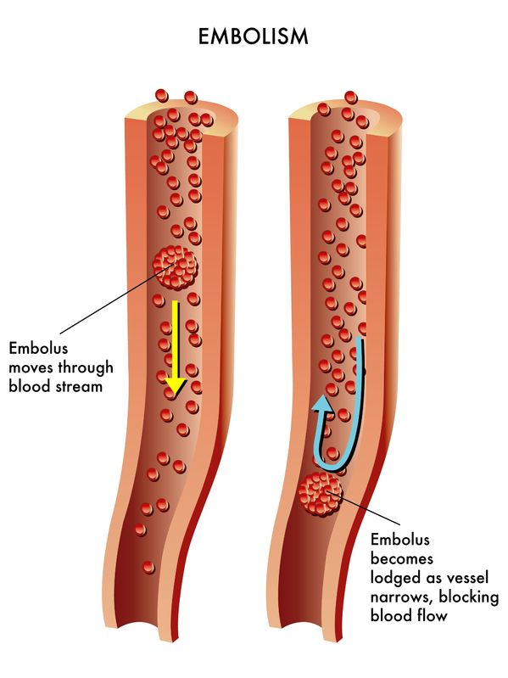
Arterial embolism
result of a material (embolus) passing through the arterial tree and obstructing a peripheral artery
Source
  the heart
  atherosclerotic debris
  tumors
  foreign bodies
  …
Source: http://www.secondscount.org/heart-condition-centers/info-detail-2/cardiac-embolism-stroke

Slide 4
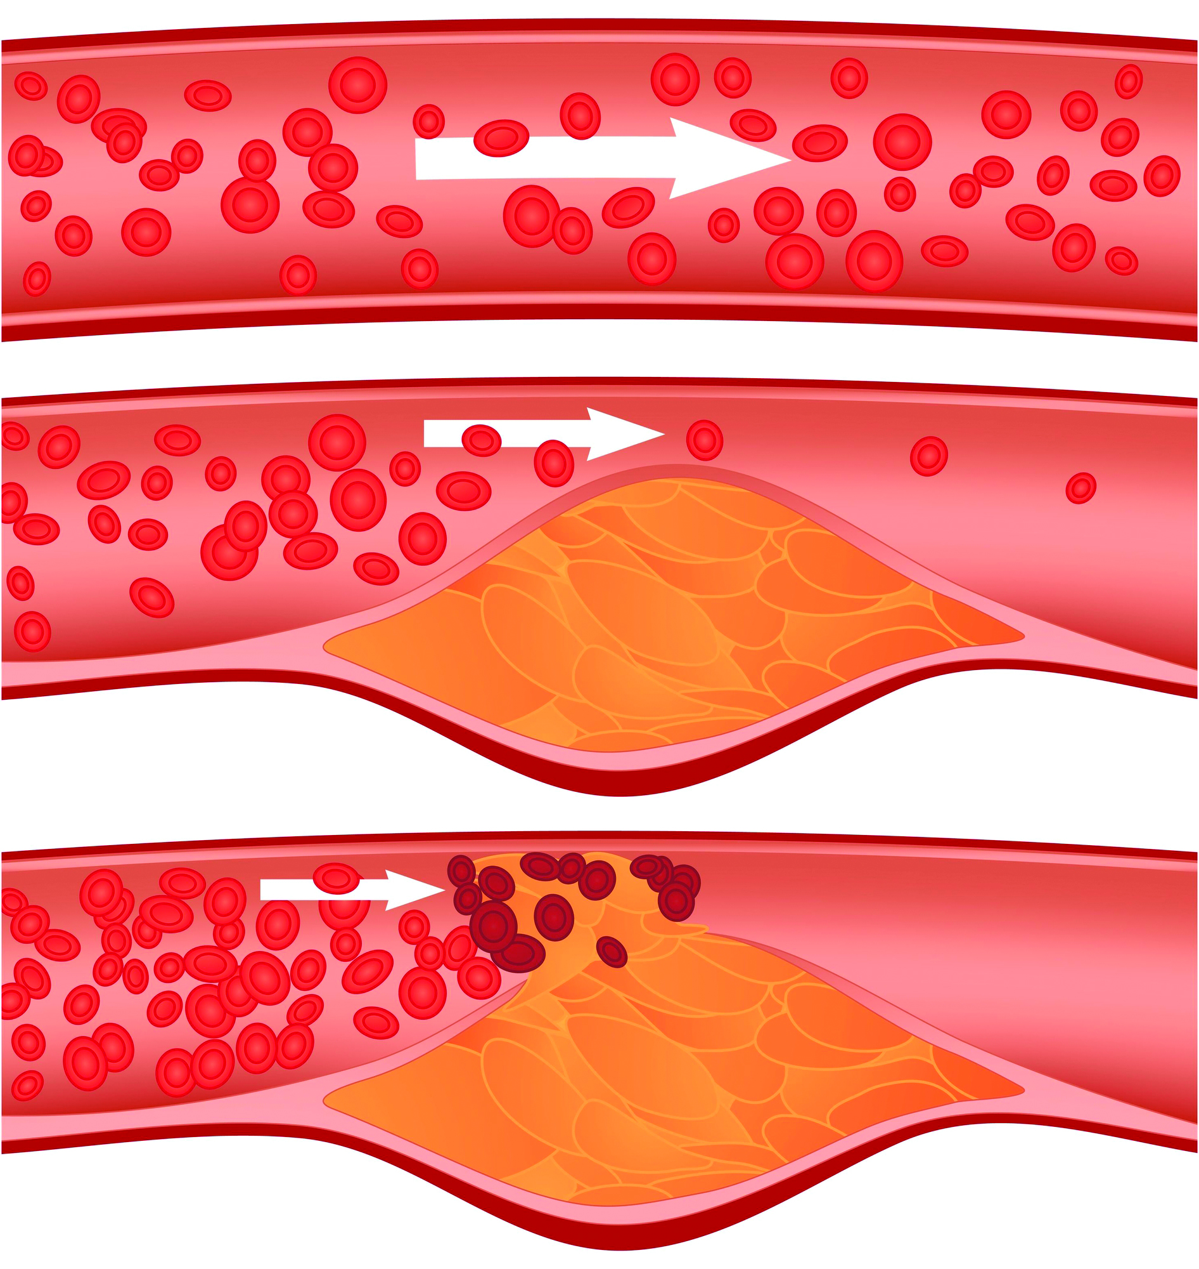
Arterial thrombosis
most commonly the result of progressive atherosclerotic narrowing in peripheral arteries
hypercoagulable states
shock
arterial dissection

Slide 5
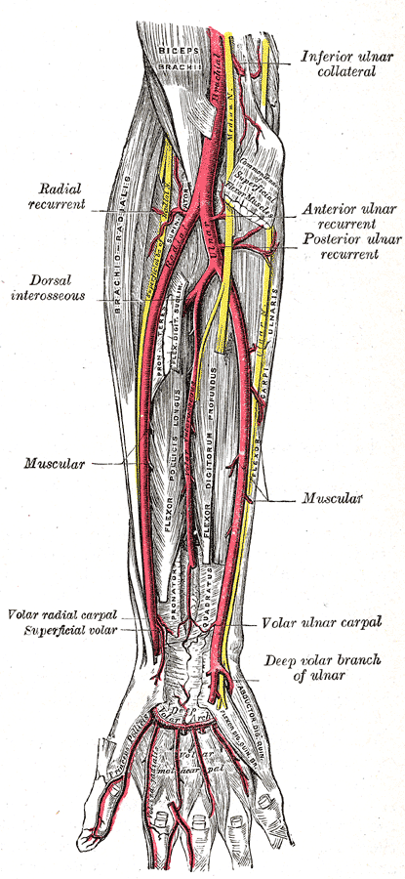
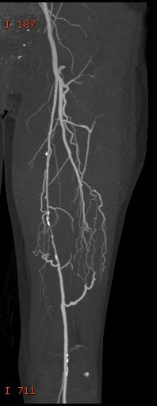
Clinical presentation
depends on
  size of occluded artery
  available collaterals (physiological or developed)
e.g. superficial femoral artery occlusion in the presence of well-established collaterals may be entirely asymptomatic

Slide 6
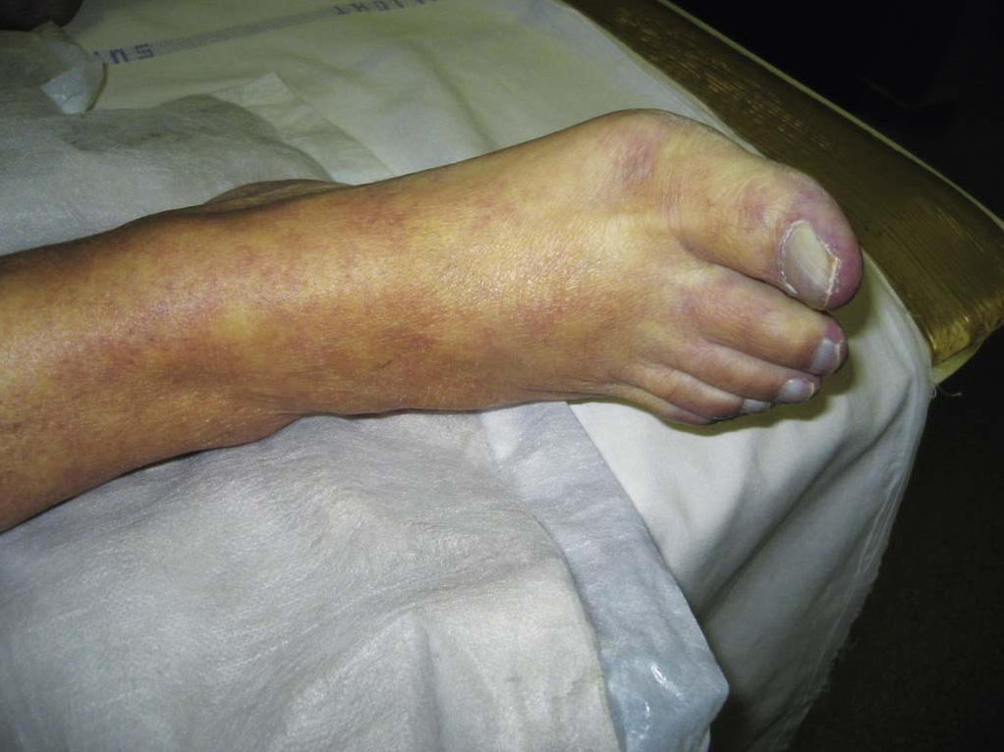
Clinical presentation
sensory loss
motor loss
sudden pain
cold leg
white leg
absent peripheral pulses
Source: Ruhterford‘s Vascular Surgery 8th Edition

Slide 7
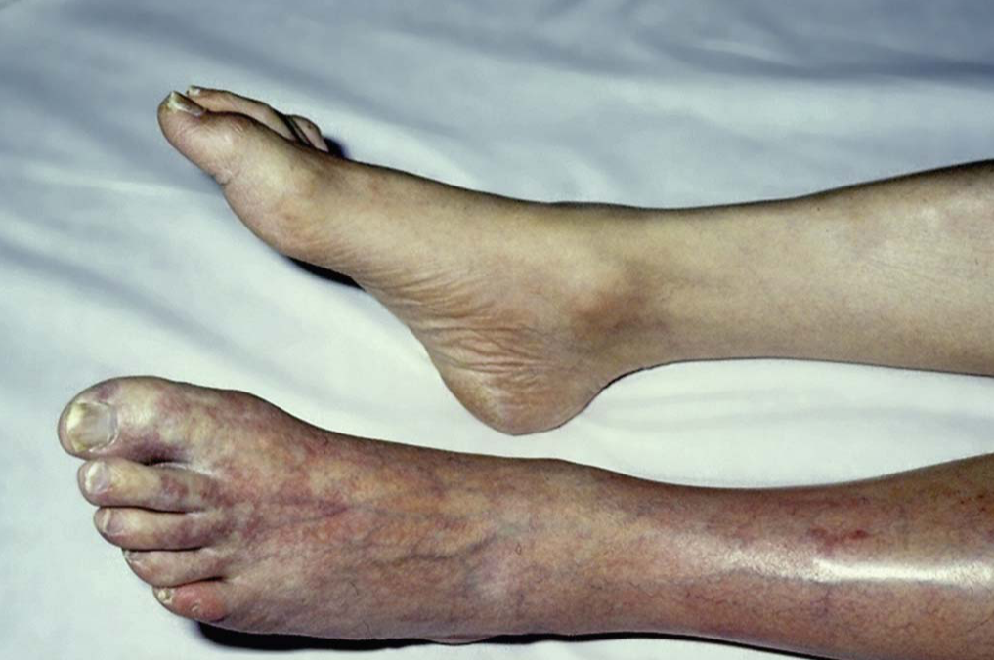
Clinical presentation
sensory loss
motor loss
sudden pain
cold leg
white leg
absent peripheral pulses
Source: Ruhterford‘s Vascular Surgery 8th Edition

Slide 8
Clinical assessment
History
clinical presentation assessment, duration
source of embolism
  atrial fibrillation, previous myocardial infarctions, valvular heart disease, …
peripheral arterial disease
    intermittent claudication
atherosclerosis risk factors
Physical findings
rule of Ps
  pain
  pallor
  paresis
  pulse deficit
  paresthesia
  poikilothermia
aneurysms
irregular pulse
contralateral extremity

Slide 9
Embolism vs. thrombosis
Embolism
History
  source of embolism
  no claudication
Physical findings
  irregular pulse, …
  normal peripheral pulses in contralateral extremity
Thrombosis
History
  no source of embolism
  claudication
Physical findings
  regular pulse, …
  no peripheral pulses in contralateral extremity
!
Embolism might occur in a patient with claudication/peripheral arterial disease and without known sources of embolism in history and vice versa!

Slide 10
Classification of Acute Limb Ischemia
Category / class | Description / Prognosis | FINDINGS |  | DOPPLER SIGNALS
 |  | Sensory Loss | Muscle Weakness | Arterial | Venous
I. Viable | Not immediately threatened | None | None | Audible | Audible
II. Threatened
a. Marginally | Salvageable if promptly treated | Minimal (toes) or none | None | Inaudible | Audible
b. Immediately | Salvageable with immediate revascularization | More than toes, associated with rest pain | Mild, moderate | Inaudible | Audible
III. Irreversible | Major tissue loss or permanent nerve damage inevitable | Profound, anesthetic | Profound, paralysis (rigor) | Inaudible | Inaudible

Slide 11
Diagnosis
the anatomical location of arterial occlusion
  aortic occlusion
  iliac occlusion
  femoropopliteal occlusion
  popliteal and infrapopliteal occlusion
Imaging may be valuable
However, there may be no time!

Slide 12
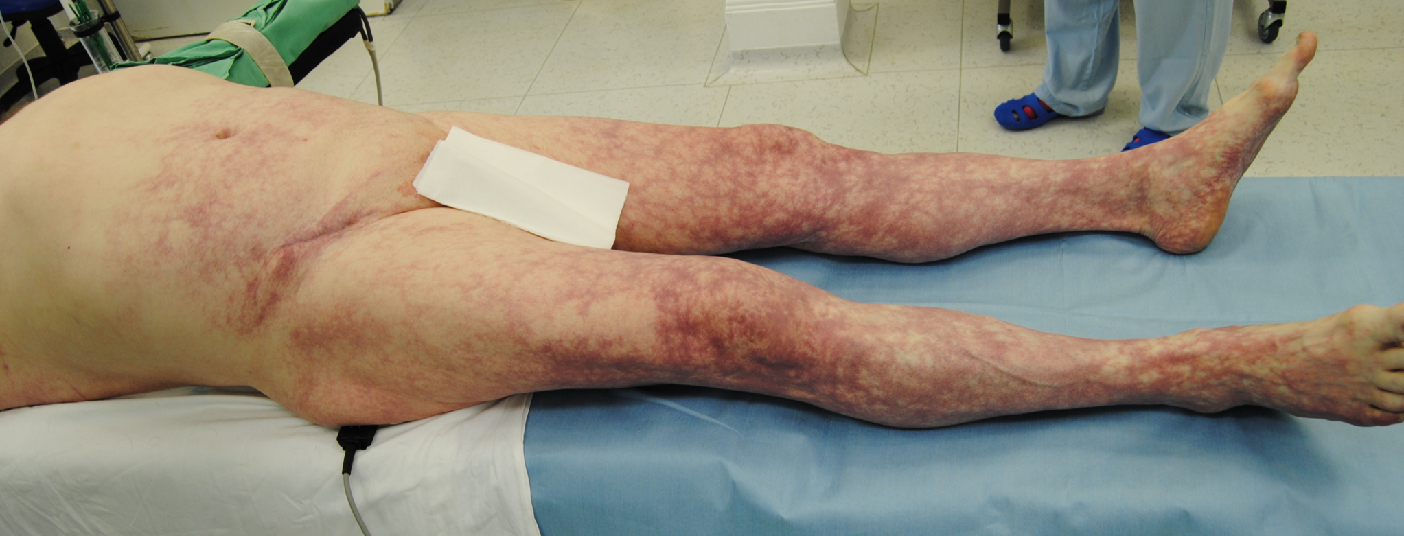
Aortic occlusion

Slide 13
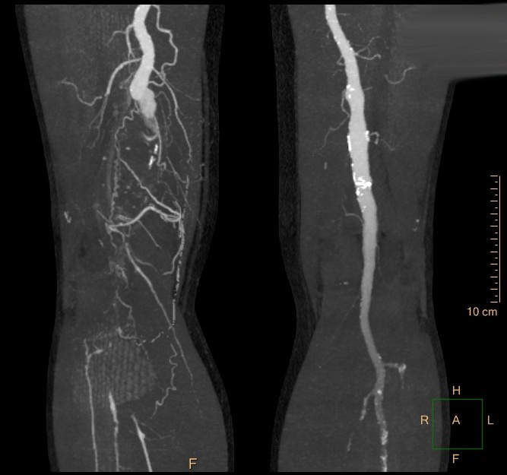
Diagnosis - imaging
Computed Tomographic (CT) Angiography
usually available 24/7
the investigation of choice for acute arterial ischemia

Slide 14
Diagnosis - imaging
Duplex ultrasonography
  availability?
Digital subtraction angiography
  less accessible than CT angiography
  best choice when an endovascular solution to the arterial occlusion is likely
Magnetic resonance angiography (MRA)
  not suitable
  usually not available at off hours

Slide 15
Initial management
Anticoagulation
  immediate anticoagulation with intravenous calcium heparin can stabilize the condition of the leg
  the potential for immediate reversal with protamine makes calcium heparin the drug of choice
Ancillary supportive measures
  oxygen delivered by facemask
  intravenous fluid administration
  analgesia

Slide 16
Treatment
Anticoagulation
Operative intervention
  embolectomy or thrombectomy using Fogarty catheters
  vascular reconstruction (bypass, endarterectomy, patch angioplasty)
Endovascular intervention
  percutaneous intra-arterial thrombolysis
  mechanical thrombectomy / aspiration embolectomy

Slide 17
Treatment selection
Category I
  medical therapy
  elective revascularization (optional)
Category IIa
  immediate revascularization not necessary
  endovascular or surgical options may be considered
Category IIb (sensory and motor deficit)
  immediate revascularization is necessary
  surgical revascularization is generally preferred
  endovascular options may be considered

Slide 18
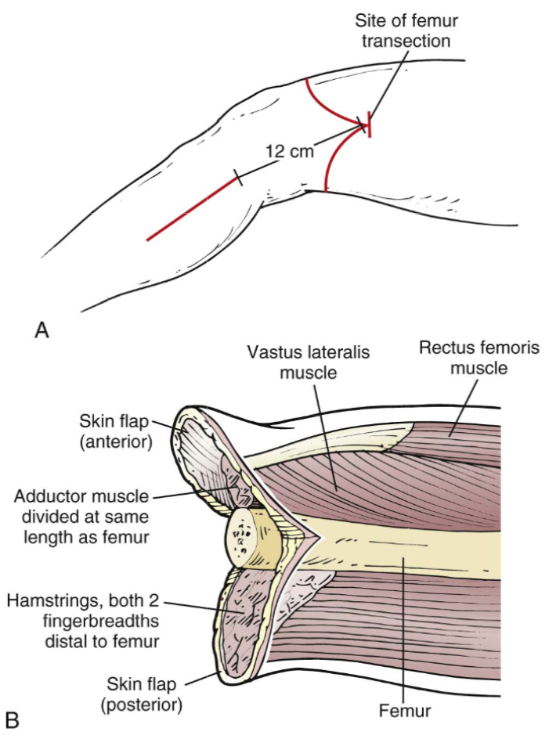
Treatment selection
Category III
  primary amputation should be considered
Source: Ruhterford‘s Vascular Surgery 8th Edition

Slide 19
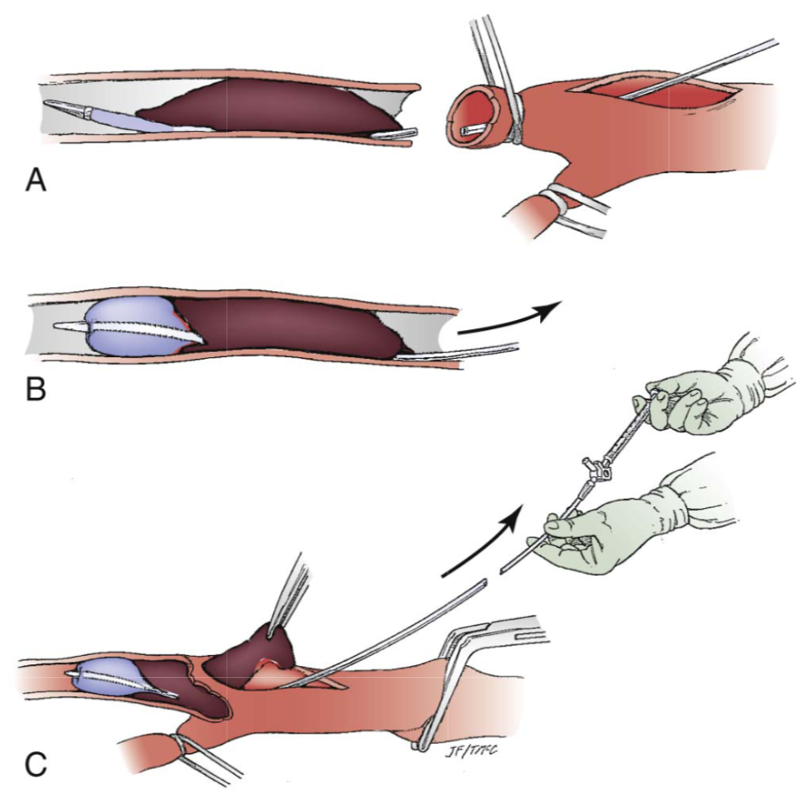
Operative intervention
Embolectomy or thrombectomy
  balloon catheters are passed proximally and distally until no visible thrombus is removed and a pulse or backflow is established
  completion angiography is important to evaluate the effectiveness of thrombus removal
Source: Ruhterford‘s Vascular Surgery 8th Edition

Slide 20
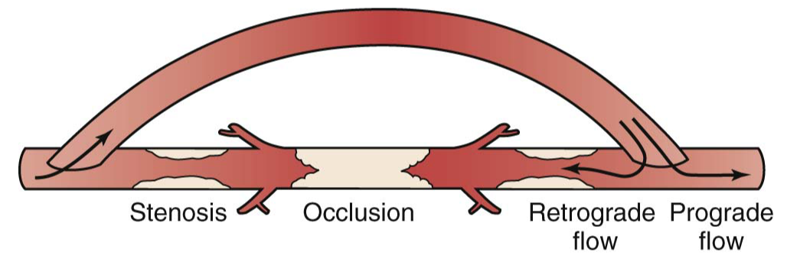
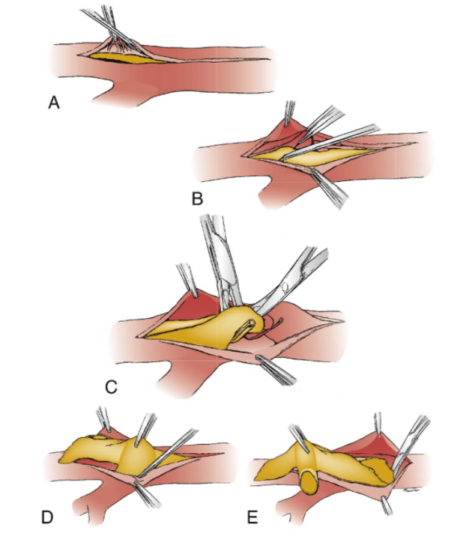
Operative intervention
Bypass
Endarterectomy and patch plasty
Source: Ruhterford‘s Vascular Surgery 8th Edition

Slide 21
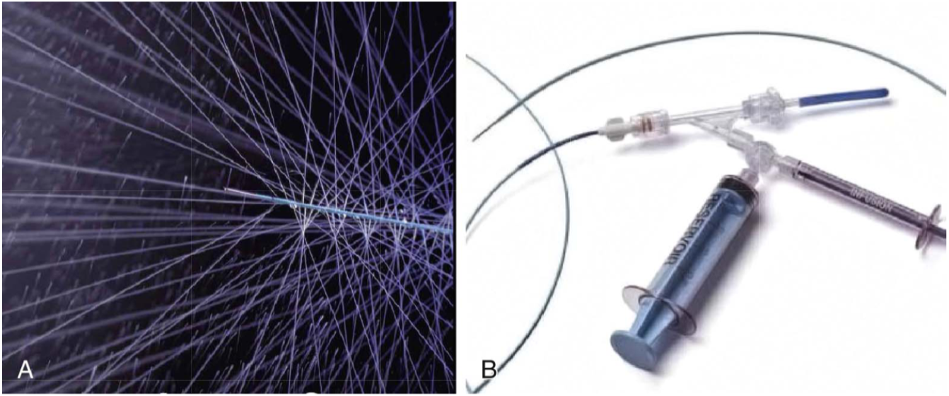
Endovascular treatment
Catheter-directed thrombolysis
  tissue plasminogen activators are used (e.g. Actilyse)
Source: Ruhterford‘s Vascular Surgery 8th Edition

Slide 22
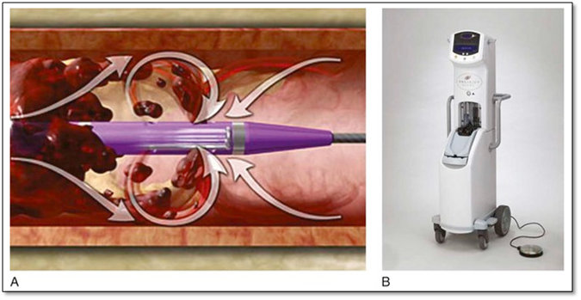
Endovascular treatment
Percutaneous mechanical thrombectomy
  devices
    hydrodynamic
    rotational
    aspiration thrombectomy catheters
Source: https://epos.myesr.org/esr/viewing/index.php?module=viewing_poster&pi=138573

Slide 23
Prognosis
The medical state of a patient who presents with acute leg ischemia is a good prognostic index of survival.
The outcome after treatment for acute limb ischemia is often poor.

Slide 24
Upper limb ischemia
Patients are on average about 4 years older.
seldom threatens the limb
treatment is to prevent late complications
  activity-induced arm fatigue and pain (up to 50% patients have late symptoms if untreated)
cardiac embolism is the main cause
atherosclerosis is rare

Slide 25
Upper limb ischemia
often cold feeling and numbness rather than pain in the arm
diagnosis is clinical
  (can be confirmed by duplex imaging)
up to 20% of patients with acute arm ischemia do not survive the acute event!

Slide 26
Compartment syndrome
is an increase in intracompartmental pressure
up to 20% of patients after revascularization
mechanism is ischemia-reperfusion
risk factors
  prolonged ischemia time (>6 hours); young age; insufficient arterial collaterals; acute time course for arterial occlusion; hypotension; poor back-bleeding from the distal arterial tree at embolectomy

Slide 27
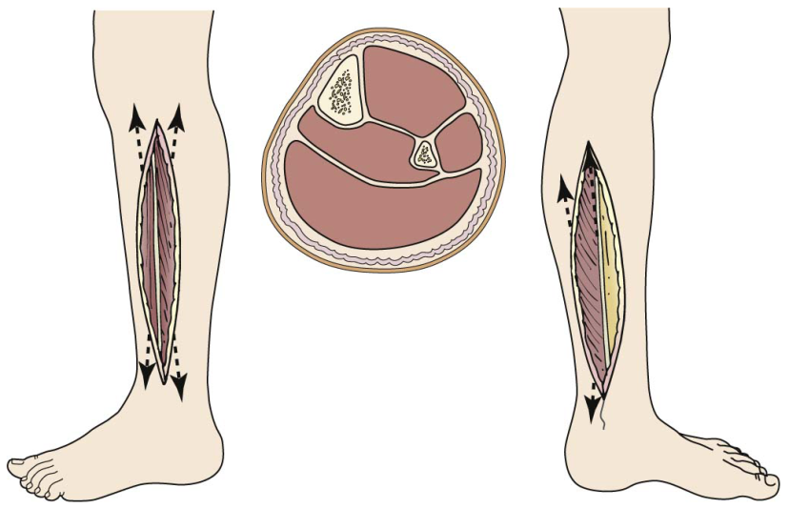
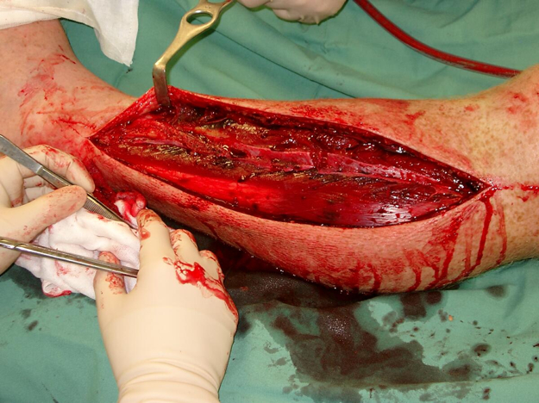
Compartment syndrome
Fasciotomy

Slide 28
Fasciotomy - indications
Absolute Indications | Potential Indications
• Tense compartment plus either: • Pain with passive motion of muscles traversing the same compartment or • Paresis or paresthesias referable to the same compartment • Tense compartment in a patient who cannot be examined serially due to obtundation or need for other operations. • ICP minus mean blood pressure <40 mm Hg • ICP minus diastolic blood pressure <10 mm Hg | • Acute ischemia >6 hr with few collaterals • Combined arterial and venous traumatic injuries • Phlegmasia cerulea dolens • Tense compartment after crush injury • Tense compartment after fracture
ICP, Intracompartmental pressures.
Source: Ruhterford‘s Vascular Surgery 8th Edition

Slide 29
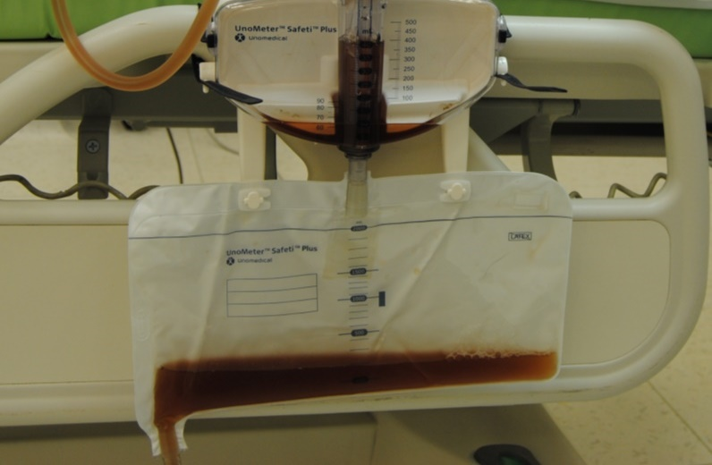
Systemic sequelae of myonecrosis
large quantities of intracellular potassium, phosphate, myoglobin, and creatine phosphokinase are liberated
Hyperkalemia
  dialysis or continuous veno-venous hemofiltration might be needed
Myoglobinuria
  tea-colored urine

Slide 30
Systemic sequelae of myonecrosis
Myoglobinuria induces
  renal vasoconstriction
  tubular cast formation
  direct heme protein-induced cytotoxicity
Management of myoglobinuria
  aggressive crystalloid infusion
  forced diuresis
  alkalinization of the urine with bicarbonate (optional)
  hemodialysis is not a useful

Slide 31
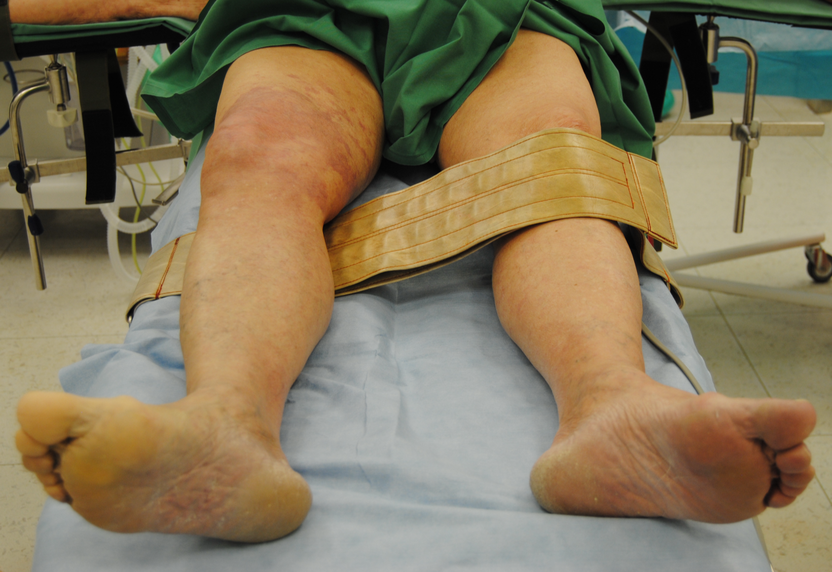
Thank you for your attention!

